Slide 1

Epithelial Cells and Their Role in Immunity
Dr. Irving Coy Allen
Virginia Tech
VA-MD Regional College of Veterinary Medicine
Department of Biomedical Sciences and Pathobiology

Slide 2
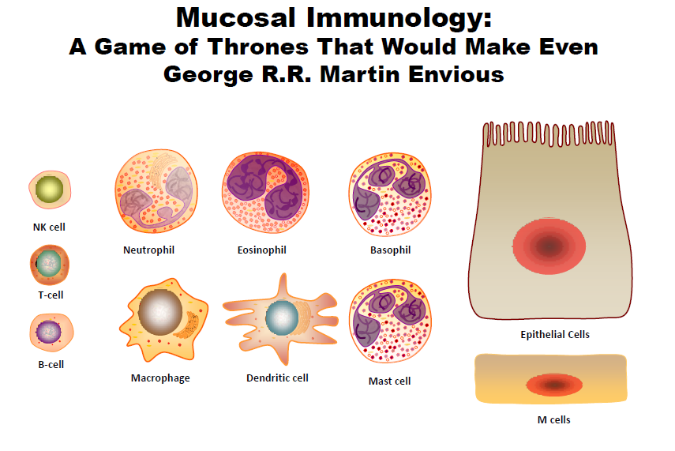

Slide 3
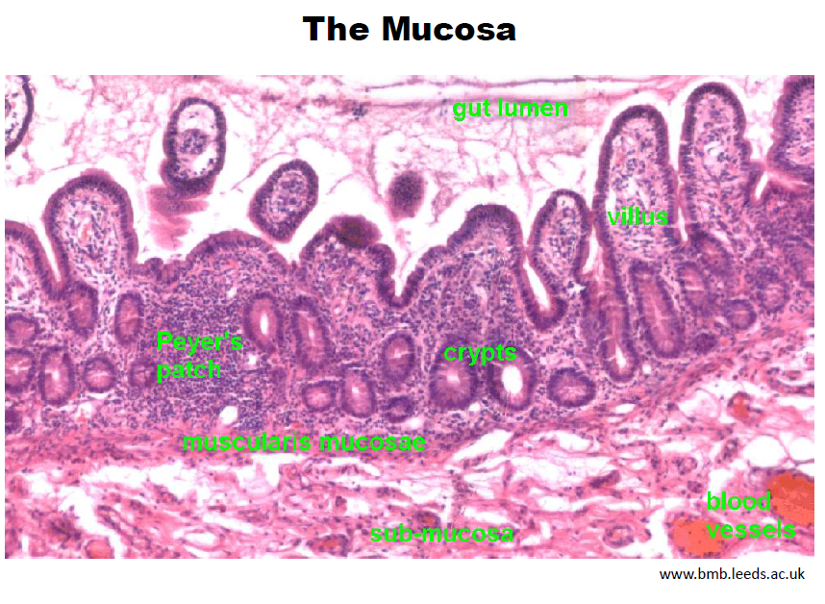

Slide 4
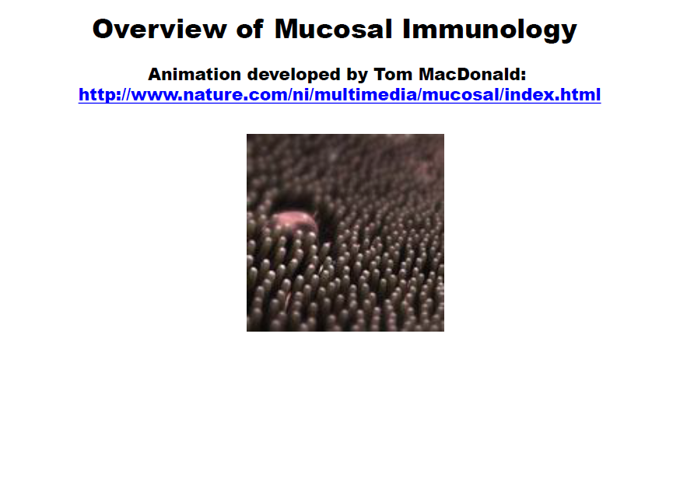
Mucosal Immunology: An Overview
Animation Developed by Tom MacDonald
http://www.nature.com/ni/multimedia/mucosal/index.html

Slide 5
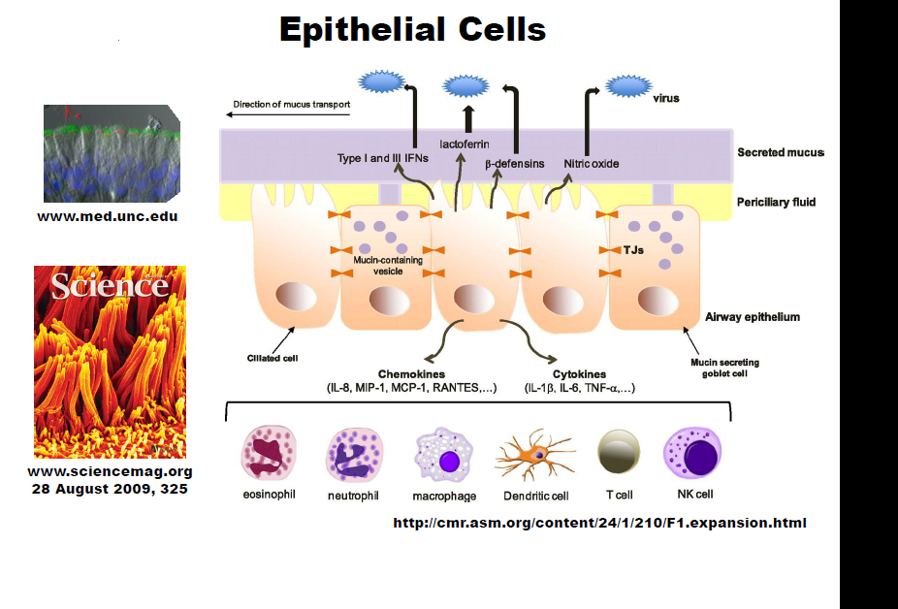

Slide 6
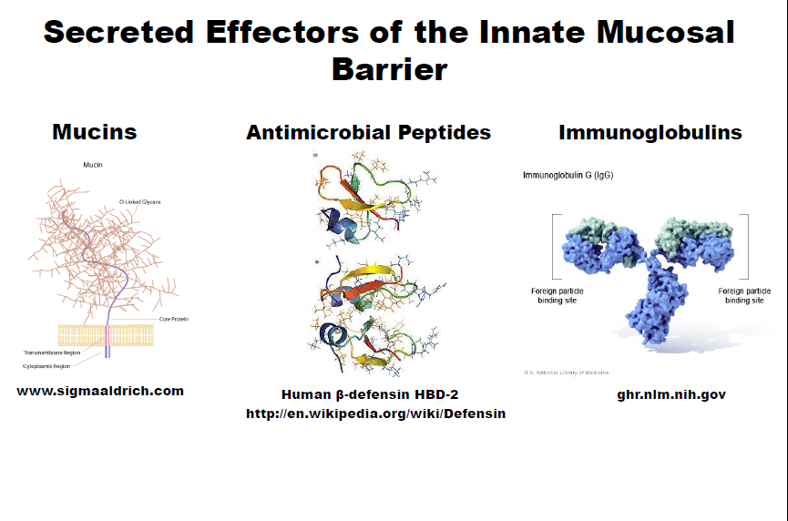

Slide 7
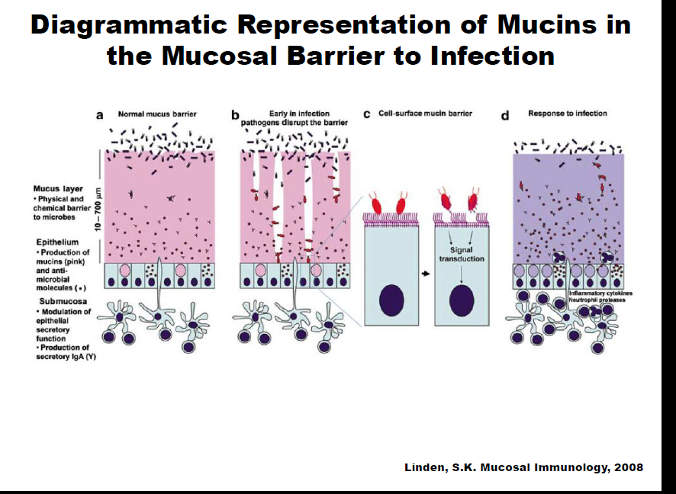

Slide 8
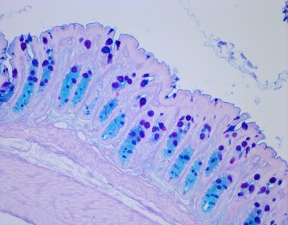
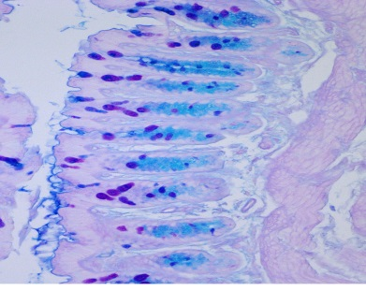
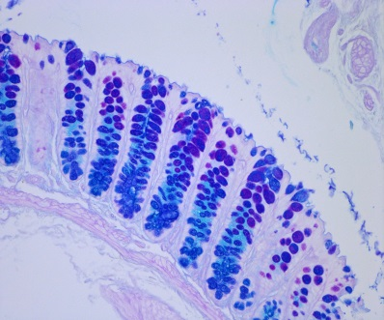
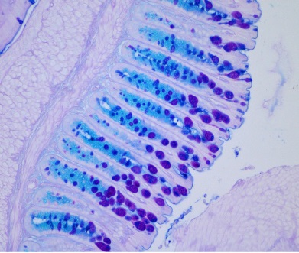
AB/PAS Staining Goblet Cell and Mucus Staining
Mock
Mock
AOM/DSS
AOM/DSS

Slide 9
Three Classes of Pattern-Recognition Receptors
Modified From: Osamu Takeuchi and Shizuo Akira; Immunological Reviews (2009)
TLR
RLR
NLR
TLR-7
TLR-3
RIG-I
MDA5
NLR
Inflammasome
MyD88
TRIF
MAVS
cleavage
IRF7
IRF3
pro-IL-1β
IL-1β
NF-κB
pro-IL-18
IL-18
Cytokine Genes
Type-I IFN Genes

Slide 10
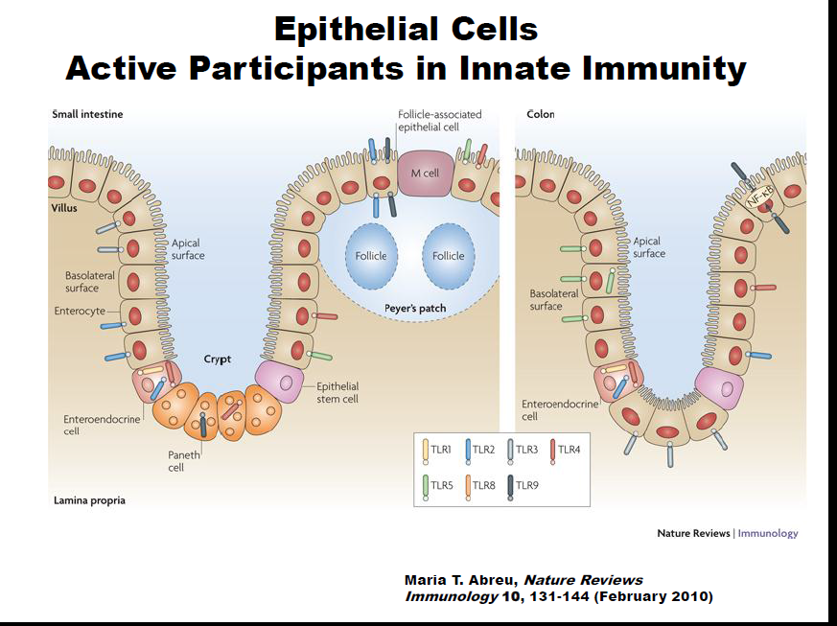

Slide 11
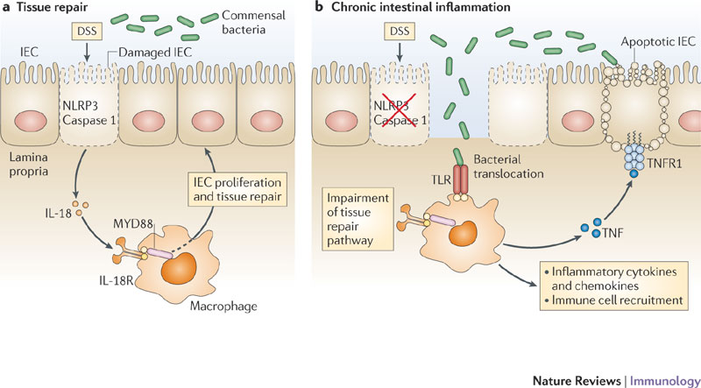
NLRs in Intestinal Homeostasis

Slide 12
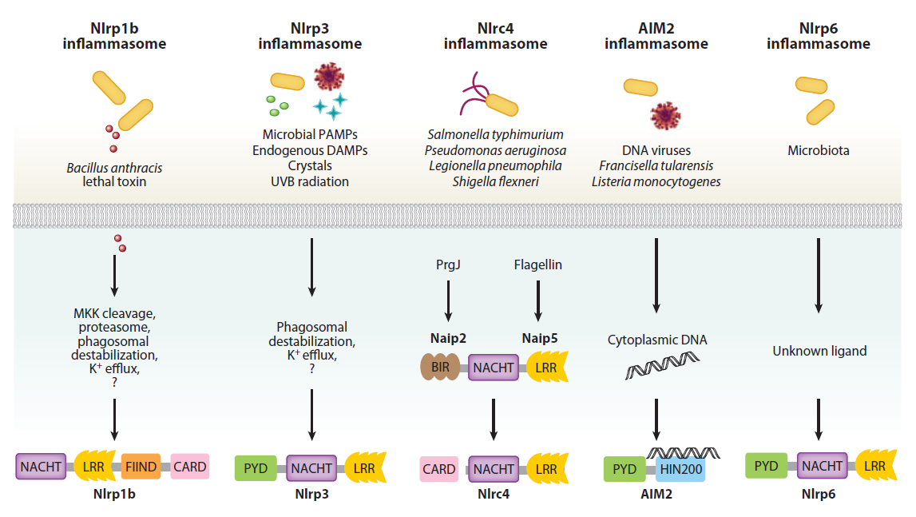
NLR SPECIFICITY

Slide 13

Inflammasome Forming NLRs
ATP
Crystals
TNF
LPS
polyI:C
IFN-β
IFN-γ
DAMPs
Toxins
TNFR
TLR4
TLR3
IFNαR
IFNγR
Cytosolic Gram Negative Bacteria
STAT1
ROS
mtDNA
NLRP3
priming
LPS
Ca2+
K+
ASC Speck
Hypothetical
Non-Canonical
Inflammasome
Caspase-11
GBP5
Caspase-1
p10
pro-Caspase-1
p20
Pyroptosis
NLRP3
Oligomer
pro-IL-1β
IL-1β
pro-IL-18
IL-18

Slide 14
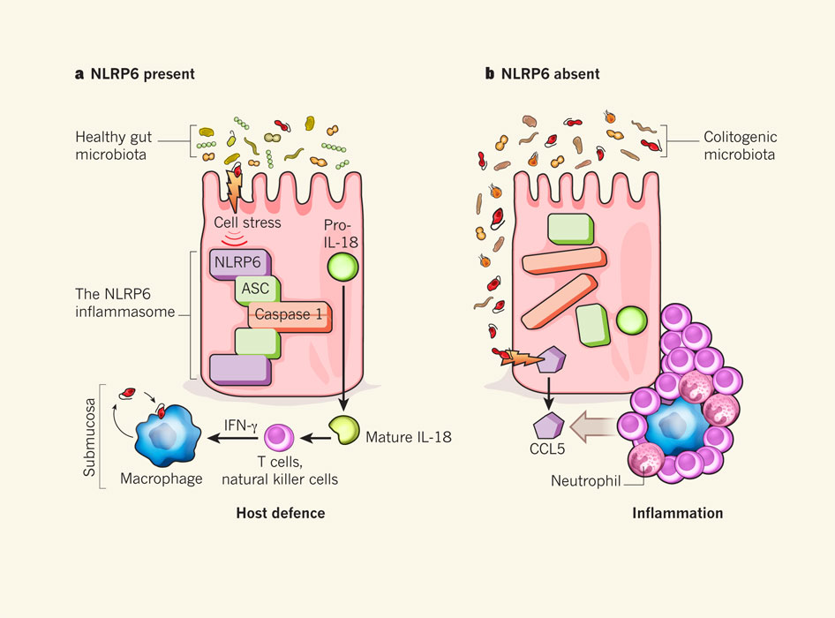
NLRP6
Menno van Lookeren Campagne & Vishva M. Dixit
Nature 474, 42–43 (02 June 2011) doi:10.1038/474042a

Slide 15
Pyroptosis
Nat Rev Microbiol. 2009 February ; 7(2): 99–109.

Slide 16
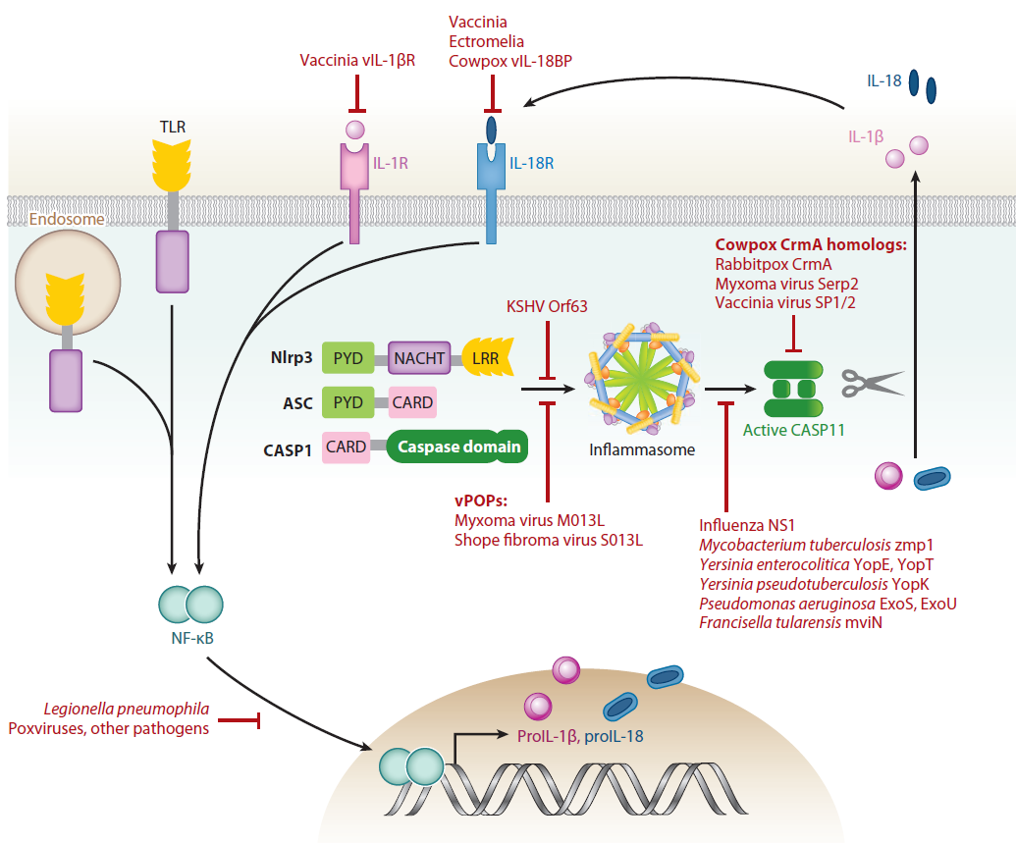
Pathogen Modulation of Inflammasome Function

Slide 17
Inhibitory NLRs
TLR
MyD88
IRAK1
IKK-γ
NF-κB
IKK-α/β
IκB
p50
p65
p50
p65
RelB
NF-κB Binding Motif

Slide 18
RNA
NLRX1
NLRX1
RIG-I
MAVS
RIG-I
NLRX1
NLRX1
MAVS
TUFM
UQCRC2
TBK1
ATG16L1
ATG5
ATG12
IRF
Mitochondria
IFN-I
IL-6
Autophagy
ROS

Slide 19
Computational modeling should prove highly useful to elucidate the complex interplay between immunity, metabolism and the microbiota, and provide insight on pharmacokinetic and pharmacodynamic regulation of new IBD therapies
Predicting IBD prognosis is patient-specific, time sensitive and often elusive, yet crucial for deciding effective treatment and disease control.
Mathematical and computational modeling offers a novel perspective for identifying molecular targets aimed at the development of more efficacious and safer personalized interventions for IBD.
Publically available microarray studies offer robust datasets for calibrating, or fitting, mathematical equations to observed biological phenomenon.
Notes:
Models engineered from data-rich signaling networks offer invaluable predictive power for hypotheses that are experimentally challenging.
For example, multi-scale modeling offers a feasible means to study the combined effect of modulating cytokine production, NLR expression and microbiome composition for IBD treatment whereas laboratory procedures could not reasonably explore these compounding factors.

Slide 20
Computational Modeling:
PRRs and Epithelial Cell Pathobiology
Reconciling conflicting genomic results, integrating transcriptomics, proteomics, flow cytometry and histology data with specific clinical outcomes in patients with well-characterized gene variants through bioinformatics and computational modeling approaches would provide an invaluable assessment of TLR and NLR functionality among heterogeneous populations of IBD patients.
Computational modeling could be used to investigate cell specificity of NLRs and the role of NLRs in sensing dysbiosis in addition to mechanisms underlying modulation of T cell differentiation by dysregulated NLR signaling.

Slide 21
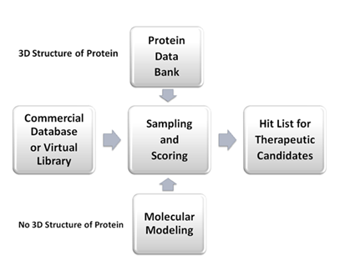
Modeling:
Structure-Based Virtual Screening (SBVS)
Notes:
Recent successes in predicting new ligands and their receptor-bound structures make use of structure-based virtual screening (SBVS), which is a more cost-effective approach in drug and natural product discovery. The basic procedure of SBVS is to sample binding geometry for compounds from large libraries into the structure of receptor targets by using molecular modeling approaches. Each compound is sampled in thousands to millions of possible poses and scored on the basis of its complementarity to the receptor. Of the hundreds of thousands of molecules in the library, tens of top-scoring predicted ligands are subsequently tested for activity in experimental assays (Figure 5). We plan to perform SBVS to identify new ligands of NOD-like receptors (NLRs). One of the main requirements for SBVS is availability of the three dimensional structure of a validated protein target. The crystal structures of some NLRs have been determined by experiments, which are published in the Protein Data Bank (PDB)

Slide 22

Questions?
Irving Coy Allen
icallen@vt.edu
http://upload.wikimedia.org/wikipedia/commons/0/0b/Burruss_Hall,_Virginia_Tech.JPG

