Slide 1
The Use of ENISI in the Context of
Agent-Based Modeling and High-Performance Computing
Stephen Eubank
Modeling Mucosal Immunity
Summer School in Computational Immunology
Blacksburg, VA June 10, 2014

Slide 2

A model is …
1. a standard or example for imitation or comparison.

Slide 3
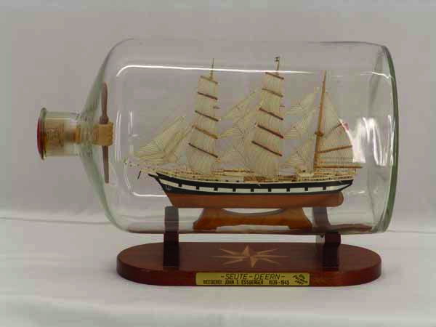
A model is …
2. a representation, generally in miniature,
to show the construction or appearance of something.

Slide 4
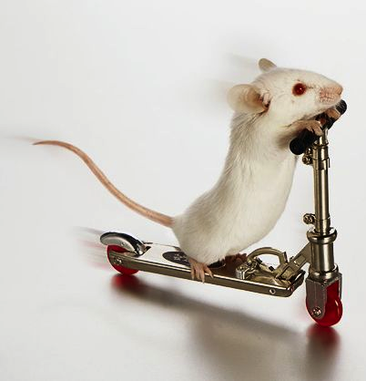
A model is …
10. a simplified representation of a system or phenomenon, as in the sciences …, with any hypotheses required to describe the system or explain the phenomenon, …
Notes:
Not a mouse model!
What hypotheses explain this phenomenon?

Slide 5
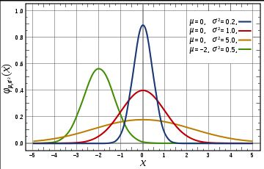
A model is …
10. a simplified representation of a system or phenomenon, as in the sciences …, with any hypotheses required to describe the system or explain the phenomenon,
often mathematically.
Wikipedia

Slide 6
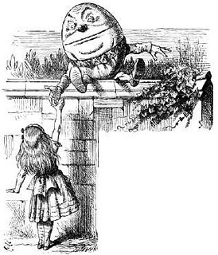
X
Statistical, correlational,
compact representation of data
“When I use a word,” Humpty Dumpty said in rather a scornful tone, “it means just what I choose it to mean – neither more nor less.”
Predictive, causal, explanation of outcome
Notes:
Both can be used for generalization, extrapolation, etc.
Sometimes the difference is subtle

Slide 7
High Performance Computing has created a revolution in modeling
Then: coupled rate equations
  nonlinear response, phase transitions
  results like this:
Concentration
Notes:
mathematical modeling of ID has a history dating back at least to Bernoulli
the dominant paradigm in the last century has been compartmental models

Slide 8
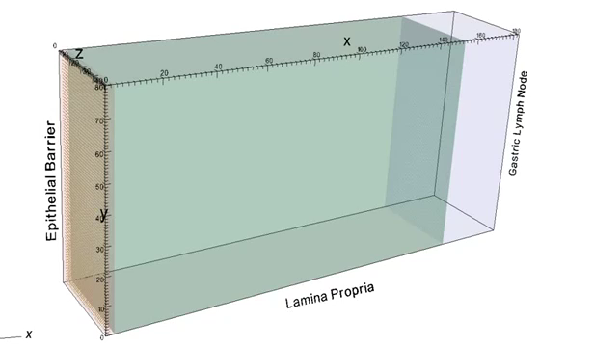
High Performance Computing
has created a revolution in modeling
Now: systems science perspective
  simulations with diverse, interacting parts
  results like this:
Notes:
High performance computing coupled with a renewed appreciation of complex systems has enabled a new approach to comp epi
This picture illustrates spatial heterogeneity – not to say that older models couldn’t describe it.
There are many other heterogeneities that can be included, and they can be tailored to represent particular circumstances.
Synthetic information extends John Snow’s use of data for public health policy-making by creating an in-silico high-resolution laboratory.

Slide 9
What is an Agent-Based Model (ABM)?
ABMs represent
things with states that interact
(by changing each other’s states)
according to a mathematical rule.

Slide 10
What is an Agent-Based Model (ABM)?
ABMs represent
things with states that interact
(by changing each other’s states)
according to a mathematical rule.

Slide 11
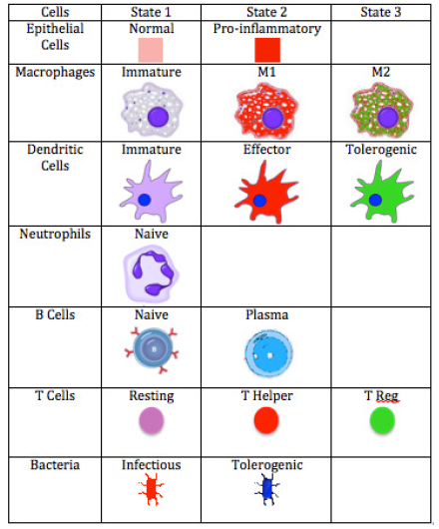
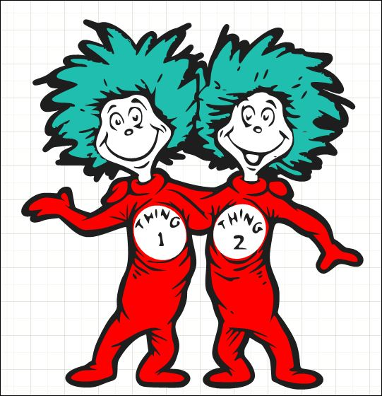
What is an Agent-Based Model (ABM)?
Things: nouns
  individual entities
  collections of entities
with states: adjectives
  finite set
  continuous or discrete
  parameterized

Slide 12
What is an Agent-Based Model (ABM)?
that interact: verbs
  what interacts with what?
  is the network of interactions static or dynamic?
  what makes it dynamic? Brownian motion, chemotaxis
according to a mathematical rule: adverbs
  deterministic vs stochastic
  continuous vs discrete in time

Slide 13
ABMs require specifying an interaction network
things-> vertices
interactions-> edges
Interactions change entities’ internal states and
network structure, producing system-level dynamics.
Notes:
These representations capture the essentials of systems at scales from inside the nucleus to galaxy formation
But this is abstract, and I assure you we are focused on concrete infectious disease systems.

Slide 14
An interaction network for the immune system
Vertices -> cells
Edges -> cytokine-mediated interaction
Interactions change cells’ behavior and
neighbors, producing immune system dynamics.
Notes:
They not only represent the “naturally occurring” system, but also interventions.

Slide 15
Targeted interventions can be represented as network changes
pathway disruption
knock-outs
antigen priming
regulated expression
Notes:
They can be specialized to include only the most relevant features for a particular disease

Slide 16
Vertex / edge choices represent many systems
T-reg
macrophage
IL-17
H. pylori

Slide 17
Vertex / edge choices represent many scales
molecules
binding affinities

Slide 18
Vertex / edge choices represent many scales
vectors
humans
biting behavior
livestock

Slide 19
Hybrid models can represent discrete agents interacting with continuous fields
[Discrete] cells secrete cytokines into the environment
  cells are point sources of cytokines
  cytokines diffuse as chemical concentrations
  local concentration of cytokines affects cells’ states
[Continuous] populations of bacteria in the gut
  population dynamics [predator / prey] in the gut
  individual bacteria make their way through epithelium

Slide 20
ENISI Modeling Environment
Host cells and bacteria are agents
Each agent represented as an automaton
Agents move around gut mucosa and lymph nodes
Nearby agents are “in contact”
Agents in contact can interact:
  Agent-Agent interaction
  Group-Agent interaction
  Timed interaction

Slide 21
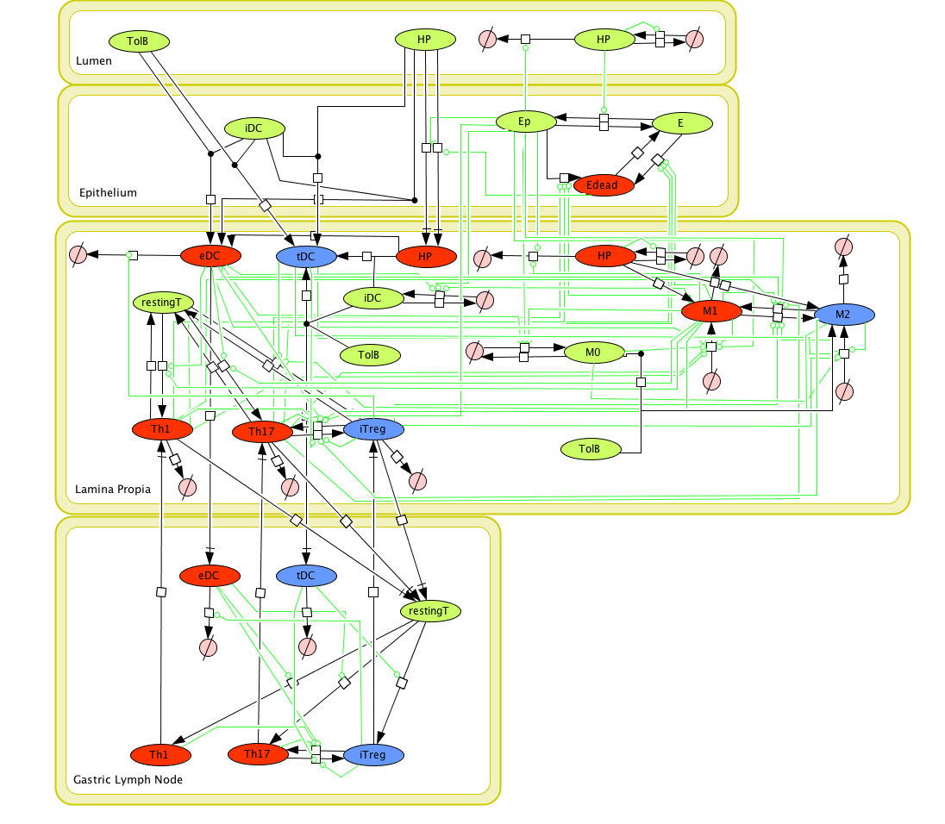
An ABM for host / H. pylori interaction
http://www.modelingimmunity.org -> Models -> Host responses to H. pylori -> ABM

Slide 22
Interactions in the Lamina Propia
For example, see http://www.modelingimmunity.org/enisi_0_9_results/scenario_2/

Slide 23
Parameterized Interactions
v_{BD}
v_{T}
Th₁
eDC
iDC
a_{T}
v_{T}, p₁₇
restT
a_{T}
v_{T}
iTreg
eDC_{L}
v_{Bs}
DC
v_{T}
a_{r}, y_{r}, i₁₇
a_{r}, y_{r}, i₁₇
a₁₇, y₁₇, i_{r}
v_{T}
a_{T}, p₁₇
a₁₇, y₁₇, i_{r}
v_{T}
Th₁₇
a₁, y₁, i₂
a₂, y₂, i₁
M₂
M₁
pEC
a₁, y₁, i₂
a₂, y₂, i₁
ECell
v_{EC}
v_{BM}
v_{BM}
v_{EB}
u_{CE}
Ed
M₀

Slide 24
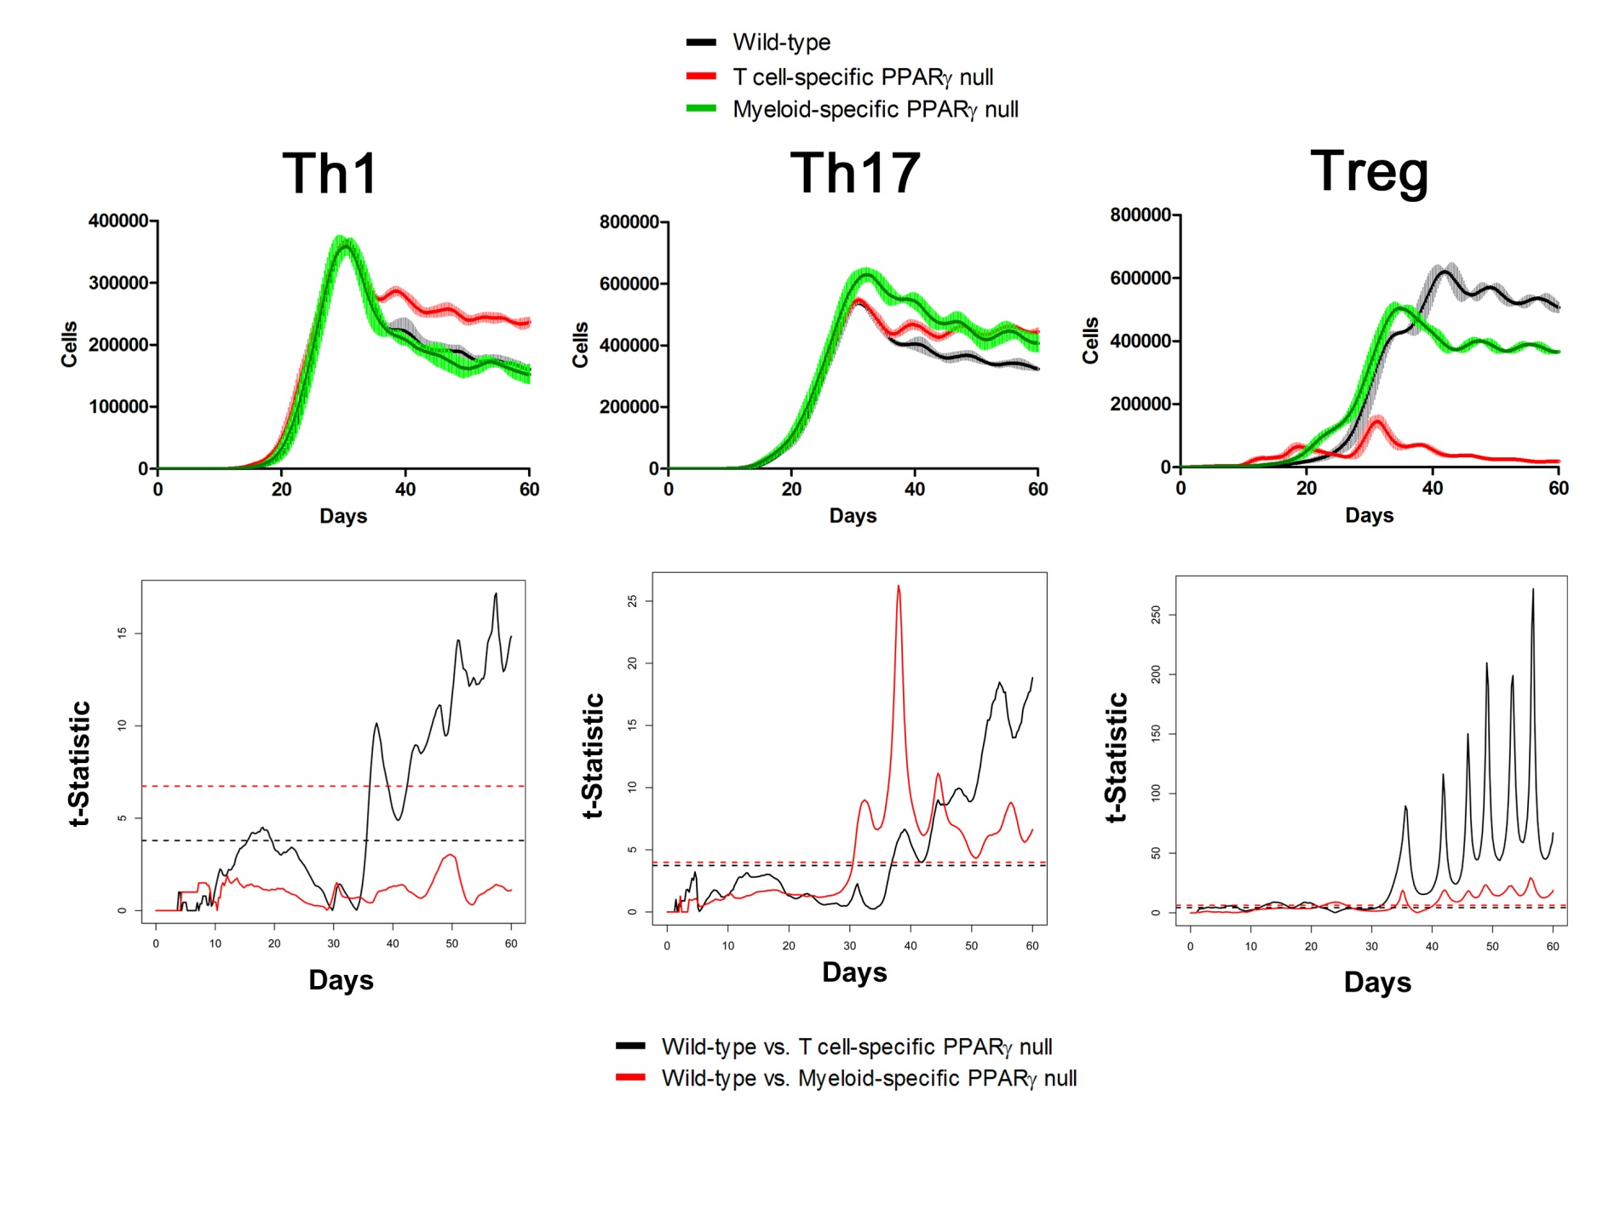
ENISI LP Simulation Results
Notes:
The objective is to test whether two groups of functional curves are statistically different
FUNCTIONAL T-test using permutation technique

Slide 25
Calibrating cell/cytokine interactions
Cell | Cytokines secreted, Reference
pEC | IL-8, MCP-1, GM-CSF and TNF-a; IL-6(L), Artis 2010 Ann. Rev Imm.; IL-1B, IL-6 (Littman Rudensky); Did not secrete: IL-2, IL-4, IL-5, IL-6, IL-12p40, or IFN-y
eDC | IL23 (Ng10) TNFa (Iwasaki, though associated with peripheral DC)
Th17 | IL-17, IL-22 (Littman and Rudensky 2010)
M1 | L1, IL6, IL23, IFNy (Mosser and Edwards 2008), IL-12 (Subhra K Biswas & Alberto Mantovani 2010); TNFa (Schook, Albrecht Galllay, Jongeneel 1994); MCP-1 (Immunology 2001 Roitt, Brostoff, Male)
M2 | IL-10 (Mosser and Edwards 2008)
tDC
Th1

Slide 28
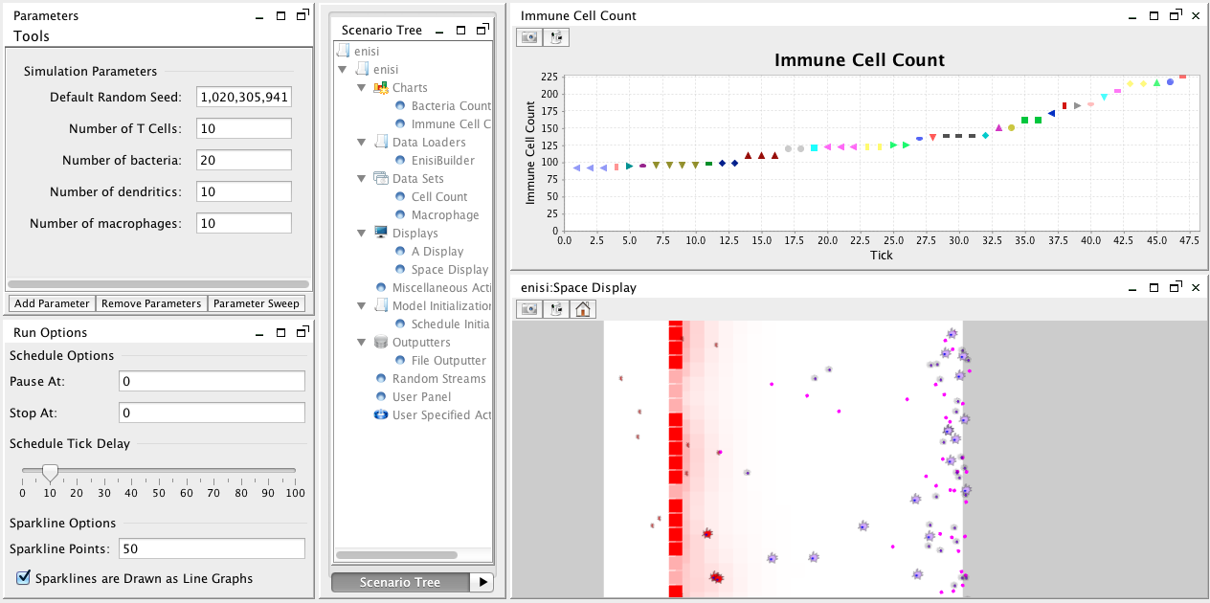

Slide 29
What does an ABM compute?
Interactions among things correlate their states.
Each time step in each run gives the
state of the system at that time:
The state in any one run is a sample from
the joint distribution of possible states:
(kN numbers)
(k^{N} numbers)

Slide 30
A complete description of the resulting joint distribution is impossible
Describing the distribution for just 32 cells, each with 3 states
– here Naive, Inflammatory, Regulatory –
would require 1.5 PB
Alice | Bob | Carol | David | Ellen | probability of this configuration of states at time T
N | N | N | I | N | 0.002
I | N | R | R | N | 0.013
I | I | N | N | N | 0.004
N | I | R | N | R | 0.108
I | I | I | R | N | 0.006
Notes:
Offhand it might seem that kN numbers would describe it, but that ignores correlations induced by the network among ll the vertices.

Slide 31
Instead, compute averages over multiple simulations (Monte Carlo samples)
Each run of the (stochastic) simulation produces a different result, drawn from the joint distribution
Estimating the joint distribution itself is not feasible
Statistics of the joint distribution can be estimated from many samples
Efficient computation is essential!

Slide 32
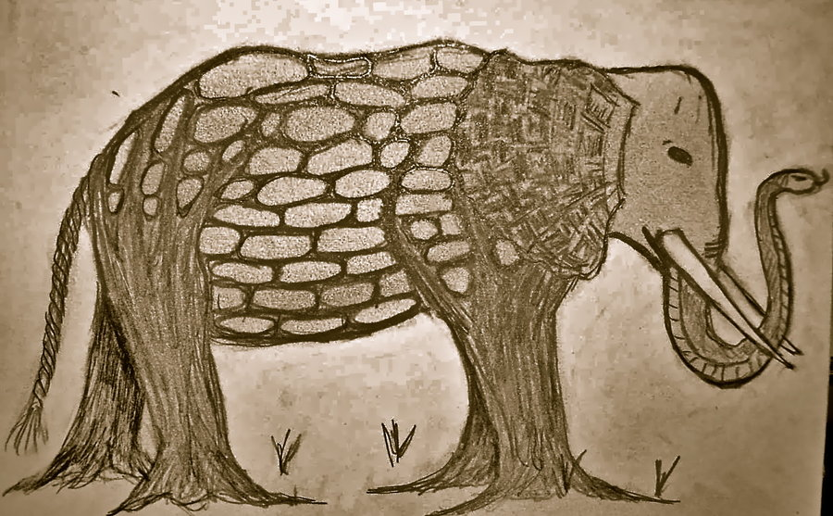
Reaction-diffusion models
Agent-based
models
Ordinary differential equation (ODE) models
Notes:
In the absence of a complete solution, what can we do?
We are like blind men who can understand isolated aspects of the system.

Slide 33
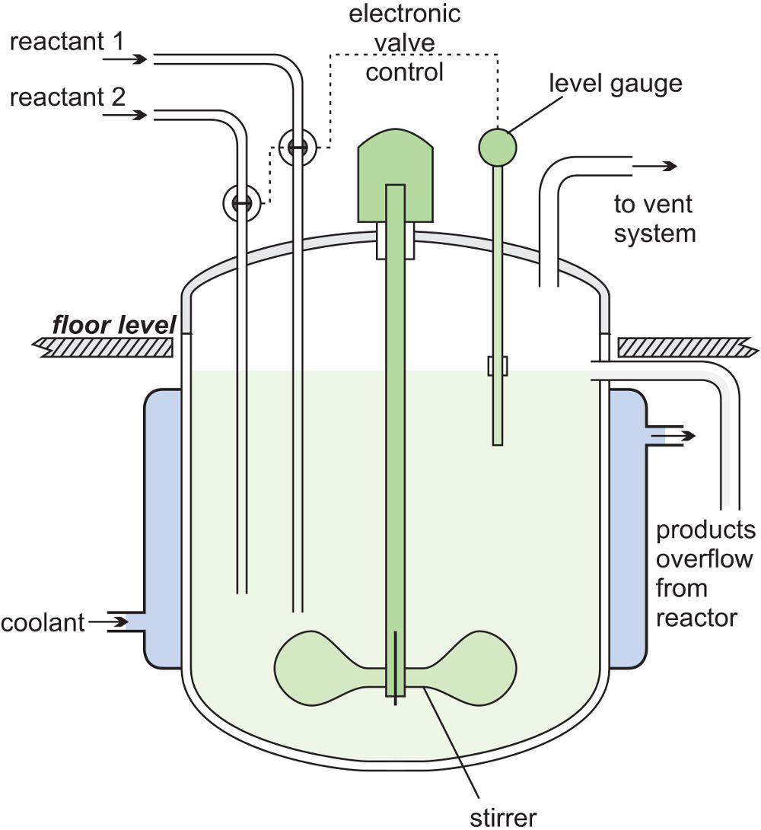
Ordinary differential equation (ODE) models
emphasize aggregate, population outcomes
assume network exhibits regularities
assumes averages are representative
produce dynamical equations of state

Slide 34
Reaction-diffusion models
emphasize network structure
assume fixed detailed network
are “equation-free”
subgraph selection
transmission tree reconstruction
Notes:
The extreme case creates a “group” out of each entity.
A statistician looking at this assumption is horrified by the number of parameters;
a modeler looking at compartmental models is horrified at the smoothing.
But we can also create a “ladder” of models.
“Pick up” the subgraph by the index case and the transmission tree will dangle from it.

Slide 35
Agent-based models
emphasize individual interactions
assume interaction network
simulate a few instances

Slide 36
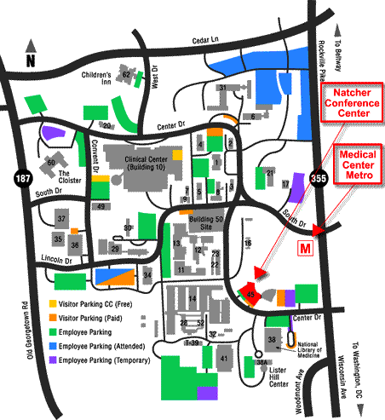
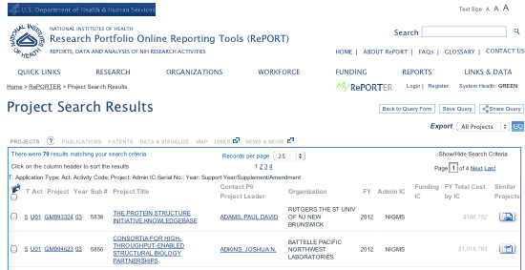
Different models are appropriate for different questions
It’s better to have an approximate answer to the right question than an exact answer to the wrong question.
- John Tukey
Notes:
.. and the need to support PH policy drives the questions.
This is perhaps obvious, but the power of MIDAS extends beyond this mapping of models to questions..
When MIDAS is at its best, we realize the synergies made possible by combining our understanding of these complementary aspects of the problem.

Slide 37
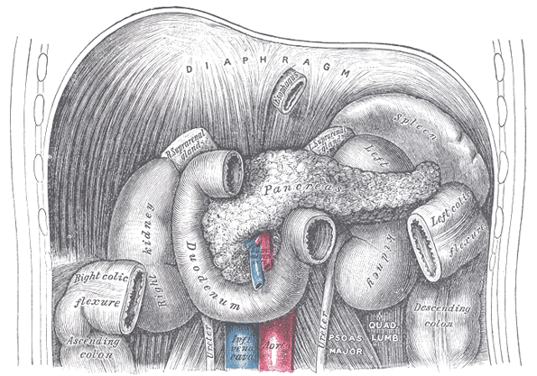
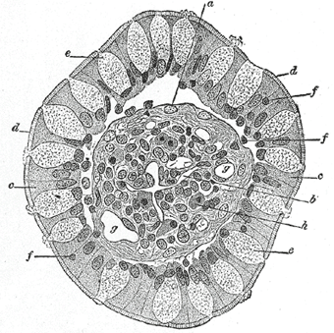
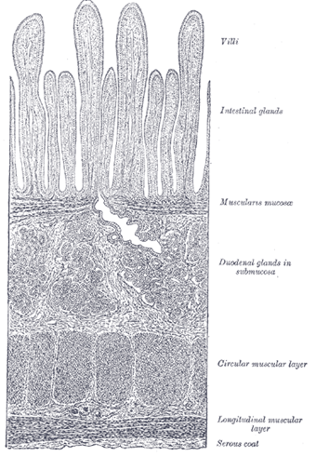
How can you tell which is appropriate for your problem?
Is the interaction network random or structured?

Slide 38
How can you tell which is appropriate for your problem?
Is the interaction network random or structured?
Are the interactions nonlinear?

Slide 39
How can you tell which is appropriate for your problem?
Is the interaction network random or structured?
Are the interactions nonlinear?
Do the model, questions, & observables distinguish outcomes?
spatial extent of model

Slide 40
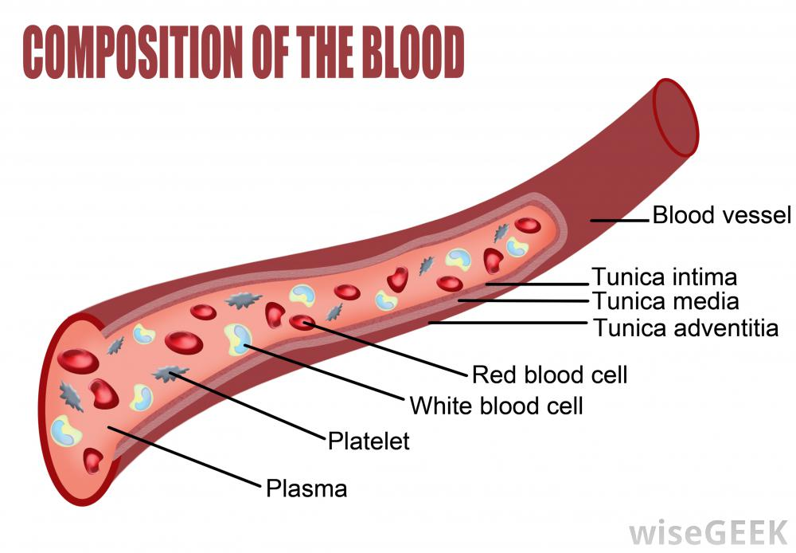
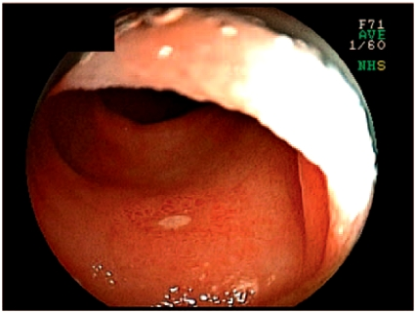
How can you tell which is appropriate for your problem?
Is the interaction network random or structured?
Are the interactions nonlinear?
Do the model, questions, & observables distinguish outcomes?
    lesion formation
    serology

Slide 41
How can you tell which is appropriate for your problem?
Is the interaction network random or structured?
Are the interactions nonlinear?
Do the model, questions, & observables distinguish outcomes?

Slide 42
How can you tell which is appropriate for your problem?
Is the interaction network random or structured?
Are the interactions nonlinear?
Do the model, question, & observables
distinguish outcomes?
Is discreteness important?

Slide 43
How can you tell which is appropriate for your problem?
Is the interaction network random or structured?
Are the interactions nonlinear?
Do the model, question, & observables
distinguish outcomes?
Is discreteness important?
Is randomness important?
  Throwing dice in a simulation is easier than integrating stochastic [partial, delay] differential equations

Slide 44
How can you tell which is appropriate for your problem?
✓
✗
The art comes in knowing what to leave out and designing experiments that confirm or contradict modeling assumptions.

Slide 45
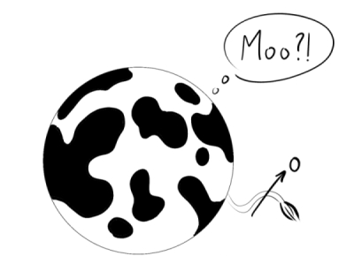
What to expect from the new systems models
Not “assume a spherical cow …”
Expect simplifications
that reflect biomedical understanding,
not mathematical / computational convenience.

Slide 46

What to expect from
the new systems models
Not “turn to page 79 of your textbooks …”
Scientific modeling
is an art and a
research program.
Expect creativity,
not pat solutions.
MODEL

Slide 47
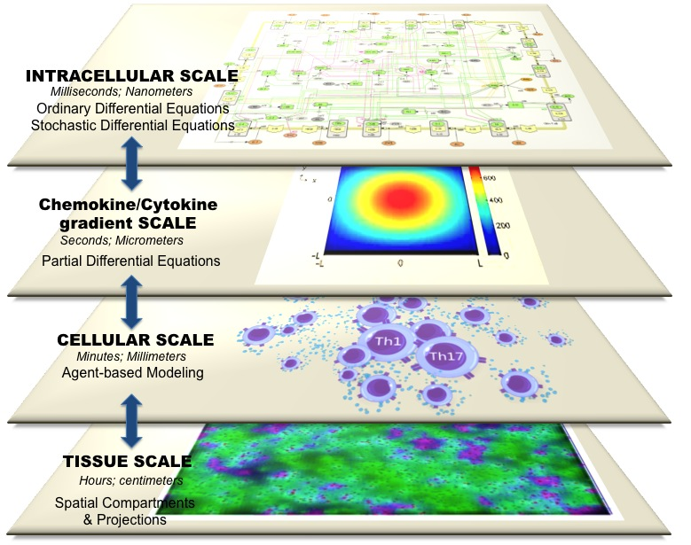
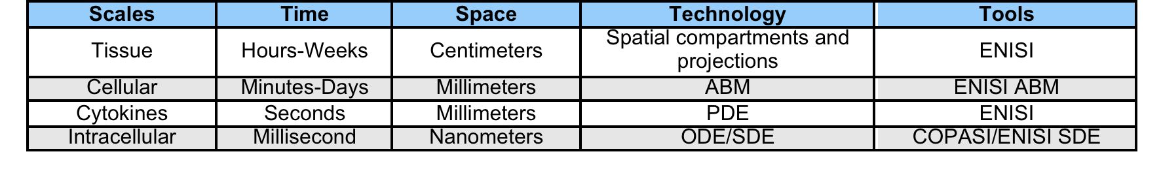
Multiscale modeling
Notes:
Problem: CD4+ T cell differentiation also depends on events happening at the cellular and tissue scale, however, these events are intimately linked to the intracellular activation during differentiation.

Slide 48
Leveraging transdisciplinary insights
Physics:
  How do transition properties depend on network topology?
  Phase transitions, hysteresis, nonlinear dynamics
Chemistry:
  How do aggregate properties of well-mixed systems emerge?
  Coupled rate equations (structured compartmental model)
Discrete math, combinatorics, computer science:
  How can I approximate solutions efficiently?
  Feasibility of solving/approximating classes of problems
Notes:
Just as different modeling approaches are complementary, different disciplinary perspectives are essential
It takes a village to inform a policy

