Slide 1
ENISI Tool Suite
Yongguo Mei
PhD in ECE
June 10, 2014

Slide 2
ENISI Tool Suite
ENISI: ENteric Immune SImulator
A suite of mathematical and computational modeling tools, inclduing
ENISI ABM Agent-based modeling (covered)
ENISI SDE, stochastic differential equations
ENISI ISE, In Siliso Experimentation
ENISI ANN, artificial neural network

Slide 3
ENISI SDE: Outline
Stochastic modeling
SDE in computational biology
ENISI SDE, a web-based tool
A case study on a CD4+ T cell model
Conclusion and future work

Slide 4
Why stochastic modeling
Modeling and simulations and important for computational biology
Capturing existing knowledge and mechanisms
Effective reasoning and predicting
Modeling technologies
Equation-based such as ODE and PDE
Agent-based
Why stochastic modeling
Deterministic models the average behavior
Biological processes are of stochastic nature
Notes:
Models can be used to synthesize, organize, and integrate existing knowledge
Effective knowledge discovery algorithms can be applied to large-scale networked models
In Silico experiments can be performed in time and cost-saving manner to generate novel hypotheses for further wet-lab experiments
Agent-based models can be easily stochastic, however they
Are hard to develop and calibrate
Require much computational resources
ODE models are deterministic
User-friendly tools to develop models such as COPASI
Effective algorithms to calibrate models

Slide 5
Gillespie’s algorithm
Chemical reactions can be represented by master’s equations that are ODEs
When the particle numbers are small, chemical reactions are stochastic
Gillespie’s algorithm uses limited computational resources and can accurately simulate stochastic chemical reactions
However, it applies directly only to biochemical reactions

Slide 6
SDE: Stochastic Differential Equations
SDE: adding random variables into the differential equations
dy/dt = f(t) + rv(t)
Used to model stochastic processes
SDE has been used in modeling economy markets and some physical systems
Some Matlab or R packages are available
However, SDE has not been widely used in computational biology
One of the reasons is the lack of user-friendly tools
Notes:
Stochastic processes

Slide 7
Modeling tools for biologists
Biological processes are very complex systems
Models are usually of many variables
Prefer less mathematics
Existing SDE packages of R or Matlab are thus not the best options
Example: Matlab can be used to model ODEs, but the most popular ODE modeling tools is COPASI
Notes:
COPASI: complex pathway simulator
No math needed
But COPASI has no SDE

Slide 8
ENISI SDE: a web-based tool
ENISI SDE is the first SDE modeling tool targeting for computational biologists
Front-end: Web-forms
Back-end: cgi, perl, R, COPASI
Numerical algorithm: Euler–Maruyama method
Notes:
complex network structures

Slide 9
Modeling with ENISI SDE
Two-step solution for SDE
Regular ODE model development
Estimate and inject stochasticity into ODEs
Three ways of adding stochasticity
Species/nodes
Reactions/edges
Parameters
Url: https://nimml-labkey.vbi.vt.edu/SDE/
Notes:
complex network structures

Slide 10
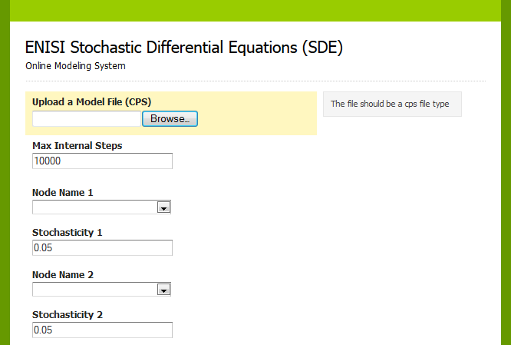
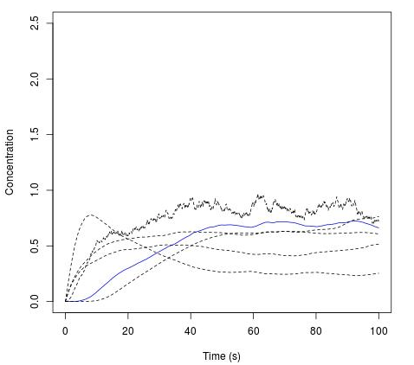
Notes:
Load a cps file (ODE model file)
Node and stochsticity

Slide 11
CD4+ T cell computational model
A comprehensive T cell differentiation model
94 species
46 reactions
60 ODEs
A deterministic model for in silico experiments with T cell differentiation: Th1, Th2, Th17, and Treg
However, this model cannot represent the stochastic nature of T cell differentiation
Transcription
Translation rate

Slide 12
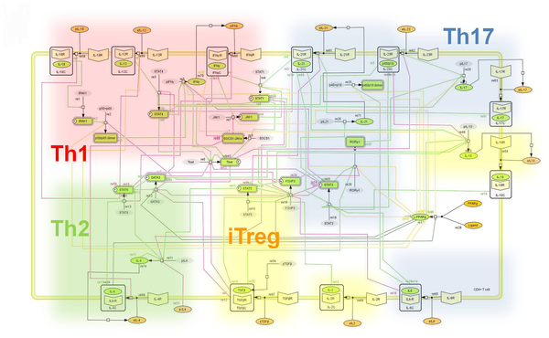

Slide 13
SDE with CD4+ T cell model
Assumption: Treg and Th17 have a tight equilibrium regulated by FOXP3 and RORgt
Conforming to experimental data
In silico SDE experiments by adding stochasticity
FOXP3 and RORgt: relatively stable IL-7 production
STAT3: less stable IL-7 production
IL-6: Phenotype balance is broken
Double-positive RORgt+ FOXP3+ is observed
Confirming with a previous study [Tartar 2010]

Slide 14
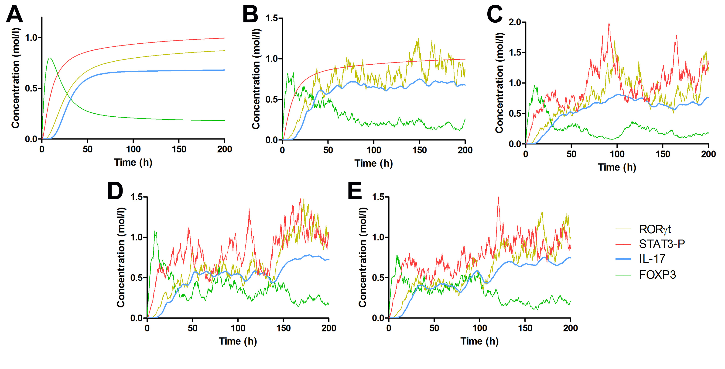

Slide 15
ENISI SDE: Future Work
Major Contributions:
The first user-friendly web-based SDE tool for computational biologists
A case study with a complex model shows its effectiveness
Future work
Improve ENISI SDE and its user friendliness
Develop more SDE models
Develop parameter estimation algorithms
Investigate multi-scale modeling

Slide 16
ENISI NN: Outline
Immune cell and cell differentiation
Immune system modeling
Model reduction and multi-scale modeling
Neural network models
Future work

Slide 17
Immune cell types and subsets
Immune cells are of different types
B, T, and Macrophages etc.
Different functions
Immune cells are differentiate into different subsets/sub-types
Regulated by cytokines in micro-environment
T cells: Th1, Th17, Treg, etc.
Macrophages: M0, M1, etc.

Slide 18
Modeling immune systems
Immune systems are complex systems
Modeling and simulations can help
Capturing knowledge and mechanisms
Effectively reasoning and predicting
Challenges
Multi-scales
Multiple technologies and algorithms

Slide 19
Modeling immune systems (cont.)
Scales
Organ and tissue: blood, lymph nodes, mucosal
Cellular: cell movement and cell-cell interactions
Intracellular: cell differentiations
Technologies
Equation-based: ODE, PDE
Agent-based
Stochastic

Slide 20
Previous works
ENISI Visual (BIBM 2012)
An agent based simulation platform for tissue and cellular level simulations
Friendly user interfaces
Modeling both inflammatory and regulatory immune responses
CD4+ T cell computational model (PLOS computational biology 2013)
ODE model of 60 equations
CD4+ T cell differentiations
Th1, Th2, Th17, and Treg

Slide 21
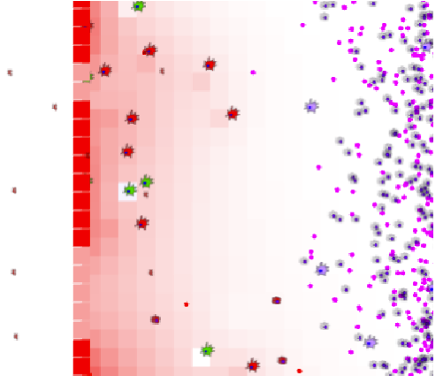

Slide 23
Multi-scale models Integration of models of scales
Integrating cellular and intracellular models
Brute-force
Each agent/cell can be represent by an intracellular ODE model
Performance is a big challenge
Model reduction
Necessary for performant simulations
Sufficient for multi-scale modeling needs

Slide 24
Model reduction
In the multi-scale model, needs for the intracellular models
Interactions with the environment
The cytokines regulate the cell differentiation
The cytokines secreted into the micro-environment
Cell subset classification to determine its functions
The ODE model has 60 ODEs for modeling detailed pathways
In regard of multi-scale model needs, complex model should be reduced

Slide 25
Neural network models
Neural networks are widely used for machine learning and pattern recognition
Neural networks can also be used for model reduction and function approximations
This study developed two neural network models for modeling immune cell differentiation in regard of multi-scale modeling needs
A model for secreting cytokines
A model for subset classification

Slide 26
The problem in general
M inputs: i_1, i_2, …, i_m
N outputs: o_1, o_2, …, o_n
o_1 = f_1(i_1, i_2, …, i_m)
o_2 = f_2(i_1, i_2, …, i_m)
…
o_n = f_n(i_1, i_2, …, i_m)
Find out the n functions f_1, f_2, …, f_n
Notes:
Are they linear?
If not, what are they?

Slide 27
Cytokines in CD4+ T cell Differentiation
Inputs: four external cytokines that regulate cell differentiations
IFNg, IL6, IL12, TGFb
Different levels of the four cytokines will trigger the naive T cells into different subsets
Outputs: secreting five cytokines into the micro-environment
IL17, RORgt, IFNg, Tbet, FOXP3
Different subsets secrete different level of the five cytokines

Slide 28
Data generation
Using the CD4+ model as an example
Randomize the 4 inputs and calculate the 5 outputs of the steady state using COPASI parameter scanning
Use part of the data to train the linear regression model and some other part of the data to test the model
Notes:
For training and testing
Copasi represents Coplex Pathway Simulator, a popular ODE based modeling tool for computational biologists
Using the CD4+ model as an example
Randomize the 4 inputs and calculate the 5 outputs of the steady state using COPASI parameter scanning
Use part of the data to train the linear regression model and some other part of the data to test the model

Slide 29
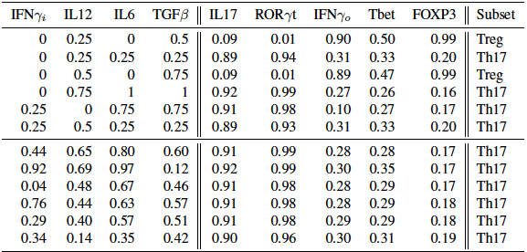
The data set

Slide 30
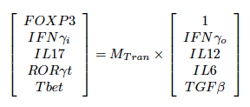
Linear regression model
Linear regression algorithms can be used to fit the constants
Notes:
Using the CD4+ model as an example
Randomize the 4 inputs and calculate the 5 outputs of the steady state using COPASI parameter scanning
Use part of the data to train the linear regression model and some other part of the data to test the model

Slide 31
Linear regression model
Model constants, the matrix
Mean errors of prediction
Notes:
Big errors suggest that linear functions or linear models are not enough to capture the relationship between the inputs and outputs

Slide 32
Neural network development
Neural network can capture non-linearity
Neural network models are sensitive to
model structure
Training data
Training algorithms
Thresholds settings
Feed-forward network structure
Back-propagation learning algorithm
Notes:
We need to learn to swim in different technologies!

Slide 33
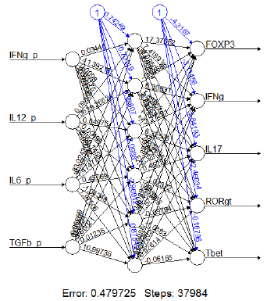
Neural net model for cytokines
Errors are smaller; this shows ANN models are better than linear models to capture the relationship between the input and output cytokines
Notes:
Feed-forward
Back propagation

Slide 34
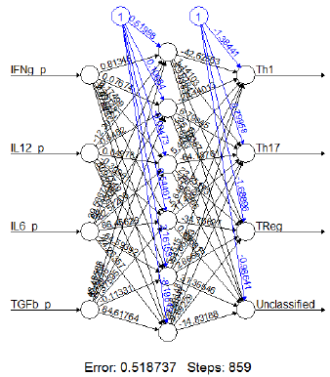
Neural net model for classification
The prediction accuracy is 98% with 2 wrong predictions and
98 correct predictions.

Slide 35
ENISI NN: future work
Neural network models can be successfully applied to model reduction and immune cell subset classification
For future work
More mature methodology for neural network model development
more neural network models for other immune cell types
Comparison between neural network models with other types of teniques
Multi-scale models
Notes:
We need to learn to swim in different technologies!

