Slide 1
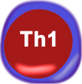
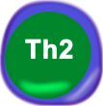


PPARγ activation drives Th17 cells into a Treg phenotype
The CD4+ T cell computational model
June 2014, MMI Summer School

Slide 2
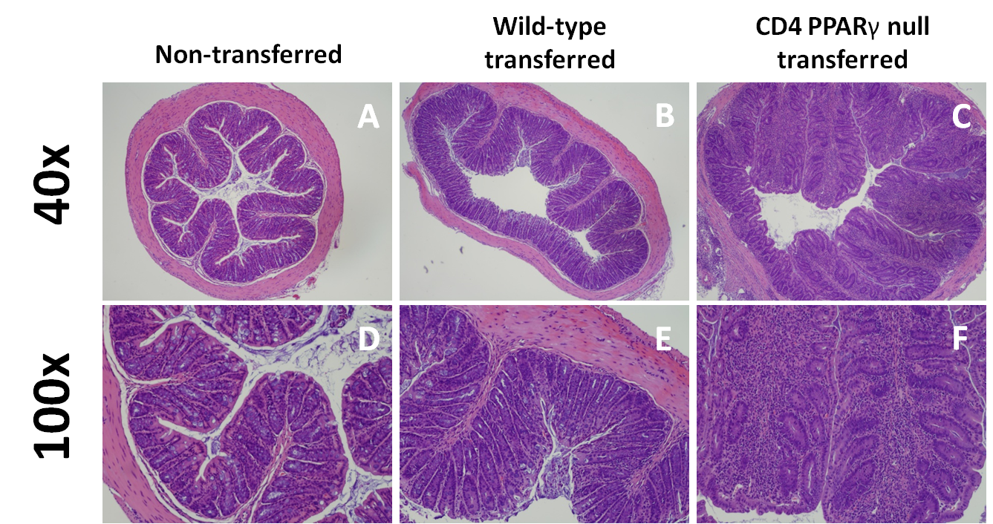

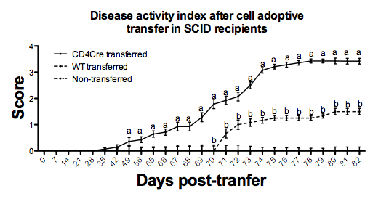
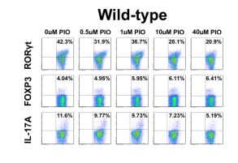
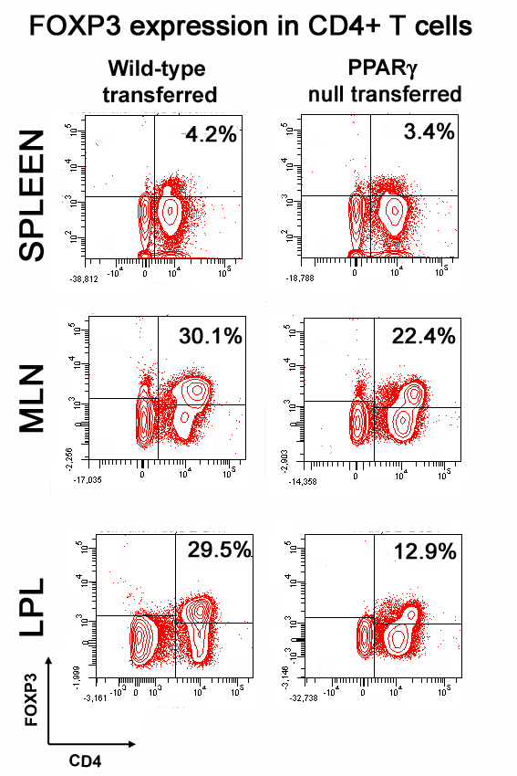

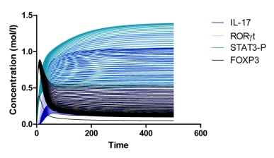
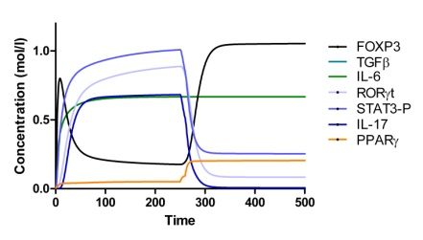
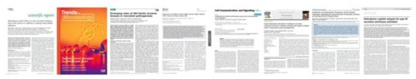


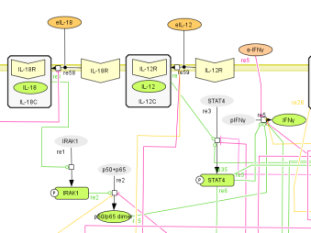
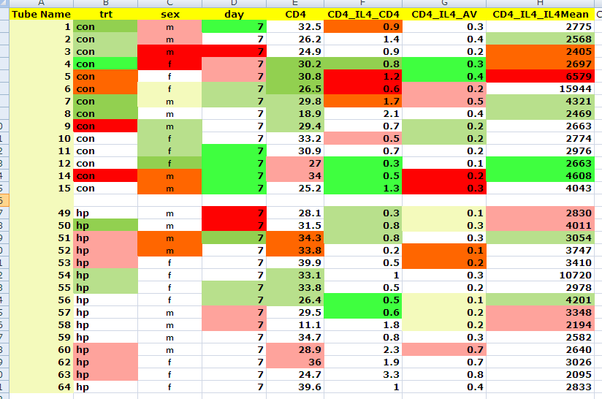
What will this presentation show you?
Refinement of the model with new generated data
In vivo/vitro validation Hypothesis testing
Modeling approach
Literature mining & in-house generated data
In silico experimentation Prediction generation
Creation of the network
Parameter estimation and ODEs adjustments

Slide 3
Outline
Background introduction
The CD4+ T cell computational model
Model calibration: Parameter estimation process
In silico experimentation
Experimental validation
Conclusions

Slide 4
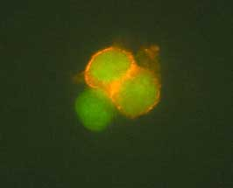
Introduction
The immune system is mainly characterized by TWO different responses:
The INNATE immune response
NON-SPECIFIC: Macrophages, dendritic cells, neutrophils, epithelial cells
2. The ADAPTIVE immune response
SPECIFIC: CD8+ T cells, B cells, CD4+ T cells
CD4+ T cells orchestrate adaptive and innate immune response by secretion of cytokines and other soluble factors in the environment

Slide 5
Introduction
Cytokine signaling
TCR signal
Co-stimulatory signal
CD4+ T cell
development and differentiation

Slide 6
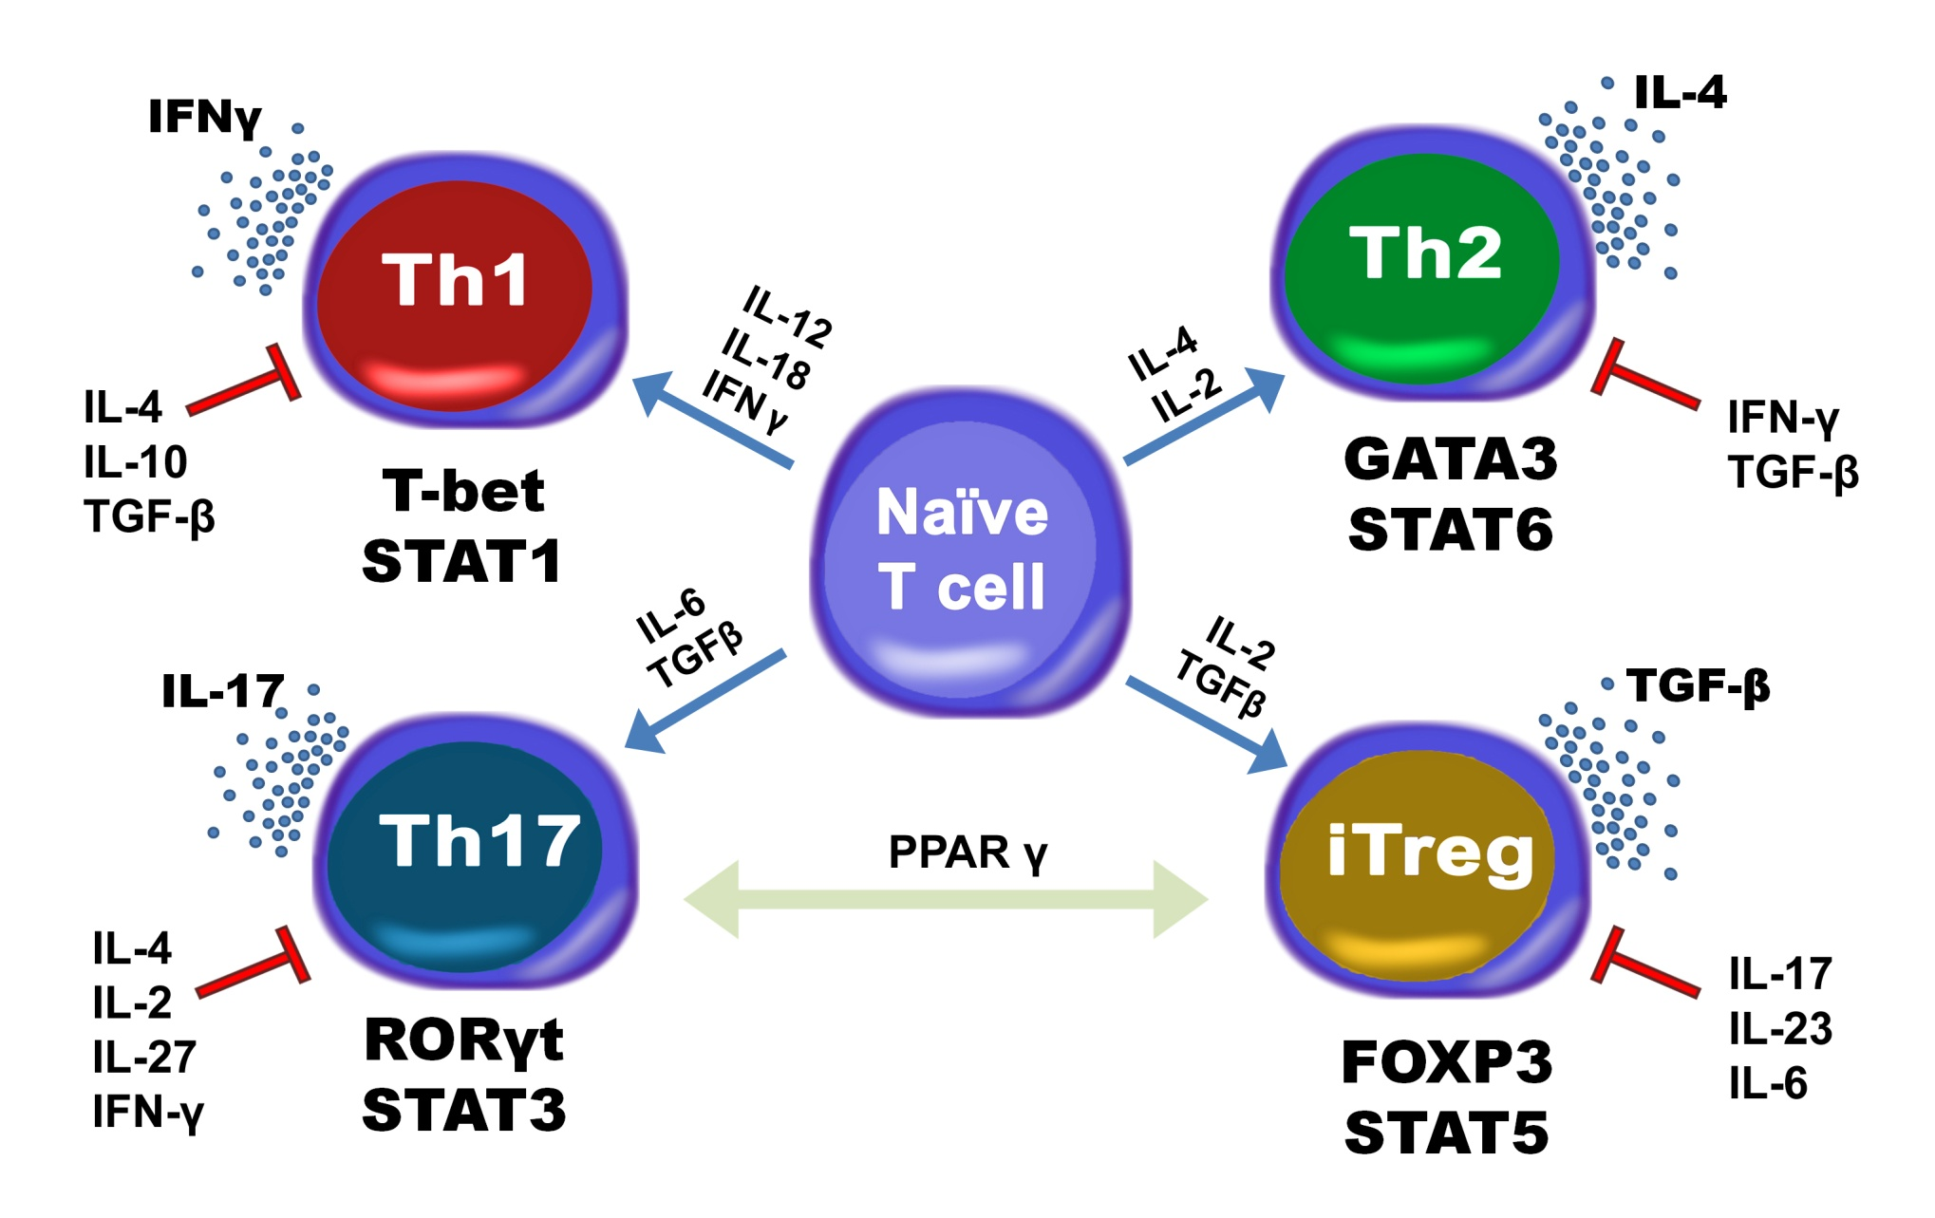
Introduction

Slide 7
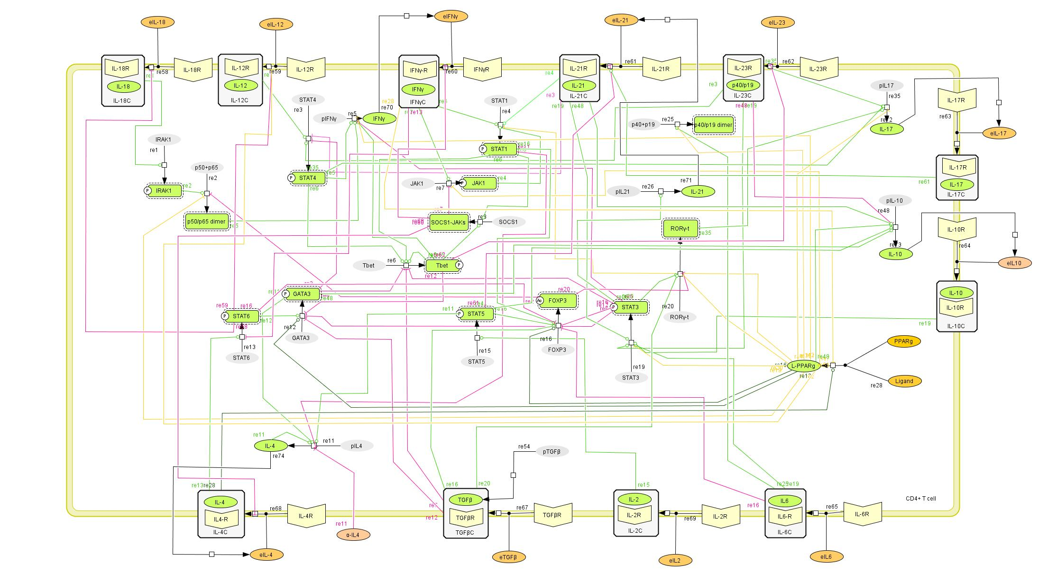
The CD4+ T cell computational model
Th17
Th1
Th2
iTreg

Slide 8
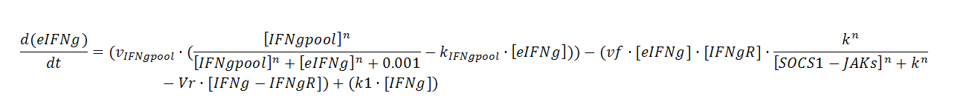
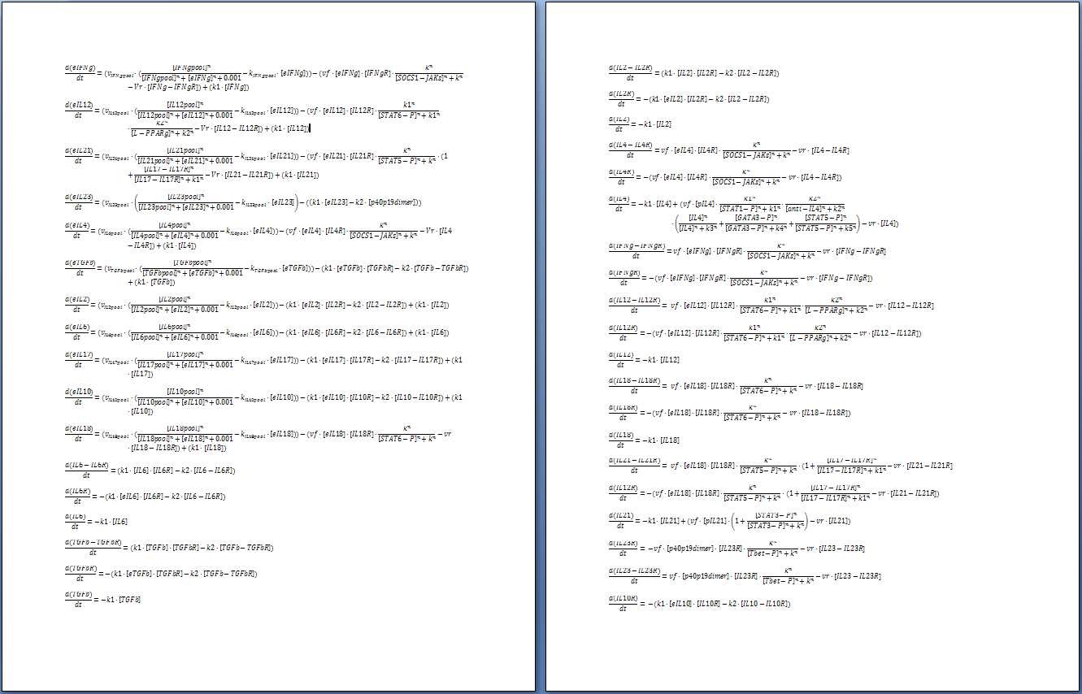
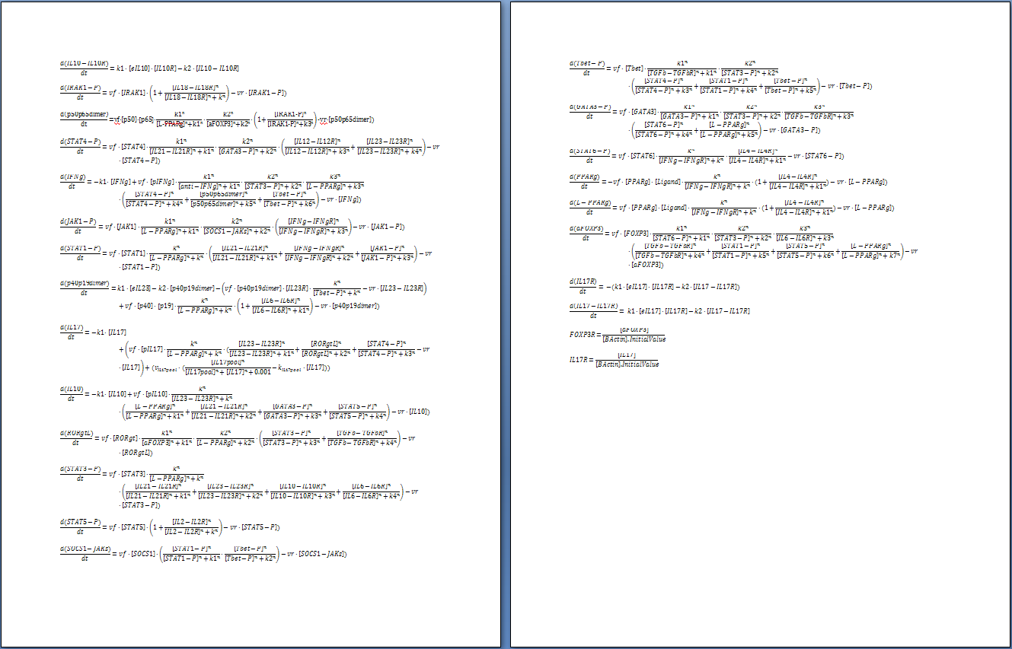
The CD4+ T cell computational model
93 species & 52 reactions
A
k1
B
eIFNg + IFNgR
K1, k2, … , kn
IFNg-IFNgR
We need to adjust the dynamics of the model

Slide 9
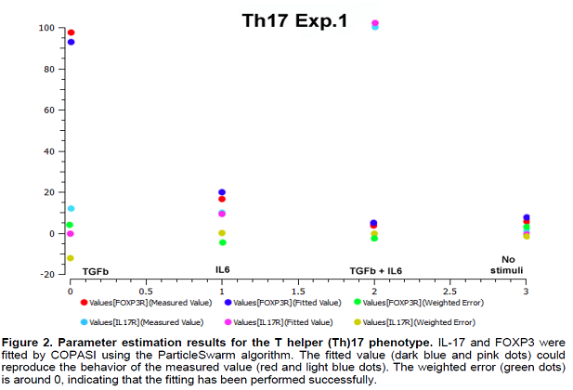
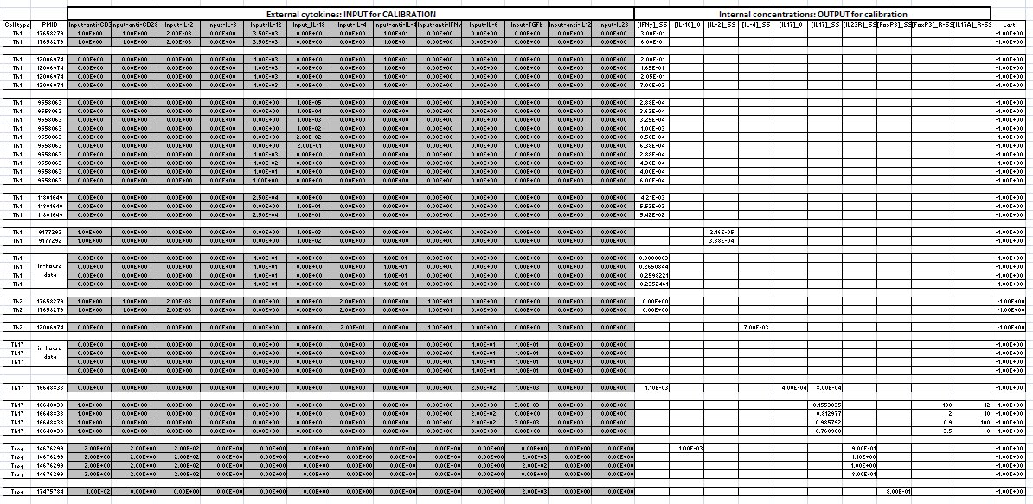

Model Calibration
Experimental data & In-House generated
Calibration database
COmplex PAthway SImulator
Fitting algorithm in COPASI

Slide 10
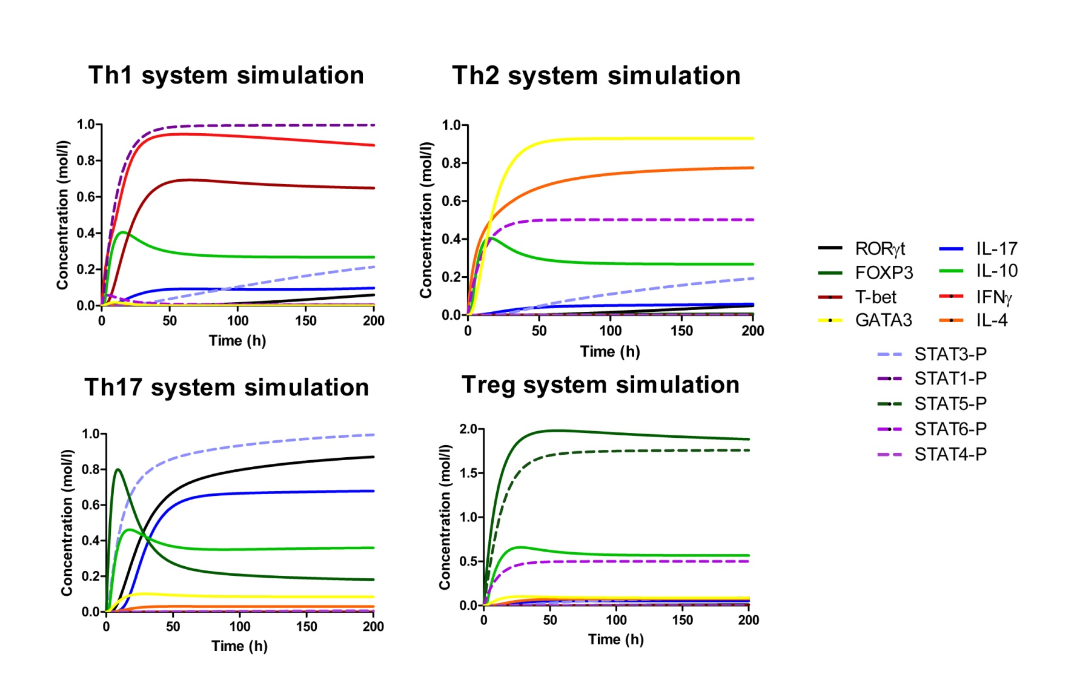
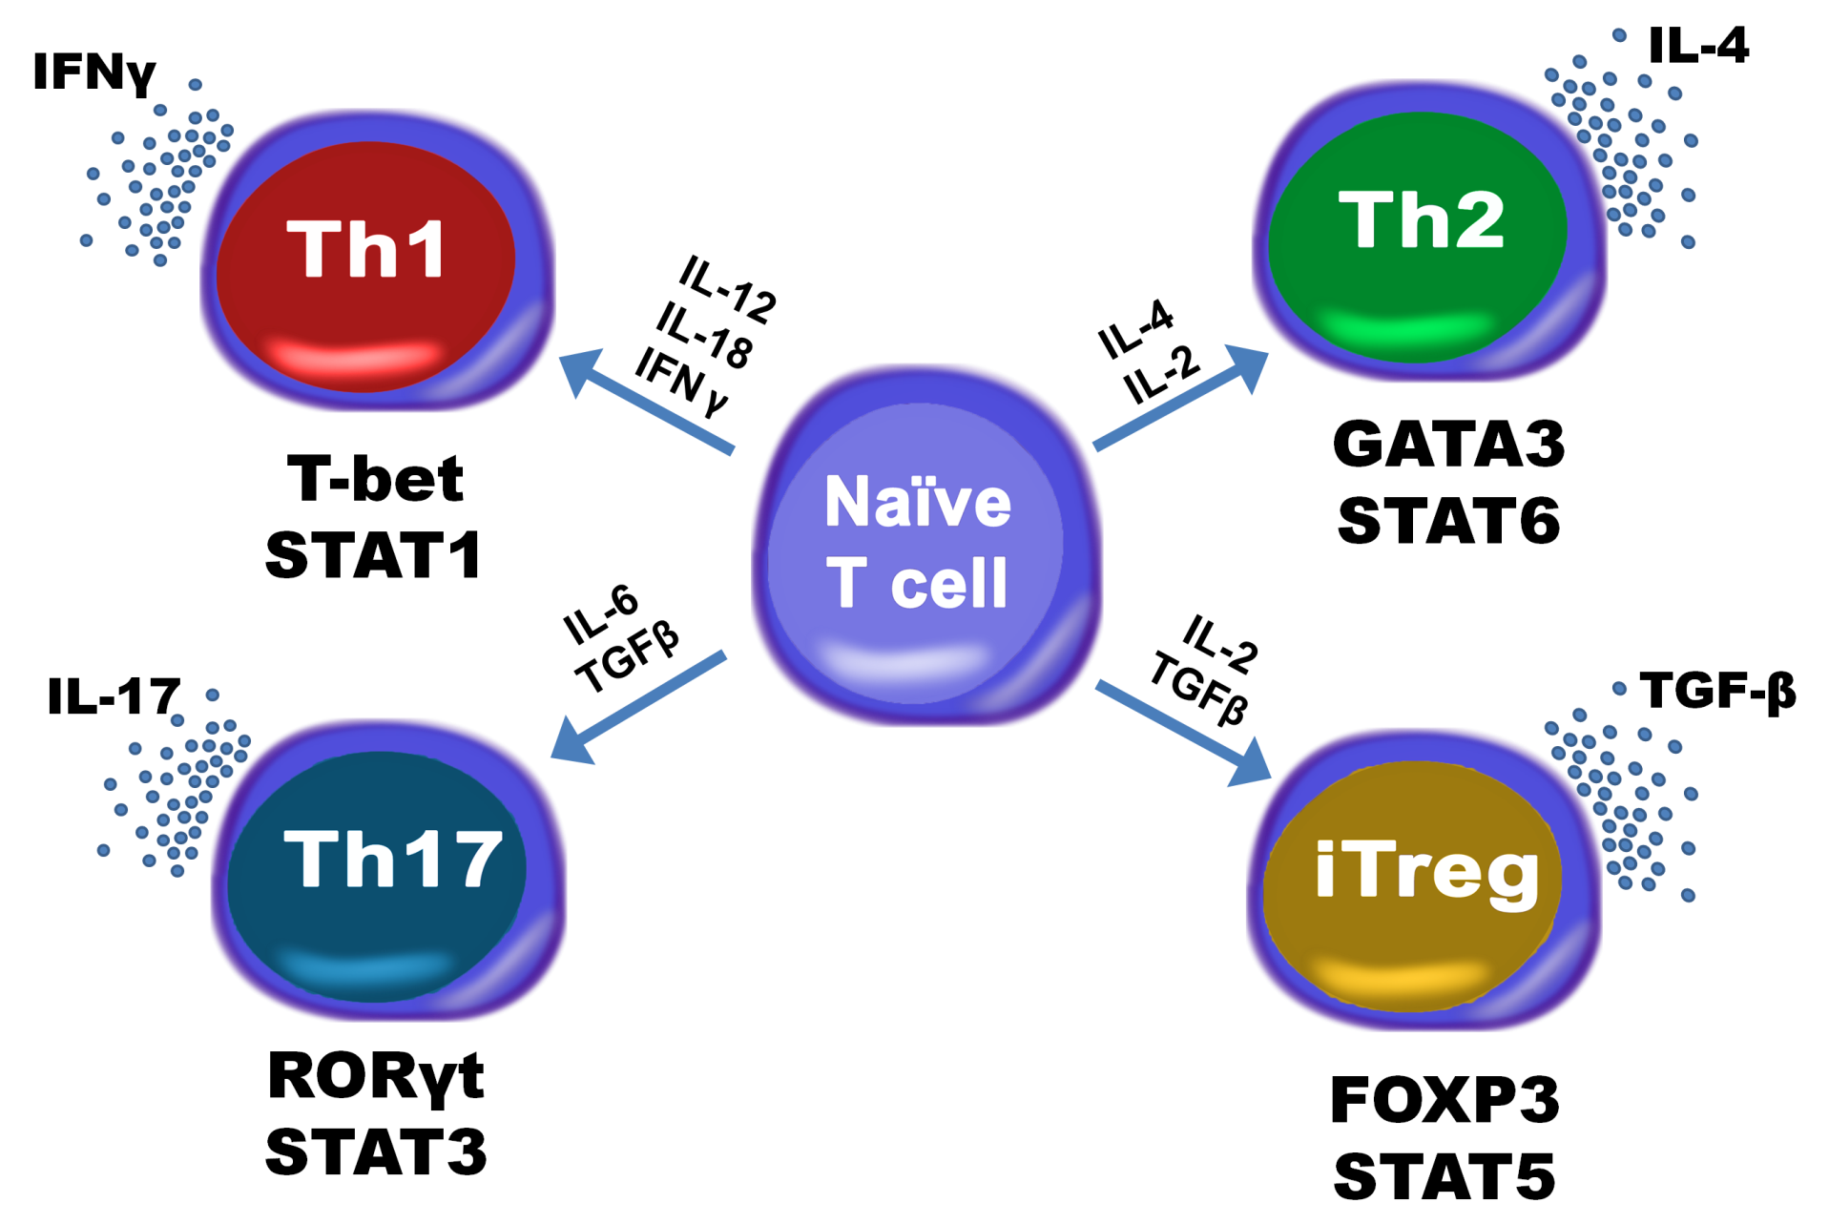

Quality Control

Slide 11
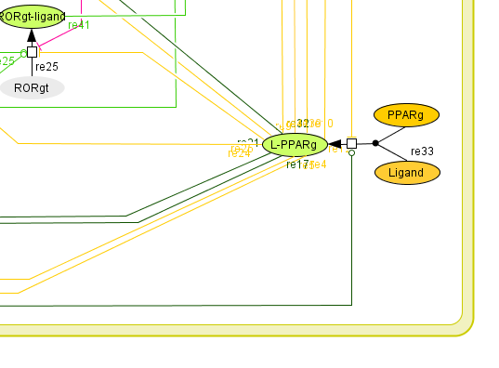
PPARγ
The peroxisome proliferator activated receptor gamma
Loss of PPARγ results in enhanced Ag-specific proliferation and overproduction of IFN-γ.
(Raquel Hontecillas and Josep Bassaganya-Riera. Journal of Immunology. 2007)
PPAR γ inhibits Th1 and Th17 responses in experimental allergic encephalomyelitis
(Kanakasabi et al. Immunology. 2009)
PPARγ inhibits TGFβ/IL-6-induced expression of RORγ-t in CD4+ T cells.
(Klotz et al. Journal of Experimental Medicine. 2009)
PPARγ promotes together with TGFβ the switching from CD4+ CD25- T cells into functional FOXP3+ regulatory T cells.
(Lei et al. Journal of Immunology. 2010)

Slide 12
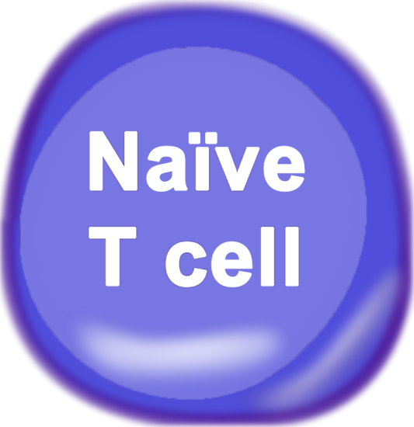
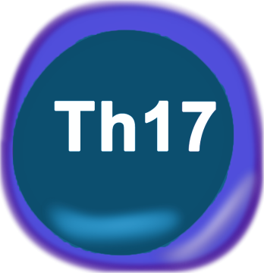
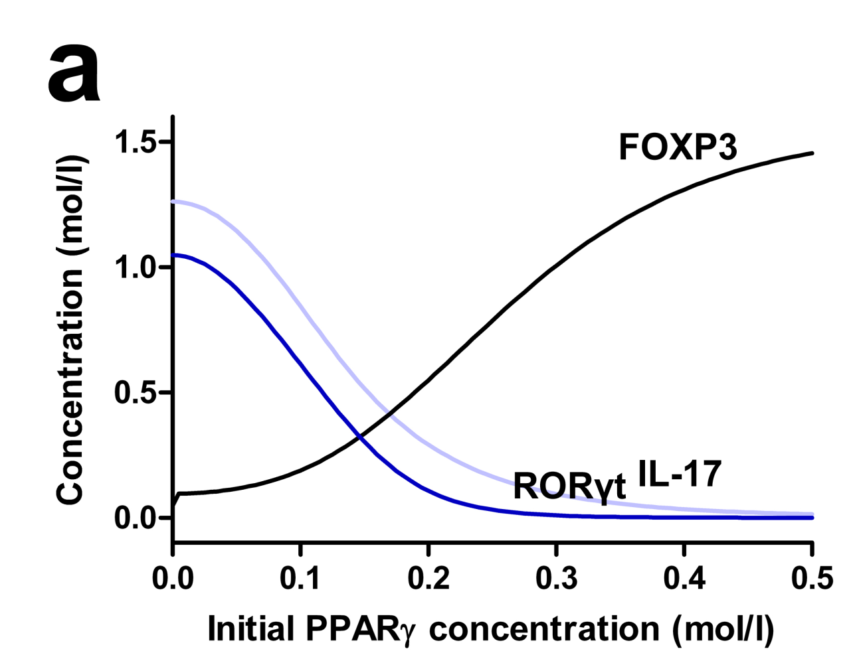
In silico experimentation
GOAL: Check whether activation of PPARγ influences differentiation and state
in either a naïve or differentiated T cell
IL-6 + TGFβ
Parameter SCAN:
We are scanning the concentration of PPARγ, from
0 mol/l to 0.5 mol/l to determine the impact on the dynamics of the system

Slide 13
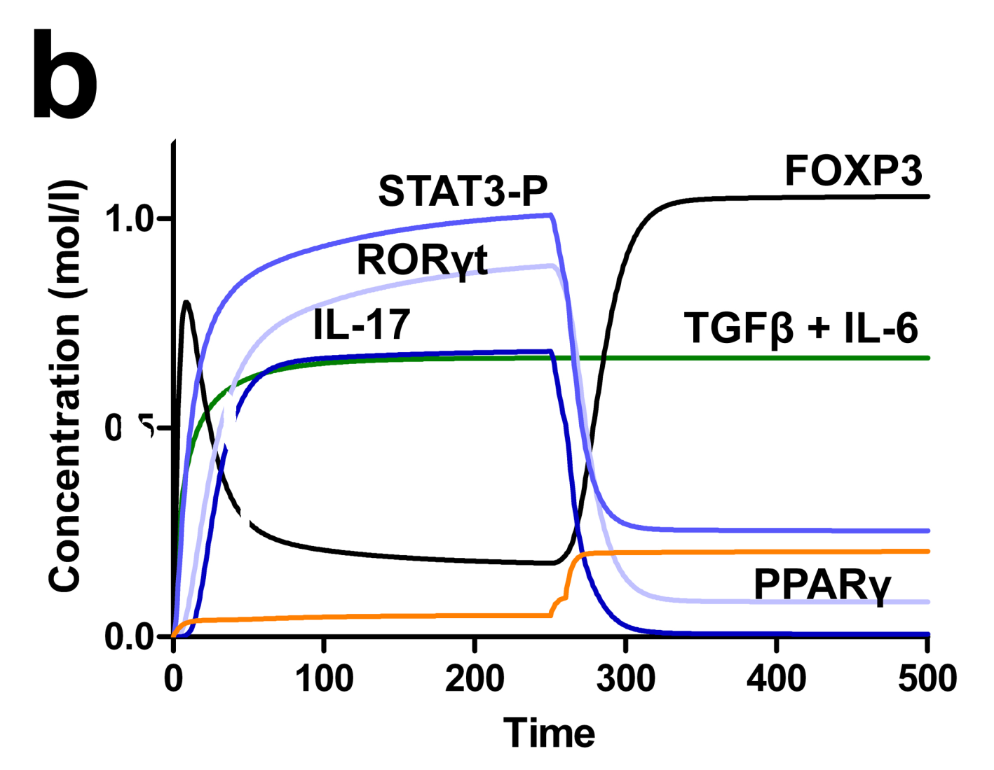
In silico experimentation
GOAL: Check whether activation of PPARγ influences differentiation and state in either a naïve or differentiated T cell
TIME-COURSE:
We differentiate to Th17 and t=250h we activate
PPARγ in the system.

Slide 14
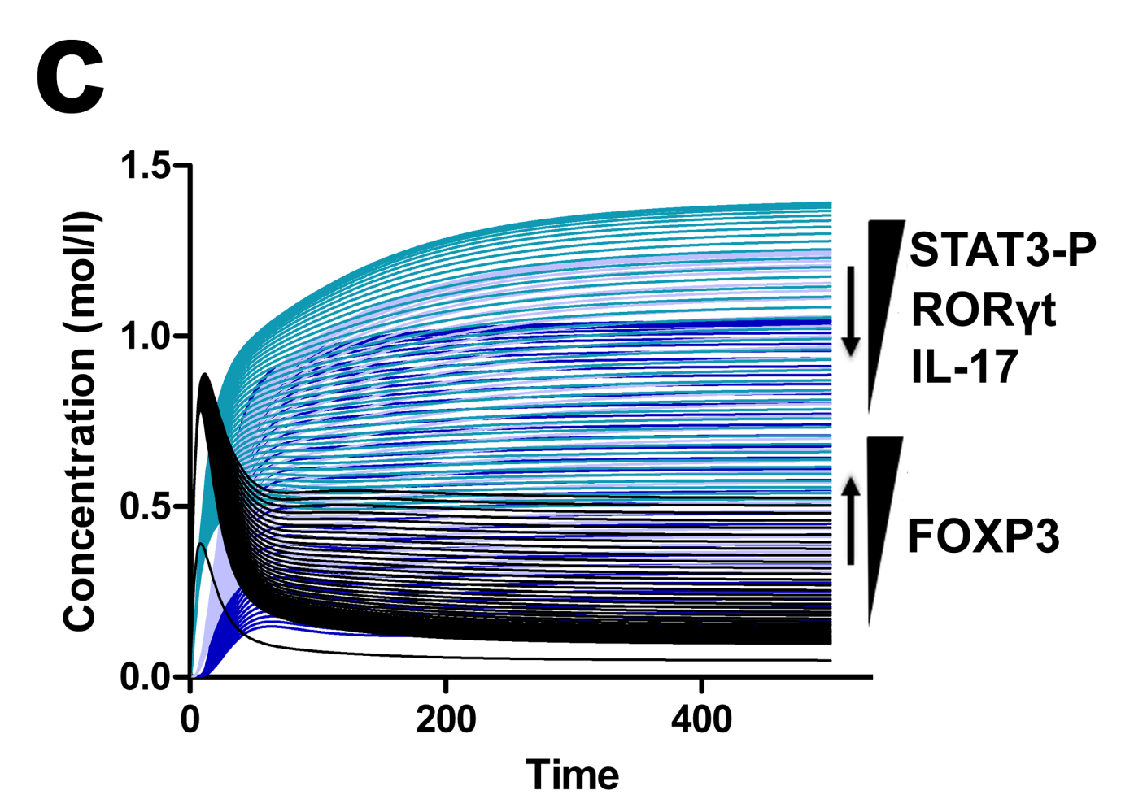
In silico experimentation
GOAL: Check whether activation of PPARγ influences differentiation and state in either a naïve or differentiated T cell
TIME-COURSE & Parameter scan together:
We differentiate to Th17 and we run several time-courses together, each one with an increased concentration of PPARγ

Slide 15
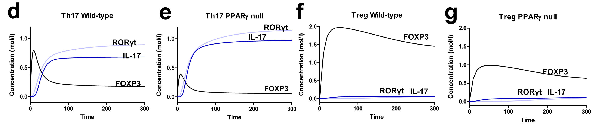
In silico experimentation
GOAL: Check whether activation of PPARγ influences differentiation and state in either a naïve or differentiated T cell
In silico PPARγ KNOCK-OUT:
We are impairing the ability of PPARγ to exert its functions in the CD4+ T cell system. We are then differentiating the system to Th17 and Treg.

Slide 16

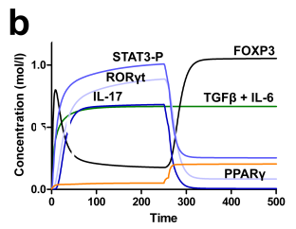
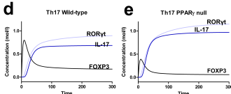
In silico experimentation
PREDICTIONS
Activation of PPARγ in a Th17 cell downregulates RORγt and IL-17A and upregulates FOXP3
    PPARγ triggers a change in phenotype from Th17 to Treg
2. The loss of PPARγ impairs the ability of Tregs to express FOXP3 and accentuates the expression of RORγt and IL-17 in Th17
    PPARγ modulates Th17 and iTreg fates and functions
3. Increasing concentrations of PPARγ led to increasing concentrations of FOXP3 and decreasing concentrations of RORγt and IL-17 in Th17
    PPARγ can exert its effects in a dose-dependent manner

Slide 17
Main hypothesis
PPARγ activation drives Th17 cells into a iTreg phenotype

Slide 18
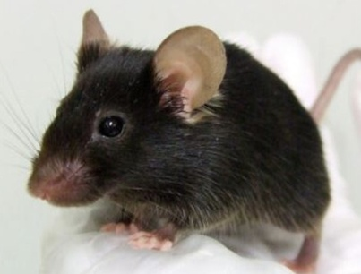
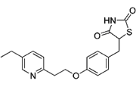
In vitro experimentation
Pioglitazone is a PPARγ agonist:
It activates PPARγ!
Wild-type
Isolated naïve CD4+ T cells
Culture cells under Th17
polarizing conditions for 60h
Add increasing concentrations of
pioglitazone to the culture
PPARγ null
Assess RORγt and IL-17 levels
using flow cytometry

Slide 19
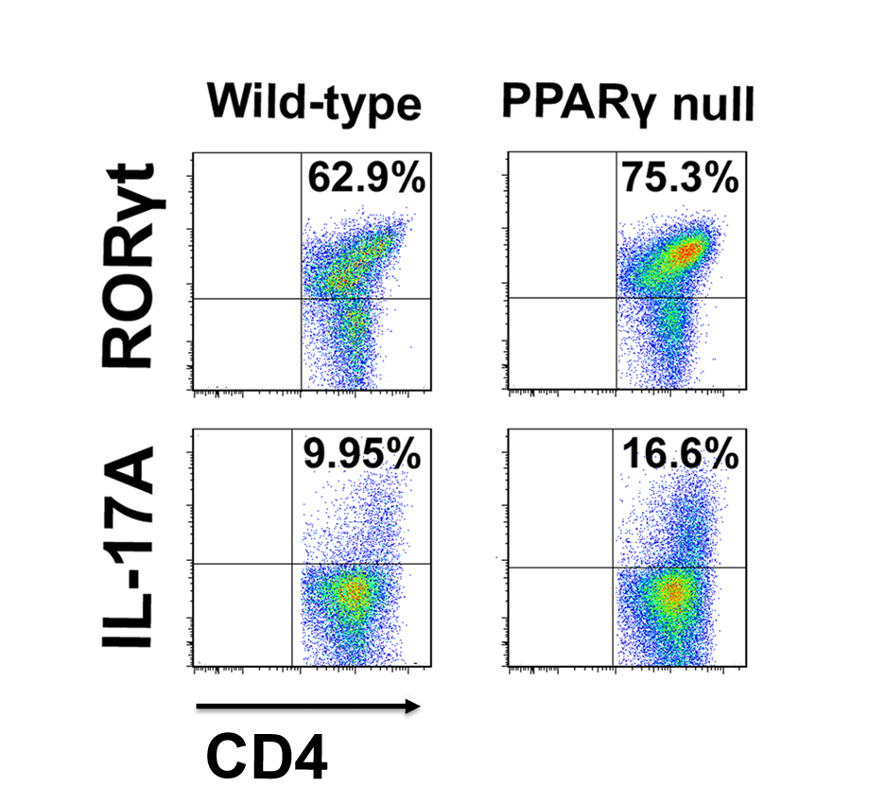
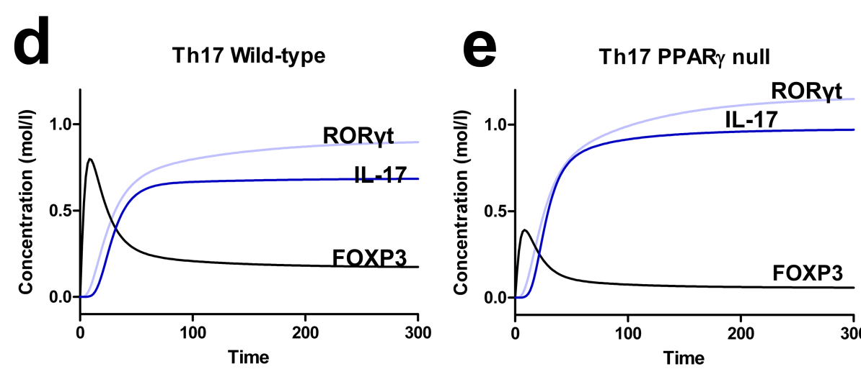
In vitro experimentation
(Computational prediction)

Slide 20
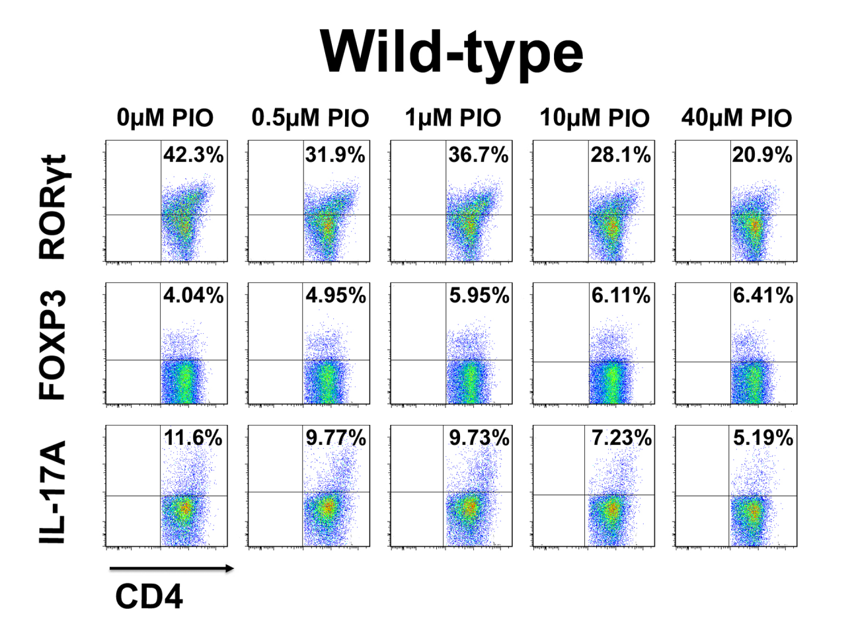
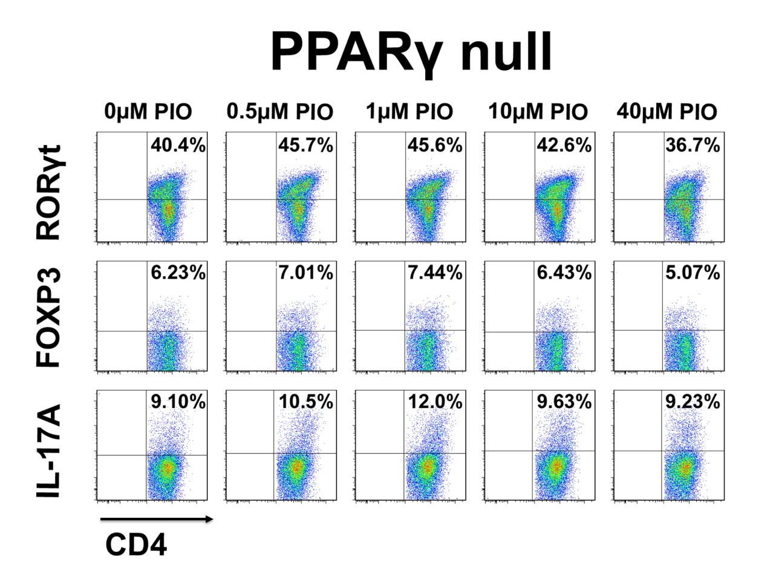

In vitro experimentation

Slide 21
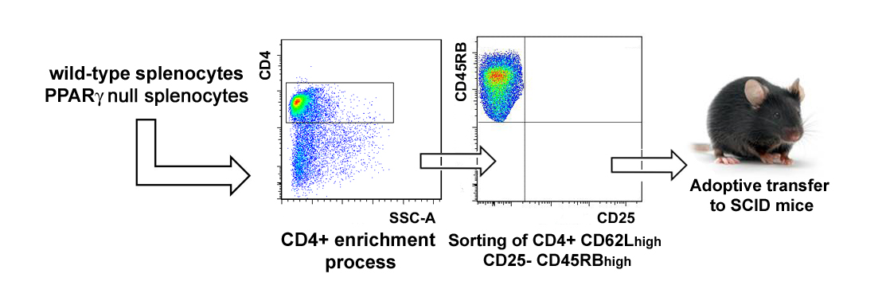
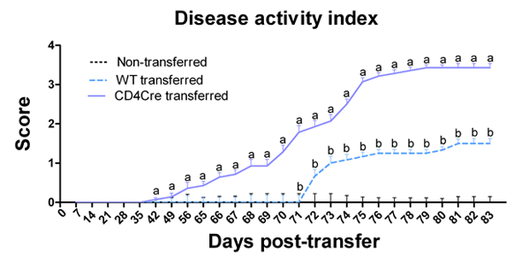
In vivo experimentation
SCID: Immunosuppresed mice
-They do not have any functional T cells-
DISEASE ACTIVITY INDEX

Slide 22
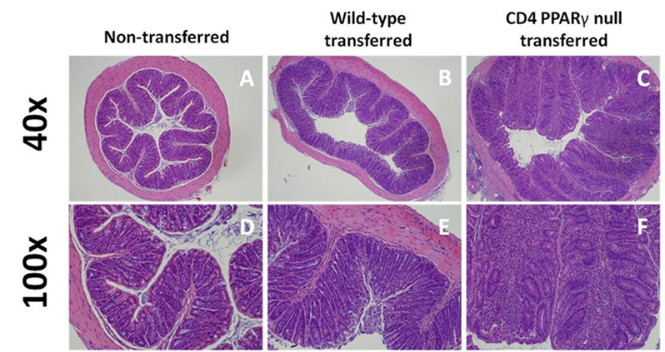
In vivo experimentation
HISTOPATHOLOGY

Slide 23
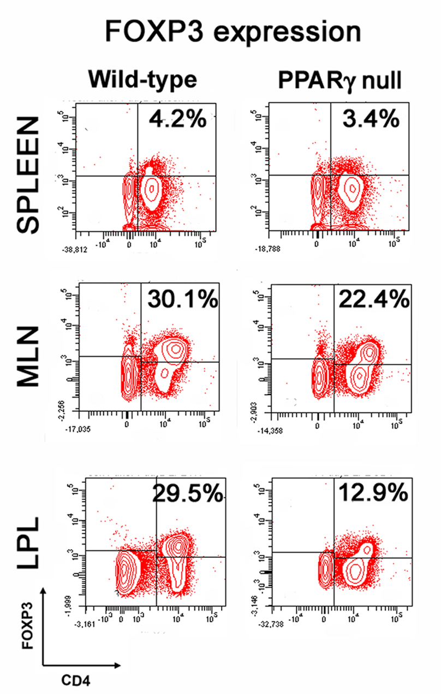
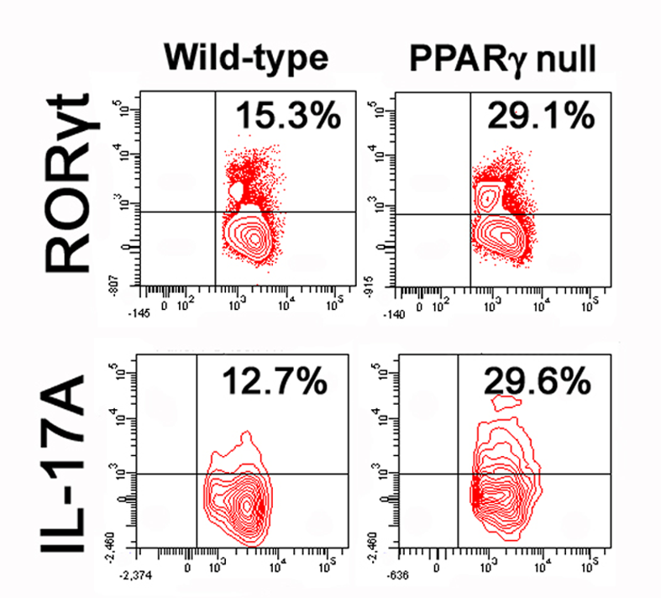
In vivo experimentation
FLOW CYTOMETRY ANALYSIS

Slide 24
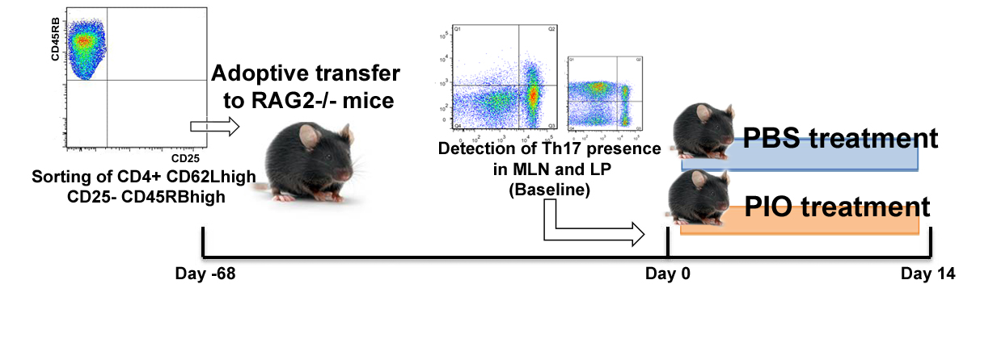
In vivo experimentation (2)

Slide 25
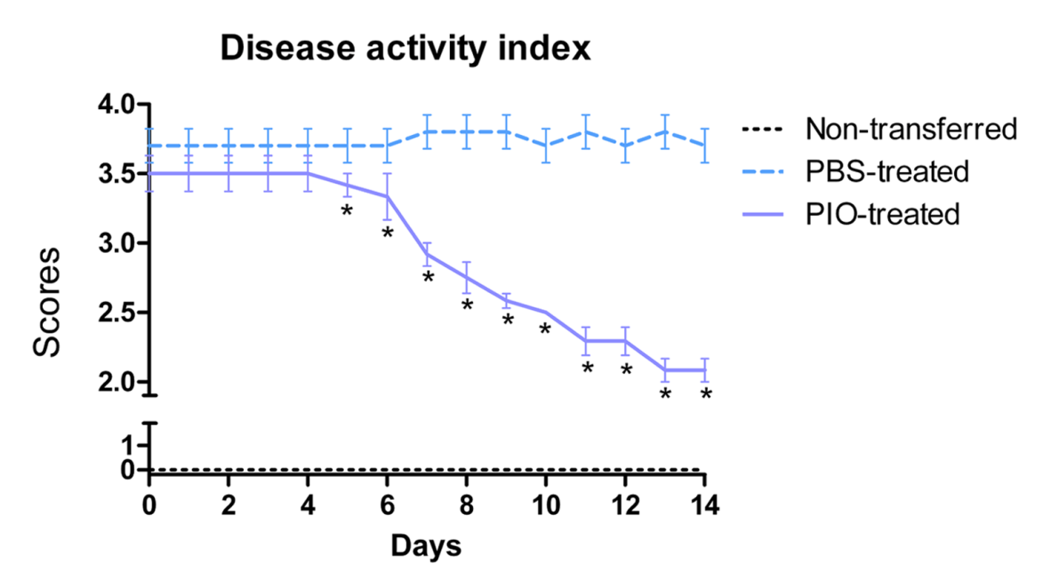
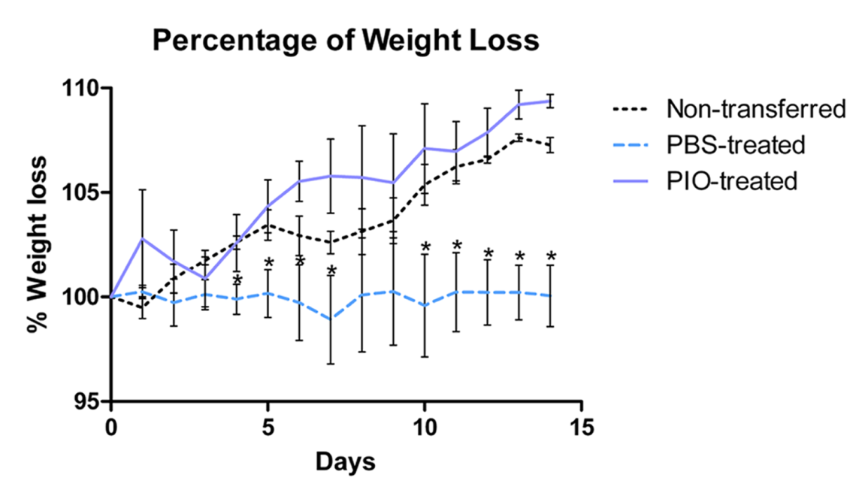
In vivo experimentation (2)
Disease activity index
Weight loss

Slide 26
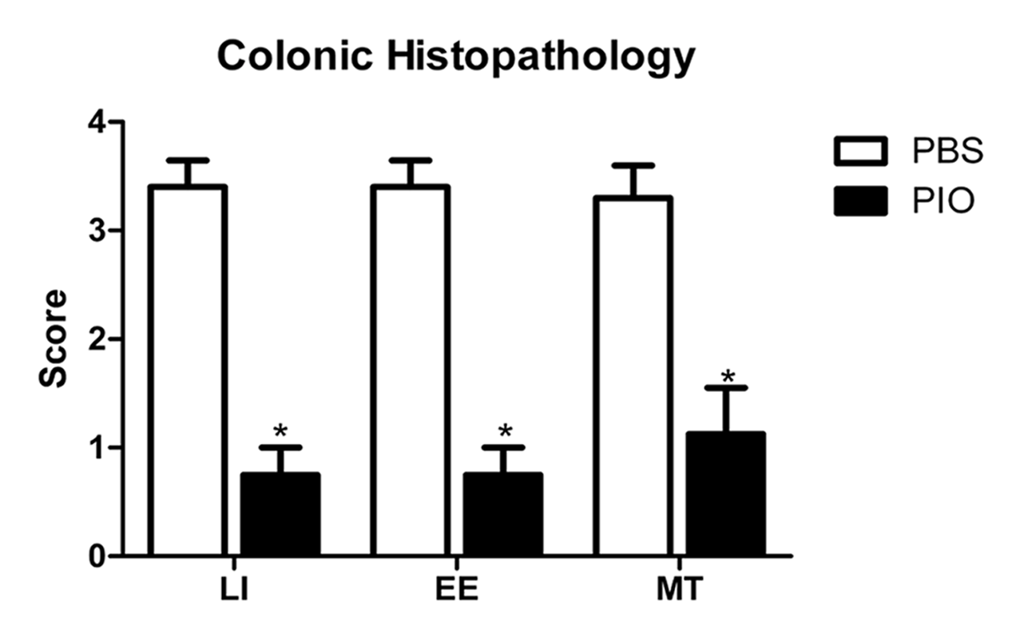
In vivo experimentation (2)
HISTOPATHOLOGY

Slide 27

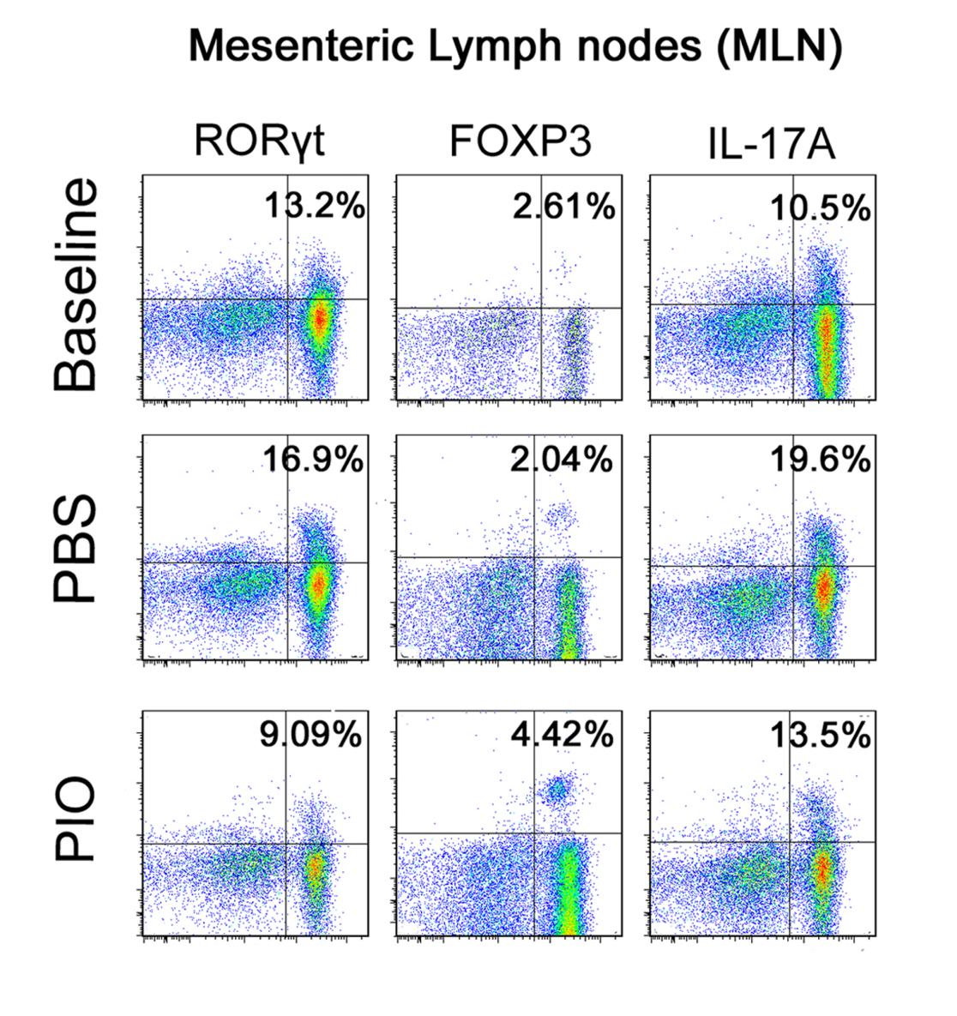
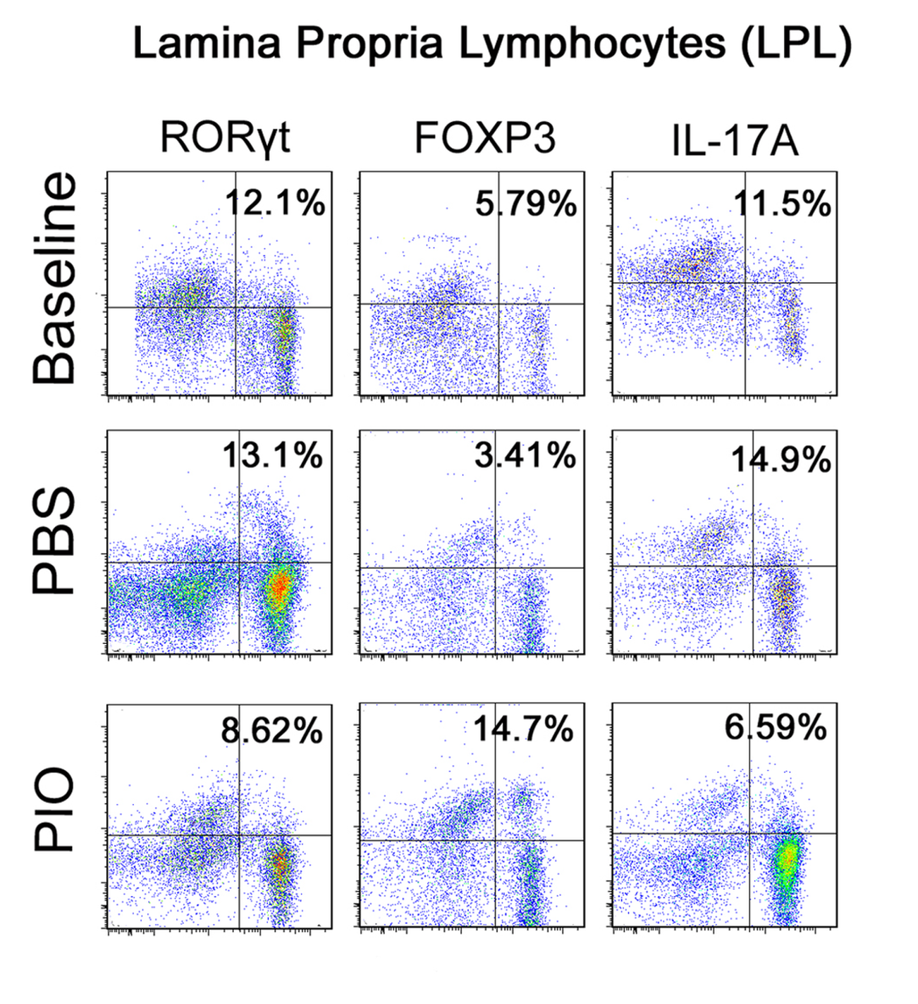
In vivo experimentation
Flow cytometry ANALYSIS

Slide 28

In vivo/vitro validation
Activation of PPARγ in a Th17 cell downregulates RORγt and IL-17A and upregulates FOXP3
    Validated with pharmacological activation of PPARγ in vivo, and in vitro studies
2. The loss of PPARγ impairs the ability of Tregs to express FOXP3 and accentuates the expression of RORγt and IL-17 in Th17
    Validated with PPARγ KO experiments in vivo and in vitro
3. Increasing concentrations of PPARγ led to increasing concentrations of FOXP3 and decreasing concentrations of RORγt and IL-17 in Th17
    Validated with in vitro studies performing increasing concentrations of pioglitazone

Slide 29
What will this presentation show you?
Refinement of the model with new generated data
In vivo/vitro validation Hypothesis testing
Modeling approach
Literature mining & in-house generated data
In silico experimentation Prediction generation
Creation of the network
Parameter estimation and ODEs adjustments

Slide 30
Conclusions
We succesfully created a computational and mathematical model of the CD4+ T cell differentiation
Computational modeling studies predicted that the PPARγ modulates the balance between Th17 and iTreg cells
Our in vitro results support the dose-dependent effect and in vivo findings further demonstrate that pioglitazone treatment favors a switch from Th17 to iTreg
Results of adoptive transfer studies indicate that activation of PPARγ by oral pioglitazone treatment favors a switch from Th17 to iTreg in MLN and colonic
PPARγ is implicated in the modulation of CD4+ T cell plasticity in vivo.
The loss of PPARγ favors Th17 differentiation and reduces the conversion of CD4+FOXP3+ T cells from IL-17A-producing Th17 cells in vivo.
This is broadly applicable to the development of immune therapeutics for infectious, allergic and immune-mediated diseases.

Slide 31

Questions?
Thanks!

