Slide 1
Ingenuity Pathways: a modeling strategy for network inference
Katherine Wendelsdorf, PhD
Field Application Scientist
MIEP Summer School
June 2014
Notes:
I am the FAS with Ingenuity/QIAGEN and this is the training for Ingenuity Pathway Analysis (IPA)

Slide 2
Getting started: Network Construction with IPA
Katherine Wendelsdorf, PhD
Field Application Scientist
MIEP Summer School
June 2014
Notes:
Today I am going to introduce you to IPA and specifically to features that you can use to construct wiring diagrams [curse over screens]- the backbone of a model.
First, I’ll give a brief introduction to IPA
[And today I am going to talk about how to get you started with network construction in IPA]

Slide 3
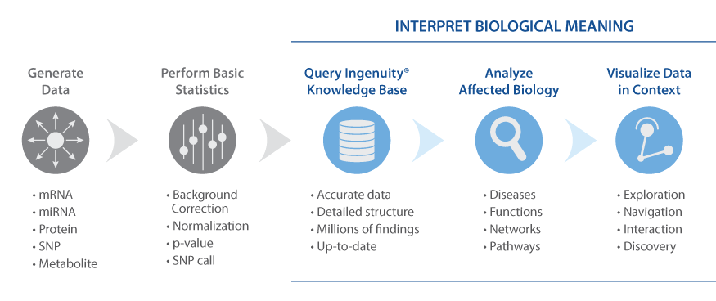
What is Ingenuity Pathway Analysis [IPA]?
Gene/proteins of Interest
Given a large set of gene/proteins that are activated/inhibited affected
What are likely downstream effects?
disease phenotypes, impact on cell functionality
What specific pathways are likely being affected?
What upstream regulators are involved?
Notes:
What is Ingenuity? What is Ingenuity Pathway Analysis [IPA]?
What IPA is:
For those not familiar, IPA, is a tool created for ’tertiary’ data analysis stage of –omics data- that is when one has already compiled a set of differentially expressed genes or affected proteins or genetic variants and they need to biologically interpret that set- create hypothesis/make sense of it.
[Whether case vs. control or treated vs. untreated. ]
Specifically, the tool allows you to
Leverage current scientific knowledge [stored in our KB] to answer questions like…..
Given a large set of gene/proteins that are activated/inhibited affected
What are likely downstream effects?
disease phenotypes, impact on cell functionality
What specific pathways are likely being affected?
What upstream regulators are involved?

Slide 4
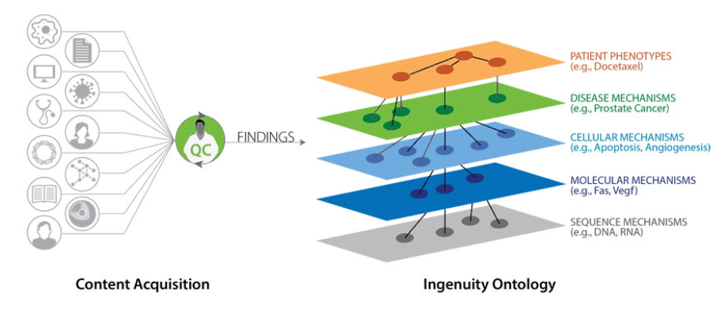
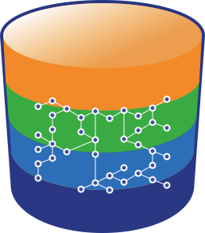
A knowledgebase (KB) that’s 15 years in the making
Unprecedented Access to Literature Knowledge
Literature findings
The Ingenuity Knowledge Base
MD/PhD level curators
Biomedical Ontology
The Ingenuity Ontology
Notes:
[Just to dispel mysticism right off the bat: It does this by using information stored in The Ingenuity Knowledge Base.
This is an in-house DB composed of millions of experimental findings taken from peer-reviewed journals and further curated by MD/PhD level scienstists plus information from commonly used third party databases.
All this information is pulled together to make connections between diseases, genes,drugs/compunds, pathways, and pathway regulators.
Our trained scientists use data from each finding to create a connection between disease phenotypes, pathways, genes/protein, drugs/comopunds. These are all pooled together in to the knowledge base that can be seen as a master network of all the relationships that exist in the literature labelled by the context of the finding [the species it was found in, the experienmental evidemce, etc. ]]
IPA then uses this information to run its predictive aglorithms and the user can directly pull out relevant information.
***
It does this based on the KB and takes advantage fo the fact that each of these relationships in the KB is labelled with the species and experimental systems that the finding came from.
[Just as a refresher or for those who didn’t catch it], the KB is a network constructed from curated peer-reviewed experimental findings that links associated diseases, This master network of all the relationships is labelled by the context of the finding [the species it was found in, the experimental evidemce, etc.

Slide 5
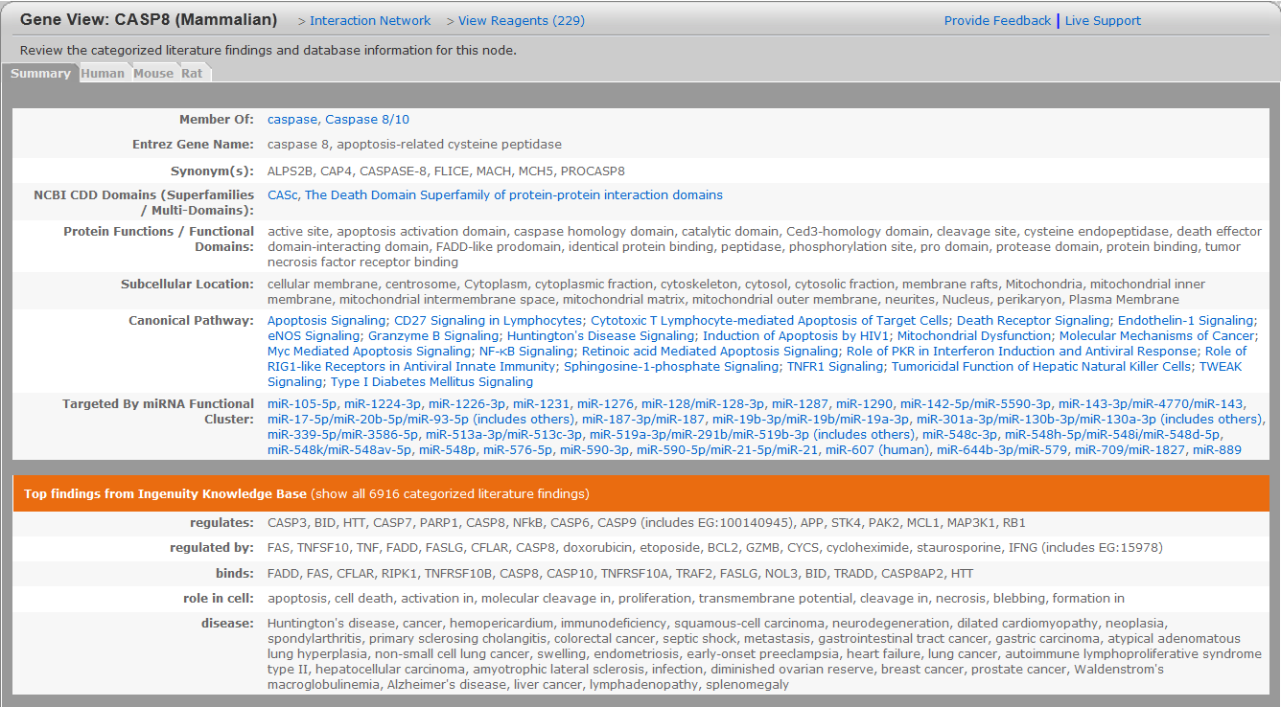
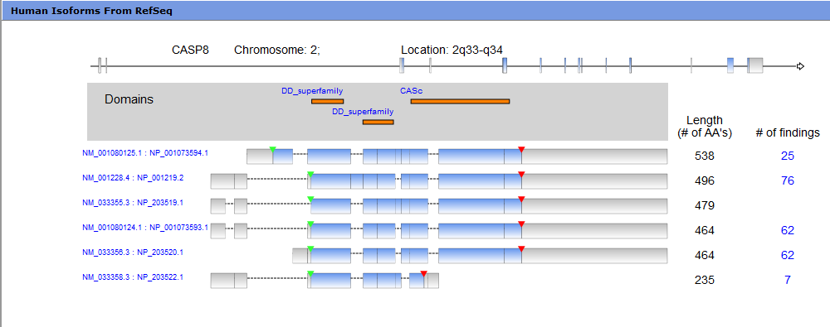
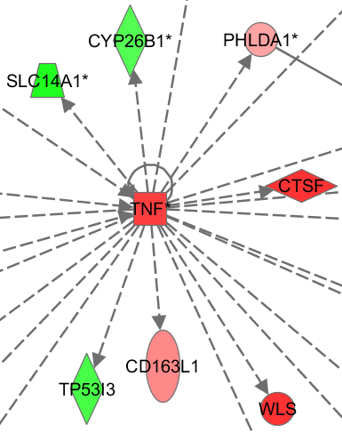
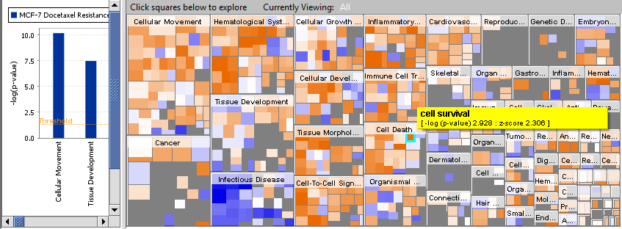
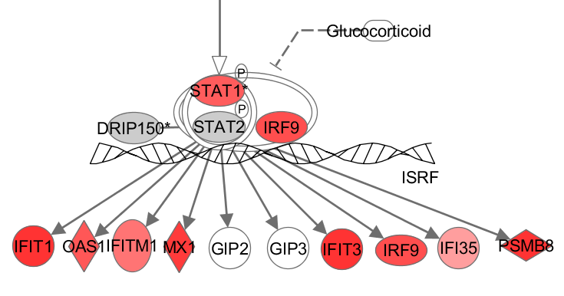
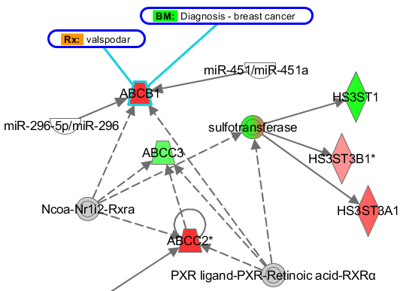
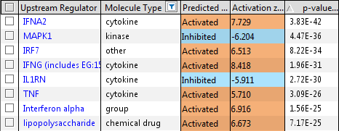
IPA:Tools for Genomic Data Interpretation
Gene View Summaries
Gene View Summaries
Human Isoform Views
Human Isoform Views
Interaction Networks
Interaction Networks
Biological Functions
Biological Functions
Canonical Pathways
Canonical Pathways
Upstream Regulator Analysis
Upstream Regulator Analysis
Build & Overlay Tools
Build & Overlay Tools
miRNA-mRNA Relationships
miRNA-mRNA Relationships
Notes:
General: IPA is a suite of tools to answer a variety of questions about your dataset and generate plausible hypothesis from your data.
Large set: IPA is a suite of tools to address these questions in your dataset.

Slide 6
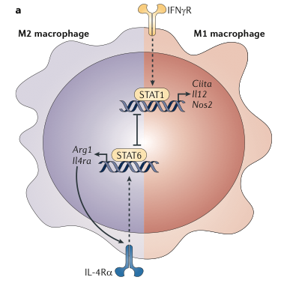
IPA and Model Networks
What we need network models for:
Provide a framework for organizing existing data,
Generate novel mechanistic hypotheses
Determine focus of validation experiments in time and space.
-omics data
Computational Model/Simulation
GENERATION of HYPOTHESES for experimental testing
Notes:
So, you all are the choir when it comes to the benefits of models and why you are here.
Where can IPA help you in making these models? [So, where does IPA fit in to the modeling workflow- to create data-driven, predictive, and comprehensive computational models.]

Slide 7
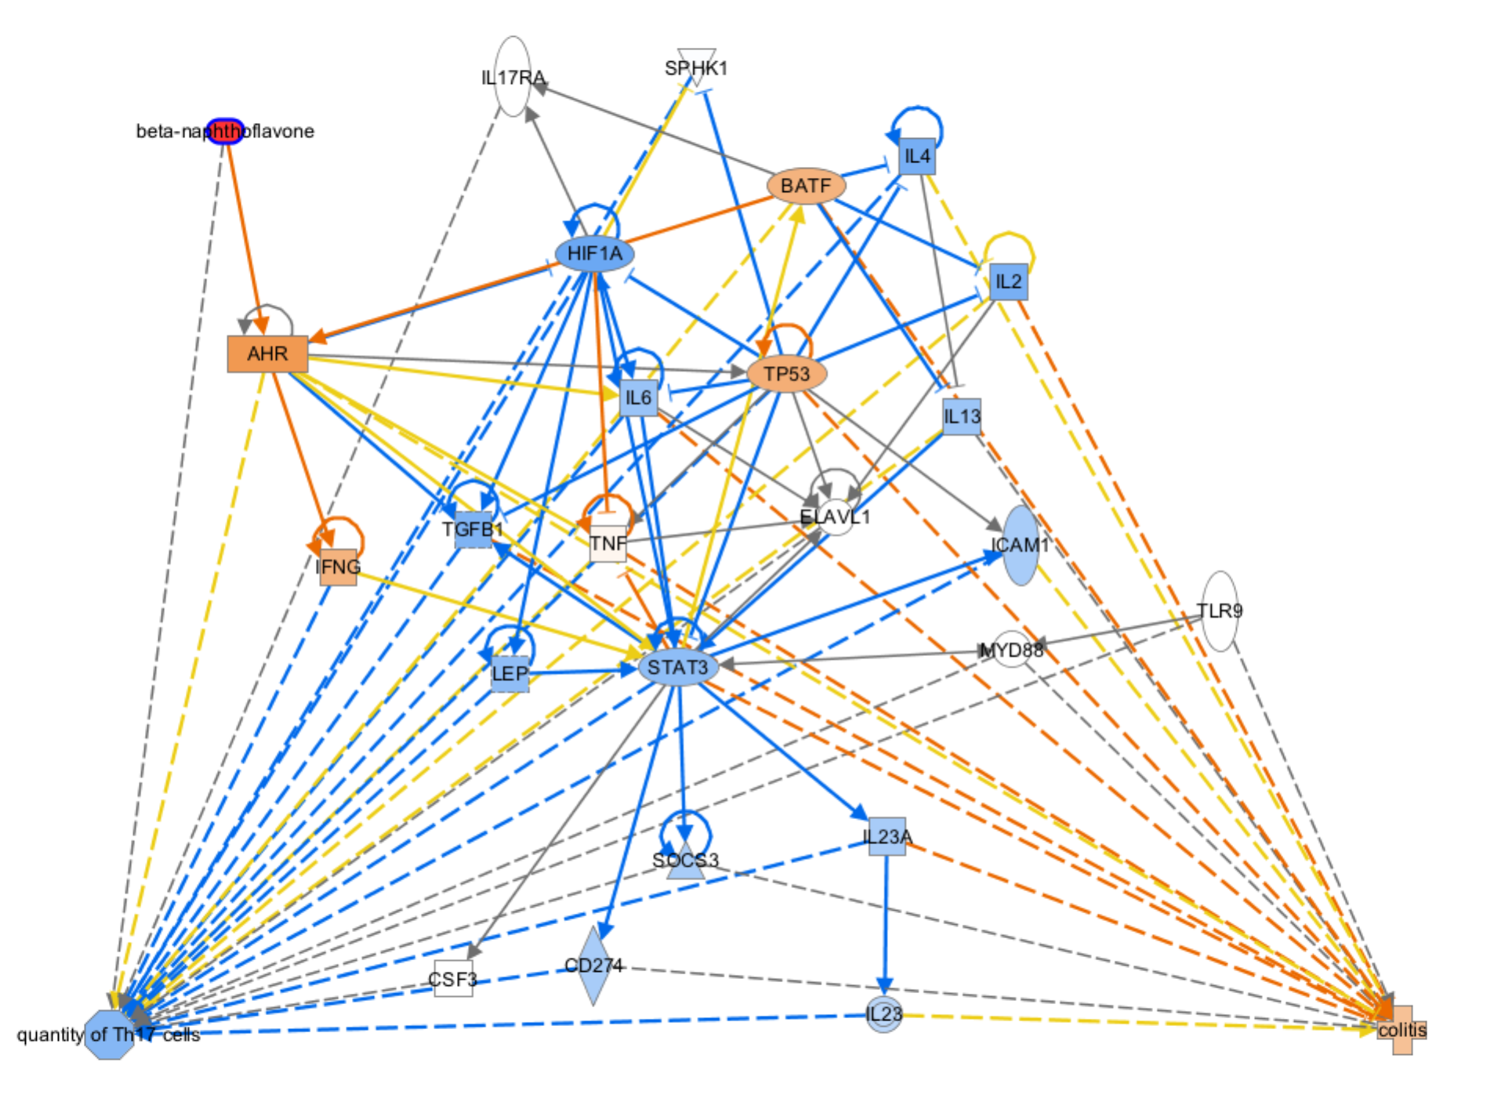
IPA and Model Networks
What we need network models for:
Provide a framework for organizing existing data,
Generate novel mechanistic hypotheses
Determine focus of validation experiments in time and space.
Notes:
It allows you to infer mechanistic networks construct most plausible stories for what is occurring in your system based on CURRENT LITERATURE KNOWLEDGE AND YOUR DATA.
..such as how administering a specific compound could be affecting TH17 levels or colitis in my model. How certain knockout phenotypes would affect that outcome.

Slide 8
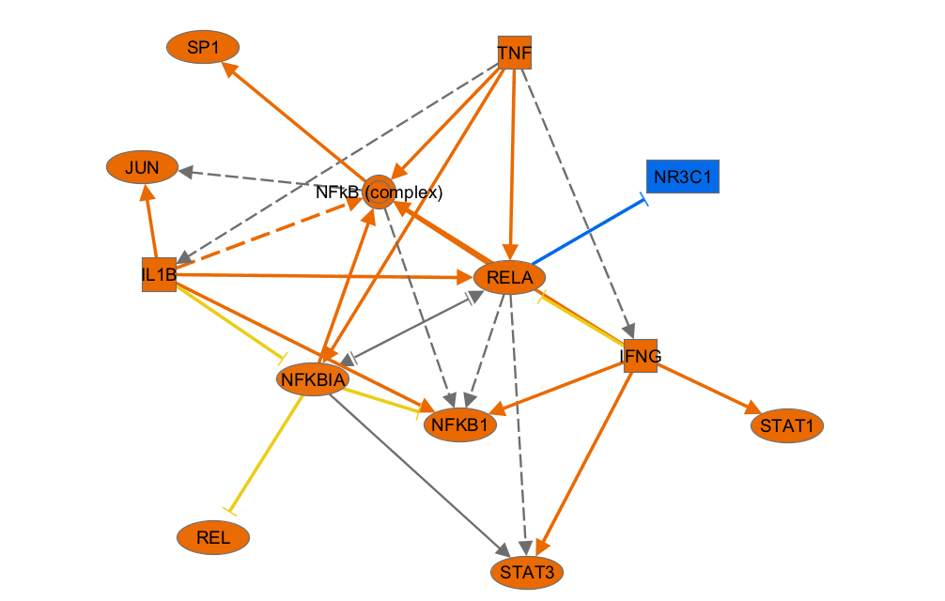
IPA and Model Networks
What we need network models for:
Provide a framework for organizing existing data,
Generate novel mechanistic hypotheses
Determine focus of validation experiments in time and space.
Notes:
…If applying perturbation to cells [macrophages] leads to different phenotypes in different conditions, then how can you use the expression data collected to create a plausible skeleton network?
This then gives a hypothesis

Slide 9
IPA and Model Networks
What we need network models for:
Provide a framework for organizing existing data,
Generate novel mechanistic hypotheses
Determine focus of validation experiments in time and space.
-omics data
Notes:
[the modeling workflow- to create data-driven, predictive, and comprehensive computational models.]
These can then be used to create dynamic simulations in COPASI or ENISI

Slide 10
IPA and Model Networks
What we need network models for:
Provide a framework for organizing existing data,
Generate novel mechanistic hypotheses
Determine focus of validation experiments in time and space.
Making Networks with IPA:
Data- independent methods: Search and Explore
Omics Data-derived networks: Core Analysis
Gene expression, methylation, proteomics, etc.
New stuff: Advanced Analytics
Notes:
There are multiple approaches to creating/deriving networks in IPA. We will cover two of these
One approach is to create networks based on what is already known in the universe of literature before even incorporating own data: Search and Explore
Data- independent methods: Search and Explore
Another is to derive/infer what is occuring in your system using what is known in the literature as well as your own Omics Data as additional clues/support: Core Analysis
Gene expression, methylation, proteomics, etc.
Lastly, we will go over two, new additional features to each of these approaches in Advanced Analytics.

Slide 11
Search & Explore: Data-independent networks
Notes:
First approach we will learn is Searhc & Explore tools- Essentially constructed from literature in a very methodical way.
Networks based solely on current literature

Slide 12
Search & Explore- Exercise
Build a network based solely on current literature:
Mechanism for ‘increased Th17’ observation
How could this be connected to colitis?
What would be the effect of different interventions?
YOU DON’T HAVE TO REMEMBER EVERY STEP!!!
TUTORIALS/RESOURCES ARE AVAILABLE
Notes:
For our first exercise, we are going to use the IKB to construct a plausible molecular interaction network that leads to Th17 increase at a tissue site.
But, before we get started I just want to say:
You don’t have to remember every step!!!! If it is between taking copious notes or paying attention/keeping up, then keep up. The are tutorials/resources I will give you for future reference.
Please do stop with questions or if get lost. ..truly
FOR TRAINING FOLLOW SCRIPT HAVE
MIEP_Apr23_notes.doc

Slide 13
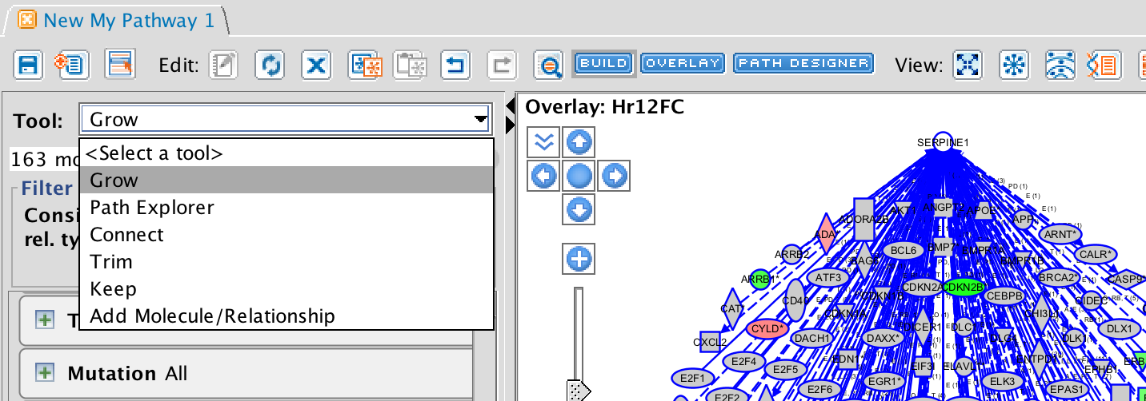
Search & Explore- Build Tools
Networks based solely on current literature
Connect: Connects molecules given the criteria that the user specifies
Grow: Adds new molecules and their relationships given the criteria that the user specifies
Path Explorer: Calculates the “Shortest Path” between 2 molecules or 2 sets of molecules
Add Molecule/Relationship: Allows adding a custom molecules or relationship to the current pathway that does not exist in Ingenuity’s KB as well as ones that already exist
Trim: Removes molecules/relationships that meet the criteria that the user specifies
Keep: Keeps molecules/relationships that meet the criteria that the user specifies
13
Notes:
Screen if NET

Slide 14
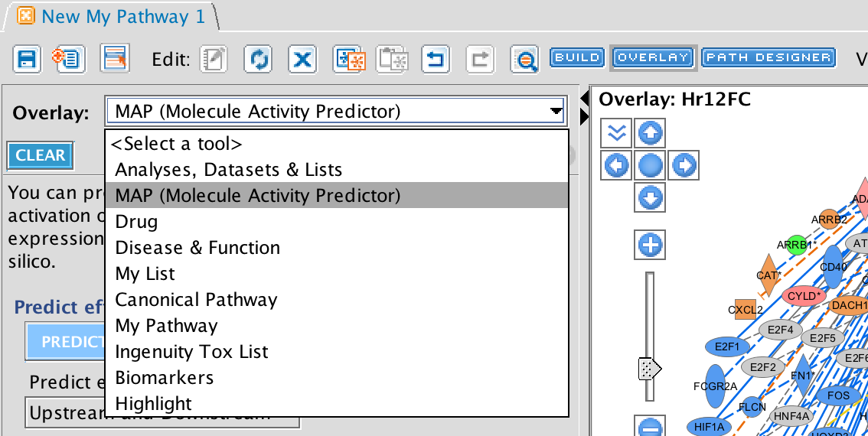
Search & Explore- Overlay Tools
Networks based solely on current literature
Analysis/ Dataset: Expression/data values that have been uploaded into IPA
MAP (Molecule Activity Predictor): To predict upstream / downstream effect of activation or inhibition on unknown molecules
Drug: Known drugs that target the molecules on the pathways
Function & Disease: Functions and Diseases that overlap
Canonical Pathway: Canonical Pathways that overlap
Highlight: Outline molecules that match specified criteria
My List/My pathway: User created lists/pathways saved within IPA that overlap
14
Notes:
Screen if NET

Slide 15
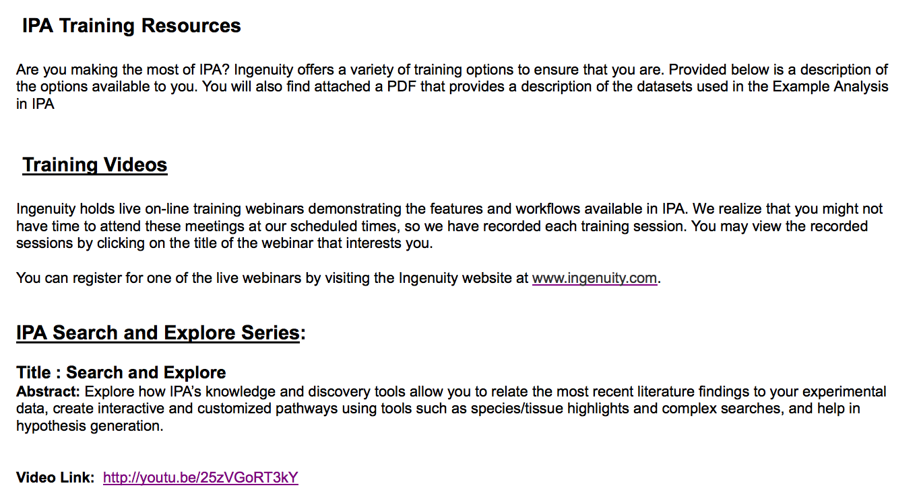
Search & Explore
Networks based solely on current literature
Organize existing data: Visualize what is currently known in the literature and databases.
Novel mechanistic hypothesis: Once have calibrated and have added the dynamics: Does what we know in the literature support what is happening in our system over time/space?
Where to focus: Hubs, most influential interventions, indirect connections, etc.
Resources
Help > Help and Support > Training
Notes:
Just in this first part there are loads of ways you could use the networks made. Just some ideas
Networks based solely on current literature
Organize existing data: Can see/visualize what is currently known in the literature/publicized findings [because also includes clinical drug trials]
Novel mechanistic hypothesis: Once have calibrated and have added the dynamics:does what we know in the literature support what is happening in system over time? If not, then can see which parts are not matching up.
Where to focus: Can tell you what areas to focus on, - look at that these that are indirectly connected, but have no direct relationships with this group.
1. Also, no need to remember anything I have said because it is all on YouTube.

Slide 16
Core Analysis: Data-derived networks
Notes:
Content of Core that may or may not have seen
Core Analysis:
CP: canonical pathway to be the model involved in your system
UR: construct based on one regulator HRAS-like, network involved and how, mech network
DS: construct from one DS effect, the genes you can mere and preliminary predicted perturbation effect
Reg effects: Any of the wiring diagrams reported. Specify the type of network want
Own data-based: Core Analysis
8-?. Core Analysis walkthrough
9. Exc for each way of making a network-
REALLY JUST ALL SAME SORT OF EXAMPLES HAVE SUPER STRAIGHTFORWARD, just now with the immunology case study
** Make screen shots AND have the networks saved so can just open them up
One slide to say what asking/screen shot of end results
SHOW actual network with each result
Then have them make the end result

Slide 17
Peer-reviewed publications citing IPA
10,000+ Published Studies Citing IPA
Sorted by Research Area, Through December 2013
Notes:
IPA is an established tool in a variety of research areas having been cited in over 10k peer reviewed studiesany many different fields

Slide 18
Peer-reviewed publications citing IPA
Breakdown by Experimental Platforms Through December 2013
Notes:
This is a breakdown of the data types used in those 10k+ studies.
As you an see the majority is gene expression, but the tool has been successfully used on many other data types.

Slide 19
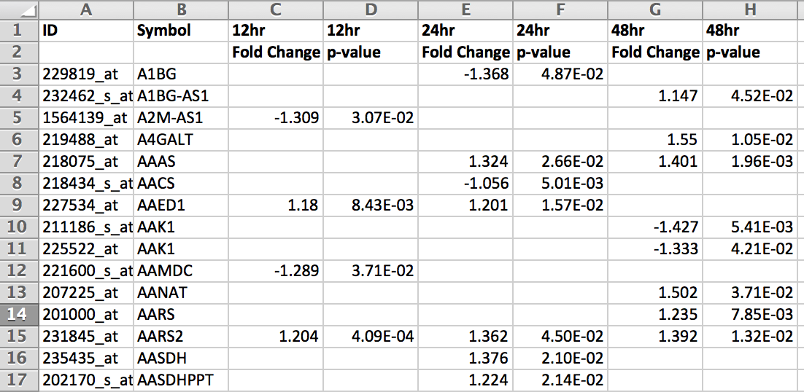
Data Upload- Data format supported
Two file formats:
Excel spreadsheet (single sheet only)
tab delimited text file
One ID column and header row
Multiple observation or single observation

Slide 20
Supported identifiers for data upload
Vendor IDs | Gene | Protein | RNA-Seq | MicroRNA | SNP | Chemical
Affymetrix | Entrez Gene (LocusLink)* | GenPept | Ensembl | miRBase (mature) | Affy SNP IDs | CAS Registry Number
Agilent | GenBank | International Protein Index (IPI) | RefSeq | miRBase (stemloop) | dbSNP | HMDB
ABI | Gene Symbol-human (HUGO/ HGNC, EG) | UniProt/ Swiss-Prot Accession | UCSC (hg18) |  |  | KEGG
Codelink | Gene Symbol- mouse (EG) |  | UCSC (hg19) |  |  | PubChem CID
Illumina | Gene Symbol- rat (EG)
Ingenuity | GI Number
 | UniGene
*Primary mapping to Entrez Gene
Notes:
As of Dec 2011

Slide 21
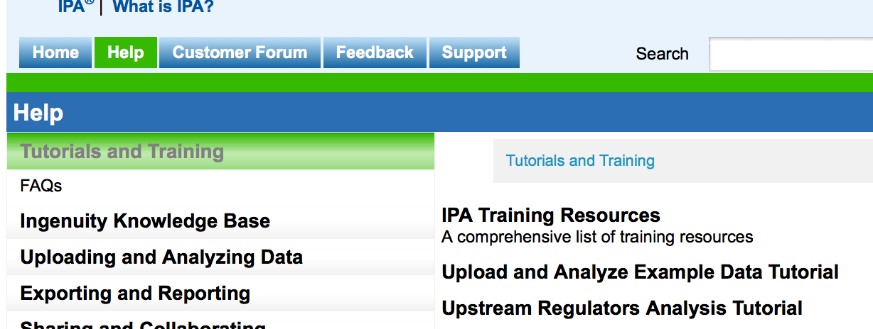
Data Upload- Instructions
Data upload and Core Analysis steps: http://ingenuity.force.com/ipa/IPATutorials#
Tutorials and Training > Upload and Analyze Example Data Tutorial
Notes:
UPLOAD is very straighforward, Wont cover here, just look at on-line documentation
LIVE- take them to help page.

Slide 22
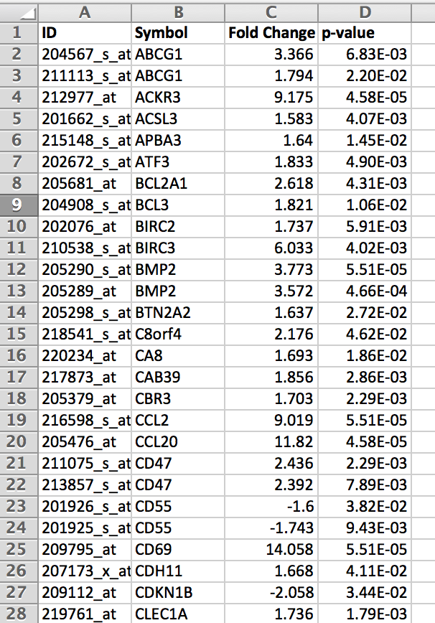
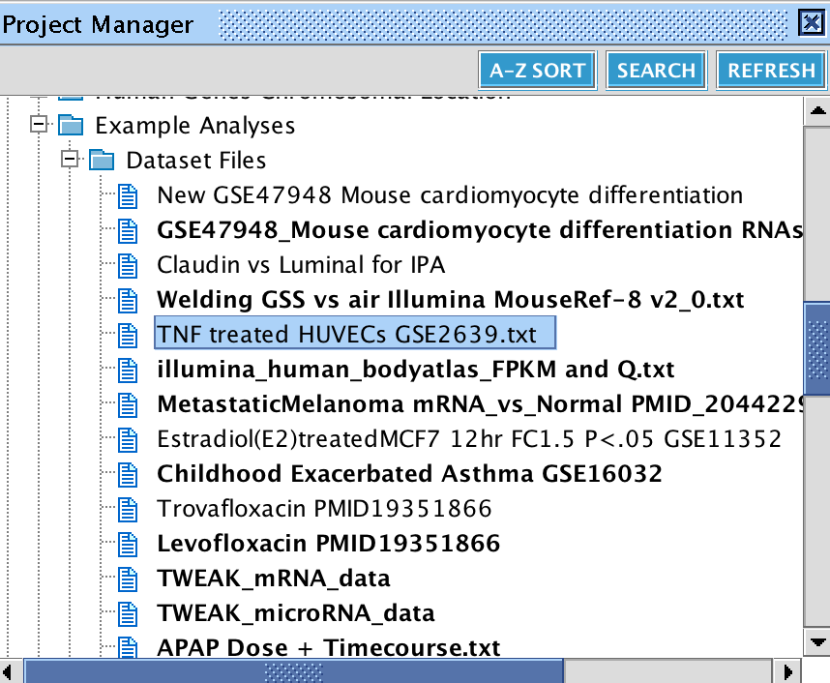
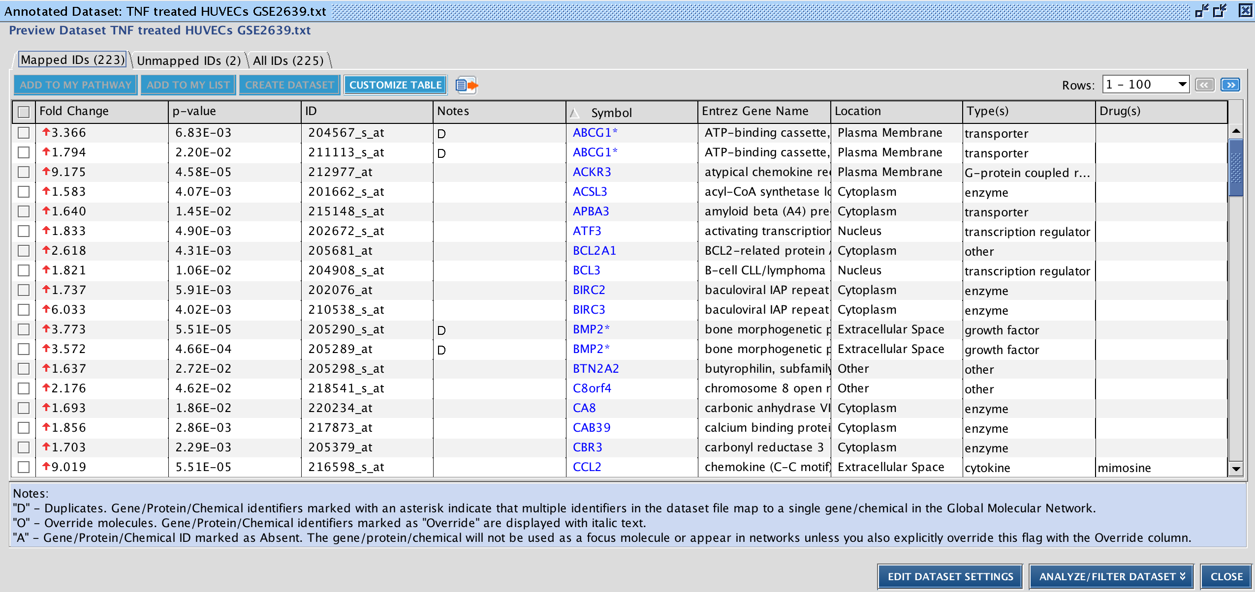
Sample Dataset- TNF treated HUVECs
Authors wanted to see effects of inflammation factor tumor necrosis factor (TNF) on macrovascular human umbilical vein ECs (HUVEC)
HUVEC were left untreated or stimulated in triplicate for 5h with 2 ng/ml TNF
Gene expression fold change treated vs. untreated
Uploaded Dataset already at:
My Projects > Example Analyses > Datasets > TNF treated HUVECs GSE2639.txt
Notes:
There is already an example dataset that we will be working with:
http://www.ncbi.nlm.nih.gov/geo/query/acc.cgi?acc=GSE2639
Authors wanted to see effects of inflammation factor tumor necrosis factor (TNF) on macrovascular human umbilical vein ECs (HUVEC)
I chose because it is available in the Example Analysis
http://www.ncbi.nlm.nih.gov/pubmed/16617158
Here the authors wanted to see the effects of inflammation factor
tumor necrosis factor (TNF) on expression profile in human microvascular ECs (HMEC) and macrovascular human umbilical vein ECs (HUVEC)… specifically to see if different endothelial cells responded differently.
Here we are only analyzing results for HUVEC response

Slide 23
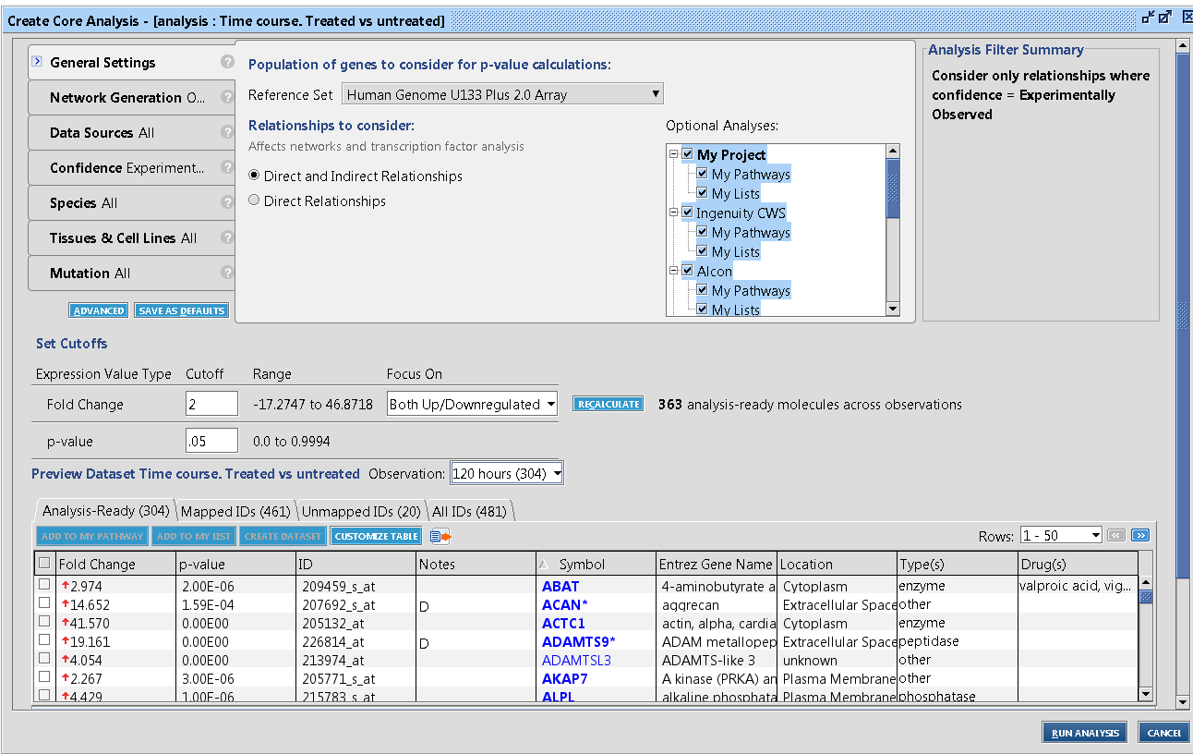
Creating an IPA Core Analysis: Using Filters
Several filters available. Set criteria to filter out findings of less interest.
Set data cutoff filters
Notes:
At setup the user has the option to filter the KB findings to be used.
Options include
Species [mouse, rate human] specific tissues or cell lines to include or EXCLUDE
Here is the dataset with the values, if had other measurements corrected vs. uncorrected or RPKM fo rRNAseq..

Slide 24
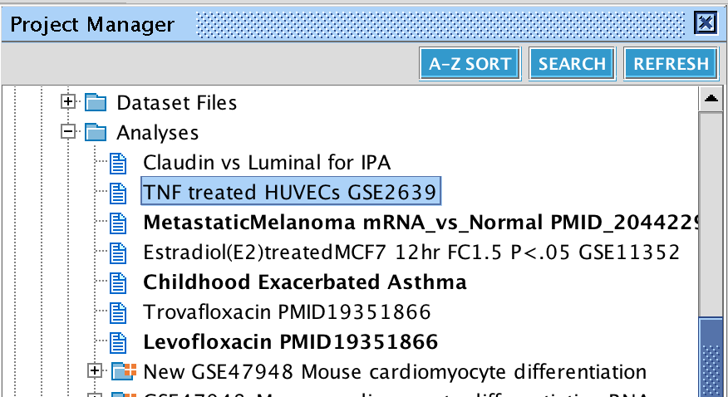
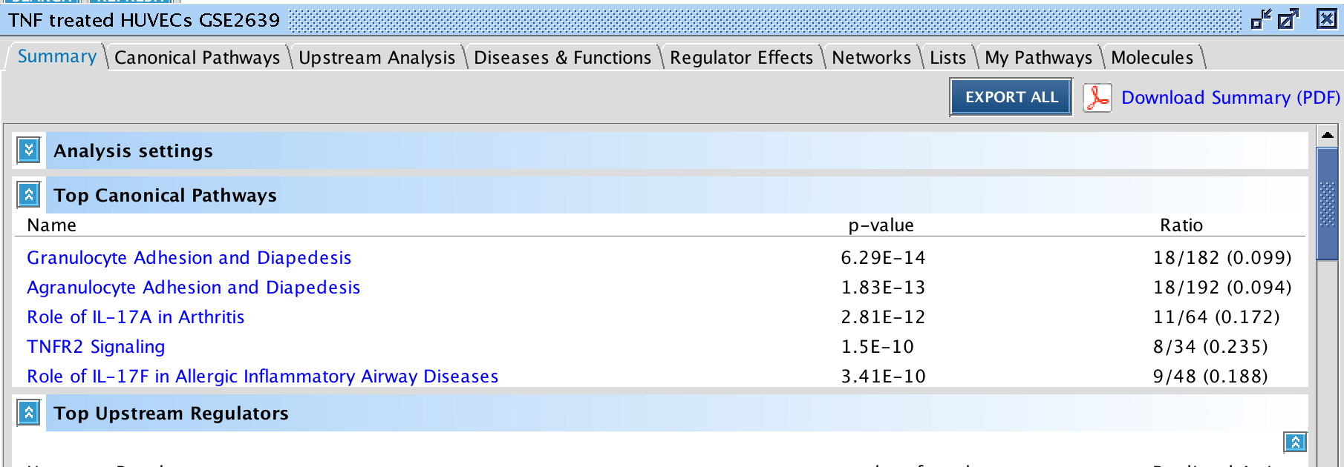
Open a Core Analysis
Core Analysis already available at:
My Projects/
Example Analyses/
Analyses/
TNF treated HUVECs GSE2639
Notes:
5 minute Core Overview
When finished the report is available in your account. When you open the analysis that has multiple tabs, each is a separate analysis that has been done automatically.

Slide 25
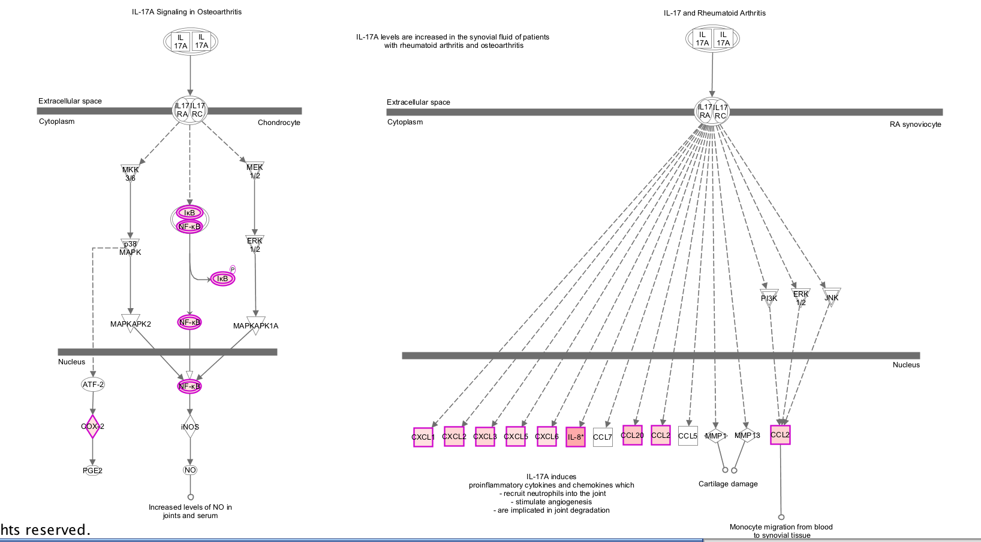
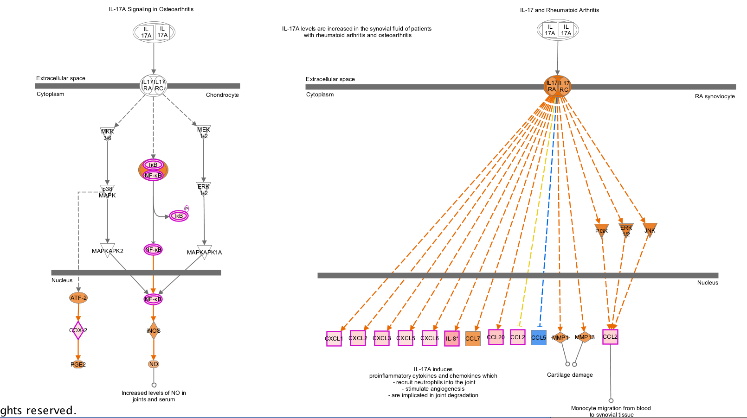
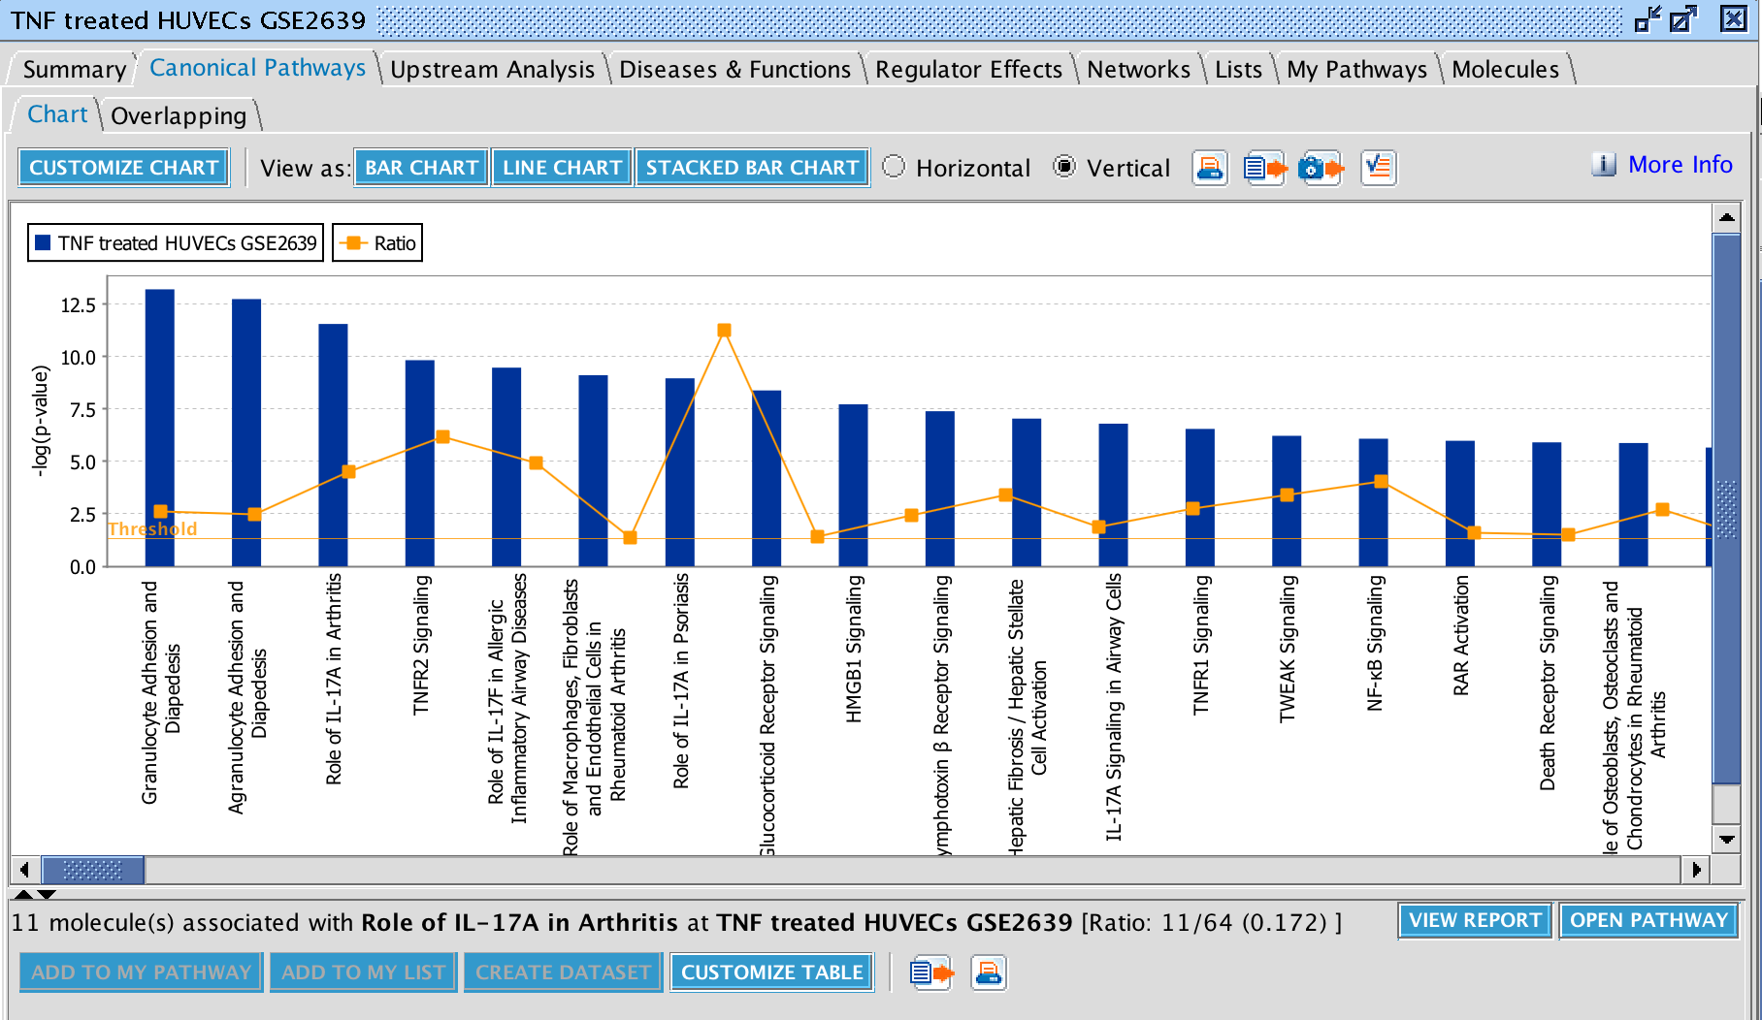
Canonical Pathway Analysis
Biological pathways enriched in my dataset?
Which genes in a pathway are affected and what effect might that change have on the pathway?
Notes:
Where one can access all the genes that map to the any given pathway and even
View expression data overlayed on to pathway,
Canonical pathways: Role of IL17A in Arthritis
See that this is a S&E window, so can…
Can even predict the expression values of unmeasured genes.

Slide 26
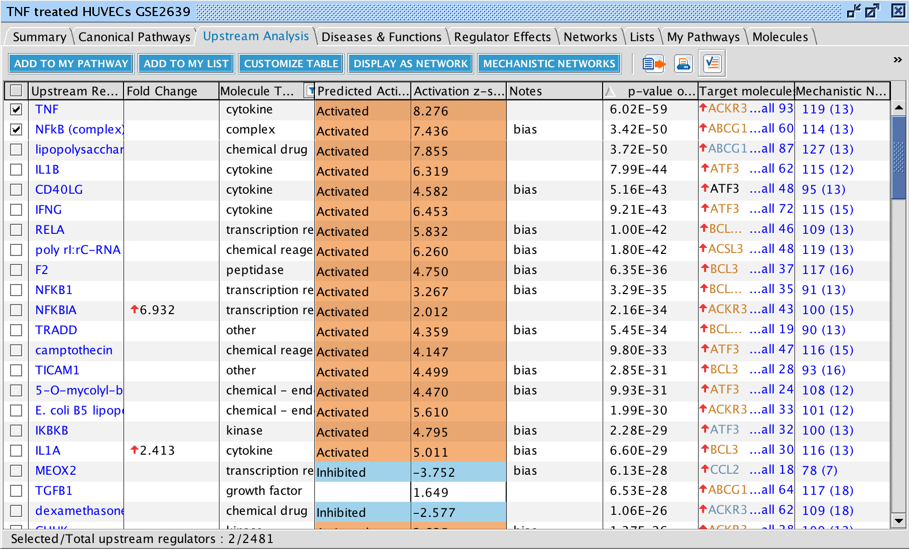
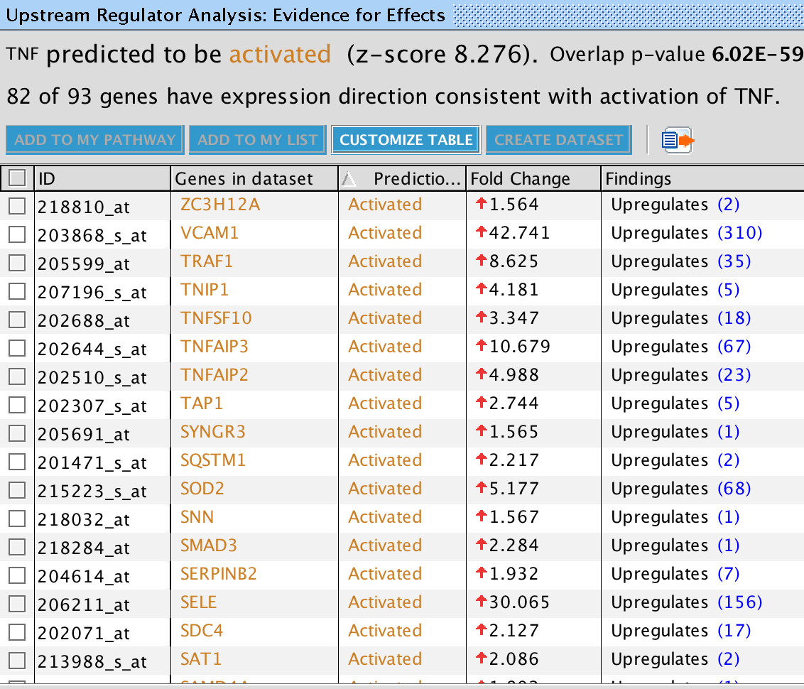
Upstream Regulator Analysis
Filter to the most relevant molecules causing expression changes
Notes:
Next an Upstream Analysis returns a table of upstream factors- TF, microRNAs, compunds, biological drugs that are predicted to be involved
-As well as whether act/inh depending on expression of its known tgt genes in your set.
-This is very unique to IPA and only possible with our KB.
Not exciting that TNF coming up, but also give Mechanistic Network.
Here one can also access a network of how each predicted regulator interacts with other regulators likely to be involved to answer the question: ‘’ How might the upstream molecule drive the observed expression changes?’ in the molecules it does target in my dataset?
This is done by finding other regulators that significant overlap in target genes in your dataset and reporting their relationships based on current literature.
One click can get for any upstream regulator
Add target molecules

Slide 27
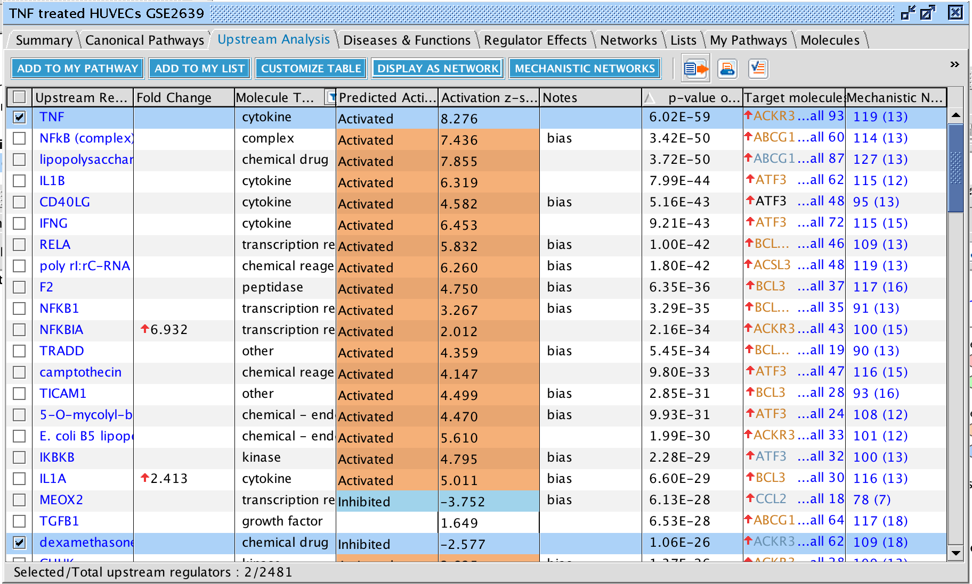
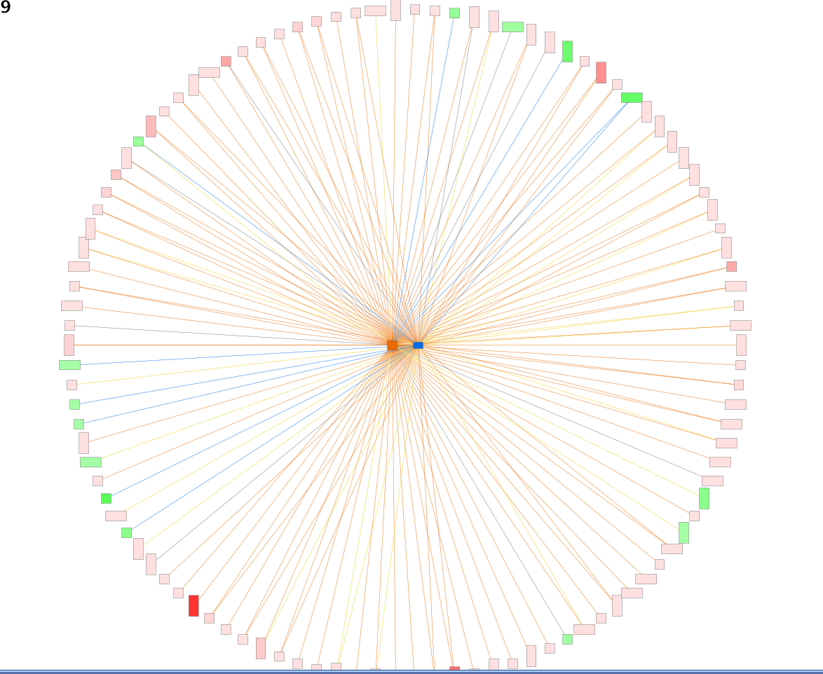
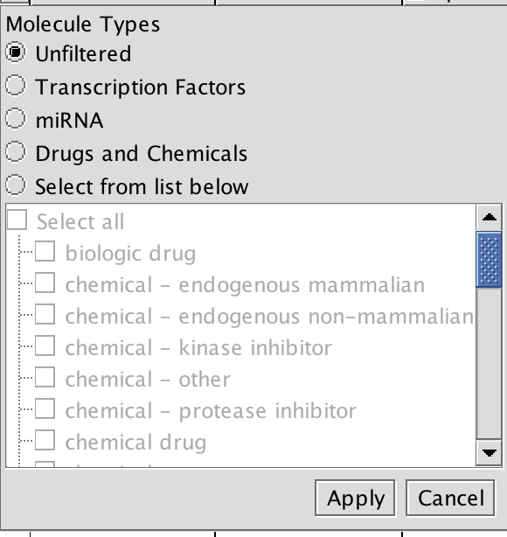
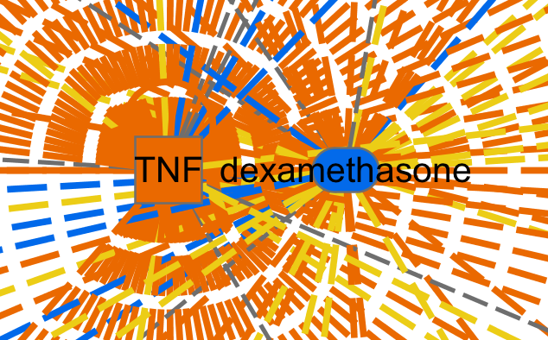
Upstream Regulator Analysis
Filter to the most relevant molecules causing expression changes
Notes:
Filter: Not so interested that TNF comes up, but what drugs would have a similar or opposite effect?
Or which TF’s is it acting through? Orr wihc microRNAs may be involved?
Also note that can open any of these in a S&E window.
Then if see something interesting, can see what affects and build a network of molecules IN your datasets.

Slide 28
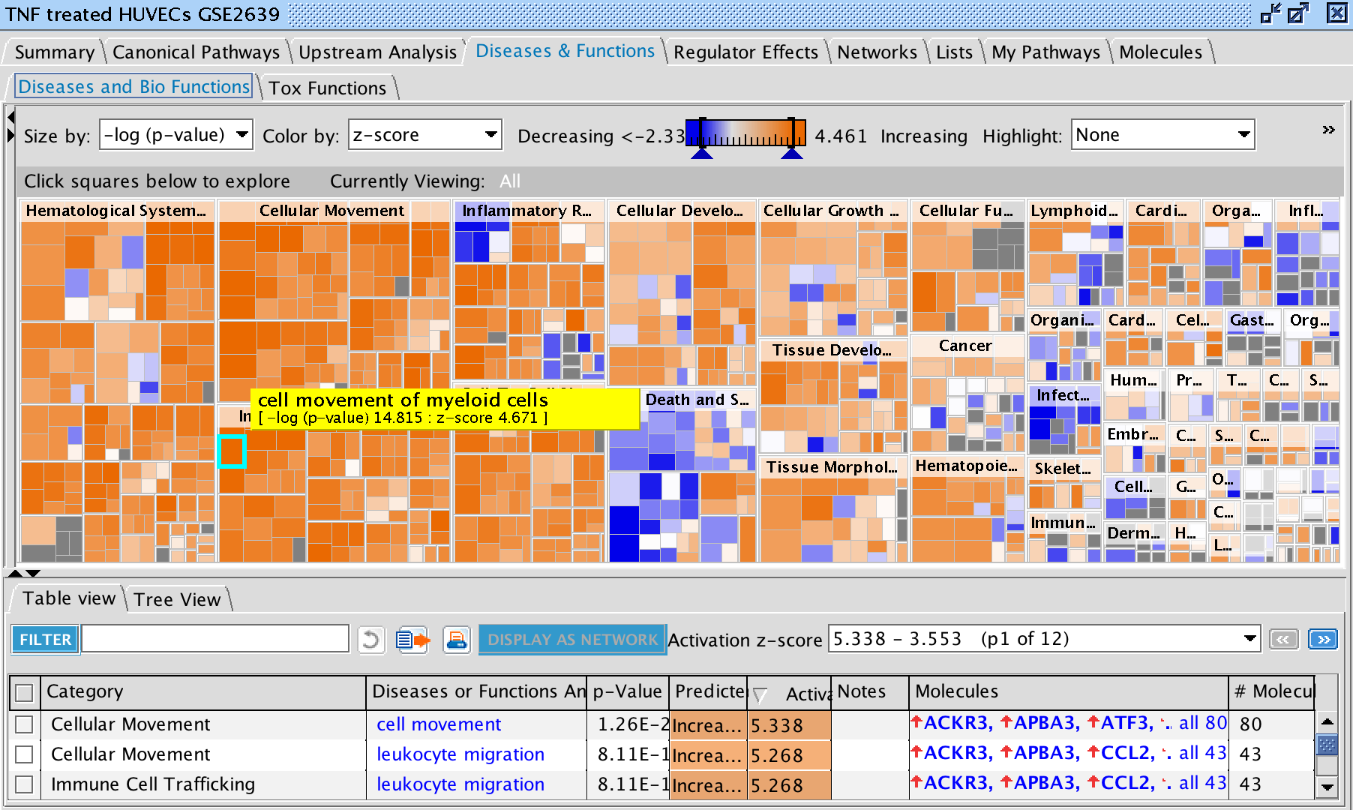
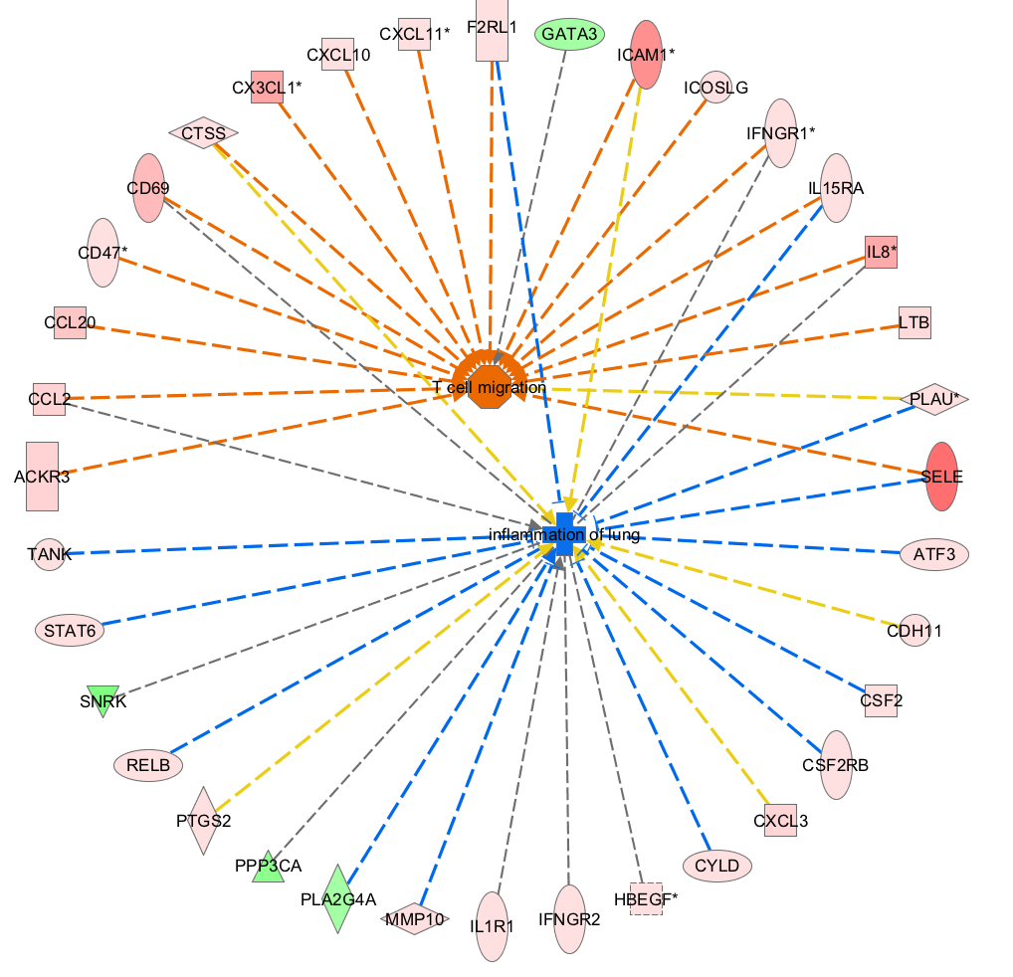
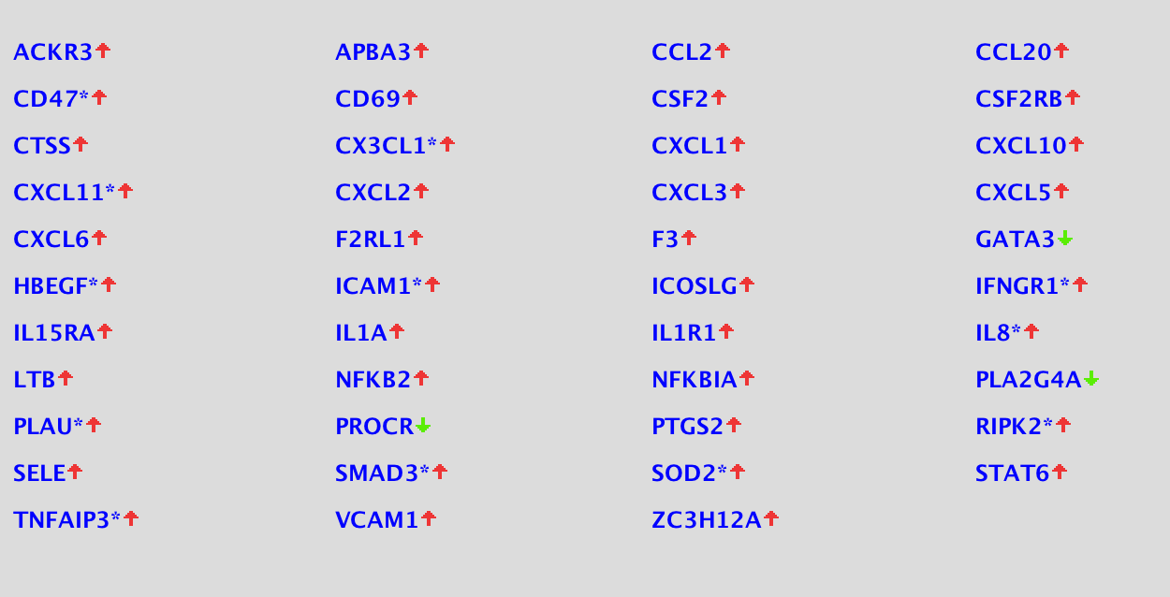
Downstream: Disease and Functions
Interpret Downstream Biological Functions
Notes:
Predict what downstream phenotypes might occur in your system bases on disease/functions that are enriched in your set and whether they are increased or decreased
Again, based on pattern matching with the genes for which experimental evidence has linked them to the phenotype.
Then with one click see how the genes are reported to affect the phenotype in a search and explore window.
DS: construct from one DS effect, the genes you can measure and preliminary predicted perturbation effect
-With heatmap, get a global sense of what is happening.
-Increase in immune cell trafficking.
Interesting that see decrease in organ inflammation
May be tempted to look for which upstream regulator here have targets in this part of the transcriptome that could lead to increased immune cell trafficking…

Slide 29
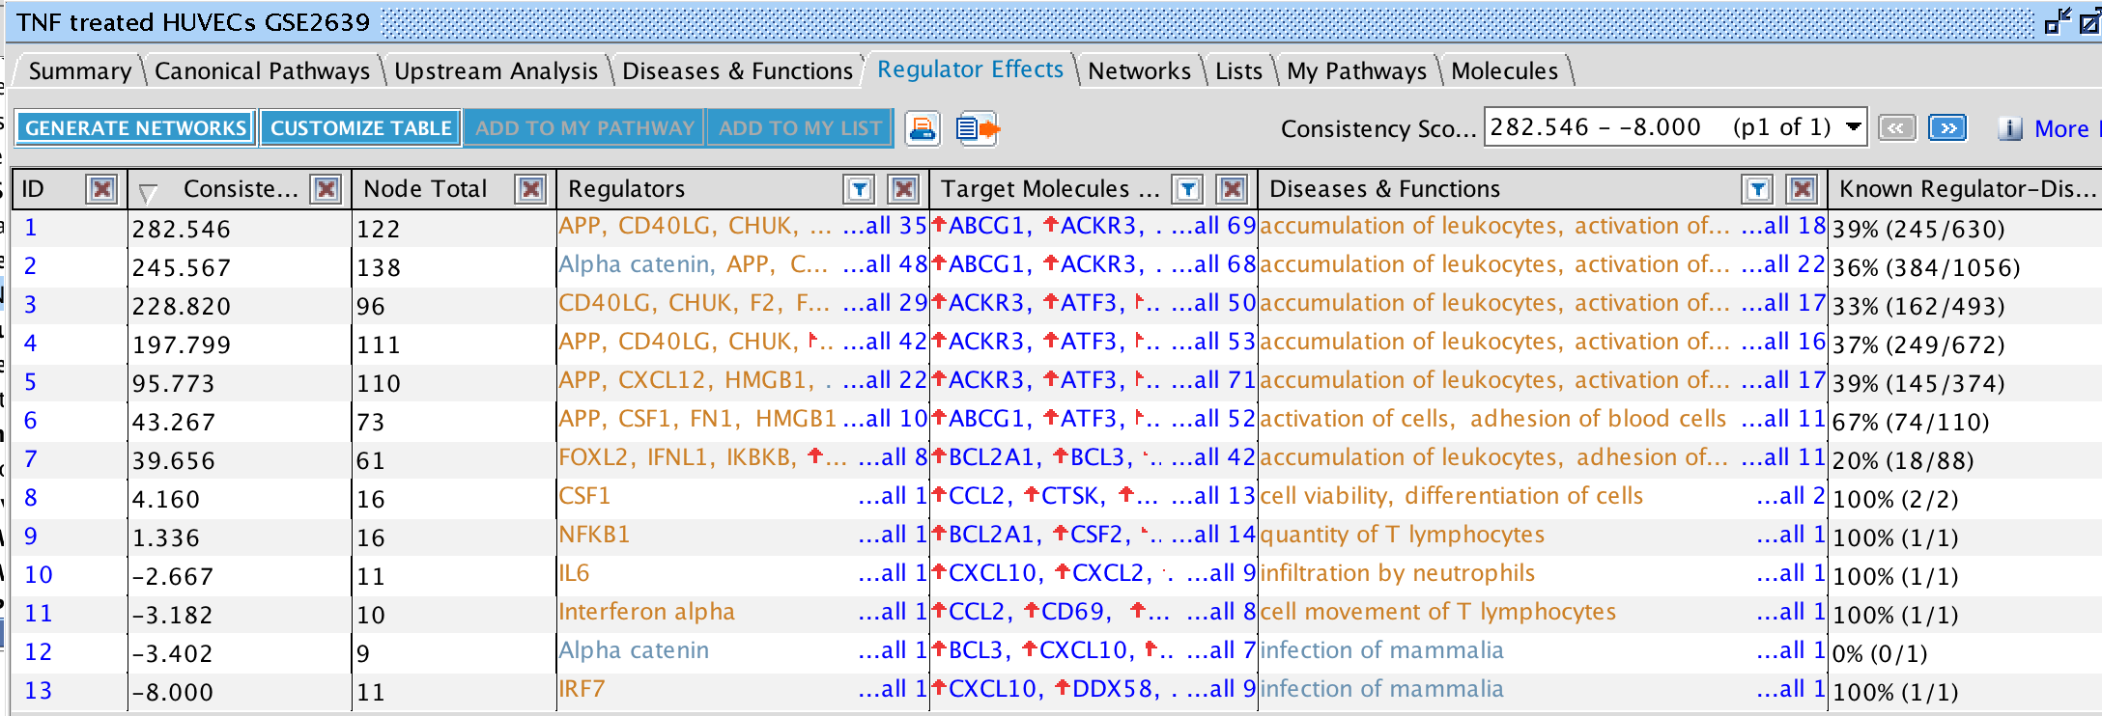
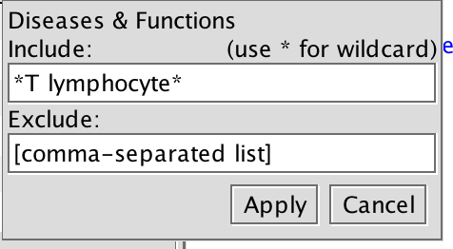
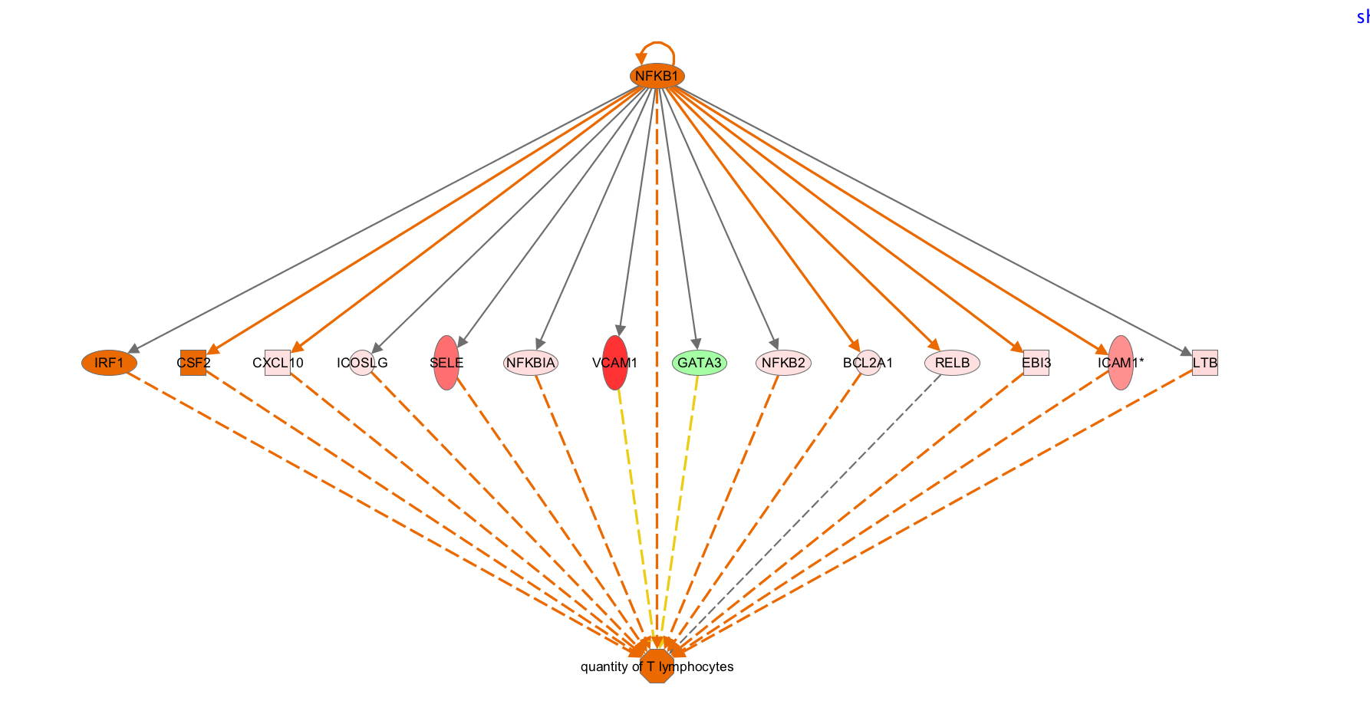
Regulator Effects
Upstream regulators likely causing predicted the downstream effect
Score
Regulators
Targets
Diseases & Functions
Ingenuity Pathway Analysis – Finding The Connections
Notes:
Finally, identify which of the upstream regulators predicted to be involved are causing which predicted downstream effect. Each row in this table is such a network
Reg effects: Any of the wiring diagrams reported. Specify the type of network want
Search for *T lymphocytes*, sort by % known, take the top
Way in which TNF treatment leads to these cells expressing genes associated with incrased quanityt of T lumphocytes in tissue

Slide 30
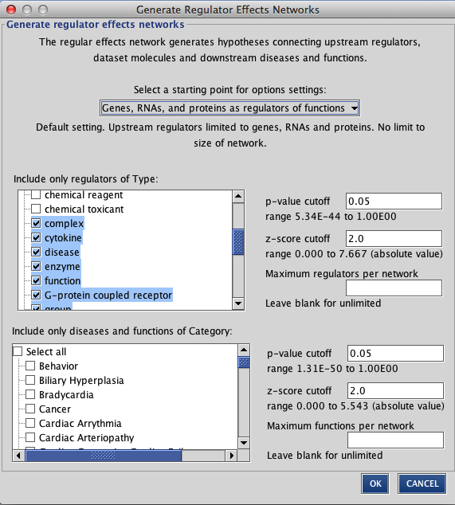
Regulator Effects
Upstream regulators likely causing predicted the downstream effect
Score
Regulators
Targets
Diseases & Functions
Ingenuity Pathway Analysis – Finding The Connections
Notes:
, and the algorithm can be customized to ask your specific question- Only look for transcription factor may be affecting DS effects associated with Cardia Arrythmia..

Slide 31
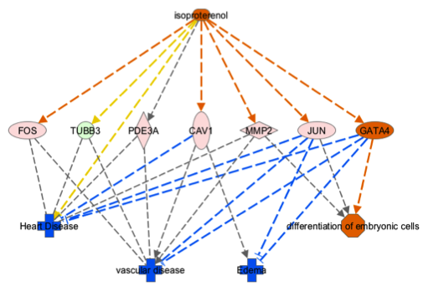
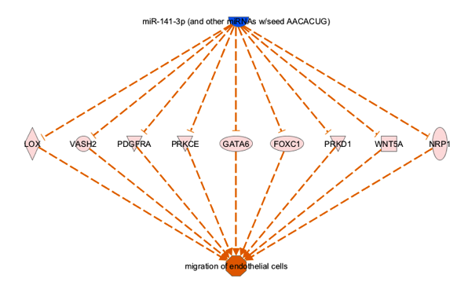
Concept of “Regulator Effects” - Spring 2014
Alternate presets to answer different questions
Transcription factors and functions
Compound as regulator of functions
Minimal regulator to function networks
Notes:
Allowing you to decide what sort of networks you want to be reported to you.

Slide 32
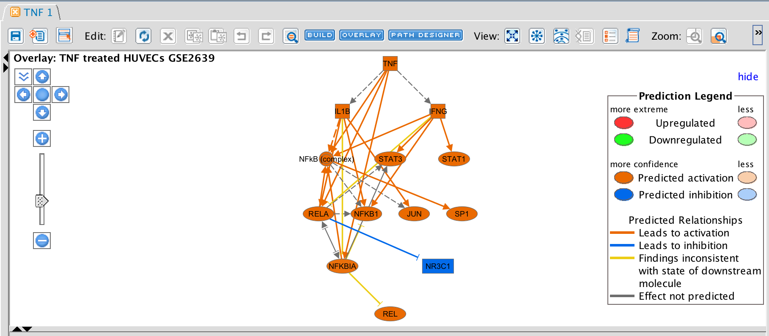
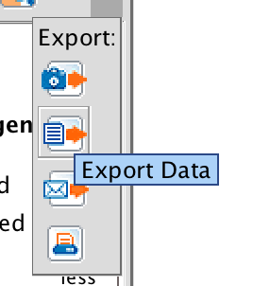
Network Export
Get the network out of IPA:
Image
Text file
Email to Colleague
Print directly
Read in to other tools: COPASI, CellDesigner
Manually
Minor scripting
Notes:
Once a network has been created/or chosen a derived one you want to use, you have a number of options for getting it out of IPA:
WILL ADD CASSIE’s SLIDES FOR INTEGRATING WITH OTHERS.

Slide 33
Core Data Analysis- Exercises
Create Networks to identify/explain TNF effect on HUVEC cells
Canonical Pathways
Upstream Regulators/
Mechanistic Networks
Diseases/Functions in Search&Explore
Regulator Effect Networks
Notes:
So, now we will poke around in the tool together to use these features of the core analysis to construct a network

Slide 34
Core Data Analysis- Summary
IPA Analysis Tools
Canonical Pathway Analysis
Predicts pathways that are changing based on your dataset
Predict directional effects on the pathway molecules not in dataset (MAP overlay tool)
Upstream Regulator Analysis
Predicts activated/inhibited regulators responsible for observed data
Creates de novo pathways based on upstream regulators (Mechanistic Networks)
Diseases and Functions Analysis
Predicts the directional biological effects (cellular processes, biological function) of gene/protein set
“Increase in cell cycle”
“Decrease in apoptosis”
Regulator Effects
Identifies plausible hypothesis: specific upstream regulator pathways leading to a downstream phenotype.
Notes:
Any questions about Core Analysis?
Now, just going to breeze over some other useful features, and can go over in more detail afterwards..

Slide 35
INGENUITY Pathway Analysis
Comparison Analysis for multi-observations
Notes:
VERY briefly just want to let you know that in IPA you can see multiple observation side-by-side that can be very helpful.

Slide 36
Data Upload- Data format supported
Multiple observation datasets
Timecourse: 12hr, 24hr, 48hr
Treatment panels: IL-10, TNF, IL-4+IL-13

Slide 37
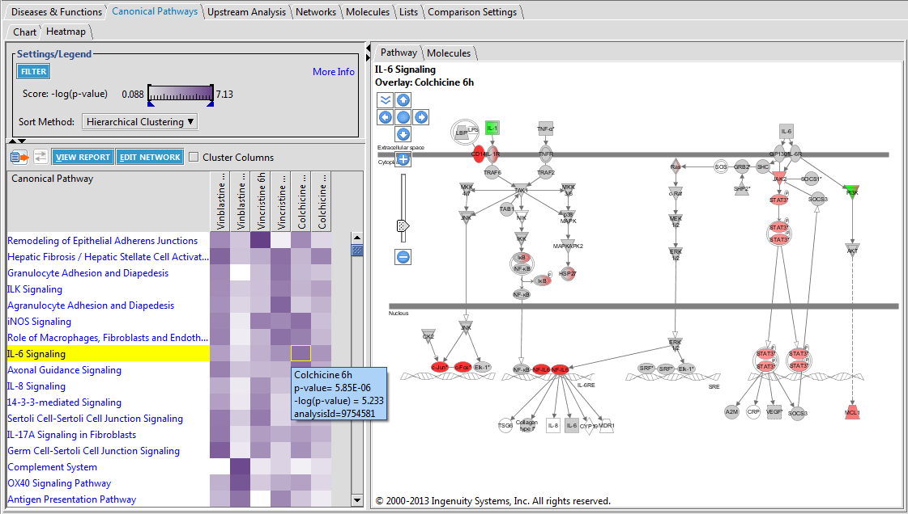
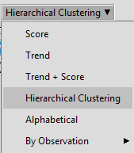
Comparison Analysis : Pathway
Quickly visualize trends across time points or dose response
Visualize expression changes across the pathway for each dose/time point

Slide 38
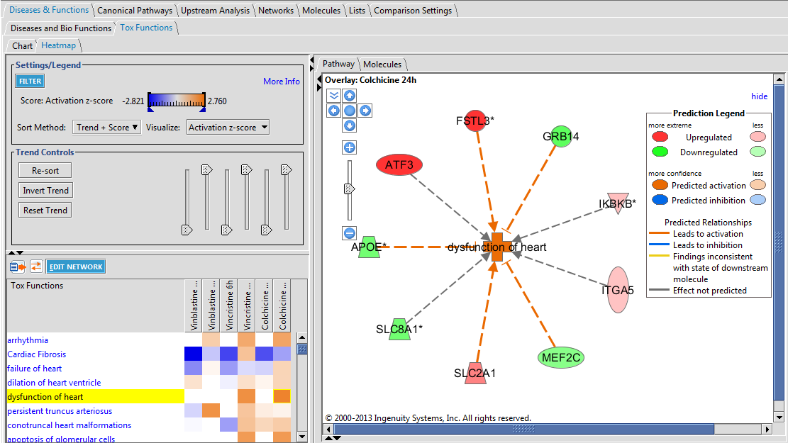
Comparison Analysis : Diseases & Functions

Slide 39
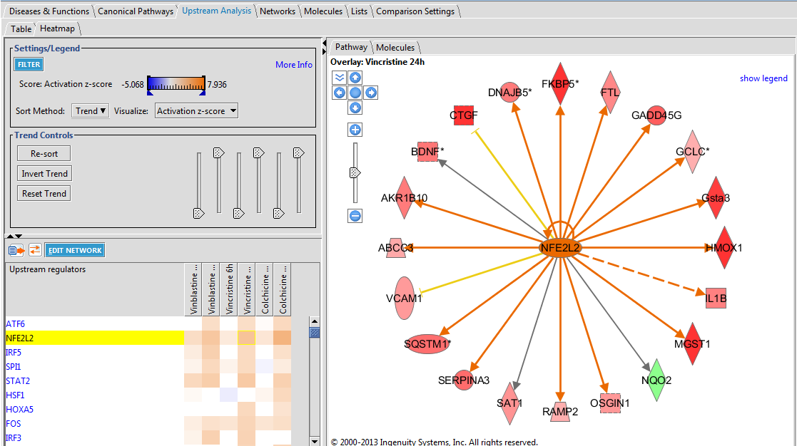
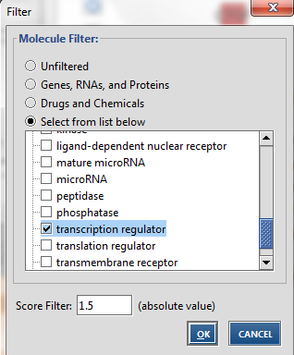
Comparison Analysis : Upstream Regulators
Notes:
OPEN Cancer subtype if people are intersested

Slide 40
INGENUITY Pathway Analysis
Advanced Analytics
Notes:
Before you get too blazed, I want to briefly introduce Advanced analytics package.

Slide 41
Advanced Analytics
Bioprofiler:
Identify list of compelling genes/proteins/compounds to analyze
Data-independent
Causal Networks:
Obtain list of plausible Master Regulators along with mechanism
Data-derived
Notes:
Advanced analytics package gives you access to two new features: Causal Networks and Bioprofiler and Causal Netowrks
12. Advanced Analytics offers 2 additional features- one data-independent and one data-dependend
13. Bioprofiler- just show slides, maybe live
14. Causal Networks- just show

Slide 42
Bioprofiler- Advanced Analytics
What genes/proteins/comopunds do I want to measure in my experiment?
Get access to Ingenuity’s Knowledge Base:
Targets of toxicity: Which genes when decreased in activity increase liver cholestasis? What types of [genetic] evidence support this?
Target discovery: What heterozygous knockouts in mouse can decrease asthma? Which drugs or which targets have been in late stage clinical trials or approved to decrease diabetes?
Biomarker research: Which genes are potential diagnosis OR prognosis biomarkers of breast cancer and are upregulated in breast cancer?
Notes:
ADD ONE Bioprofiler slide- Do breast cancer demo
What genes when increased decrease breast cancer?

Slide 43
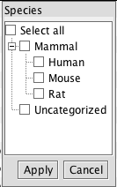
BioProfiler: Find, Filter and Explore

Slide 44
BioProfiler: Find, Filter and Explore
Notes:
To make in to a network- Highlight and can then open in a new S&E window, or add to one, or open connected to disease

Slide 45
Causal Networks- Advanced Analytics
Identify likely, relevant root regulators
Causal Network
Oxidation of lipid
Causal Network
Scoring
Casual connection to disease, function, or gene of interest
*Available at additional cost
Notes:
Causal networks – is an additional feature of the upstream analysis. It provides a list of plausible root regulators that are acting upstream of the regulators show in the primary UR analysis.
The algorithm uses a similiar calculation as is used in the primary UR analysis that identified a set [point to 3] of regulators known to affect molecules in my dataset, except that instead of looking at the up/down regulated values of dataset molecules it is looking at the pattern of predicted activated/inhibited states of the primary upstream regulators.
The key difference here is that , unlike the regulators given with the primary UR analysis and mechanistic networks, this additional algorithm doesn’t require that the predicted Master regulator have any known direct interaction with molecules in your dataset. So the root-dataset molecule link does not have to be in the KB already and may be completely novel.
CAUSAL NETWORK bubble: then you can visualize the network, and also specify a phenotype or DS effect that you specifically want to predict a mechanism for. This is doen at the time of Core Analysis setup and will return only regulator networks that are associated with the phenotype.
NCOA4 example
Like with UR table, I can look just for Genes, RNA, proteins- NCOA4, which I have not heard of in relation to estrogen. Then I can click on 60(5) to show a network of 5 total, 4 regualtors downstream of NCOA4, that could plausibly explain the the expression I am seeing in a set of 60 of my target molecules.
In relation to a disease: Breast Cancer: Only TF: NCOA4, Then in terms of BC, see U(1), one path between the predicted master regulator and BC.
Down the line, see BAG1* is U(3), this network has 3 plausible paths between the TF BAG1 and BC. When open network have options to visualize all or just some of them.
Where as Mechanistic networks tell you how regualtors may be plausibly interacting to give the [omic pattern] you are seeing, Causal network will show all the plausible root regulators.
One can go yet one step further and ask, given the upstream regulators likely involved is there a plausible root regulator?
Causal Network returned
Specifically a root regulator that has been associated with a dis/function/phenotype of interest

Slide 46
Upstream Analysis
Power to explain expression changes
Upstream Regulators
Mechanistic Network
A
Upstream Regulator
A
Upstream Regulator
Upstream Regulator:TF
B
Targets in the dataset
Significant Overlap in the Regulation
Causal Networks
Master Regulator
C
Scoring
Casual connection to disease, phenotype, function, or gene of interest
Regulator (s) are not require to share a significant overlap in the dataset regulated genes.
TF

Slide 47
INGENUITY Pathway Analysis
microRNA Target Filtering
Notes:
Do you use microRNA expression data? Do you run into obstacle of efficiently identifying relevant targets? Have you used this tool?Also included in your license is microRNA target filtering tool
Does anyone have microRNA expression data? Then could use Target Filtering to construct the pathways that might be being affected by the condition through those unregulated microRNAs.

Slide 48
microRNA Target Filter
Identify relevant microRNA targets
microRNA measured Relationship Target mRNA Target Info
*Available at additional cost
Notes:
*IF someone has many microRNAs: we have a microRNA target filter:
you upload a dataset of microRNAs, just like do for mRNA gene expression, and you are then presented a table of all possible targets based on expeirmtnal eidene as well as those predicted from Target Scan mapping.
Specifically,
First 3 columns are all about the microRNA read in: ID, symbol, FC
The next two columns are the mapping section (microRNA to mRNA). The little funnels allow you to filter on datasource as well as ‘confidence’
The next 2 columns are about the mRNAs we are mapping to: Ids, expression values if have them and nay information in KB about the genes/proteins themselves. One can edit what columns are seen.
As each column is filterable, one can specifcally look for targets only with discordant expression pairing or genes associated with a specific biological function.
For example, I may only want to keep those targets that, indeed, appear affected showing discordant expression patterns AND associated with cancer.
Or even remove those that are only based on TargetScan predictions.
Then a summary tab will show me the
filter essentially uses experimental data or TargetScan predicted interaction to show what is possibly being targeted in your sample- given these microRNAs are being expressed.
Summary tab, each microRNA and its interactors, can jump from here into a pathway

Slide 49
microRNA Target Filter
Identify relevant microRNA targets
microRNA measured Relationship Target mRNA Target Info
*Available at additional cost
Notes:
Resulting target mRNAs are then listed:
Experimentally shown to be target, discordant expression in my experimetnal syste, and associated with Cancer.
Then I can view the summary page that show microRNAs with most targets and even add them to a pathway to start using S&E tools

Slide 50
IPA and Model Networks
What we need network models for:
Provide a framework for organizing existing data,
Generate novel mechanistic hypotheses
Determine focus of validation experiments in time and space.
Making Networks with IPA:
Data- independent methods: Search and Explore
Omics Data-derived networks: Core Analysis
Gene expression, methylation, proteomics, etc.
New stuff: Advanced Analytics
Additional features: microRNA target filter, Comparison Analysis
Notes:
And then also have additional features[functionalities] for those interested.

Slide 51
IPA- To Get Started
IPA Self-Help Portal and Online Manual
http://ingenuity.force.com/ipa/IPATutorials
Free Trial for Ingenuity Pathway Analysis:
http://www.ingenuity.com/products/ipa/try-ipa-for-free
Contact: kerry.english@qiagen.com
To gain access to IPA
Get a pdf of the presentation
Set up a training
Resources are available:
Online tutorials/webinars
Technical support: 9am-8pm Eastern (M-F)
Personal Trainings (individuals or classes)

Slide 52
QUESTIONS?
Katherine Wendelsdorf, Ph.D.
Field Application Scientist
kwendelsdorf@ingenuity.com +1 502 410-9220

Slide 53
INGENUITY Pathway Analysis
My Findings

Slide 54
My Findings
Customize the Knowledge Base for your account.
How would the inferences change when I provide additional gene/protein/pathway/phenotype connections?
A proprietary chemical or some new syndrome not yet described in IPA.
Notes:
This may be proprietary knowledge, exceedingly obscure knowledge, or brand-brand new

Slide 55
My Findings: Customize content for your research needs
Facilitate integration of your proprietary content into IPA
Import relationships to increase understanding of a certain disease or therapeutic area
Share proprietary content across your IPA user community
Bulk upload available
Leverage IPA causal analytics
Uploaded within 24 hours
THE INGENUITY KNOWLEDGE BASE
*with appropriate licensing from third party

Slide 56
P-value from Fisher’s Exact test
Molecules both in the dataset AND the TF neighborhood
Genes in the
reference “universe” but not in dataset or TF neighborhood
The statistical test looks for an unexpectedly large overlap given the number of genes in each category
p-values should be insignificant (>0.05) for random datasets
Gene direction is ignored in this calculation
Genes
in the dataset but not in the TF neighborhood
Genes
in the
TF neighbor-hood but not dataset

Slide 57
Downstream Effect z-score
Downstream Functional Analysis
Differential Gene Expression
(Uploaded Data)
↓
↑
↓
↑
↑
↑
+
-
-
+
+
effect genes have on process or function (literature-based)
Bio Process/Function
Predicted Effect-
1: Increasing (correlated), -1: inhibited (anti-correlated)
-1 -1 1 0 1 1
For a given Bio Process/Function:
measures the correlation between expected gene expression values and actual gene expression values.
-ve z-score = decreased
+ve z-score = increased
weighted by relationship, relationship bias, data bias
z-score > 2 or < -2 is considered significant
Download the Whitepaper at http://www.ingenuity.com/products/ipa#/?tab=resources
Notes:
How Downstream Effects prediction works
Made so that expected value is 0 = ½ concordant with upregualtion, ½ concordant with down regulation so no agreement.
-ve means ANTI-correlated with GE values expected when the disease/function is increased.
There is also a correction for unbalanced datasets (pred
Here 5 = N = # edges with direction
N+ = 3 = Number concordant with increased
N- = 2 = # not concordant with increased.
The z-score is not calculated for a particular TF in the following scenarios:
1) The number of downstream molecules that are both in the dataset and have an expected direction < 4
2) The absolute value of (dataset bias * regulation bias) > 0.5
ominately upregulated for example)

Slide 58
Upstream Regulator z-score
IPA Upstream Regulator Analysis
← Every possible TF & Upstream Regulator in the Ingenuity Knowledge Base is analyzed
← Literature-based effect TF/UR has on downstream genes
-
-
+
+
+
+
+
+
← Differential Gene Expression (Uploaded Data)
↓
↓
↑
↓
↑
↑
↑
↑
Predicted activation state of TF/UR:
1 = Consistent with activation of UR
-1 = Consistent with inhibition of UR
1
1
1
-1
1
1
1
1
= (7-1)/√8 = 2.12 (= predicted activation)
For a given Upstream Regulator:
measures the correlation between expected gene expression values and actual gene expression values.
-ve z-score = decreased
+ve z-score = increased
weighted by relationship, relationship bias, data bias
z-score > 2 or < -2 is considered significant
Notes:
There is also a correction for unbalanced datasets (predominately upregulated for example)
The z-score is not calculated for a particular TF in the following scenarios:
1) The number of downstream molecules that are both in the dataset and have an expected direction < 4
2) The absolute value of (dataset bias * regulation bias) > 0.5

Slide 59
Mechanistic Network Algorithm
Algorithm seeks large overlaps between an upstream regulator’s targets and a more downstream regulator’s targets
Upstream molecule likely to operate thru this more downstream regulator
Upstream molecule less likely to operate thru this more downstream regulator
A
A
B
B
Shares 6 of 7 of the more downstream regulator’s targets
Shares 1 of 7 of the more downstream regulator’s targets

Slide 60
Upstream Analysis
Power to explain expression changes
Upstream Regulators
Mechanistic Network
A
Upstream Regulator
A
Upstream Regulator
Upstream Regulator:TF
B
Targets in the dataset
Significant Overlap in the Regulation
Causal Networks
Master Regulator
C
Scoring
Casual connection to disease, phenotype, function, or gene of interest
Regulator (s) are not require to share a significant overlap in the dataset regulated genes.
TF

Slide 61
Concept of “Regulator Effects” - Spring 2014
Hypotheses for how activated or inhibited upstream regulators cause downstream effects on biology
Upstream Regulators
Simplest Regulator Effects result
A
A
Algorithm
First iteration
Targets in the dataset
Disease or Function
Displays a relationship between the
regulator and disease/function if it exists
Disease or Function
Downstream Effects Analysis
Causally consistent networks score higher
The algorithm runs iteratively to merge additional regulators with diseases and functions
Notes:
Specifically it looks for DS effects and Urs with a significant overlap in target molecules and whose edges are most consistent with the data- fewest yellow edges
A UR may ultimately be predicted to be activated even if X/Y of its target gene states in the data are not concordant with this. The network of them together would be penalized. Similarly some of THESE downstream edges may be inconsistent in that Dis/Fn is ultimately predicted to be increased/decreased, eventhough Q/Y target genes measued state is not consistent with that.

