Slide 1
Multi-scale Modeling in Systems Biology
Maksudul Alam & Madhav Marathe
Network Dynamics and Simulation Science Laboratory
June 12, 2014
Modeling Mucosal Immunity —— Summer School & Symposium in Computational Immunology

Slide 2
Goals for today’s lecture
What is multi-scale modeling, the notion of scale
Why is multi-scale modeling important? When should I consider it?
What issues should I consider when developing a multi-scale model. What are the pitfalls
On-going efforts on multi-scale modeling in Systems Biology
A simple example
Mathematical and computational foundations
An example using ENISI
References

Slide 3
Material for Today’s Lectures
Sloot P and Hoekstra A (2009) “Multi-scale modelling in computational biomedicine”, Briefings in Bioinformatics, Vol II, No. I, p. 142-152
Example and slides for multi-scale modeling of heart are adapted from a presentation by Jennifer Young at Rice University http://www.caam.rice.edu/~jjy5/index.html
Hegewald J, Krafczyk M, Tolke J, Hoekstra A and Chopard B, (2008) “An Agent-Based Coupling Platform for Complex Automata”, Lectures in Computer Science, Vol 5102, p. 227-233
Schnell S, Grima R and Maini P, (2007) “Multiscale modeling in biology” American Scientist, Vol 95:2 , p. 134-142
Alberts B, Johnson A, Lewis J, Raff M, Roberts K, Walter P, Molecular Biology of the Cell, Garland Science, 1994
E W, Engquist B, “Multiscale Modeling and Computation”, Notices of the AMS, Vol 50:9, p. 1062-1070
H Schneider, T Klabunde (2013), “Understanding drugs and diseases by systems biology?”, Bioorganic & Medicinal Chemistry Letters
M Meier-Schellersheim, I Fraser, and F Klauschen (2009), “Multi-scale modeling in cell biology”, Wiley Interdiscip Rev Syst Biol Med.
J Dada and P Mendes (2011), “Multi-scale modelling and simulation in systems biology”, Integrative Biology
J. Walpole, J. A. Papin and S. M. Peirce (2013), Multiscale Computational Models of Complex Biological Systems, Ann Review of Biomedical engg.

Slide 4
What is multi-scale modeling?
“Multi-scale modeling refers to a style of modeling in which multiple models at different scales are used simultaneously to describe a system.”
  Different models focus on different scales of resolution
  Sometimes originate from physical laws of different nature (e.g. from continuum mechanics and molecular dynamics)
Notes:
Multiscale modeling refers to a style of modeling in which multiple models at different scales are used simultaneously to describe a system. The different models usually focus on different scales of resolution. They sometimes originate from physical laws of different nature, for example, one from continuum mechanics and one from molecular dynamics. In this case, one speaks of multi-physics modeling even though the terminology might not be fully accurate.
Source: http://www.scholarpedia.org/article/Multiscale_modeling

Slide 5
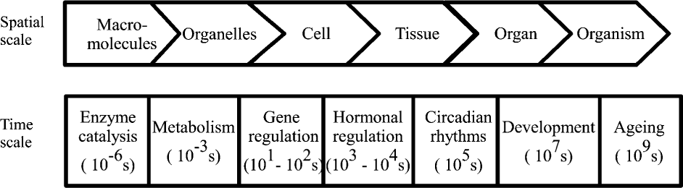
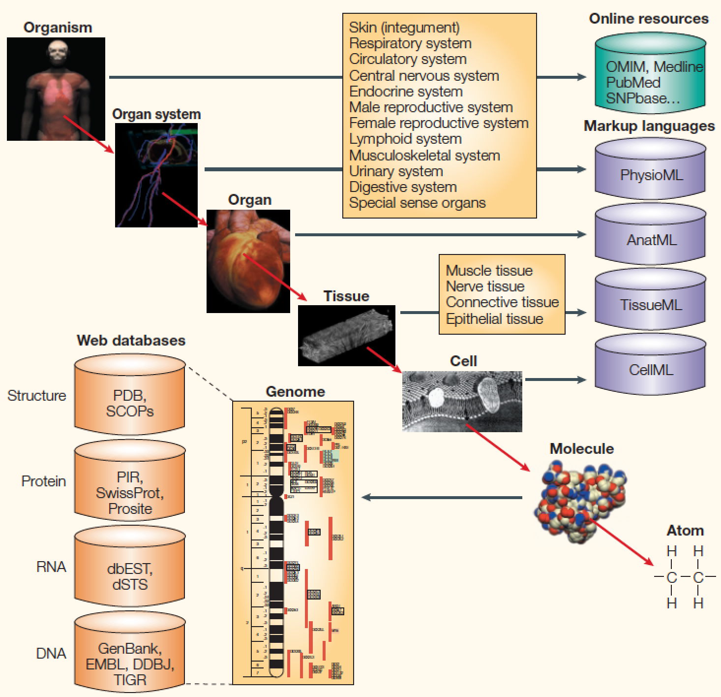
Scales in Biosystems?
Scale defines the level of granularity of a biological level using time, space and functional domain
Typical scales:
  Intracellular Scale (nanometers, milliseconds)
  Cytokine Fluid Scale (micrometers, seconds)
  Cellular Scale (millimeters, minutes)
  Tissue Scale (centimeters, hours)

Slide 6
Multi-scale modeling in biological systems
Explicit models of complex biological systems integrated across temporal, spatial, and functional domains. Through simultaneous evaluation of multiple tiers of resolution, MSM capture systems behaviors not observable using single-scale techniques.
Important topical area in biosystems modeling – interagency modeling group and Multi-scale modeling consortium established for this reason by NBIB
Notes:
Biological organization, or the hierarchy of life, is the hierarchy of complex biological structures and systems that define life using a reductionistic approach.
Each level in the hierarchy represents an increase in organizational complexity, with each "object" being primarily composed of the previous level's basic unit. The basic principle behind the organization is the concept of emergence—the properties and functions found at a hierarchical level are not present and irrelevant at the lower levels.

Slide 7
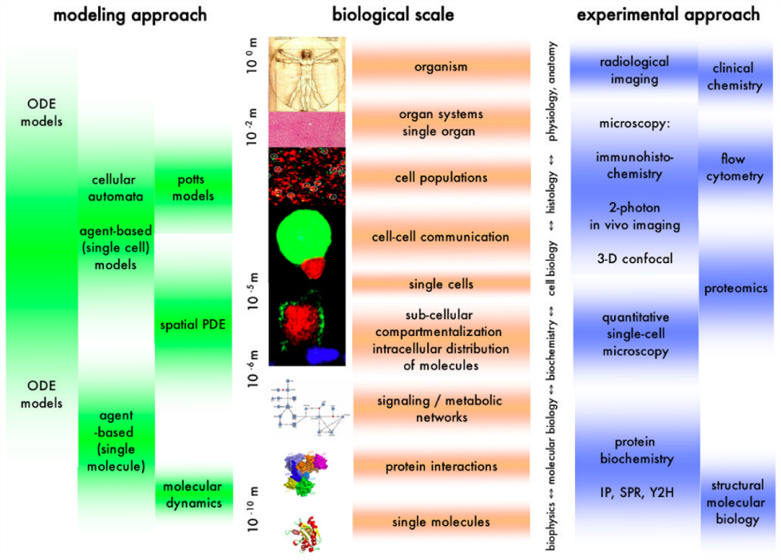
[Meier-Schellersheim’09]
Notes:
A diagrammatic representation of different biological scales and their associated modeling techniques and experimental approaches. Abbreviations: ODE: ordinary differential equation; PDE: partial differential equation; IP: immuno-precipitation; SPR: surface plasmon resonance; Y2H: yeast two-hybrid.

Slide 8
Classifying models in Biosystems
Top down versus Bottom up
  Both approaches have problems and advantages
Continuous versus Discrete
  Continuous techniques: space and time is continuous and continuous functions and differential equations are used to represent relationships between various factors
  Discrete techniques: space and time is discrete: Boolean networks, CA, network models, Discrete dynamical systems
Statistical/Phenomenological versus mechanistic/causal
  Just being mechanistic need not imply the models have explanatory power
Notes:
Approaches that start with observed features on a high level of a system and then attempt to deduce what kinds of mechanisms on lower, more fundamental scales could account for those
observations are called ‘Top-down’.
Bottom-up’ models, in contrast, aim at deriving a system’s behavior on higher spatial or temporal scales from the dynamics and interactions of model components ‘living’ on lower, more detailed scales.

Slide 9
Importance of multi-scale modeling
Conceptual clarity
  Natural way to represent biological systems
Understand the behavior of biological systems
  Bridge the gap between isolated in vitro experiments and whole-organism in vivo models
  How a change in micro-level factor (e.g. gene modifications) affects macro-level measurable changes (e.g. lesion forming) and vice versa?
  Powerful tool to capture & analyze information otherwise inaccessible via single scale models
Few existing ready-to-use tools

Slide 10
When should I consider multi-scale modeling in biosystems?
Biological questions that demand representation of explicit models of relevant scales
Either data is available or can be collected to develop an explicit model at that scale. Else when goal is to put forward an explanation of the mechanism at a specific scale
Sufficient computational resources are available
Domain expertise is available

Slide 11
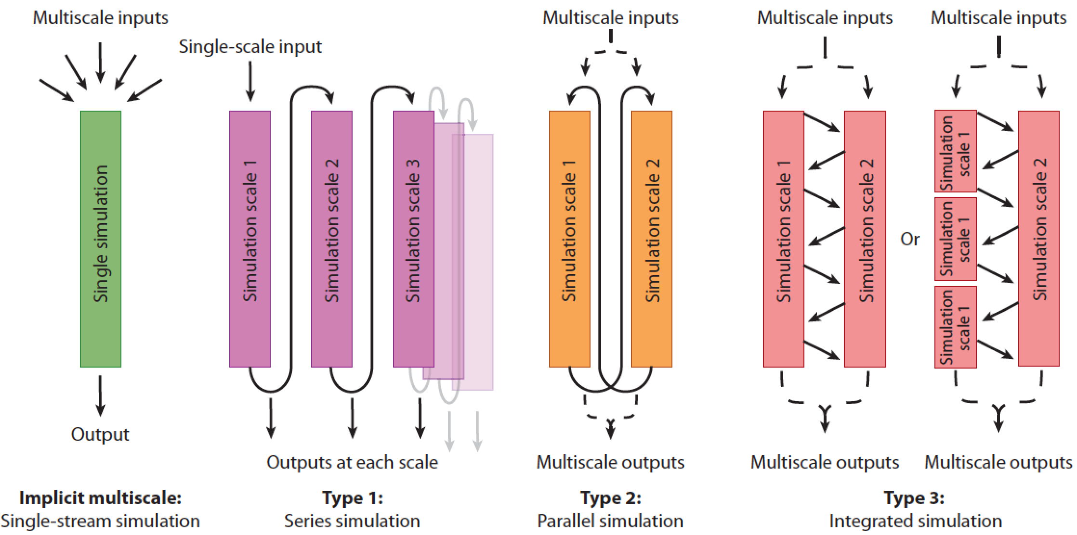
Interactions between scales
J. Walpole, J. A. Papin and S. M. Peirce (2013), Multiscale Computational Models of Complex Biological Systems, Ann Review of Biomedical engg.

Slide 12
What are the pitfalls?
Meaningful explicit models for relevant scales
Information exchange between models
  What information, how often, correctness
Computational complexity
  More scales implies more complexity in general
Availability of data

Slide 13
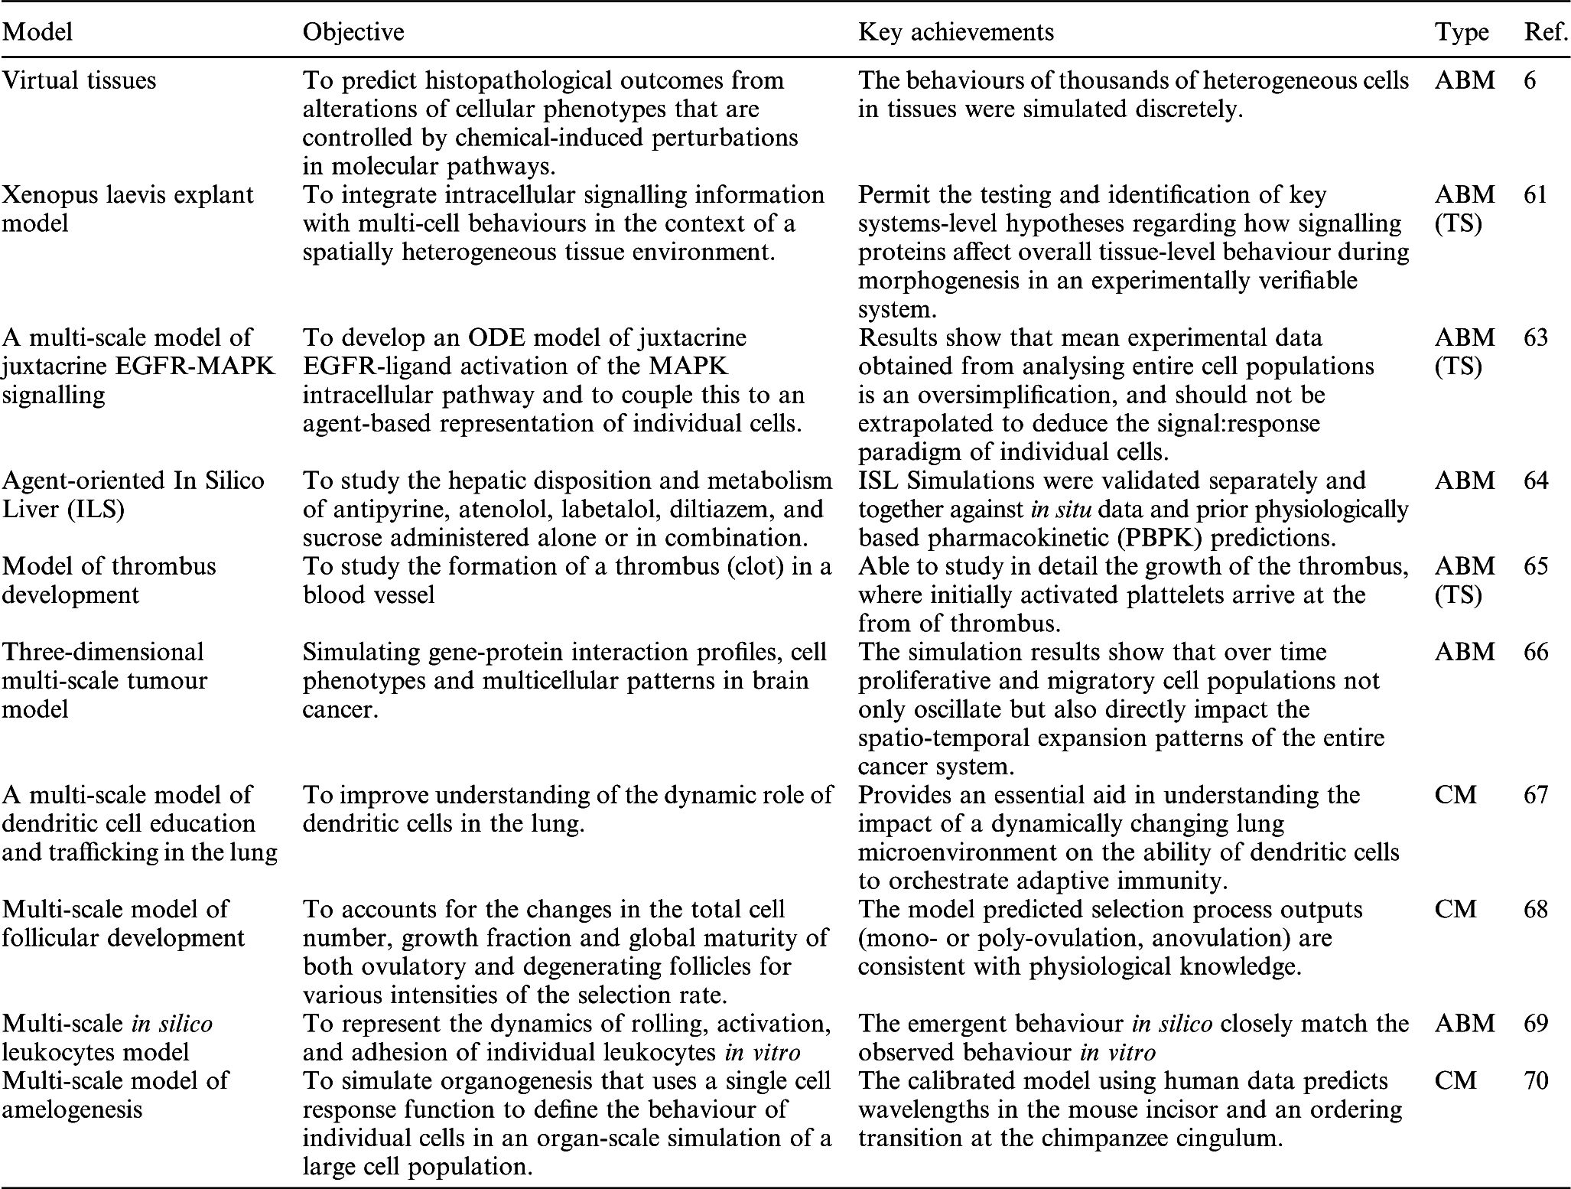
Other efforts

Slide 14
A simple example: In Stent Restinosis of the heart

Slide 15
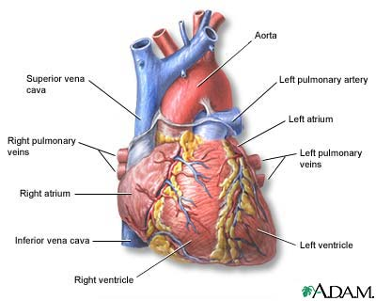
Example 1: The Heart
The Heart
  Physical Scale: 10 cm = 10⁻¹ m
http://www.healthcentral.com/heart-disease/what-is-heart-disease-000003_1-145.html

Slide 16
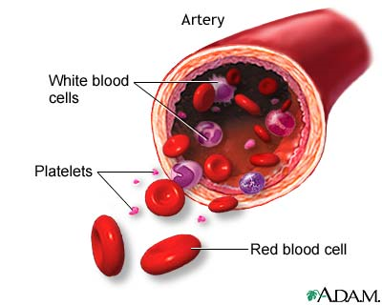
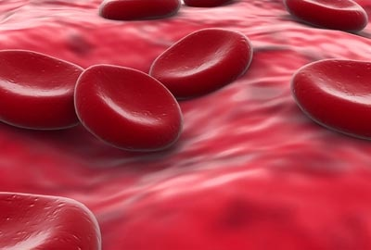
Example 1: The Heart
Artery
Physical Scale: mm = 10⁻³ m
Red Blood Cell
Physical Scale: μm = 10⁻⁶ m
http://www.pennmedicine.org/health_info/bloodless/000209.html
http://www.fi.edu/learn/heart/blood/red.html

Slide 17
Modeling ISR
Coronary Artery Disease: Accumulation of plaque in the arteries
Treatment: place a metal stent in artery to keep it open, blood flowing
In-Stent Restinosis (ISR): build-up of new cells in the area where initial problem was
Goal is to prevent ISR from occurring in patients

Slide 18
Example 1: ISR
Scale of Interest:
  Physical Scale: Cell to Artery (micron to cm)
  Time Scale: Seconds to Months
Processes of Interest:
  Initial injury due to stent
  Platelet aggregation
  Red blood cell Thrombus formation
  Cell cycle, cell signaling
  Blood Flow
  Drug Diffusion

Slide 19
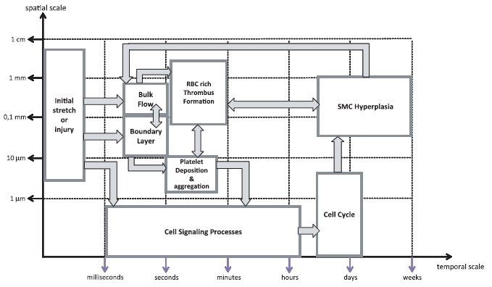
Modeling ISR
Visual Map of Processes and Scales

Slide 20
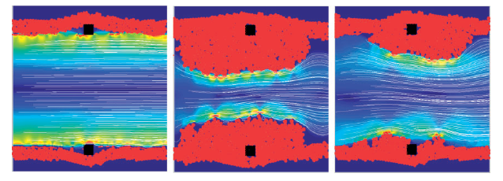
Modeling ISR
Single Process Models are available
Integration done using a coupling computer program (COAST)
Example Simulation:

Slide 21
Example 2: Modeling Mucosal immunity in the Gut

Slide 22
The consequence of exposure
What determines whether a person is infected upon exposure and the severity of subsequent disease?
    Complete tolerance that leads to non-pathogenic microbe persistence
    Hypo-inflammation in which a pathogen is not completely eliminated
    Inflammation that eliminates the microbe, but ceases prior to extensive tissue damage
    Hyper-inflammation in which the microbe is eliminated at expense of host tissue damage
    Which aspects of these competing pathways could be exploited to inhibit pathogen invasion, infection, and evolution?
Notes:
So when asking the question.. As an immunoogist I would repharase it as…
More so, …

Slide 23
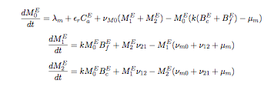
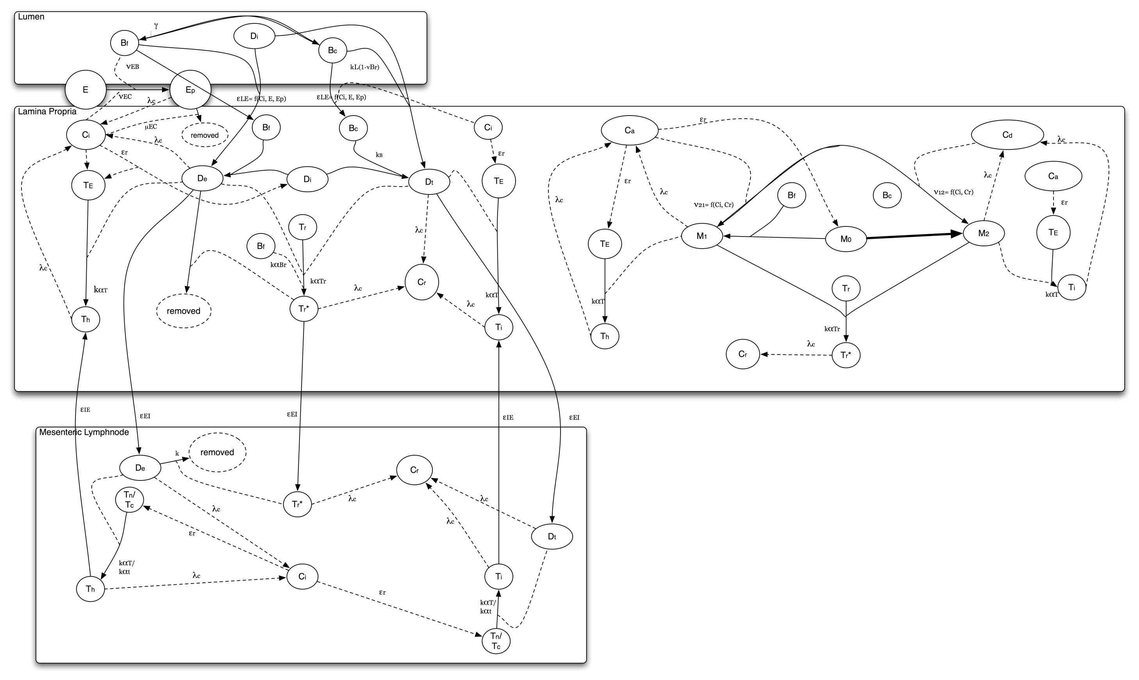

Our first attempt: Realization in ODEs
Replenishment rate
Rate of contact with bactieria
Regulatory M2 in tissue
Rate of M1 to M2
Rate of conversion to M1

Slide 24
Calibrating the model
Molecular level
  Relative secretion of IL-12, IFNy, IL-4, IL-17, IL-23, TGF-B, MCP-1, IL-10, and IL-2 upon antigen recognition by CD4+ T-cells, macrophages, dendritic cells
Cellular level
  Cytokine ratios at which M1 becomes M2 (alternatively activated)
Tissue level:
  How long do cells spend in tissue of gut mucosa during circulation?

Slide 25
The ODE realization makes assumptions
Determinism vs Stochasticity
Infinitely divisible vs discrete entities
Mass action (uniform mixing)
Spatial homogeneity within compartments

Slide 26
Consider alternative representation theory: Cellular Networked Immunology
Represent individual cells as agents/nodes of a network
Capture the interactions via a dynamic network
Local functions are endowed to the cells
…. More on this later.

Slide 27
ENISI: An (agent) interaction based modeling framework for in-silico study of GI mucosa
ENISI can be used to model immune response of gastrointestinal (GI) tract or gut mucosa and its component immune cells in response to foreign microbes.
Inflammatory Immune Response:
  The response that protects the body by eliminating pathogen and damaged cells.
  Constant inflammatory response can induce host cell damage.
Regulatory Immune Response:
  Down-regulates the inflammatory response to protect the body against constant inflammation.
Notes:
ENISI
simulates and predicts immunological events at the mucosa that cannot yet be observed or identified with current in vitro/ in vivo techniques.
Given infection in a host under a specific condition, will a certain pathogen be eliminated? Will it establish a chronic infection? Will the person be symptomatic?
Goal being to aide in the development of treatment and prevention of infection/ pathogenesis:
Current focus is application to H pylori and identifying strain-specific characteristics that lead to pathogenesis and identifying unique treatments for different host/strain conditions.

Slide 28
What is ENISI
ENISI is a modeling environment; it is NOT a specific model.
  Models for specific pathogens can be derived from ENISI.
    Leads to generality and efficiency
Users can interact with ENISI at three different levels depending on their computational expertise
  Via the ENISI User interface: (no training is required)
  Via configuration file to change model specific parameters (requires basic understanding of Linux environment)
  Making code changes to the modeling environment

Slide 29
What is ENISI: A modeling environment that supports Networked Immunology
ENISI based on a formal mathematical framework: a co-evolving graphical dynamical system (+ some aspects of Statecharts)
ENISI is specifically designed to map on modern high performance computing architectures.
    Demonstrated using Shadowfax cluster at VBI
    Can simulate 10⁸ individual cells on a modest parallel cluster in < 1hr

Slide 30
What is ENISI
Causal Model Based Immune Systems Biology
  Guide targeted biological experiments
  Provide a causal and procedural explanation of the underlying system
Big Data Immunoinformatics
  ENISI produces large amounts of highly detailed spatio-temporal data. The data can be aggregated to the desired level for calibration and validation.

Slide 31
What is an Agent-Based Model (ABM)?
Things: nouns
  individual entities
  collections of entities
with states: adjectives
  finite set
  continuous or discrete
  parameterized

Slide 32
What is an Agent-Based Model (ABM)?
that interact: verbs
  what interacts with what?
  is the network of interactions static or dynamic?
  what makes it dynamic? Brownian motion, chemotaxis
according to a mathematical rule: adverbs
  deterministic vs stochastic
  continuous vs discrete in time

Slide 33
What does an ABM compute?
Interactions among things correlate their states.
Each time step in each run gives the
state of the system at that time:
The state in any one run is a sample from
the joint distribution of possible states:
(kN numbers)
(k^{N} numbers)

Slide 34
ENteric Immune SImulator (ENISI)
Modeling Environment
Host cells and bacteria are agents
Each agent represented as an automaton
Agents move around gut mucosa and lymph nodes
Nearby agents are “in contact”
Agents in contact can interact:
  Agent-Agent interaction
  Group-Agent interaction
  Timed interaction
We will be considering an ENISI model for H. pylori infection

Slide 35
A complete description of the resulting joint distribution is impossible
Describing the distribution for just 32 cells, each with 3 states
– here Naive, Inflammatory, Regulatory –
would require 1.5 PB
Alice | Bob | Carol | David | Ellen | probability of this configuration of states at time T
N | N | N | I | N | 0.002
I | N | R | R | N | 0.013
I | I | N | N | N | 0.004
N | I | R | N | R | 0.108
I | I | I | R | N | 0.006
Notes:
Offhand it might seem that kN numbers would describe it, but that ignores correlations induced by the network among ll the vertices.

Slide 36
Instead, compute averages over multiple simulations (Monte Carlo samples)
Each run of the (stochastic) simulation produces a different result, drawn from the joint distribution
Estimating the joint distribution itself is not feasible
Statistics of the joint distribution can be estimated from many samples
Efficient computation is essential!

Slide 37
ENISI: Agents
Participating cells
  CD4+ T Helper Cells
  Natural T Regulatory Cells
  Dendritic Cells
  Macrophages
  Epithelial Cells
Bacteria
  Commensal Bacteria
  Tolerogenic Bacteria
Notes:
The cell types which participate on ENISI. We have about 100 of different phenotypes associated with the simulations which is not listed here.
commensal – typical gut flora
tolerogenic – mediate immune response
Dendritic cells – antigen response
T Cells – type of white blood cell
macrophages – engulf and destroy pathogens

Slide 38
An interaction network for the immune system
Vertices -> cells/bacteria
Edges -> cytokine-mediated interaction
Interactions change cells’ behavior and
neighbors, producing immune system dynamics.
Notes:
They not only represent the “naturally occurring” system, but also interventions.

Slide 39
Targeted interventions can be represented as network changes
pathway disruption
knock-outs
antigen priming
regulated expression
Notes:
They can be specialized to include only the most relevant features for a particular disease

Slide 40
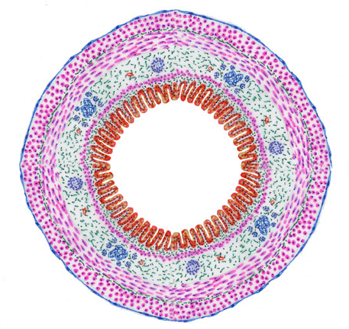
ENISI: Tissue Sites
Participating cells are located in the GI tract.
Cells move around the tissue sites.
Tissue Sites:
  Lumen
  Epithelial Cells
  Lamina Propria
  Gastric Lymph Node
Gastrointestinal Tract (cross-section)
Notes:
All the cells occupy some location. Cells can move in a location randomly. We have simplified the gut with 4 major compartments: Lumen, Epithelial Cells, Lamina Propria and Gastric Lymph Node
Lamina propria: this layer below the epithelial cells is highly vascularized. In the small intestine, nutrient absorption is accomplished by means of this tissue.
Lymph Nodes – source of T Cells and other immune cells

Slide 41
Automata-based representation of an Agent
Each cell is represented as a probabilistic finite state automaton
  The states of a cell is called
  phenotype.
State transition represents:
  Cell differentiation
  Cell death
  Cell migration
State transition is:
  Stochastic
  Time dependent
  Contact dependent
Macrophage Automaton
Notes:
Each cell also follows cellular automata. Generally the states of the automata are called phenotypes in biological literature. Note that not all states represents actual phenotypes, some are used for the modeling purposes with no direct representation but indirectly related.
State transitions represents differentiation, death, recruitment, migration etc. State transition may also be probabilistic, time dependent and contact dependent.
a Macrophage can occupy one of the states: MASource, M0, M1, M2, M21, M12

Slide 42
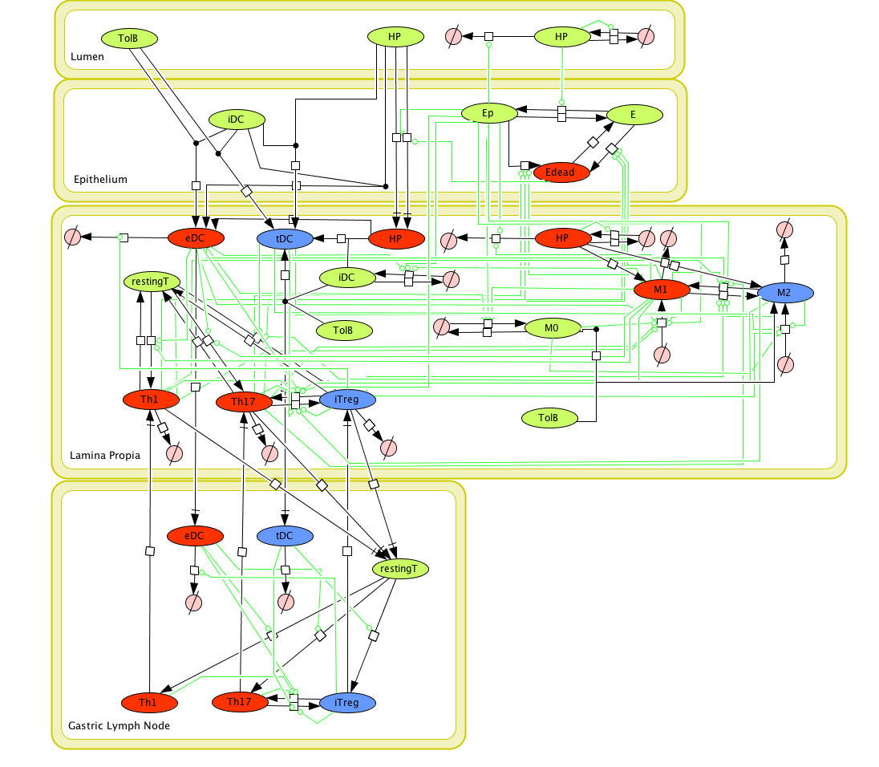





Layered view
Red cells participate in inflammatory response
Blue cells participate in regulatory response
Green cells participate in either response
Cells are compartmentalized.
Macrophage Automaton
Notes:
Each cell also follows cellular automata. Generally the states of the automata are called phenotypes in biological literature. Note that not all states represents actual phenotypes, some are used for the modeling purposes with no direct representation but indirectly related.
State transitions represents differentiation, death, recruitment, migration etc. State transition may also be probabilistic, time dependent and contact dependent.
a Macrophage can occupy one of the states: MASource, M0, M1, M2, M21, M12

Slide 43
ENISI Modeling Assumptions
Cell differentiation is modeled using a probabilistic finite state automaton
  Based on statistical approach
  Phenotype change is probabilistic
Cytokines are not represent directly
  Cells can change phenotype with presence of other cell types in close proximity
  Those other cells are assumed to secrete cytokines, although there is no real cytokines modeled
Random movement
  Movement from one spatial unit to other is considered random
  No chemokine induced movement is considered

Slide 44
Mapping ENISI on HPC architectures
Can simulate 10⁷- 10⁸ cells or ~1% of mouse gut in
1½ hours on 576 cores
Other systems limited to at most 10⁴ cells (Rhapsody)

Slide 45
Example: H. Pylori 26695 Pathogenicity
Experimental infection of H. pylori 26695 on mice.
GOAL:
  In H. pylori mediated pathogenesis, in the 85% cases, we observe no lasting epithelial cell damage. But for 15% of the cases we observe chronic cell damage. We want to find out what is causing this chronic cell damage.
Experiment:
  In ENISI we infect the in-silico gut with H. pylori after 2 days and simulate the infection for 63 days.
  Data collected from a in-vivo experiment on mice on days 7, 14, 30 and 60 post infection.
Notes:
What is the experiment all about. We find a clinical problem of H. pylori mediated pathogenicity. In 15% of the cases of this infection we observe chronic epithelial cell damage. We want to find out what is causing this.
For the experiment our in-silico gut represents about 1% of murine gastric mucosa. We infect it with H. pylori and observe the cell population dynamics.

Slide 46
Example: H. Pylori 26695 Pathogenicity
Conclusion
  Reveals a positive feedback loop triggered by H. pylori infection where chronic epithelial cell damage is observed even when there is no remaining active H. pylori in the gut.
  With the knowledge of feedback loop we now have a hypothesis for this chronic epithelial cell damage and can test this is the lab by treating mice with appropriate medicine.
Notes:
During the first phase of inflammation all the H. pylori are becoming dead or eliminated but still we get cell damage for 15% of the cases of H. pylori infection. Using the model, we have successfully found the feedback loop. We can use this knowledge for the treatment the cases.

Slide 47
ENISI Multi-scale Modeling
(ENISI MSM)
Multi-scale modeling platform
  Extension to ENISI, an agent-based modeling environment for mucosal immunity
  Integrating agent-based modeling, PDE, and ODE
  Modeling tissue, cells, chemokines, cytokines, and intracellular pathways
  Introducing chemokine dependent movements and cytokine dependent differentiation

Slide 48
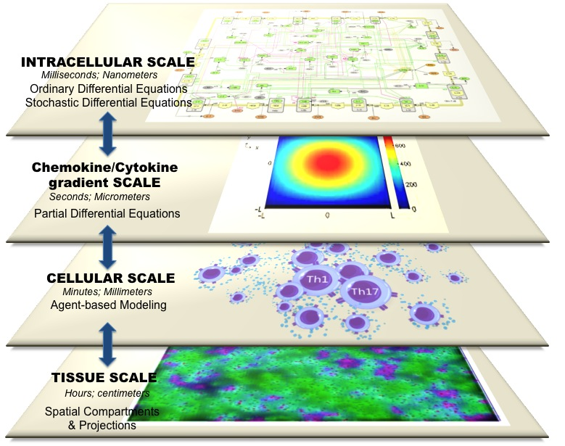
Scales of ENISI MSM
Tissue Scale
Cellular Scale
Chemokine Scale
Intracellular Scale
Scales | Time | Space | Mathematical Model | Software Environment
Tissue | Hours-Weeks | Centimeters | Spatial compartments | ENISI
Cellular | Minutes-Days | Millimeters | ABM | ENISI ABM
Cytokines | Seconds | Millimeters | PDE | ENISI
Intracellular | Millisecond | Nanometers | ODE/SDE | COPASI/ENISI SDE

Slide 49
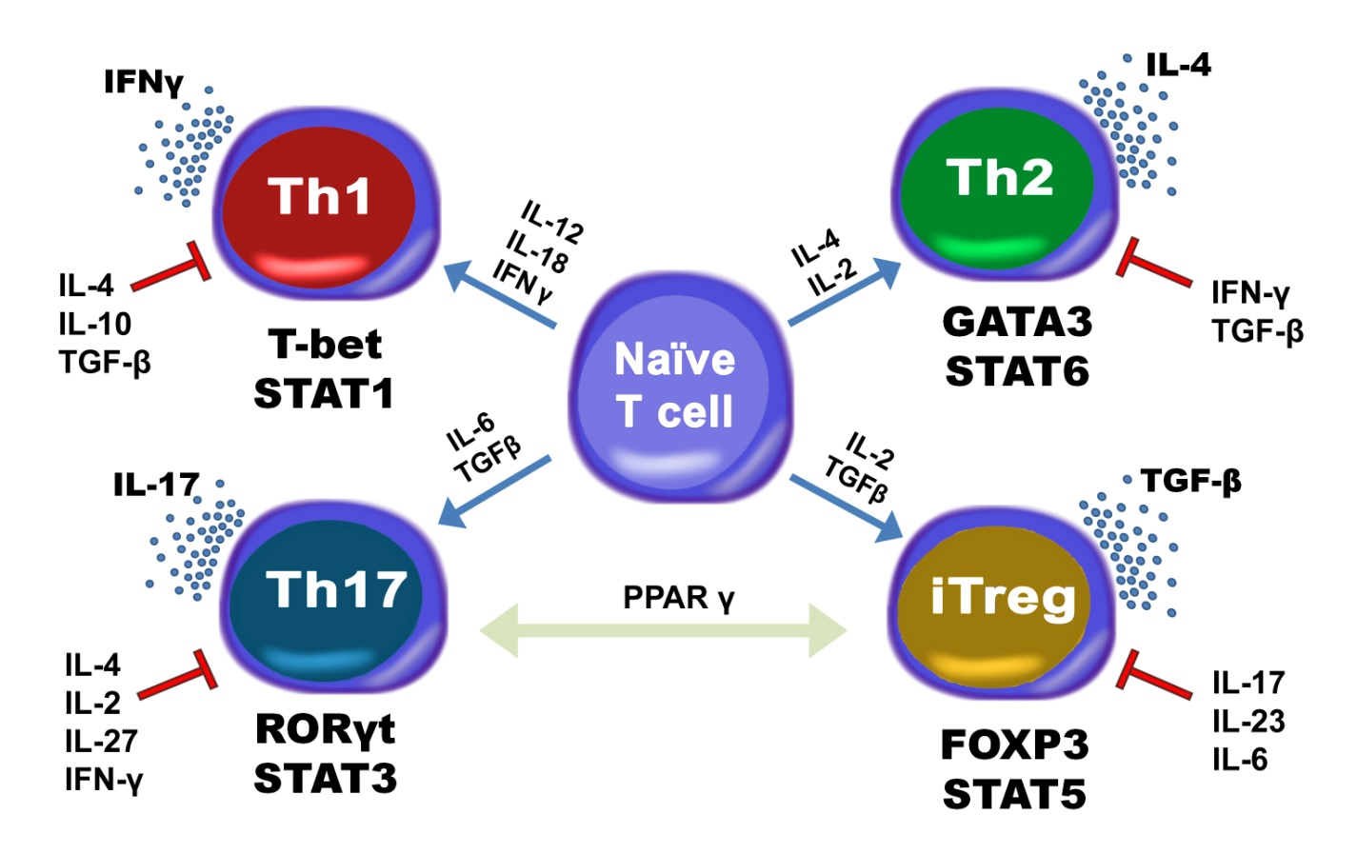
Intracellular Model: CD4+ T cell computational model
Comprehensive T cell differentiation model
  94 species
  46 reactions
  60 ODEs
A deterministic model for in silico experiments with T cell differentiation: Th1, Th2, Th17, and Treg
ODE intracellular model

Slide 50
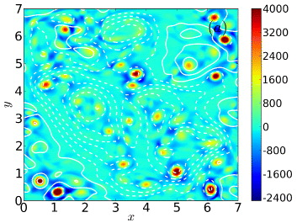

Chemokine/Cytokine Fluid Scale
Cytokines and chemokines are small molecules
Cytokines play vital role in cell differentiation
Chemokines play vital role in cell movement
Chemokines and cytokines are produced by the cells
Each cytokine or chemokine has diffusion process of the form:
  L(x,y,z)=concentration of cytokine/chemokine
  D=diffusion rate
  γ=degradation rate
  Realized with partial differential equations (PDE)
Diffusion also changes the concentration of cytokines or chemokines
Cytokine/Chemokine Diffusion

Slide 51
Cellular Scale: Agent Based Modeling Environment (ENISI)
Host cells and bacteria are agents
Each agent has an associated intracellular model
Agents move using Brownian motion
Some agents move around gut mucosa and lymph nodes by chemotaxis
Phenotypic change of state is based on intracellular model
Agent Based Model

Slide 52
Cellular Scale: Immunological Network
[Carbo’13]
Notes:
In contrast to ENISI V1: Schematic representation of the cytokines and transcription factors controlling CD4+ T cell differentiation are represented by intracellular model. Our CD4+ T cell differentiation model is firmly grounded on experimental observations and reproduces four CD4+ T cell phenotypes upon external stimulation with appropriate cytokine combinations, as well as representing the crosstalk between phenotypes, exhibiting inhibitory trends.

Slide 53
Tissue Scale
Participating cells are located in the GI tract.
Cells move in the tissue sites.
Tissue Sites:
  Lumen
  Epithelial Cells
  Lamina Propria
  Gastric Lymph Node
Notes:
All the cells are located in the GI tract and are grouped into 4 tissue sites. We have simplified the gut with 4 major compartments: Lumen, Epithelial Cells, Lamina Propria and Gastric Lymph Node
Lamina propria: this layer below the epithelial cells is highly vascularized. In the small intestine, nutrient absorption is accomplished by means of this tissue.
Lymph Nodes – source of T Cells and other immune cells

Slide 54
Interaction between scales
Appropriately characterize linkages between the scales
Tissue scale stores cytokine and chemokine concentration
Cytokine/chemokine fluid scale uses the concentration of cytokines and chemokines for diffusion which also modifies the tissue scale
Intracellular scale takes cytokines as input to perform ODE with the cytokine concentrations. This also make changes in tissue scale
Cellular and intracellular models are interdependent with regard to phenotypic changes and cell-cell interactions.
Notes:
A key step towards predictive MSM is to appropriately characterize linkages between intracellular, cellular and tissue models. Cytokine inputs of the intracellular model depend on the cytokine diffusion process at the tissue level, and tissue architecture depends on the cytokine production/degradation intracellularly. Cellular and intracellular models are interdependent with regard to phenotypic changes and cell-cell interactions. Due to distinct spatiotemporal properties and performance requirements of different scales, we will calibrate the individual model components before assembly and again following multiscale linkage. Sensitivity analysis algorithms will play an important role in the calibration process.

Slide 55
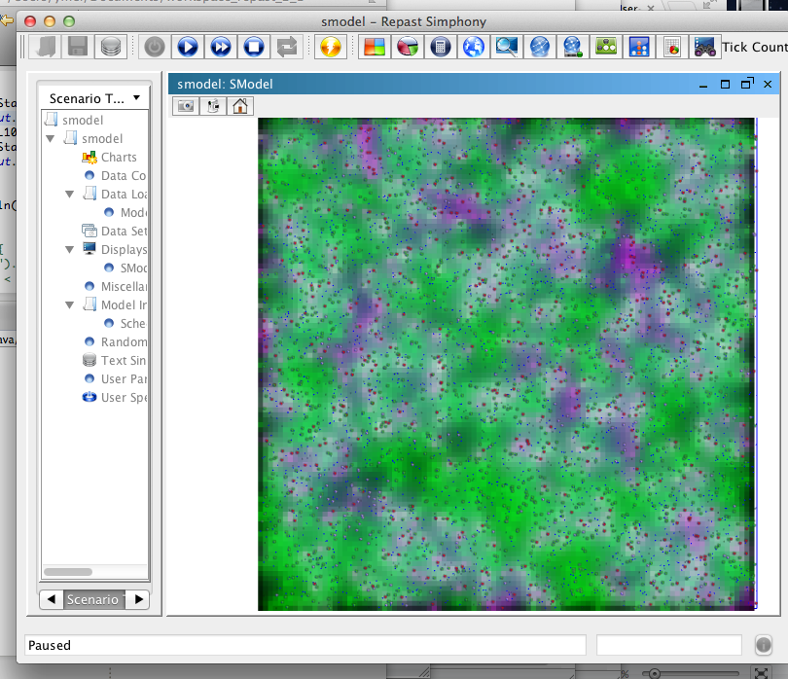
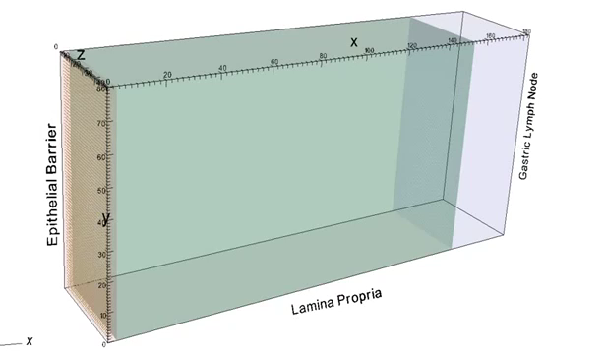
Visualization Results
Notes:
We are showing visualization tools generated from the simplified version of multi-scale model. It can show lesion formation and chemokine dependent movement.

Slide 56
Multi-scale model development
The model development process in general
  Divide and conquer
  Iterative process
Individual components
  We already have calibrated ODE models
  Cytokine PDE models need to calibrated
  Agent-based models need further calibrations
The multi-scale model
  Need integration/system calibration
  Individual components will likely need further calibrations

Slide 57
ENISI Outputs
ENISI produces detailed spatio-temporal datasets:
  Time Series describing the state of individual cells
  Aggregating by type of cells
  Aggregation by location
Typical ENISI simulation will comprise of consists of 10⁹⁻¹¹ cells.
250 time steps and 40 replicates yields 10¹³⁻¹⁵ data points per cell:
  10 Terabyte – 1 Petabyte data per cell of a design !

Slide 58
Big Data Analytics and Immunoinformatics
Data produced is: diverse, big, temporal.
New analytical and visualization tools are required to process the data to produce meaningful interpretations
Role of high performance computing is central to analyzing such outputs.
  Both traditional HPC as well clouds and data-intensive platforms

Slide 59
Sensitivity Analysis for Complex Models
Study how changes of parameter settings affecting the response in ENISI
Goal:
  Identify important parameters that significantly influence the system
  Decouple the complex relations among multiple parameters affecting the system
Methods:
  Global sensitivity analysis
  Dynamic sensitivity analysis
Notes:
Sensitivity analysis of Agent Based System is crucial to determine the factors which control the system.

Slide 60
Sensitivity Analysis
There are 25 modeling parameters (factors) in ENISI
Each modeling parameter is continuous and it’s value is normalized in the range [0, 1]
Each parameter has 4 different levels of values
Notes:
ENISI has a complex set of rules which has over 100 phenotypes and differentiation rules. We also have about 25 modeling parameters for this design.

Slide 61
Influence of Parameters using Causal Network
v_{BD}
v_{T}
Th₁
eDC
iDC
a_{T}
v_{T}, p₁₇
restT
a_{T}
v_{T}
iTreg
eDC_{L}
v_{Bs}
DC
v_{T}
a_{r}, y_{r}, i₁₇
a_{r}, y_{r}, i₁₇
a_{T}, p₁₇
a₁₇, y₁₇, i_{r}
a₁₇, y₁₇, i_{r}
v_{T}
v_{T}
Th₁₇
a₁, y₁, i₂
a₂, y₂, i₁
M₂
M₁
pEC
a₁, y₁, i₂
a₂, y₂, i₁
ECell
v_{EC}
v_{BM}
v_{BM}
v_{EB}
u_{CE}
Ed
M₀
Cell Phenotype
Positive Influence
Negative Influence
Cell Differentiation
Contact Dependency
Notes:
This is a causal network showing the influence of a modeling parameter on the cell phenotypes. This network is generated from the H. pylori ENISI model. Due to clarity, only the portion related to Lamina Propria is shown here.
In this diagram, blue ovals represents cell phenotype.
Solid directional lines indicates the probable differentiation into another cell phenotype. Dashed directional lines indicates phenotype contact dependency. For example, pEC (pro epithelial cells) must be present for the resting T cells to differentiate (because pEC secretes some cytokines which drives restingT cells into other phenotypes).
The green boxes on the directional arrows indicates which factor favors the differentiation. The Red box lists the factors which inhibits the differentiation.
It should also be noted that, each phenotype has a cell count. The cell count also plays important role in the behavior of the system. For example, a large change on parameter value for a small cell count might have little effect. But a small change in parameter value for large cell counts will affect the system more.
One way to visualize the effect of a parameter is to start from the phenotype which has direct effect from the parameter and traverse the network to get the weighted visit. The more the weighted visit, the more we can expect the parameter to have impact.

Slide 62
Full Factorial Experiments
If we use a full factorial design of 25 factors with each 4 levels, the run size is 4²⁵ =1.125 x 10¹⁵
Such a large number of run size is not feasible
Solution: Sparse Designs, e.g. Fractional Factorial Designs
Notes:
Consider a system with 2 parameters, where each parameter can take one of 4 values. To test the system against all possible combinations, it would take 4*4=16 unique experiments.
In ENISI parameter values are discrete. Moreover there are 25 parameters. If we want to test every combination, it would take 4^25 such combinations, which is not practical to experiment.

Slide 63
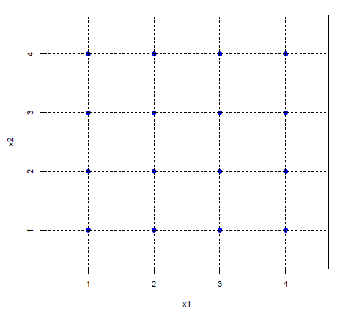
Fractional Factorial Design
The proposed design only need 128 runs with the nice property:
  for any two factor combination, it remains a full factorial (4 x 4) design with 8 replicates for each level combination
Notes:
We want to use a limited set of experiments which covers the 4^25 combinations uniformly. This is called sparse design.
We choose 128 runs as it is feasible to run experiments within acceptable time frame. It has the following additional property: for any two factor combination, it remains a full factorial (4 x 4) design with 8 replicates for each level combination

Slide 64
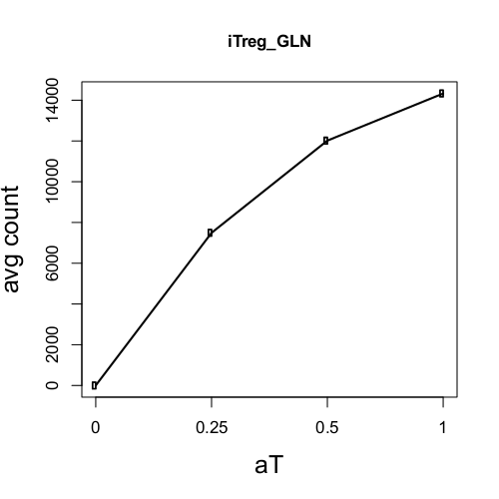
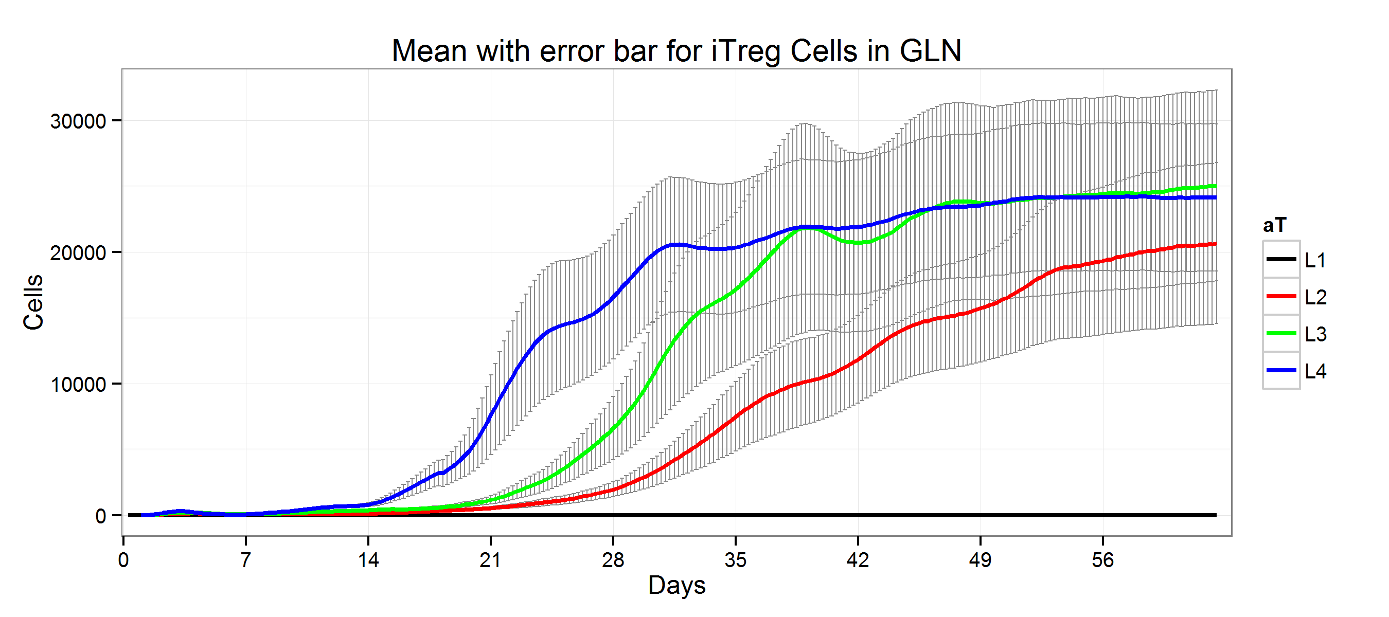
Main Effect Sensitivity Analysis
Main effect plot of parameter aT: (probability of restingT cell stimulation)
The 4 levels are L1=0, L2=0.25, L3=0.5, L4=1
Notes:
In ENISI there are 25 design parameters. Each parameter have 4 level of values. (L1=0, L2=0.25, L3=0.5, L4=1.0, in normalized way). There are total 128 different experiments. So, for each level of a particular parameter we have 32 experiments. The time-series plot shown here shows the average of these 32 experiments per level.
The main effect sensitivity analysis is concerned with the effect of a modeling parameter on the outcome of a cell population. In this particular figure, we are showing the time-series plot of iTreg cells in GLN (Gastric Lymph Node). As seen from the figure, whenever the value of aT is increased, the cell count of iTreg in GLN is also increased. To show this feature clearly, we take the average of cell count and plot it against different levels of aT. It clearly shows the monotonic relationship between aT and iTreg in GLN.

Slide 65
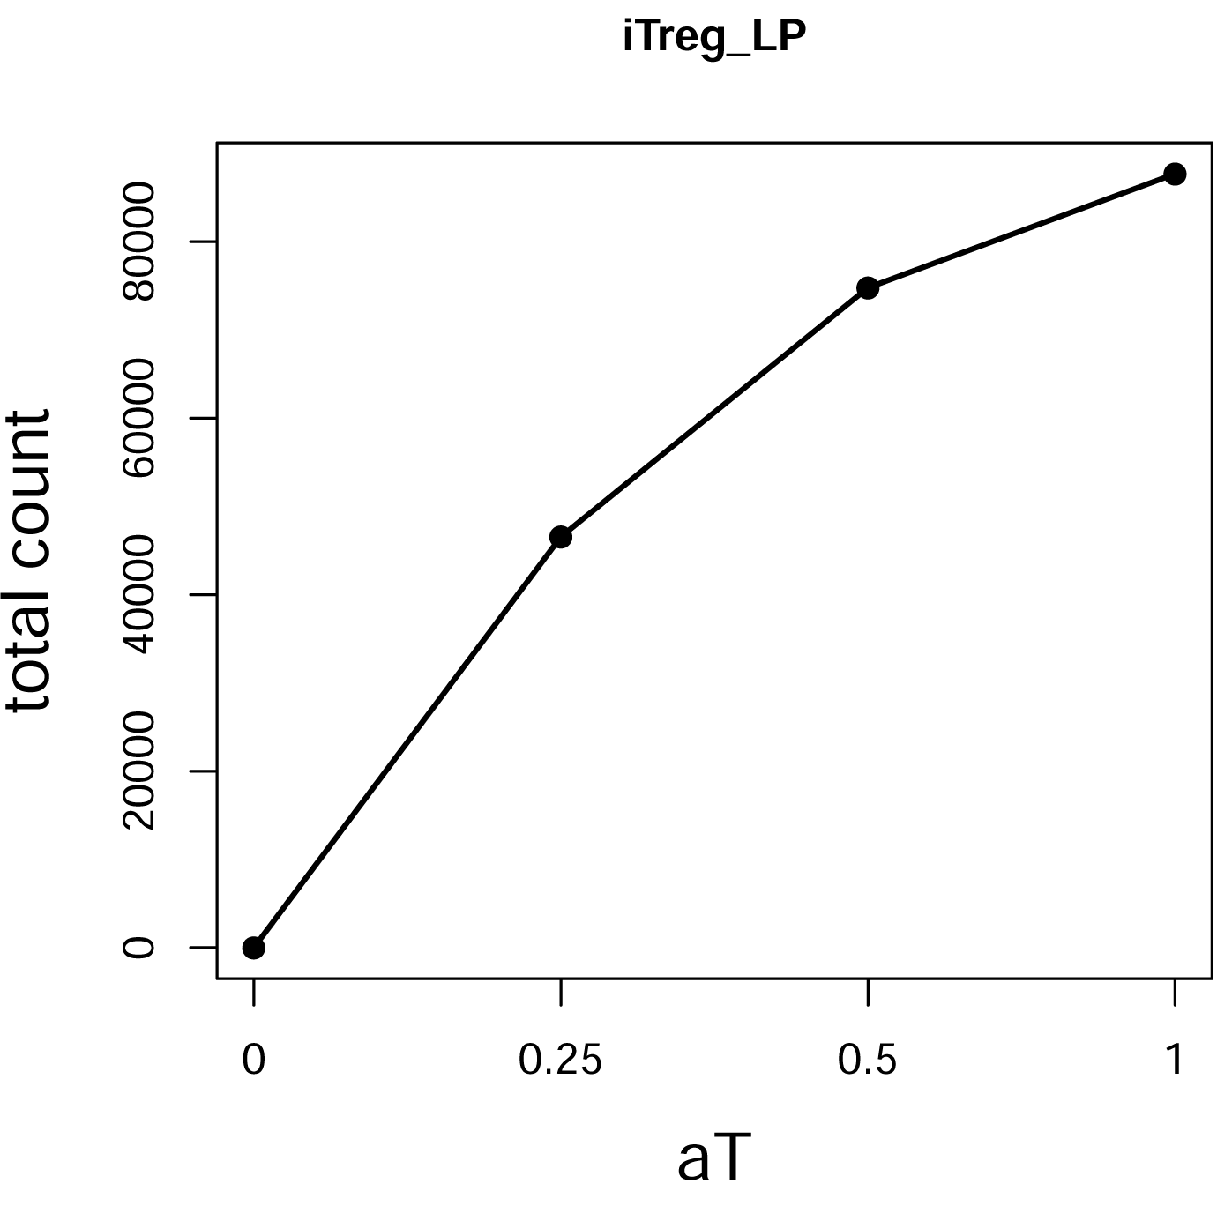
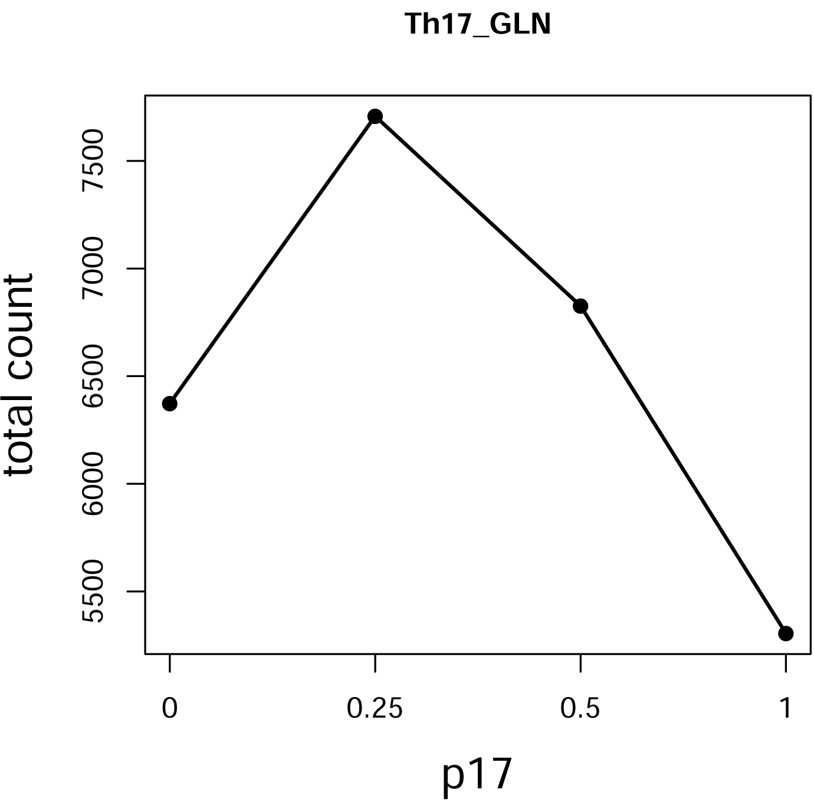
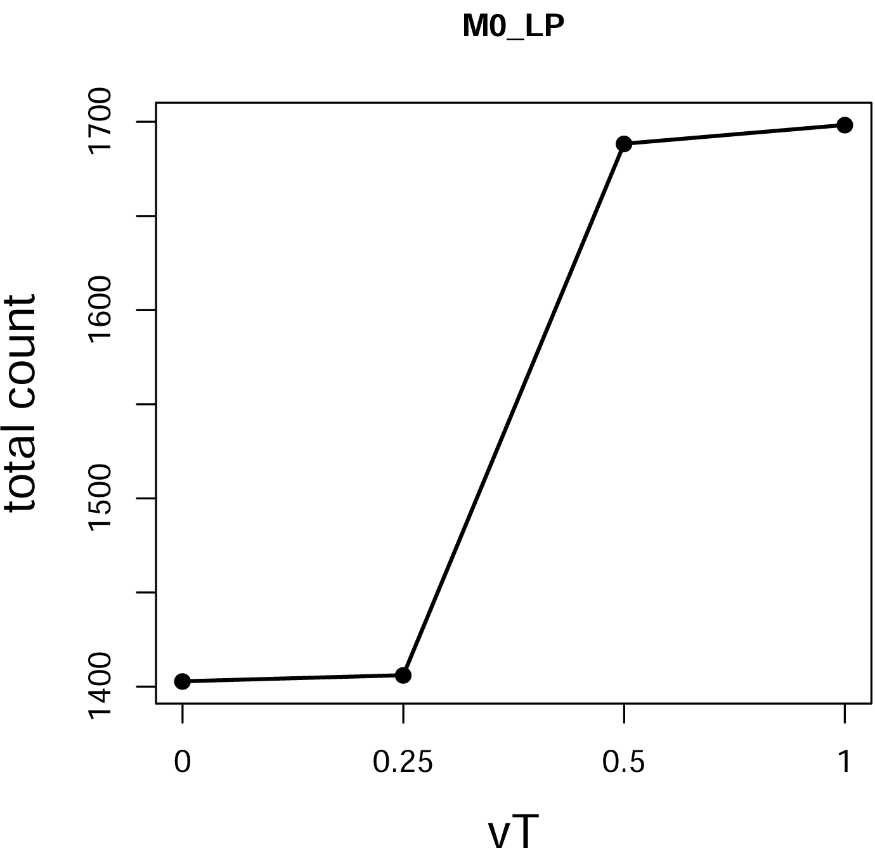
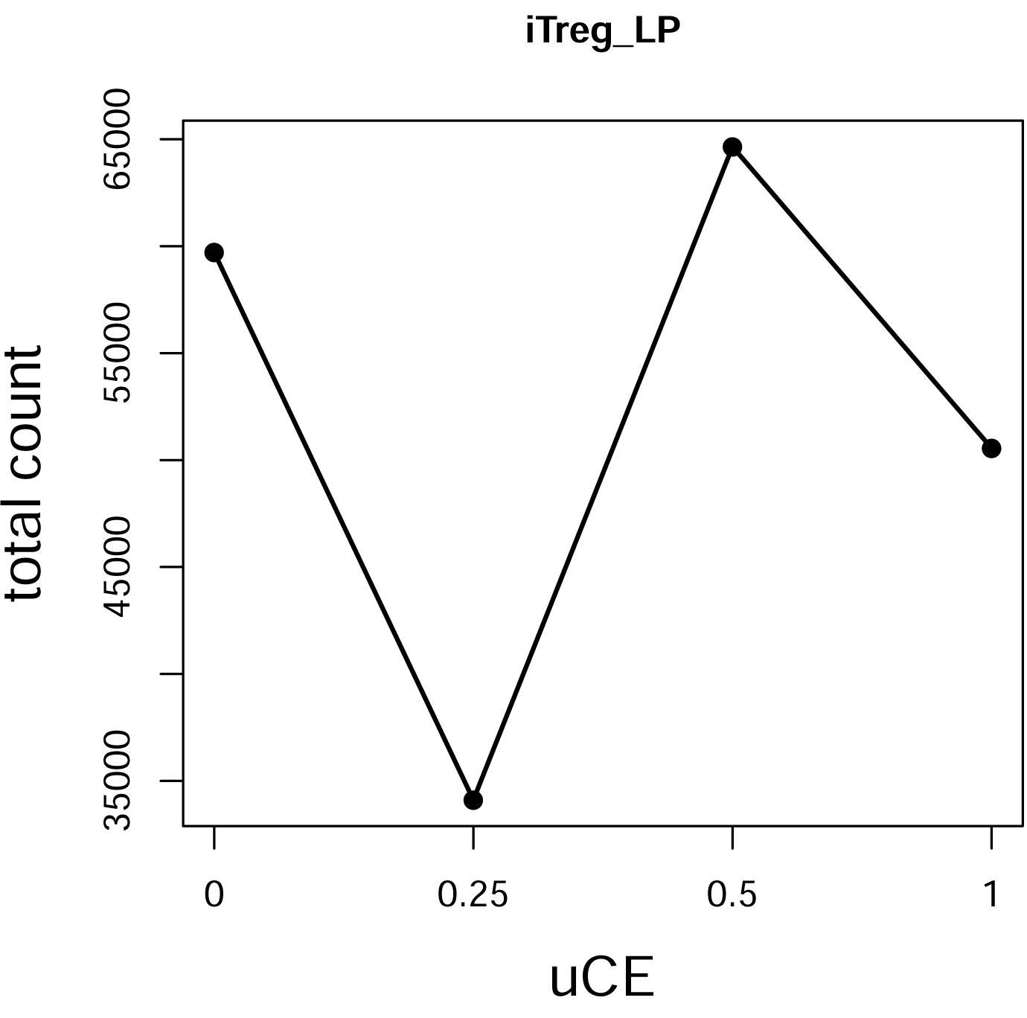
Main Effect Shapes
Monotonic
Bell
Sigmoid
Zig-Zag

Slide 66
Main Effect Shapes
Monotonic:
  Factor have significant linear impact on outcomes
Bell Shaped:
  Impact is coupled with other factors
Sigmoid
  Outcome changes significantly between two parameter values
Zig-Zag:
  Needs further study of the model

Slide 67
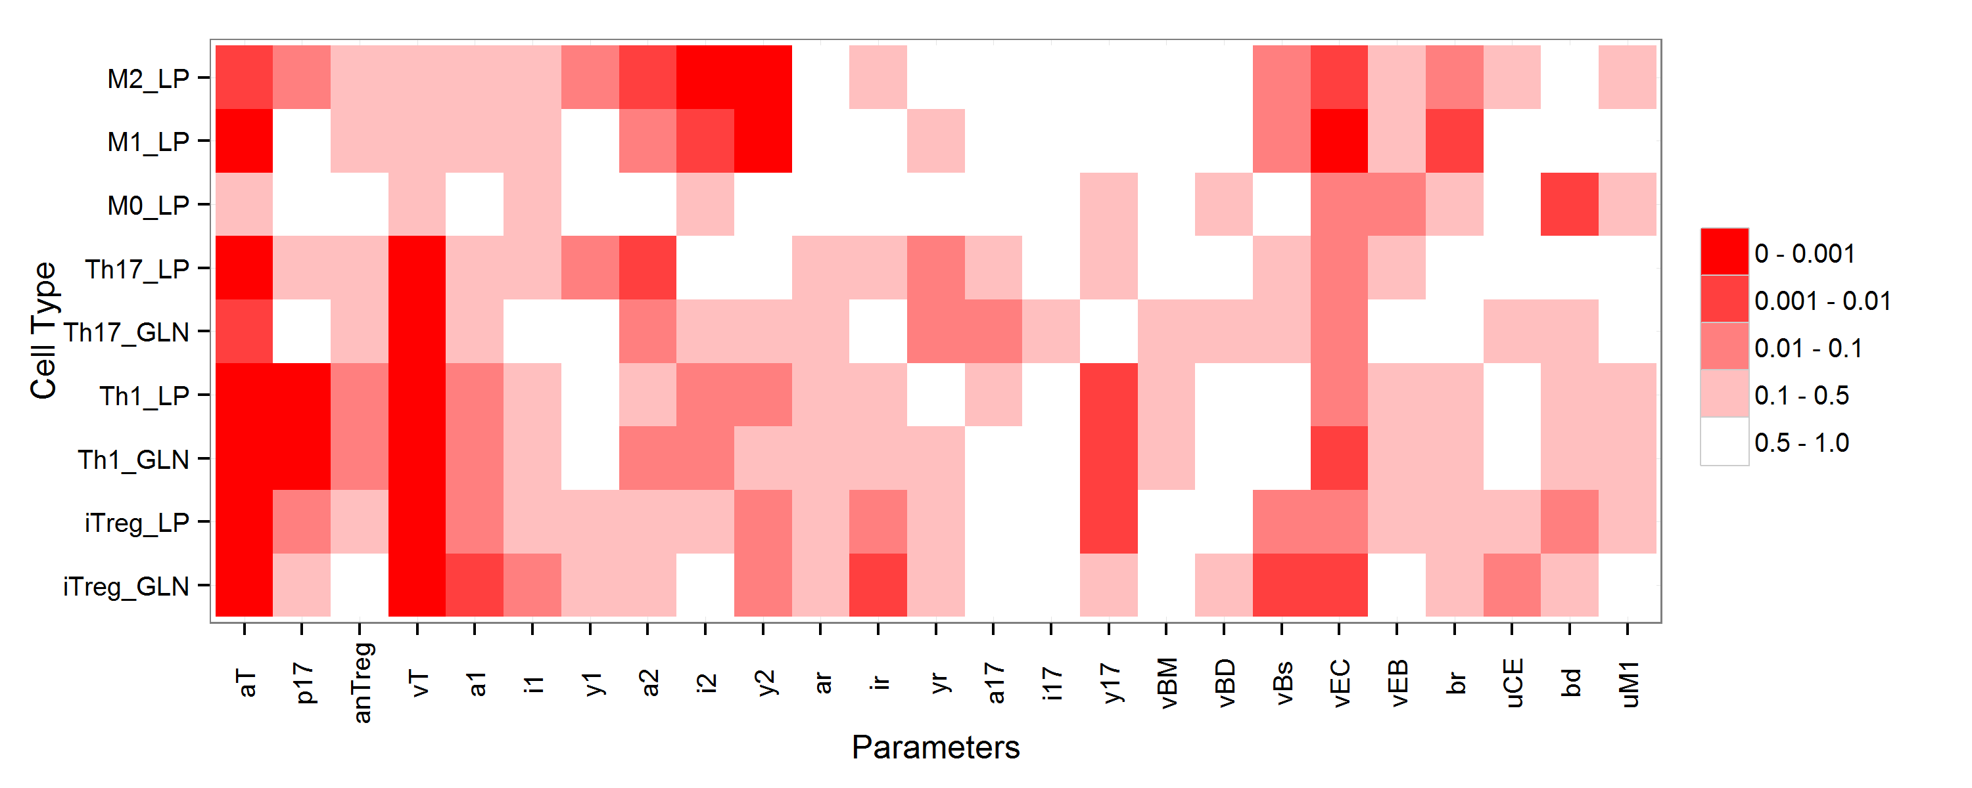
Global Sensitivity Analysis
p-value
The p-values of parameters are calculated by ANOVA
Some parameters (aT, p17, vT, vEC) are more significant than others for all cells
Some parameters (a2, i2, y2, br) are only significant for Macrophages
Notes:
In the x-axis we have the set of parameters. In the y-axis we have the observed output phenotypes. This heat map shows the p-values. The less the p-value, the more significant the factor is.
To determine which parameters are more significant, we perform ANOVA analysis. This gives us an set of parameters which are more significant than others.

Slide 68
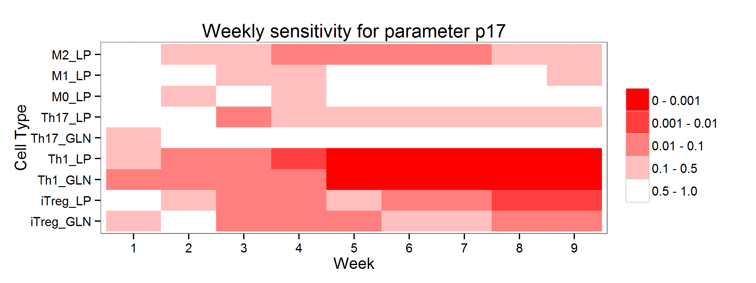
Dynamical Sensitivity Analysis
p-value
We can further analyze the significance of parameters dynamically
The weekly effect of parameter p17 at the stage of infection
This parameter tends to be significant in the later state of infection
Notes:
This particular figure shows the significance of parameter p17 for the 9 observed phenotypes.
p17 is the parameter for Th17 production against Th1. So, more p17 means higher Th17 and less Th1. Hence it has great effect for both of these phenotypes. However, Th17 can alternatively be formed from iTreg and vice verca. So, Th17 production is not entirely dependent on p17. For this reason, p17 is not that much significant for Th17 vs Th1.

Slide 69
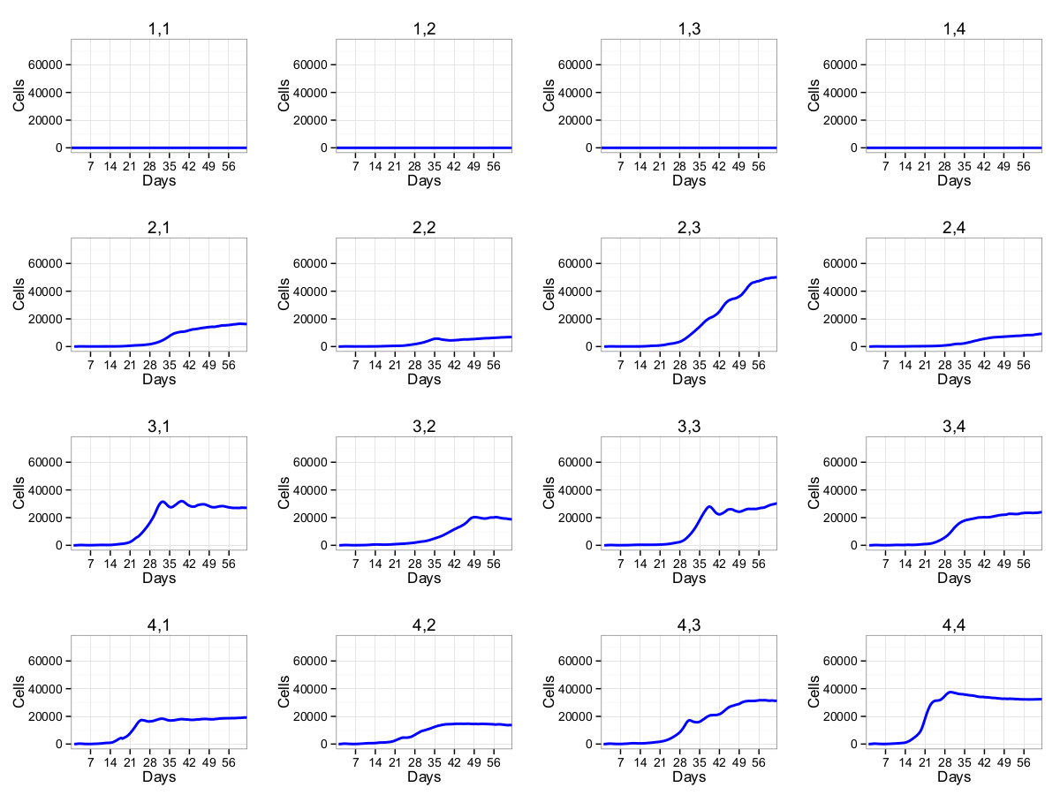
Two-Factor Interaction
p17
L1 L2 L3 L4
aT
L1 L2 L3 L4
Average number of cell for iTreg in GLN
Notes:
The next step will be determining the interaction between parameter values. Here we observe the two-factor interaction between the parameters.

Slide 70
Publications related to ENISI
Carbo A, Hontecillas R, Hoops S, Marathe M, Eubank S, Kronsteiner B, M. Viladomiu M,* Pedragosa M, Y. Mei and Bassaganya-Riera J, Modeling the mechanisms modulating plasticity of CD4+ T cells from a T helper 17 to a regulatory T cell phenotype by PPAR , in PLOS Computational Biology
K. Wendelsdorf, M. Alam, J. Basaganya-Riera, K. Bisset, S. Eubank, R. Hontecillas, S. Hoops, M. Marathe, (2012) Enteric Immunity Simulator: A tool for in-silico study of gastroenteric infections, in IEEE Trans. Nanobioscience, containing selected papers that appeared in Proc. BIBM, 273-288, 11(3), 2012.
Mei Y, Hontecillas R, Zhang X, Bisset K, Eubank S, Hoops S, Marathe M, and Bassaganya-Riera J, ENISI Visual, an agent-based simulator for modeling gut immunity, in 2012 IEEE International Conference on Bioinformatics and Biomedicine (IEEE BIBM 2012).
Bisset K, Alam M, Bassaganya-Riera J, Carbo A, Eubank S, Hontecillas R, Hoops S, Marathe M, Mei Y, Wendelsdorf K, Xie D, and Yeom J (2012), High-Performance Interaction-Based Simulation of Gut Immunopathologies with ENISI, in Proc. 26th IEEE International Parallel & Distributed Processing Symposium, (IPDPS 2012).
Wendelsdorf K, Bassaganya-Riera J, Bisset K, Eubank S, Hontecillas R, and Marathe M. Enteric Immunity SImulator: a large-scale agent-based simulator of mucosal immunity and enteric pathogenesis, IEEE International Conference Bioinformatics and Biomedicine 2011

Slide 71
ENISI MSM: future work
Performant implementations
  Different scales have different requirements on spatial and temporal resolutions
  Efficient performance matching between scales
  High performance computing
Model development with effective data processing, data fusing, and model calibration techniques
  Multiple types of data
  Stochastic data
  Multi-scale models

Slide 72
Other issues, conclusions and outlook

Slide 73
Verification & Validation of MSM
Must be rigorously tested for proper validation
Several challenges:
  Due to distinct spatiotemporal properties and performance requirements of different scales calibration is difficult
  We calibrate the individual scale
  Even though each scale is calibrated, combined multi-scale model might not show expected system level results
  This presents a significant challenge as each scale itself is validated independently
Sensitivity analysis algorithms can play an important role in the calibration process

Slide 74
Concluding remarks
Multiscale modeling techniques in systems biology are important and natural
  Can lead to qualitatively different explanation of the phenomenon
  Lead to a better grasp on what if questions that are the basis of drug discovery and novel therapeutics
In developing such, care must be taken to
  Ensure that the computational costs of the combined models are reasonable
  A clear strategy for integrating these models needs to be developed keep in mind issues of scale, computational costs and correctness
  Sensitivity analysis and uncertainty quantification become challenging problems
  Many parameters might need to be estimated in the short run.

Slide 75
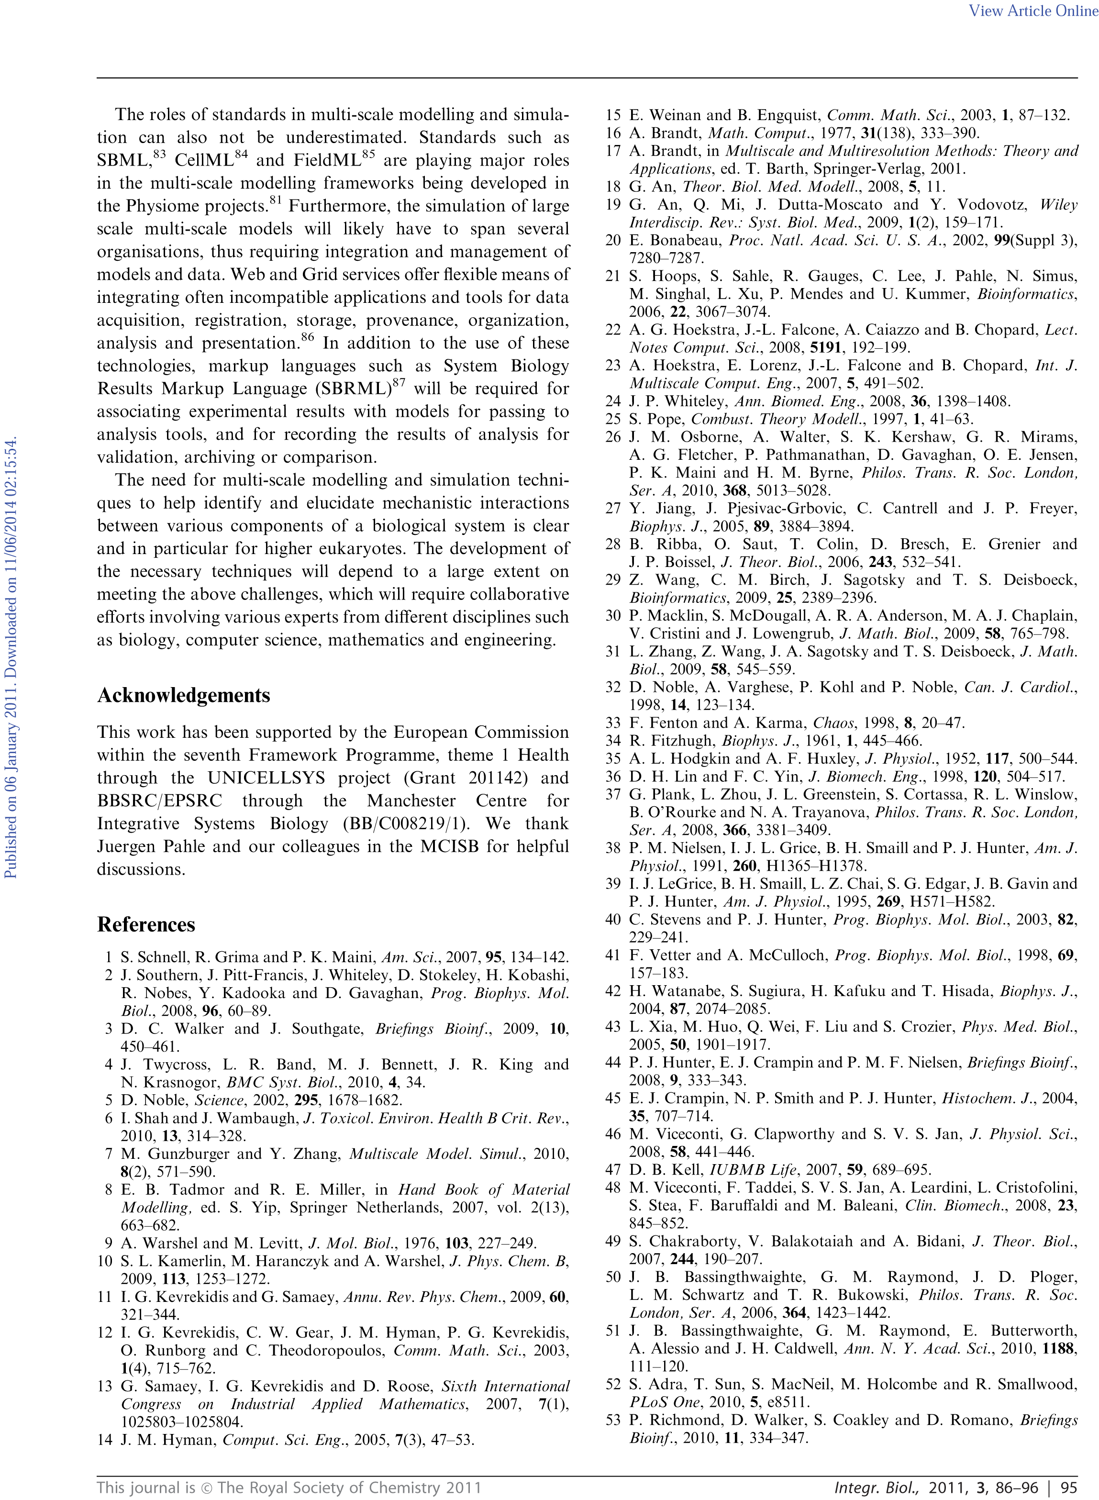
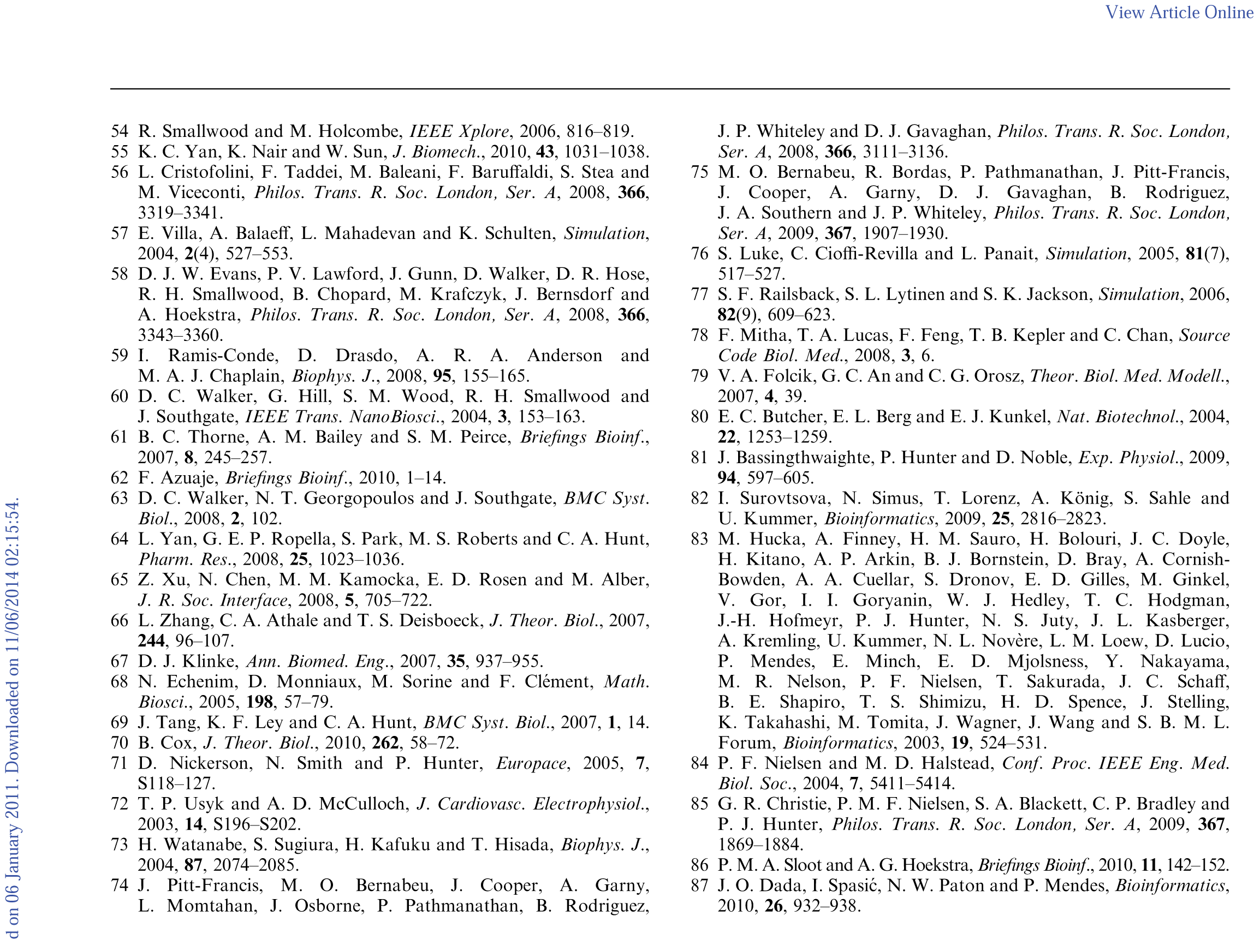
References

Slide 76
Backup Slides

Slide 77
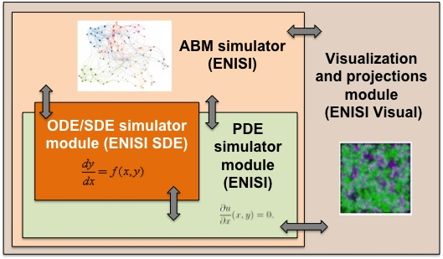
MSM System Architecture

Slide 78
ENISI MSM: initial implementation
Core: Repast Symphony, a java based simulation platform
Programming technology: object-oriented with Java, Java language bindings and libraries
Tissue: one class for continuous and one class for grid (discrete) projections
Cells: one class for each cell type and the class changes states when the cell changes its subsets (phenotypes)
Cytokines: one Java class for each cytokine diffusing following PDEs in the discrete projection space
ODE models: one class for each ODE model such as the CD4+ T Cell differentiation model

Slide 79
Initial implementation (cont.)
Each simulation tick:
A cell object first interacts with
  Cytokine objects to get their concentrations
  Projection objects to get neighbor cells
  ODE model object to calculate intracellular pathway reactions
The cell object then
  Move according to its movement schedule
  Change its phenotype
  Secrete cytokines into the environment
The projection objects will update with the cells’ new locations
The cytokines will update its concentration distributions using PDEs with constant diffusing and degrading rates

Slide 80
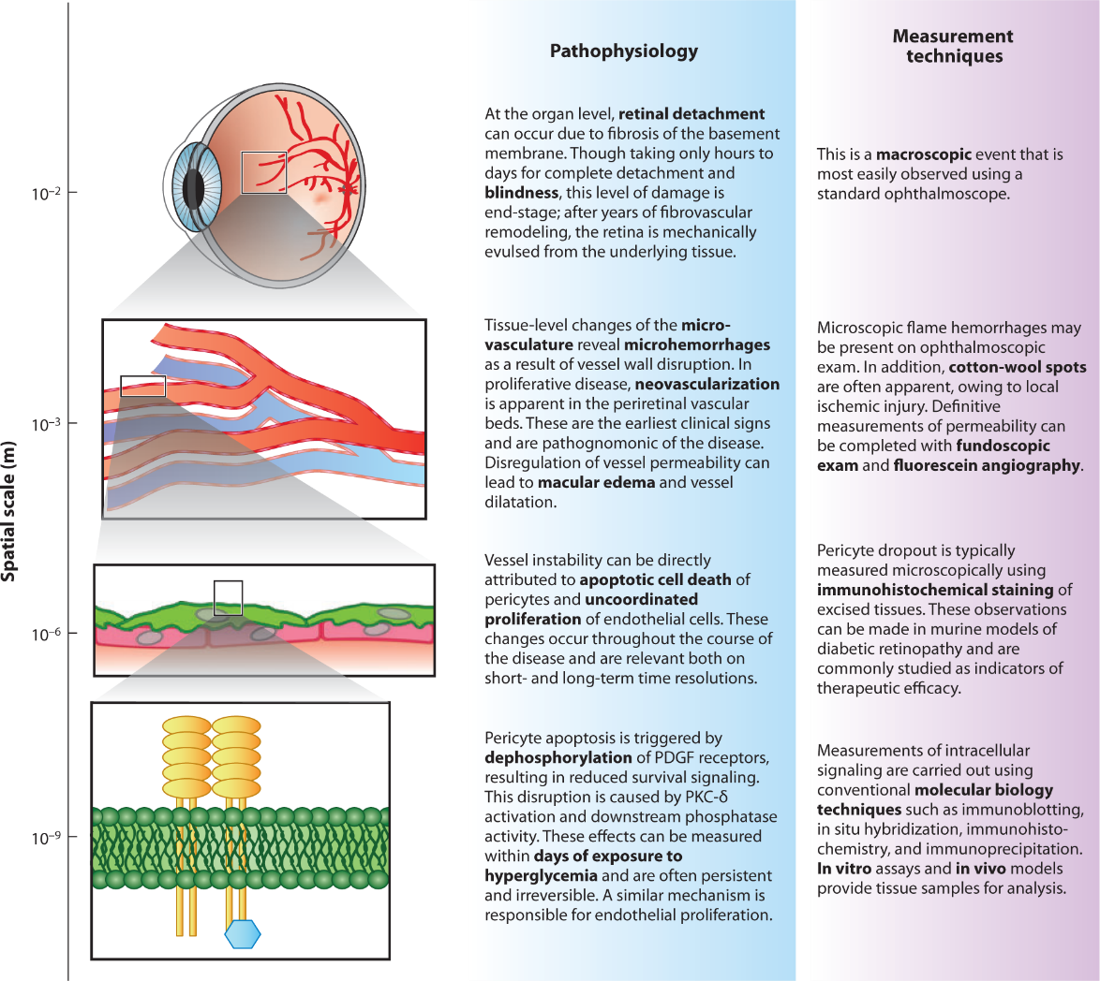
[Walpole’13]

Slide 81
Continuous modeling techniques
Assumes continuous scales
Notable techniques:
  Network Analysis
  Finite Element Method & Finite Volume Method
  Differential Equations (ODE and PDE)
  Constraint-based Methods
Used for:
  Chemical reactions
  Molecular binding
  Diffusion
Notes:
The continuum strategy usually expresses the relationship between system properties in form of continuous mathematical
equations, which are then solved numerically under a range of conditions. These equations are most often a mean-field
approximation that summarizes the result of the interactions at the lower level into an equation at the higher level.

Slide 82
Discrete modeling techniques
Scales are thought to be discrete
Notable techniques:
  Agent Based Modeling (ABM)
  State-based Boolean networks
  Markov chains
Used for:
  Modeling heterogeneous systems
  Compartmentalized or spatially defined systems

Slide 83
What issues should I consider when designing multi-scale modeling
Balance detail and computational complexity
Homogeneity within a scale
Heterogeneous materials are more difficult to model, and motivate the need for multi-scale models
Do simplifications that reflect biomedical understanding
Scientific modeling is an art and a research program. Expect creativity, not pat solutions.

Slide 84
An ODE Based approach
Replenishment rate
Rate of contact with bactieria
Regulatory M2 in tissue
Rate of M1 to M2
Rate of conversion to M1

Slide 85
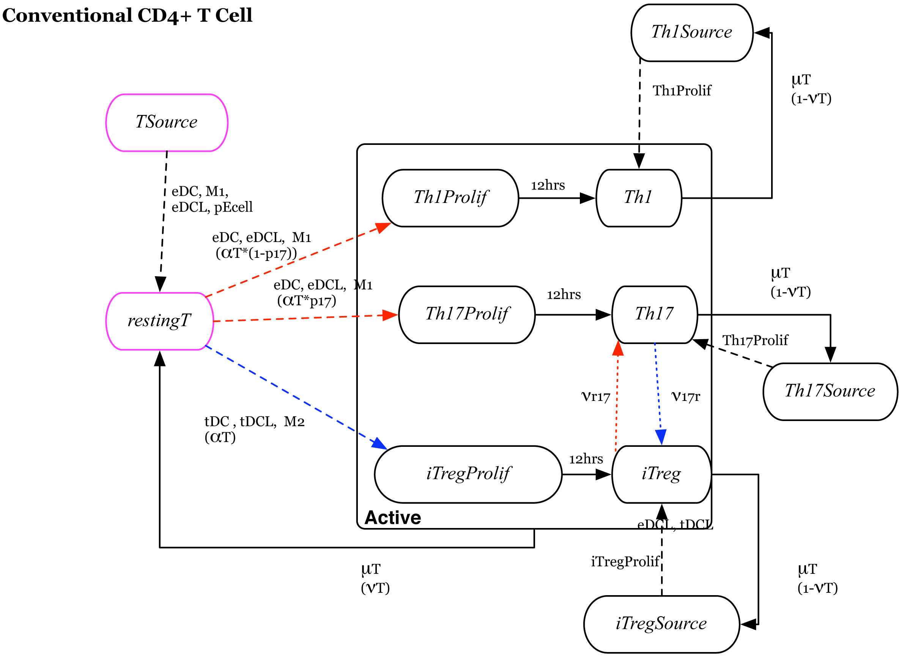
Immunological Network
Red cells participate in inflammatory response
Blue cells participate in regulatory response
Green cells participate in either response
Cells are compartmentalized.
Notes:
The immunological network of an agent based model for H. pylori infection is shown here. Oval boxes represent cells and arrows represent interactions between cells. The interaction might be differentiation, location change, or cellular death. Each cell is represented by a cellular automaton.
Generally the states of the automata are called phenotypes in biological literature. Note that not all states represents actual phenotypes, some are used for the modeling purposes with no direct representation but indirectly related.
State transitions represents differentiation, death, recruitment, migration etc. State transition may also be probabilistic, time dependent and contact dependent. For example, here CD4+ T cells are shown. The significant states are resting, Th1, Th17, iTreg. Other states are needed for modeling purpose.

Slide 86
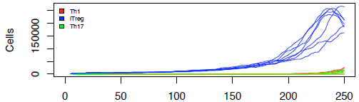
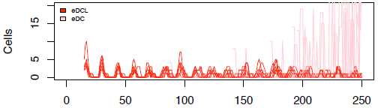
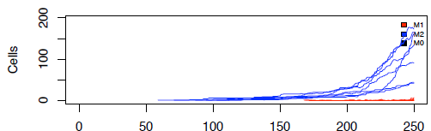
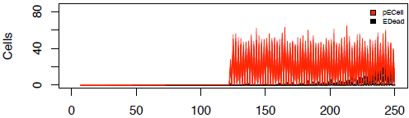
Example: H. Pylori 26695 Pathogenicity
Observations:
  Undetectable level of immune response before day 30.
  By day 60 significant increase in T-cells, M2 macrophages and effector & tolerogenic dendritic cells.
  This increase is due to mounted epithelial cell damage.
  Investigate the pathway that causes this damage.
T-cells
eDC
Macrophages
Epithelial cells
Notes:
So, first we track which is contributing the epithelial cell damage. Then we track the pathway which is the main cause of the problem. We observe that the rise of Th1 cells and Macrophases and eDC are due to epithelial cell damage. Next we investigate the cause of Ecell -> pECell

Slide 87
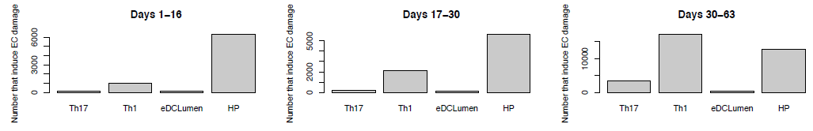
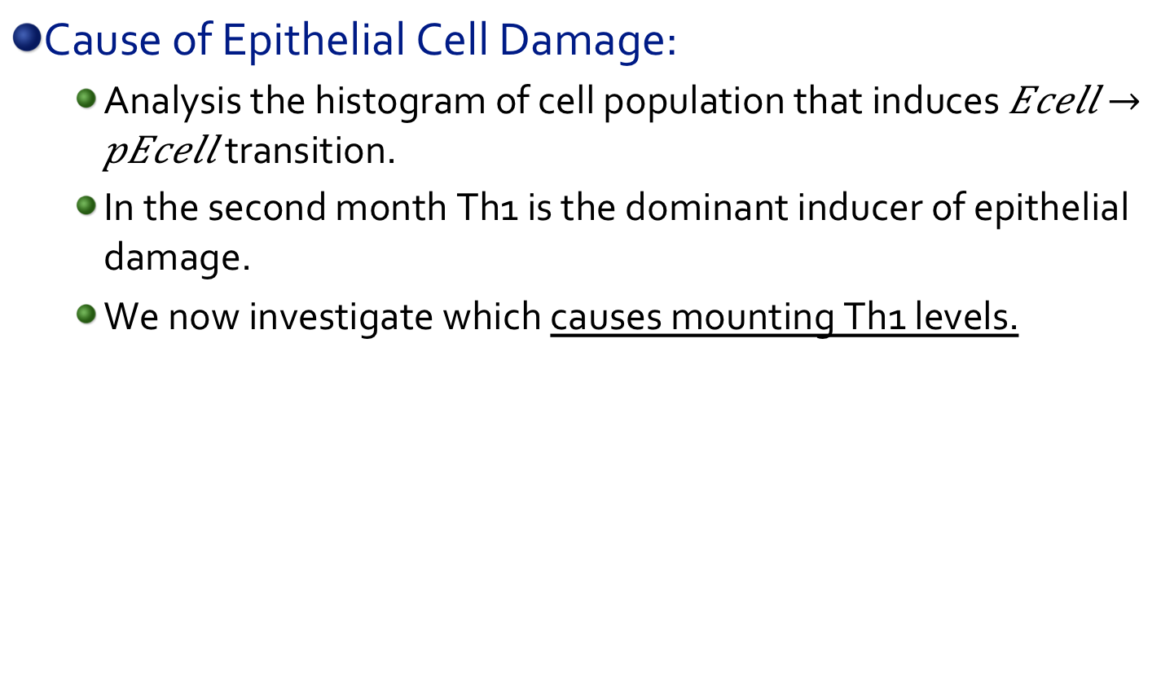
Example: H. Pylori 26695 Pathogenicity
Cause of Epithelial Cell Damage:
  Analysis the histogram of cell population that induces $Ecell → pEcell$ transition.
  In the second month Th1 is the dominant inducer of epithelial damage.
  We now investigate which causes mounting Th1 levels.
Th1
Inducer cells that cause Epithelial Cell Damage
Notes:
So, our main goal is to find the cause of Epithelial cell damage observed.

Slide 88
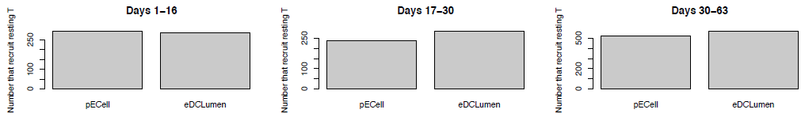
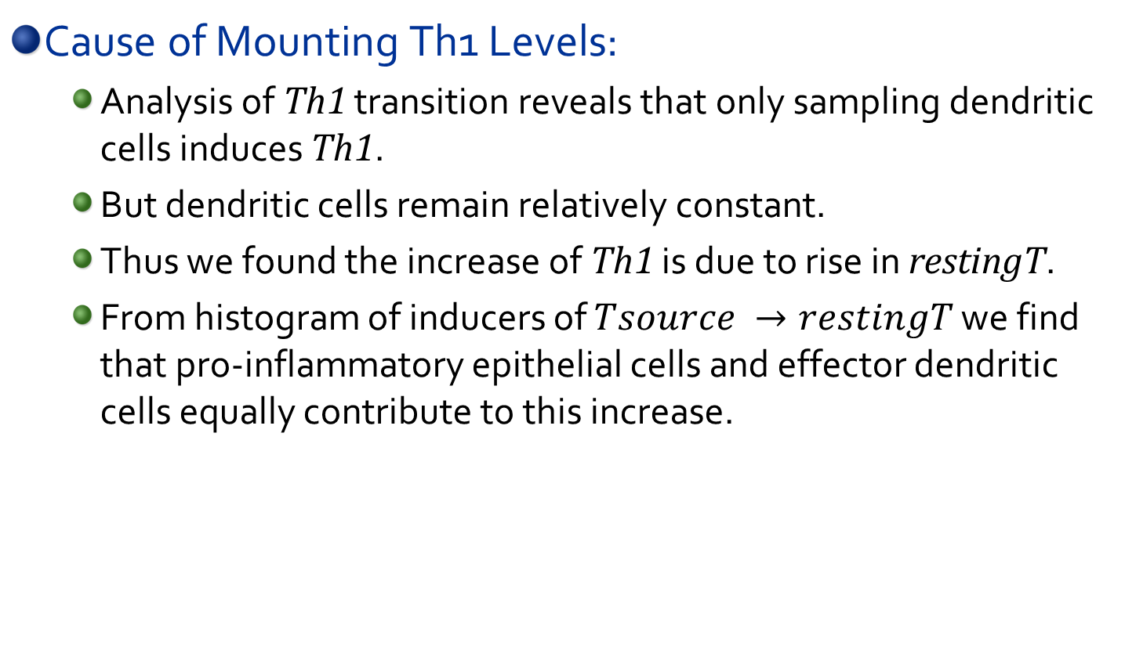
Example: H. Pylori 26695 Pathogenicity
Cause of Mounting Th1 Levels:
  Analysis of Th1 transition reveals that only sampling dendritic cells induces Th1.
  But dendritic cells remain relatively constant.
  Thus we found the increase of Th1 is due to rise in restingT.
  From histogram of inducers of $Tsource →restingT$ we find that pro-inflammatory epithelial cells and effector dendritic cells equally contribute to this increase.
Th1
Inducer cells that recruits T cells
Notes:
So, we found there is an increase of Th1 cells which was casing the epithelial cell damage. But which is causing the increase of Th1 cells. We investigate the transitions of Th1. We found that sampling dendritic cells are the contributor for generating Th1 cells. But the sampling dendritic cell level are more/less similar level during the simulation. Hence, there must be an increase in restingT cells which then make transition into Th1. So, we now investigate which is causing the increase of restingT cells. Analysis reveals that restingT cells are induced by pro-inflammatory Epithelial cells and effector dendritic cells equally. The presence of pro-inflammatory epithelial cells contribute to a positive feedback loop, as more Th1 means more epithelial cell damage and more Th1 by turns.

