Slide 1
Mathematical and Computational Modeling of Epithelial Cell Networks
Casandra Philipson
Computational Immunology PhD Student @ MIEP
June 11, 2014

Slide 2
Computational strategies for network inference and modeling
Data → network
Data → calibration

Slide 3
Overview
Generating a model
  network
  data
  mathematics
Fitting parameters
Asking questions with
your model

Slide 4
Overview
Generating a model
  network
  data
  mathematics
Fitting parameters
Asking questions with
your model
Epithelial Barrier Integrity
Intracellular Networks
Epithelial Cell Plasticity

Slide 5
Generating a Model: Network
Theoretical
  reactions in model driven by “facts”
  canonical interactions
  time consuming (literature searching)
Data driven
  use tools to identify interactions specific to your data
Hybrid
  i.e. IPA top canonical pathway hits

Slide 6
Generating a Model: Network
Theoretical
  reactions in model driven by “facts”
  canonical interactions
  time consuming (literature searching)
Data driven
  use tools to identify interactions specific to your experimental data
Hybrid
  i.e. IPA top canonical pathway hits

Slide 7
Generating a Model: Network
Theoretical
  reactions in model driven by “facts”
  canonical interactions
  time consuming (literature searching)
Data driven
  use tools to identify interactions specific to your experimental data
Hybrid
  i.e. IPA top canonical pathway hits +/- hypotheses

Slide 8
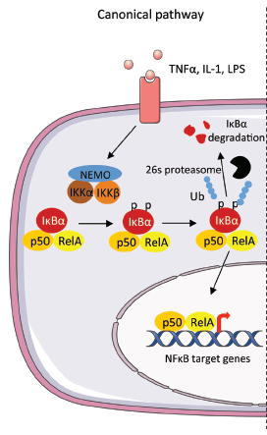
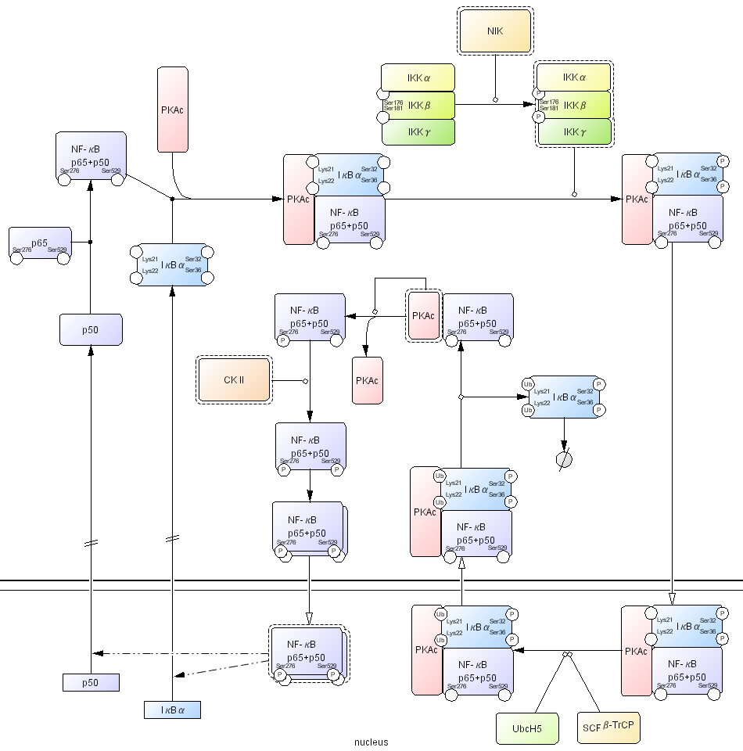
Canonical Pathway
CellDesigner Pathway

Slide 9
Canonical Pathway
CellDesigner Pathway
what kind of data is available?

Slide 10
Generating a Model: Data
Quantitative & qualitative
  if you can estimate values/trends, try it out!
Time course & Steady state
In house data
Literature
Public Repositories
  GeneExpressionOmnibus (GEO)
Consider published models

Slide 11
Generating a Model: Data
Quantitative & qualitative
  if you can estimate values/trends, try it out!
Time course & Steady state
In house data
Literature
Public Repositories
  GeneExpressionOmnibus (GEO)
Consider published models

Slide 12
Generating a Model: Mathematics
COPASI
  assign functions that characterize & simulate your trajectories

Slide 13
Generating a Model: Mathematics
COPASI
  assign functions that characterize & simulate your trajectories
If you have questions about:
How your data can be used to generate a network, for calibration, to generating modeling questions
What types of reactions may work best for your model
please ask us!

Slide 14
Epithelial Barrier Integrity

Slide 15
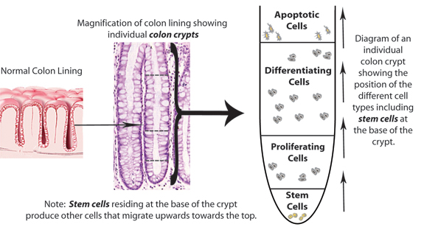
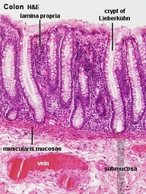
Dynamic Integrity
Proliferation, differentiation & movement
Notes:
5x10^10 cells in the colon!

Slide 16
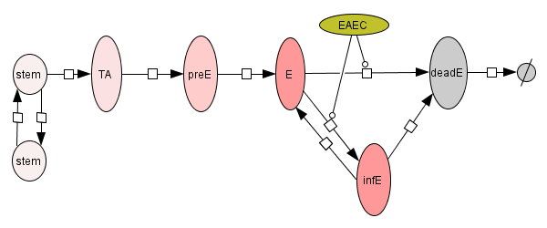
Modeling Colonic Crypts

Slide 17
Differential Equations
dStem
= stem
dt
dTA
= stem*r1 – preE*r2
dt
dpreE
= preE*r2 – E*r3
dt
dE
= E*r3 – deadE*r4
dt
ddeadE
= deadE*r4 – deadE*r5
dt

Slide 18
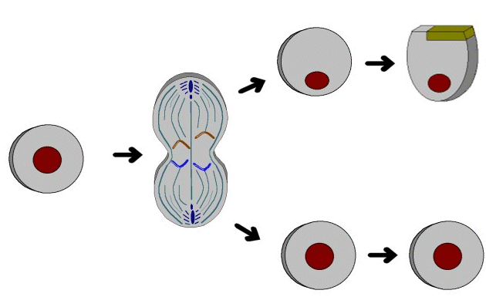
Biological Conditions
Stem cells are a self-renewing population constantly available
Divide asymmetrically to produce one transient amplifying cell (TA) per proliferative cycle
and
TA
Renewal
Approximately 4 ancestral stem cells exist per crypt

Slide 19
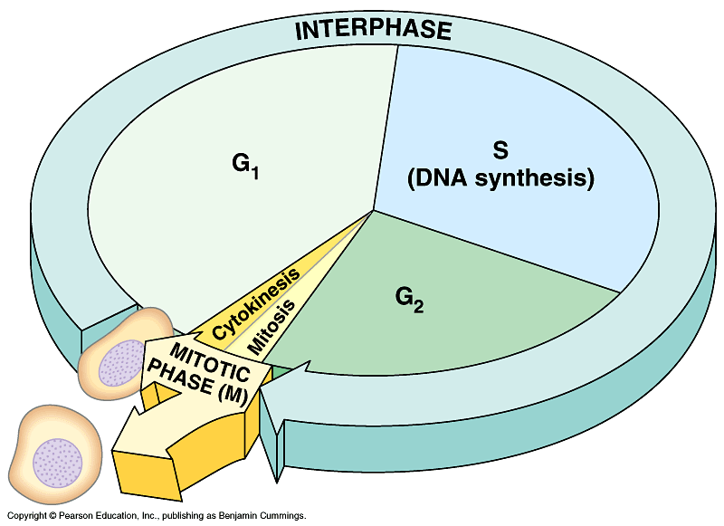
Biological Conditions
Stem cells proliferation takes approximately 24 hours

Slide 20
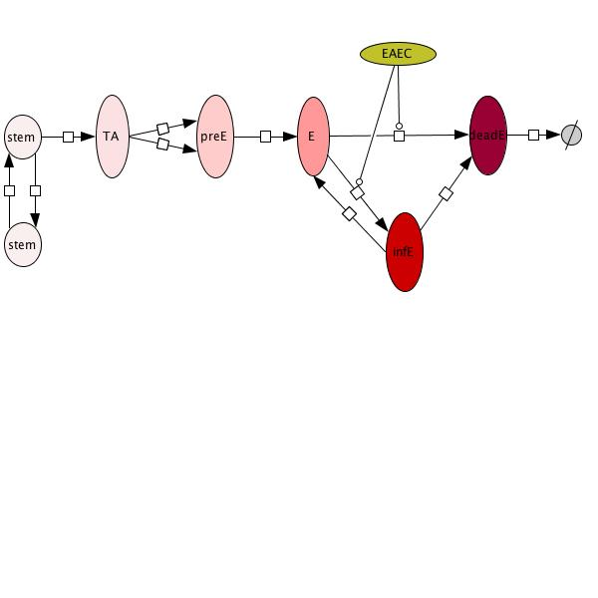
Stem cell proliferation (r1)
One stem to one TA in 24 hours :
TA = Stem# * r1
r1
1 TA cell
1 Stem cell * 1 day
r1 =
= 1

Slide 21
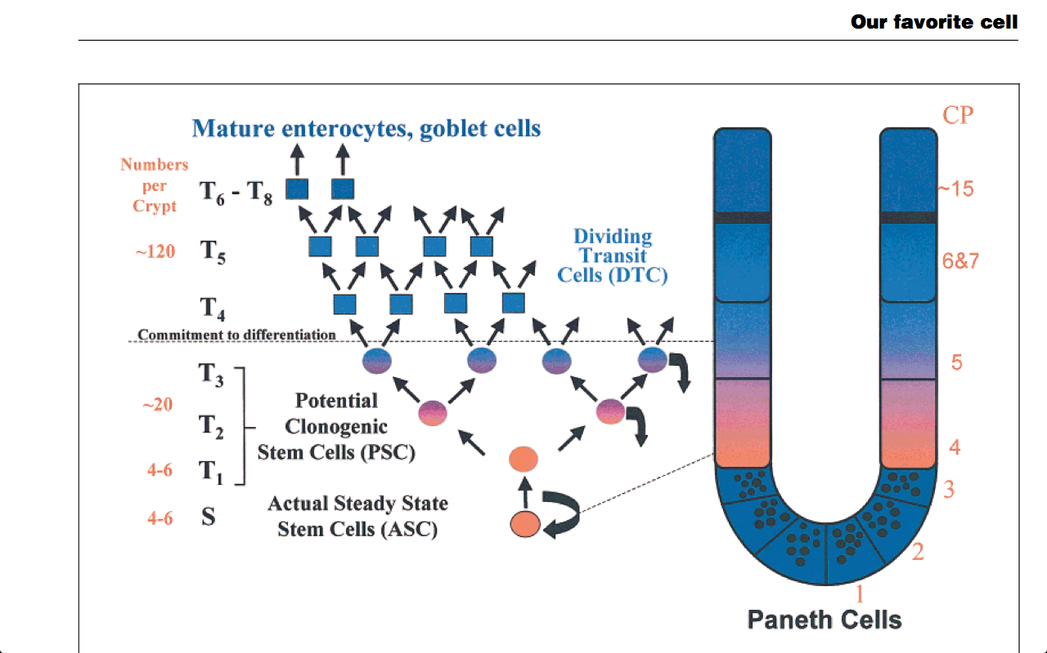
Biological Conditions
TA cells double when they divide and give rise to 7 total generations
Doubling time is equal for all divisions
Generations 4 to 7 are progenitor cells committed to differentiation into E
Marchman et al BioEssays 2002

Slide 22
TA cell proliferation (r2)
TA cells can replicate at unusually rapid rates…
up to 10 times per 24 hours!
Normal : 6 divisions per 24 hours =
7 generations (G)
preE = + TA * r2
r2 = 2 ^{t/d} = 2^{20/4} = 2⁵
r2 = doubling from G2 to G6
r2
TA = G1
preE = G7
t = time spend doubling = #divisions*time = 5 * 4h = 20
d = doubling rate = 4 hours

Slide 23
Epithelial cell differentiation (r3)
All committed progenitors will differentiate into epithelial cells in approximately 2 days
E = + preE * r3
r3
1 Epithelial cell
1 preE * 2 days
r3 =
= 0.5

Slide 24
Epithelial cell apoptosis (r4)
Epithelial cells live for approximately 5 days and then undergo apoptosis.
All dead epithelial cells are exfoliated and shed in the stool
deadE = + E * r4
r4
r5
1 deadE
1 Epithelial * 5 days
r4 =
= 0.2
r5 = 1

Slide 25
Epithelial Barrier Steady State
= 4
= 4
= 256
= 640
= 128

Slide 26
EAEC epithelial barrier model
In silico Infection Simulation
time 0 infection

Slide 27
Intracellular Networks

Slide 28
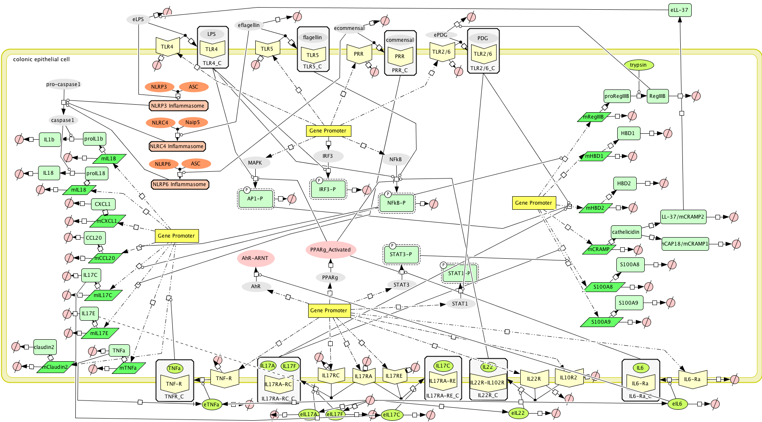
Intracellular Epithelial Model
~75 species & ~85 reactions

Slide 29
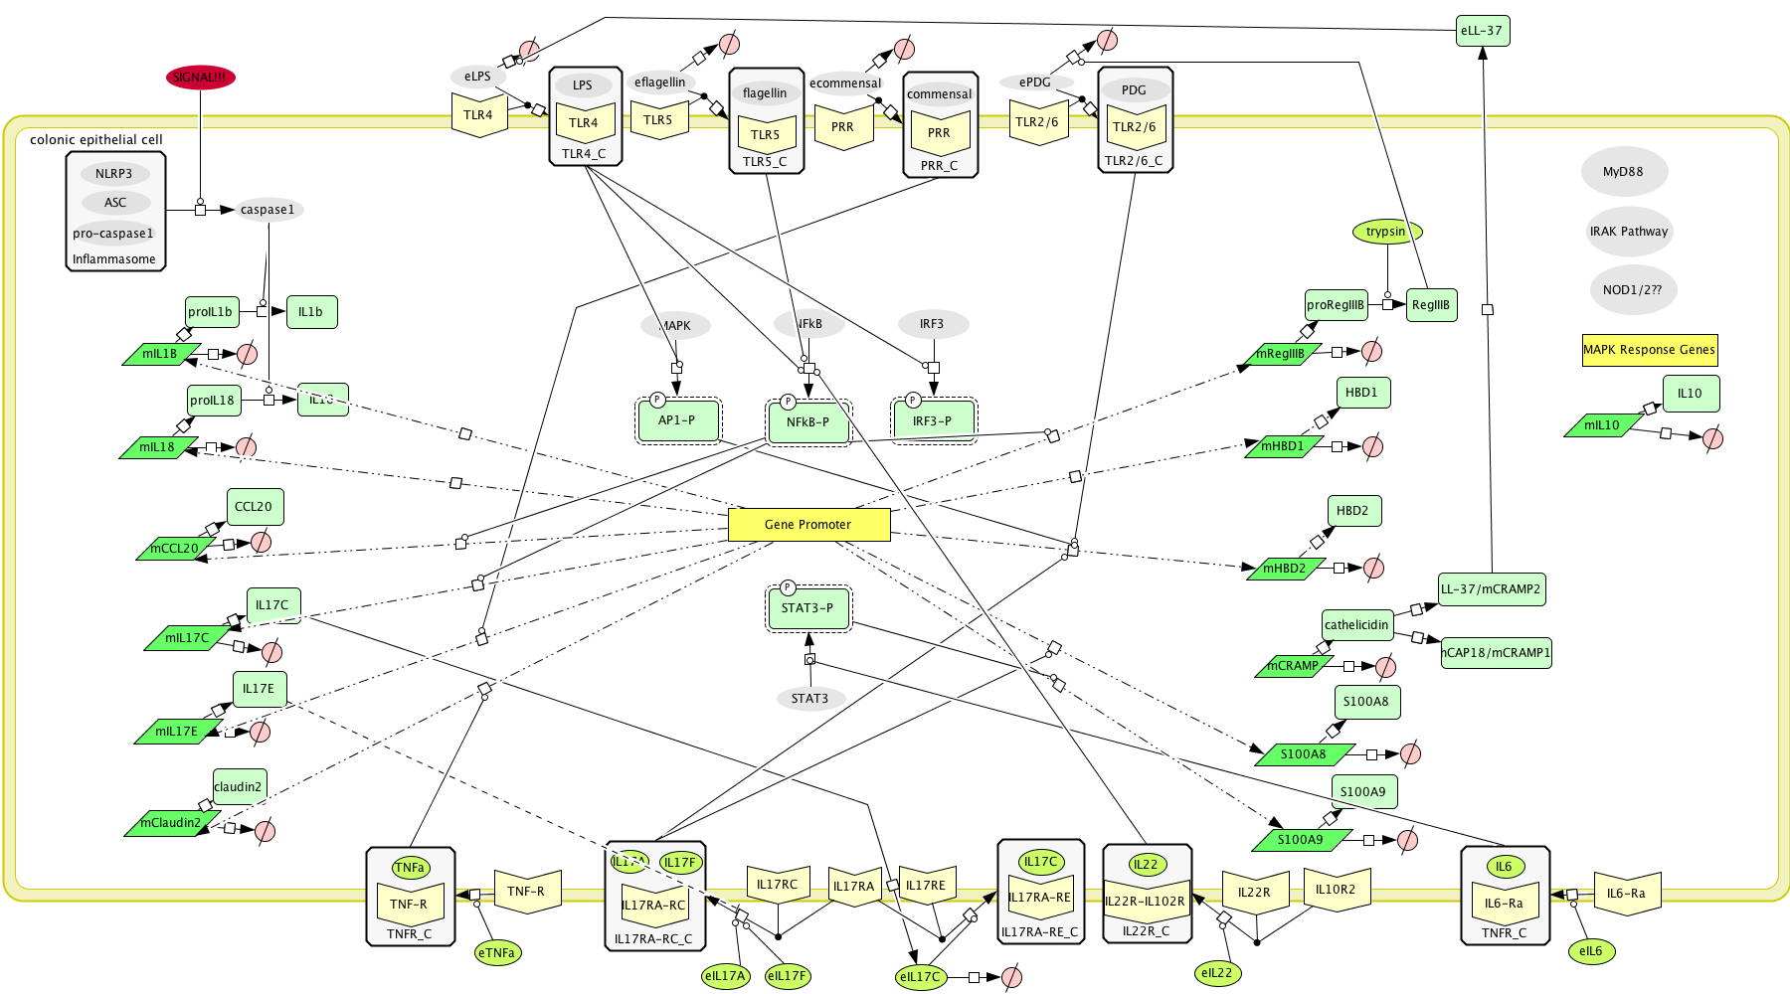
TLR Signaling
focused on TLR4 & 5 for EAEC

Slide 30
Cytokine Receptor Signaling
TNF
IL17 Family
IL22
IL6

Slide 31
Cytokines
Integrity Proteins
NLR Proteins
Inflammasome Components
Transcription and translation reactions
Allows for miRNA interactions
Incorporate mRNA degragation

Slide 32
Antimicrobial Peptides

Slide 33
Modeling Considerations
large network…
(is there data to calibrate?)

Slide 34
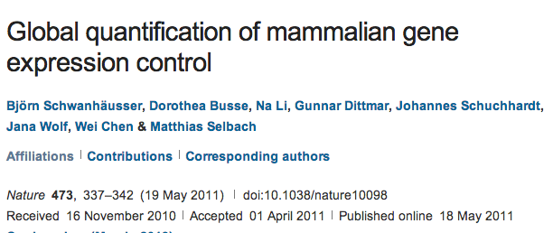
Modeling Considerations
large network…
(is there data to calibrate?)
“mRNA transcription rates are relatively uniform”
(is this actually true?)
“protein translation is similar for functionally similar proteins”
(how similar…? can we use different cell types to develop a calibration DB?)
doi:10.1038/nature10098

Slide 35
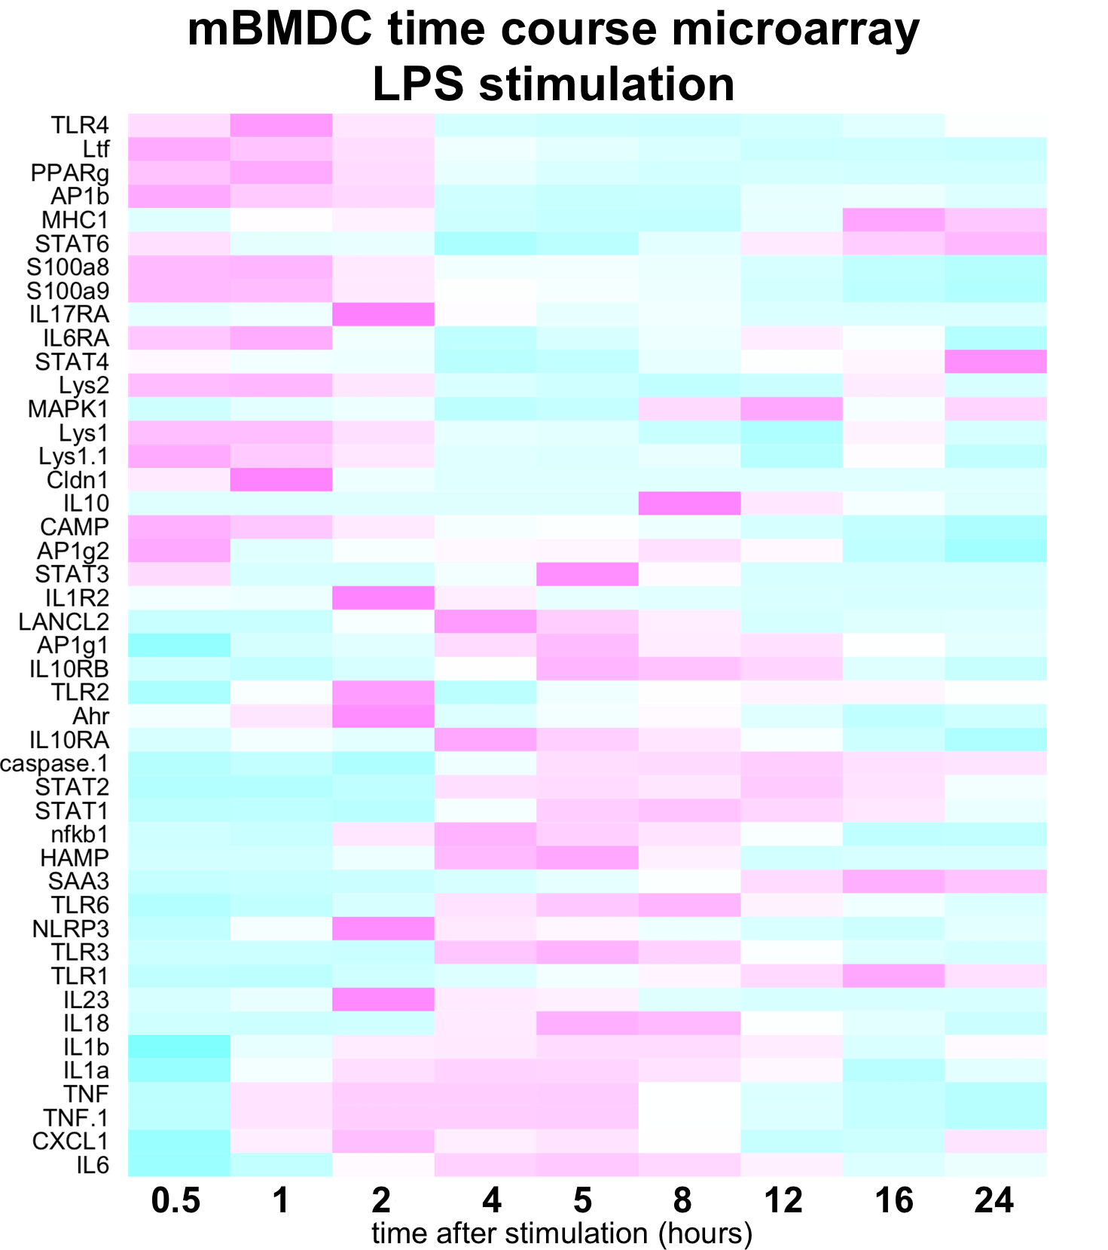
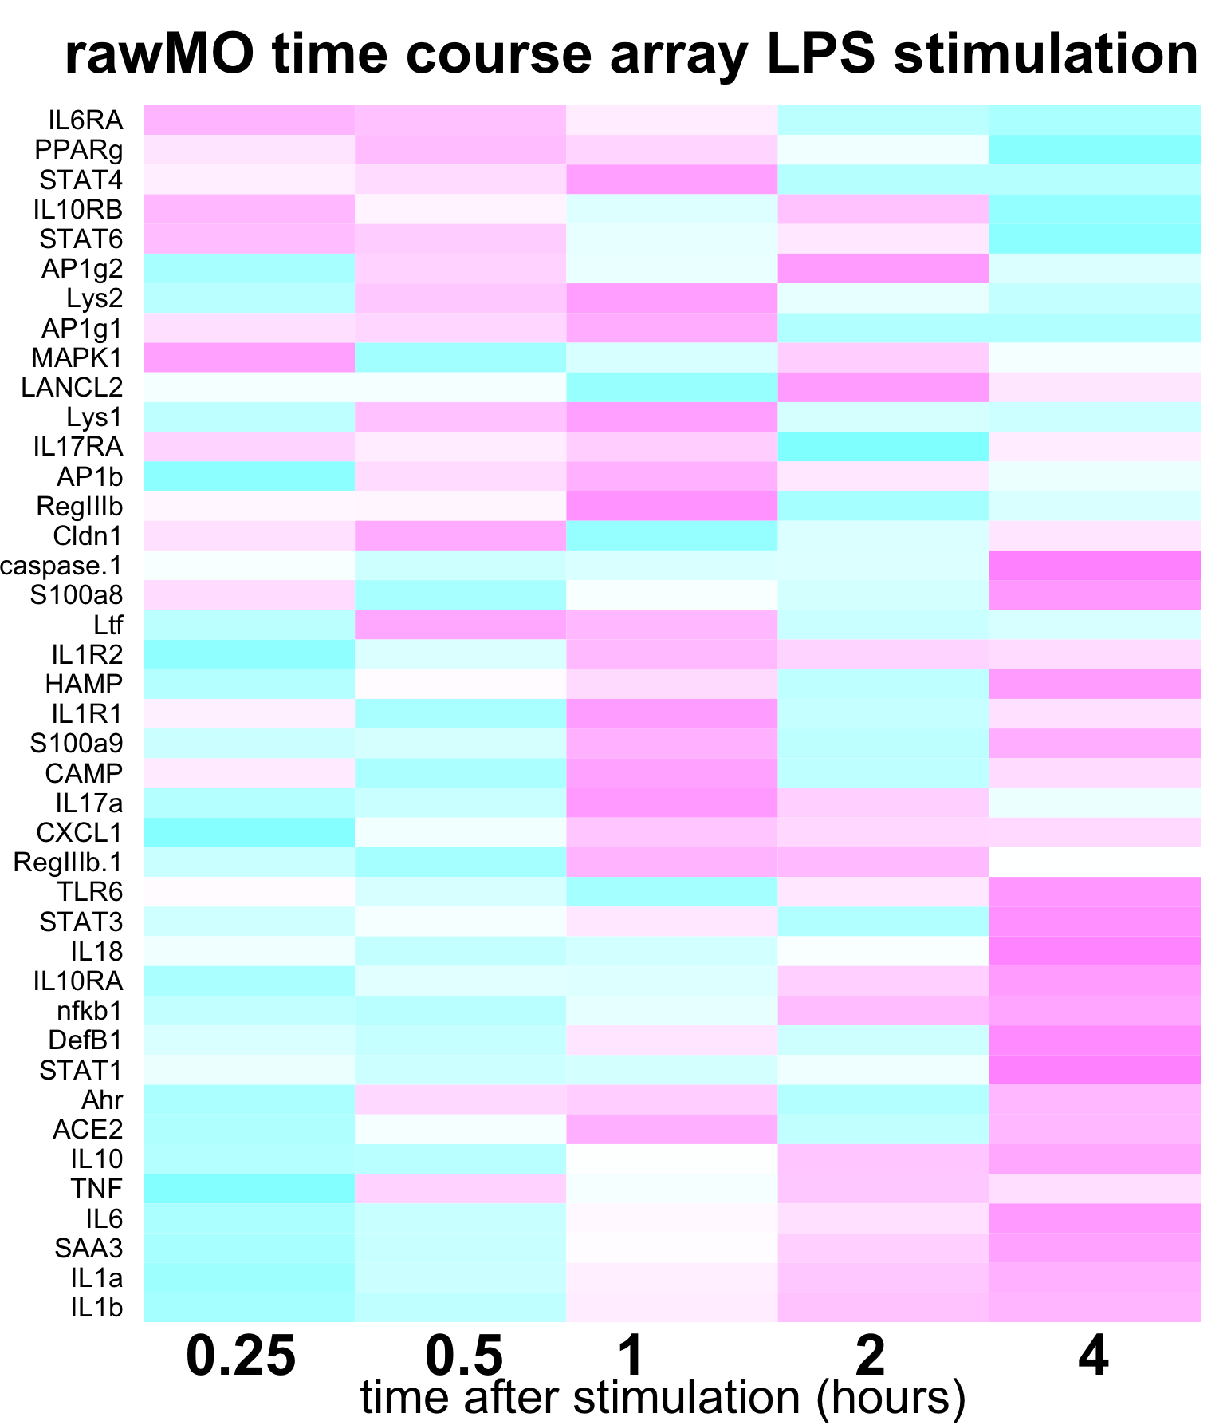
Data Mining – GEO Database

Slide 36
Data Mining – GEO Database

Slide 37
Intracellular Model Fitting

Slide 38
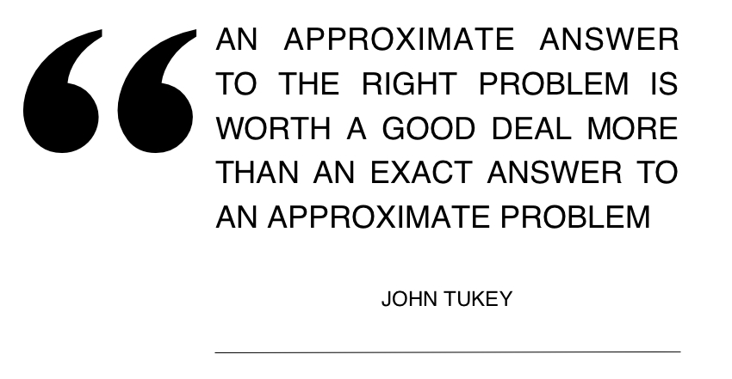
Notes:
interested in multiscale modeling between IEC and CD4 t cell
especially in the context of NLRs…

Slide 39
Modeling Questions
How do alterations in IEC NLR functionality alter T cell differentiation?
  Multiscale Modeling
  IL6, TGF, IL1B combinations
Intracellular Epithelial Cell Model
NLR over & under expression
T cell differentiation Model
T cell population model (ABM)

Slide 40
Modeling Questions
How do T cell phenotypes regulate antimicrobial peptide production from IECs?
    Different T cell phenotypes
    Multiscale Modeling
Intracellular Epithelial Cell Model
T cell differentiation Model
Th1, Th17, Treg

Slide 41
Epithelial Cell Plasticity

Slide 42
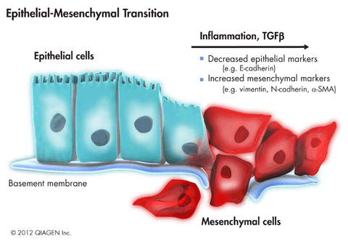
Epithelial-Mesenchymal Transition
EMT: dynamic process whereby epithelial cells undergo phenotypic conversion & become migratory
  Normal during embryogenesis & tissue remodeling
  Governed by a complex microenvironment

Slide 43
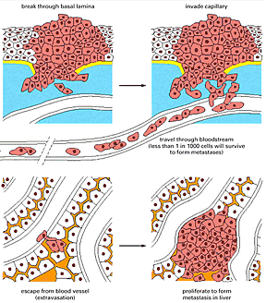
EMT & Cancer Immunobiology
  Abnormal EMT is at the initiation & invasive front of metastatic tumors
Metastatic cancer: cancer that has spread from the place it started to another place in the body
~90% of cancer-related deaths are caused by metastasis

Slide 44
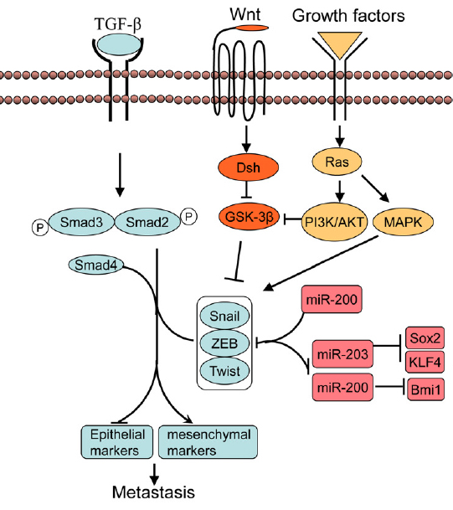
Hallmarks of EMT – TGFβ
Microenvironment
TGF-β
promotes EMT via SMAD4 signaling and increases EMT transcription factors SNAIL, ZEB, Twist
Molecular changes @ the cellular level
E-cadherin “cements” ECs together; protein significantly down-regulated during EMT

Slide 45
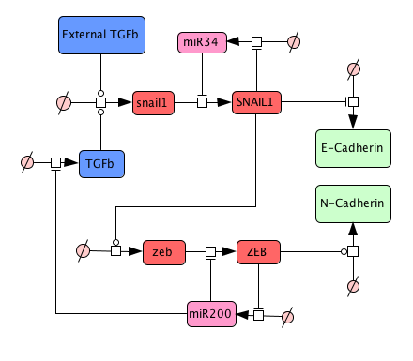
Modeling TGF Signaling

Slide 46
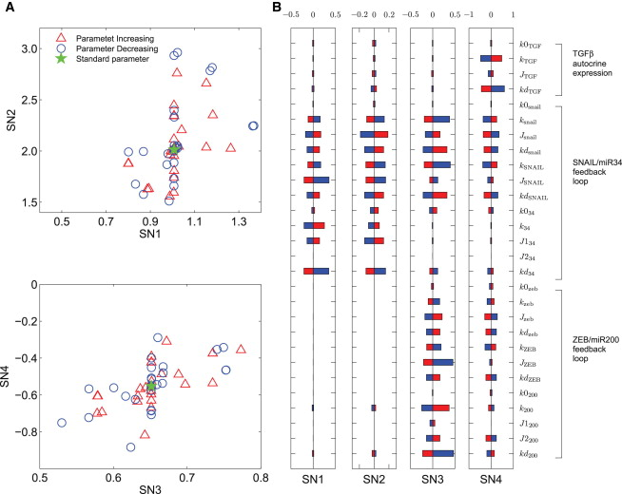
Predictions & Validations
SNAIL/mir34 double-negative feedback loop regulates initiation of EMT
ZEB/mir200 feedback loop regulates irreversible switch to maintain mesenchymal phenotype
TGF/mir200 reinforces mesenchymal phenotype
X. Tian Biophysical Journal 2013
DOI: 10.1016/j.bpj.2013.07.011

Slide 47
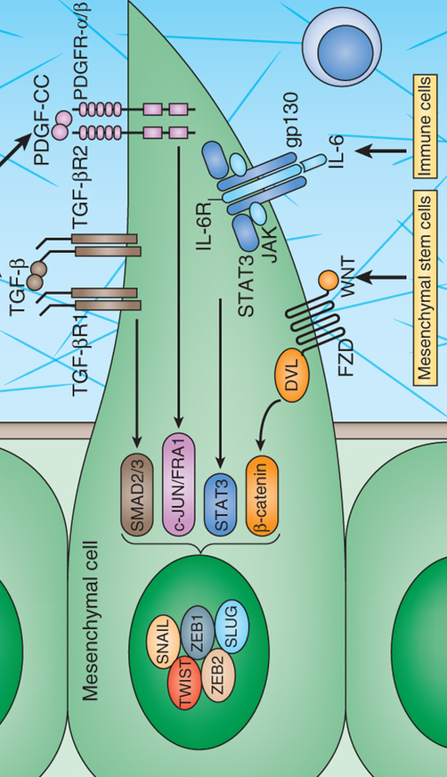
Underreported Instigator– IL6
Microenvironment
IL6
promotes EMT via JAK/STAT signaling and increases EMT transcription factors SNAIL, ZEB, Twist
Molecular Crosstalk
IL-6 & TGF-β
can mutually enhance each other’s autocrine signaling YET ALSO their downstream regulators can antagonize each other

Slide 48
Heterogeneous EMT Phenotypes
E
Does this occur sequentially?
Functional role of Twist remains unclear
Results weren’t coupled with TGF or IL6 data
TGF model only explains 1 intermediate
IE
SNAIL
ZEB1
IM
TWIST
M
Salt 2013 Cancer Discovery
Notes:
The Intermediate M phenotype is hallmarked by higher N-cadherin and ZEB1 and lower ERBB3 expressions

Slide 49
Modeling EMT Dynamics
Motivation:
TGF-β / IL-6 axis is suggested as a key mediator of resistance to cancer therapies
  (Yao et. al PNAS 2012)
α-TGF therapies alone are not successful
  (Reivewed: Connolly et. al Int J Biol Sci 2012)
Blocking IL-6/STAT3 alone is moderately successful & mechanisms are still largely unknown/underreported
  (Huang et. al Neoplasma 2011)
Treatments likely need to be combinatorial & patient specific (stage of EMT/cancer)

Slide 50
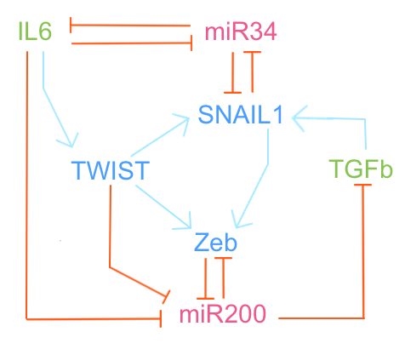
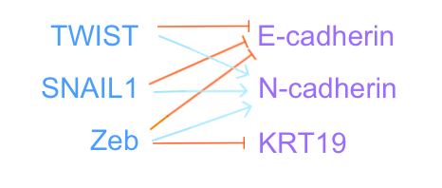
Updated “Abstracted” Network
Notes:
JAK/STAT
SMAD4

Slide 51
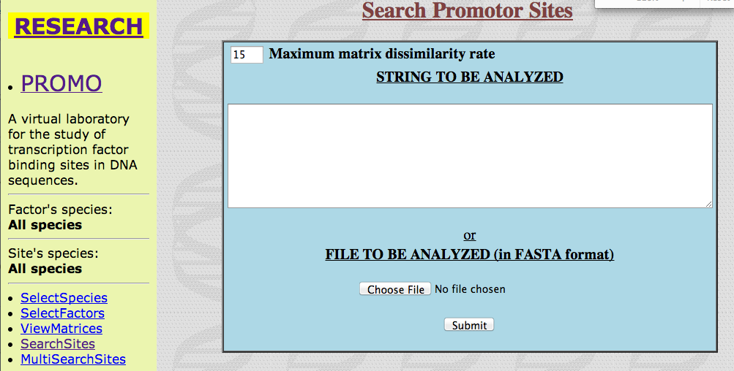
ALGGEN – PROMO
Wanted to make sure we had correct transcriptional regulation for surface markers
Predicted transcription factor binding sites for human protein sequences

Slide 52
Fitting Phenotypes

Slide 53
Fitting Phenotype Dynamics

Slide 54
Modeling Questions
Explain how IL6 & TGF contribute to 4 known EMT phenotypes
Examine how cell sensitivities change upon dual stimulation with TGF + IL6
Identify whether IL6 or TGF priming alters mechanisms of EMT
Characterize crosstalk mechanisms between IL6 & TGF
Notes:
bifurcation diagrams
dual stimulation doesn’t likely occur in a linear way… can we predict how dynamics and sensitivities will shift?

Slide 55
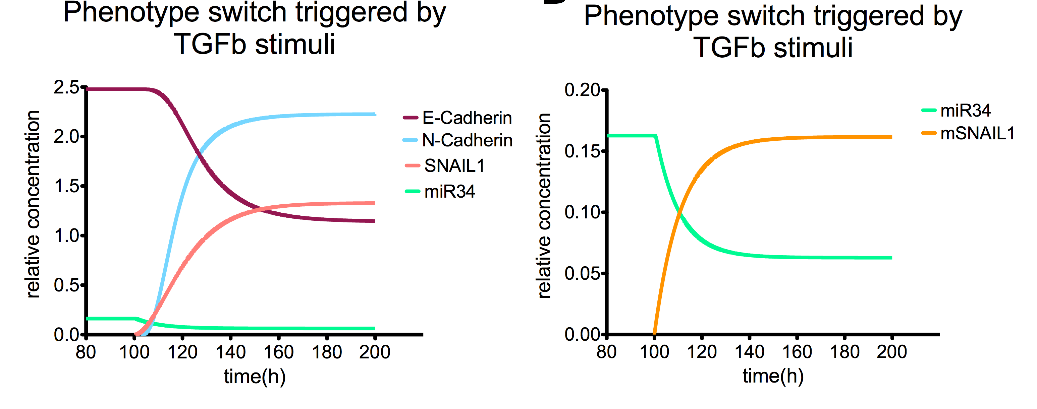
Example in silico experiments
Notes:
similar results

Slide 56
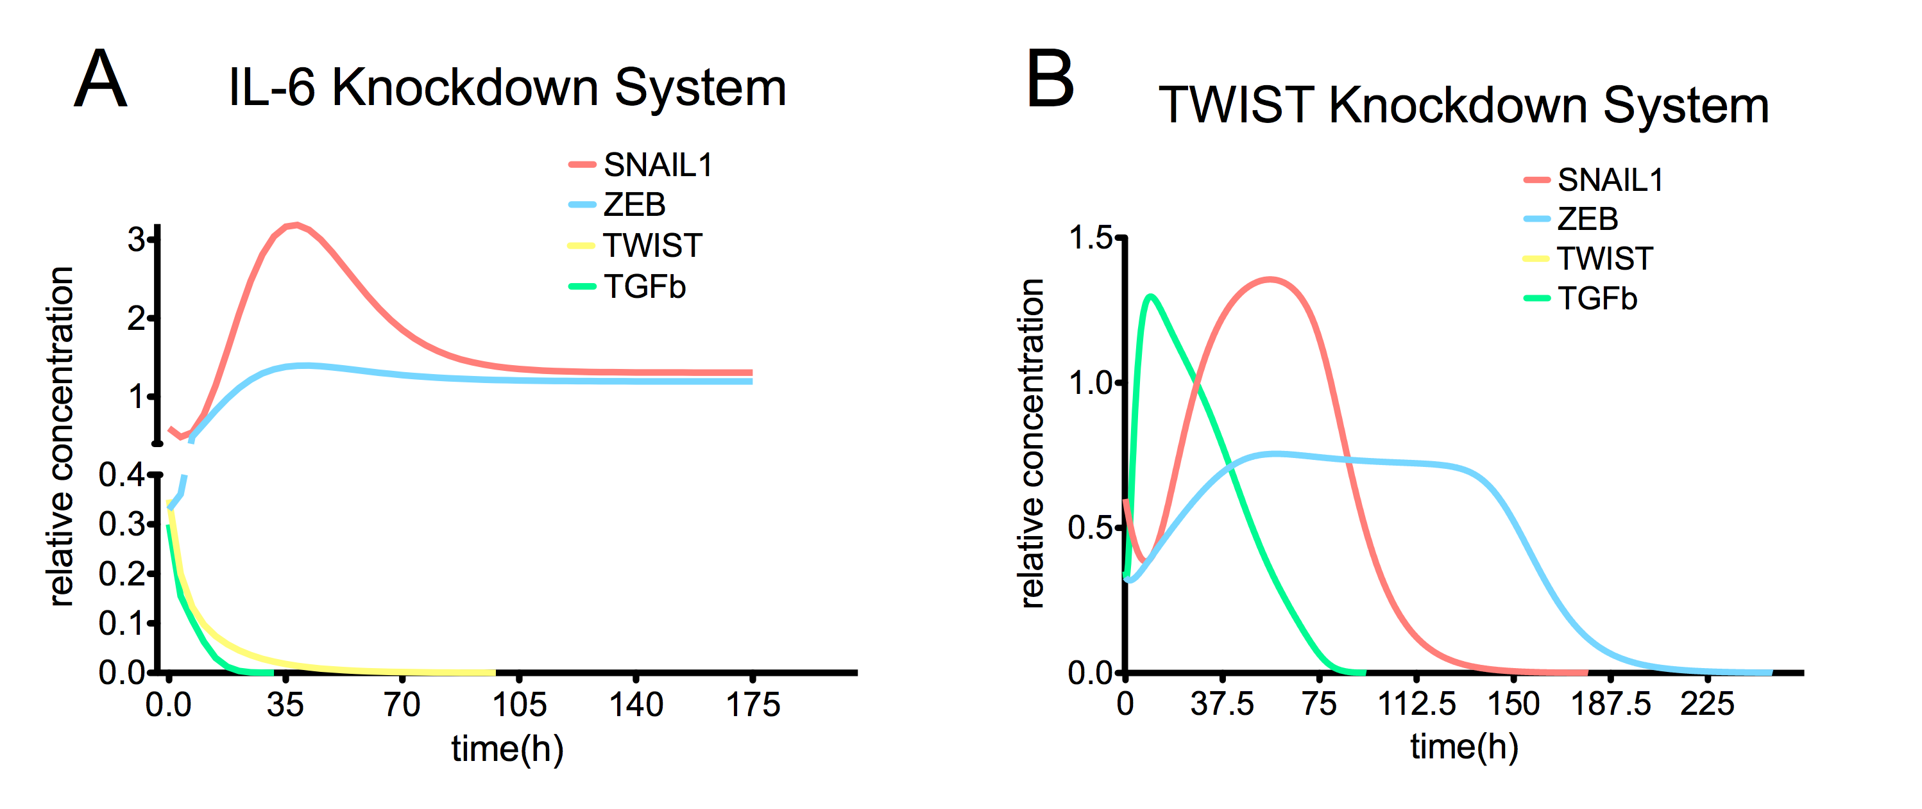
Example in silico experiments
Notes:
similar results in TGFb knockout system… VALIDATE USING GEO DATA!!!

Slide 57
Example in silico experiments

Slide 58
Summary
Computational modeling offers predictive power for generating hypotheses about biological processes
Modeling provides an efficient framework to test hypotheses in a high throughput manner
Correct questions are key
Networks can be generated creatively
Modeling must be assessed across scales

Slide 59
Questions?

