Slide 1

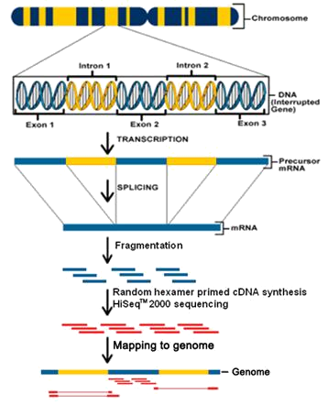



RNA-seq Analysis in Galaxy
Pawel Michalak (pawel@vbi.vt.edu)

Slide 2
Two applications of RNA-Seq
Discovery
find new transcripts
find transcript boundaries
find splice junctions
Comparison
Given samples from different experimental conditions, find effects of the treatment on gene expression strengths
Isoform abundance ratios, splice patterns, transcript boundaries

Slide 3
Specific Objectives
By the end of this module, you should
Be more familiar with the DE user interface
Understand the starting data for RNA-seq analysis
Be able to align short sequence reads with a reference genome in the DE
Be able to analyze differential gene expression in the DE
Be able to use DE text manipulation tools to explore the gene expression data

Slide 4
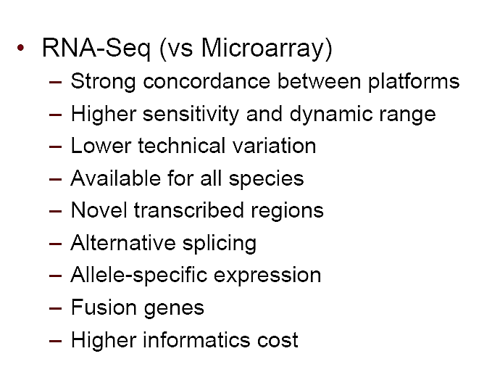

Slide 5
Conceptual Overview

Slide 6
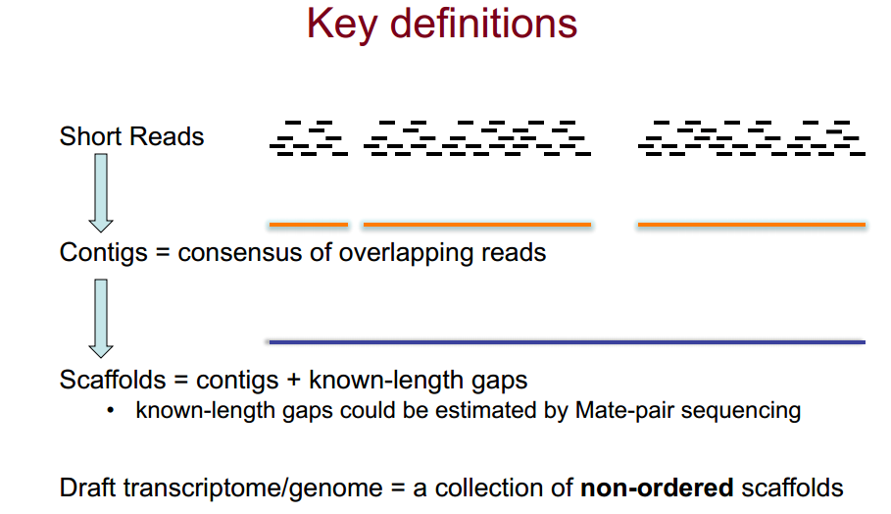
Key Definitions

Slide 7
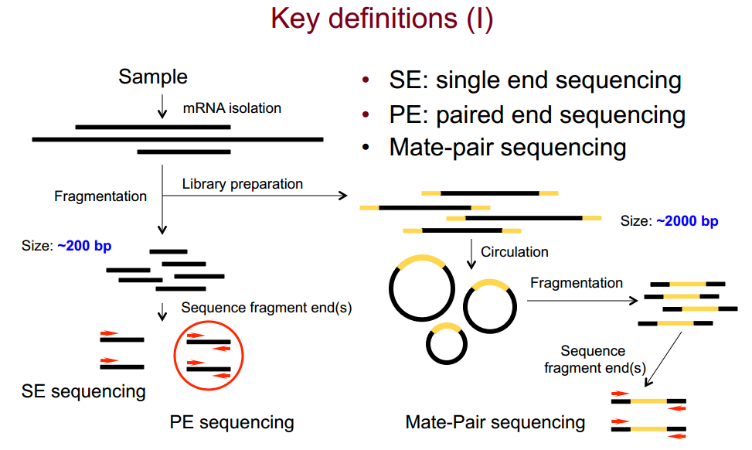
Key Definitions

Slide 8
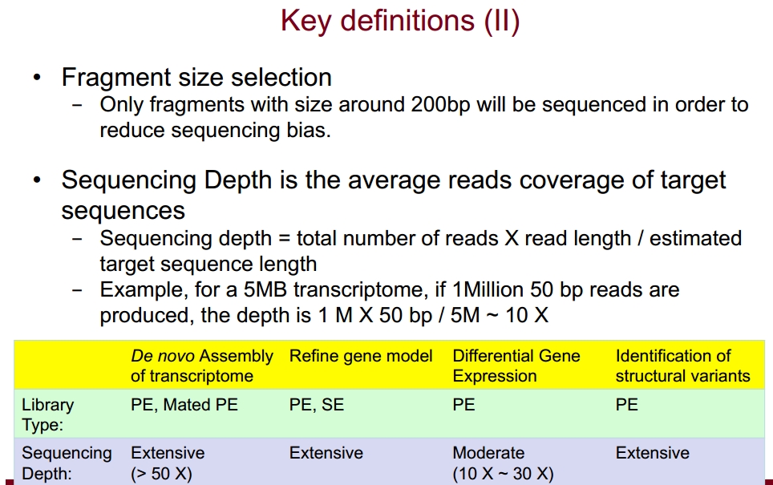
Key Definitions

Slide 9
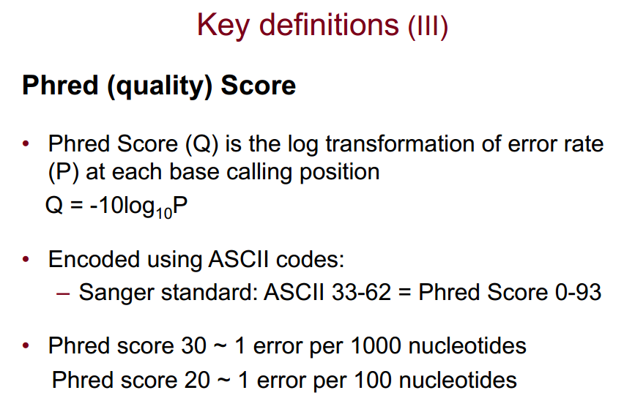
Key Definitions

Slide 10
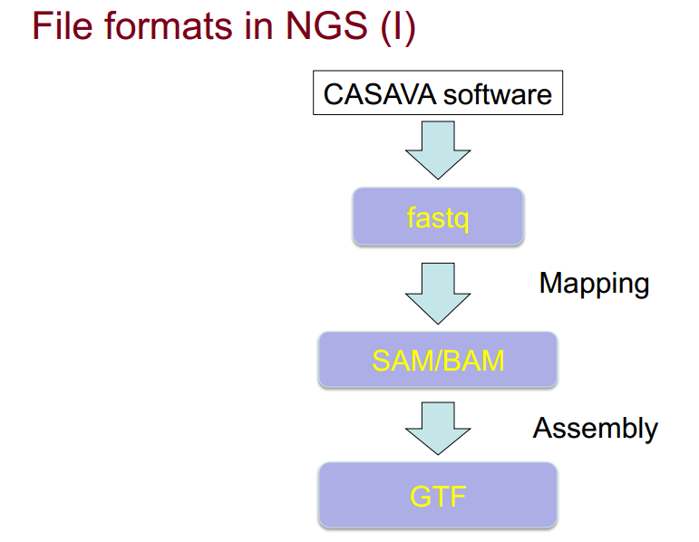
RNA-seq file formats

Slide 11
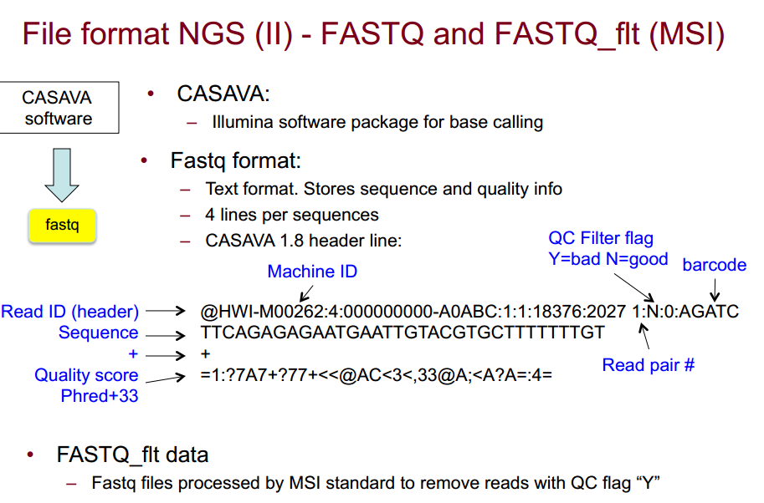
File formats – FASTQ

Slide 12
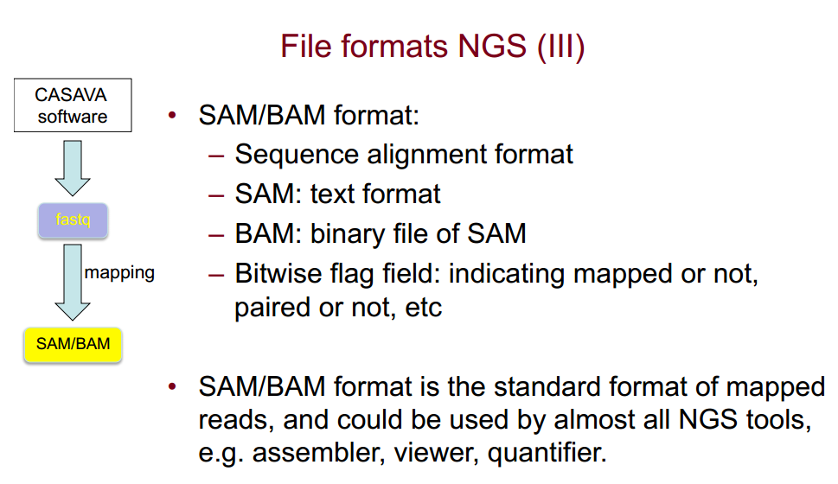
File formats – SAM/BAM

Slide 13
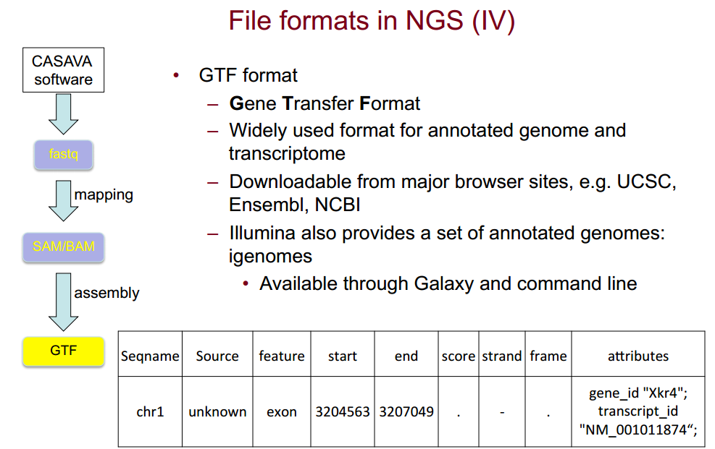
File formats – GTF

Slide 14
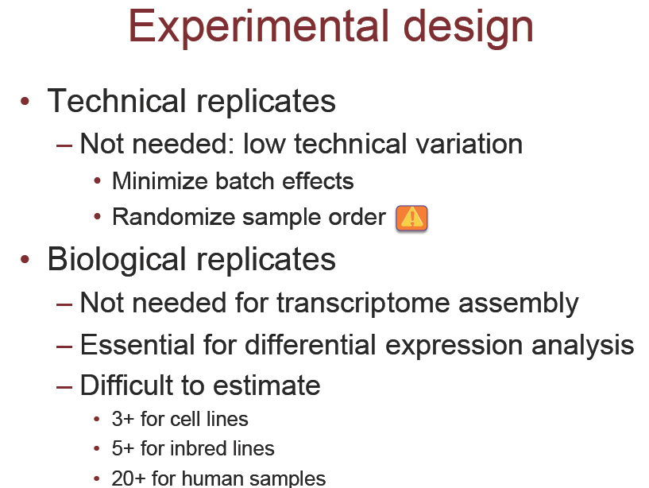
Experimental Design

Slide 15
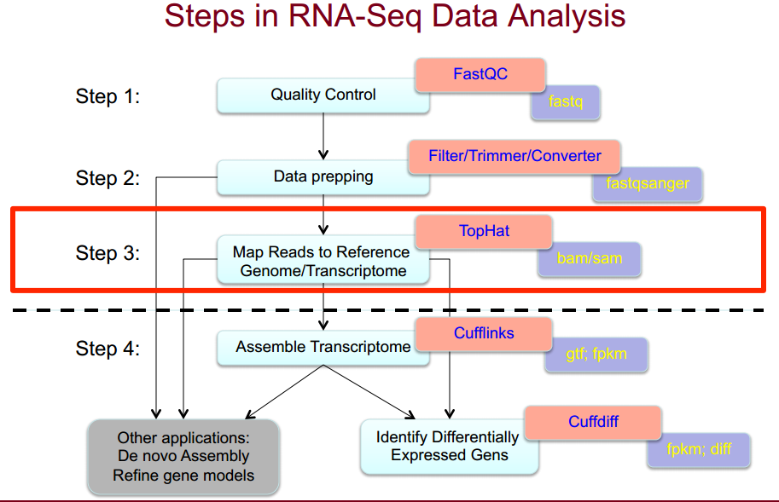
Steps in RNA-seq Analysis

Slide 16
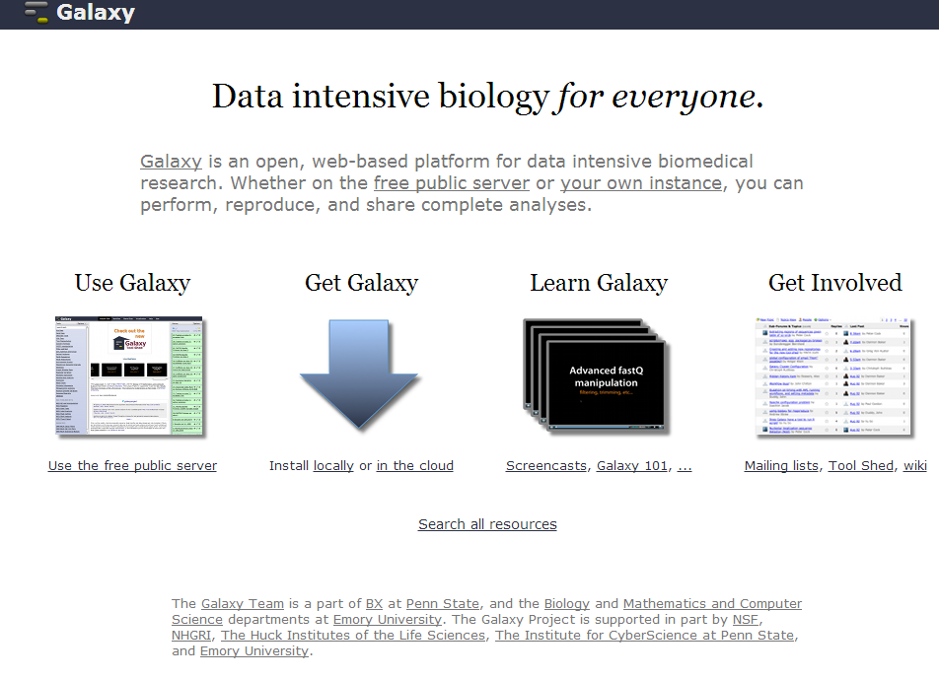
http://galaxyproject.org/
Click

Slide 17
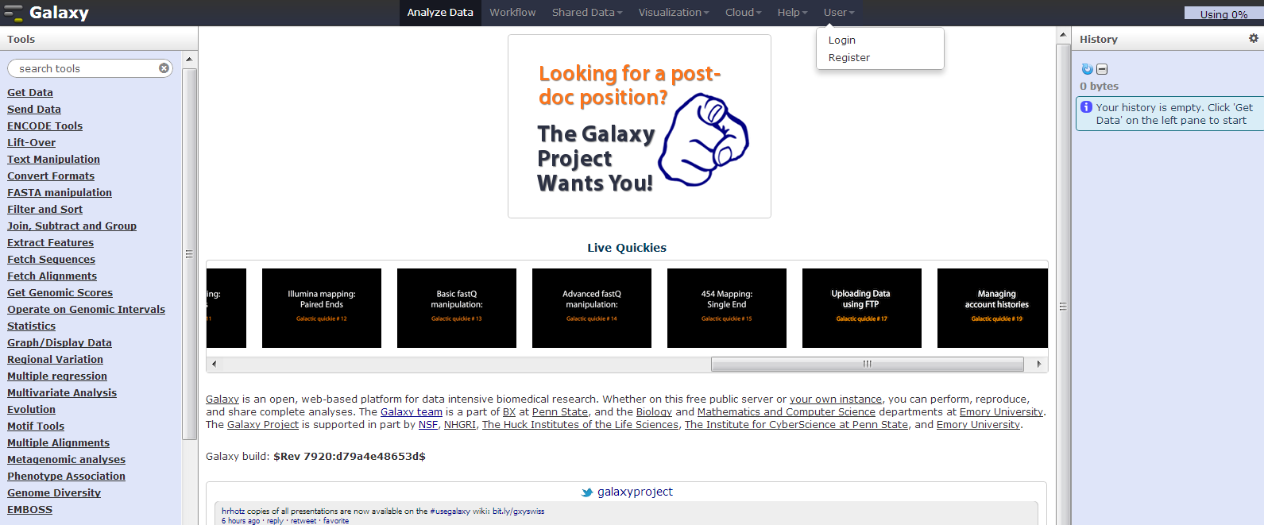
http://galaxyproject.org/
Click

Slide 18
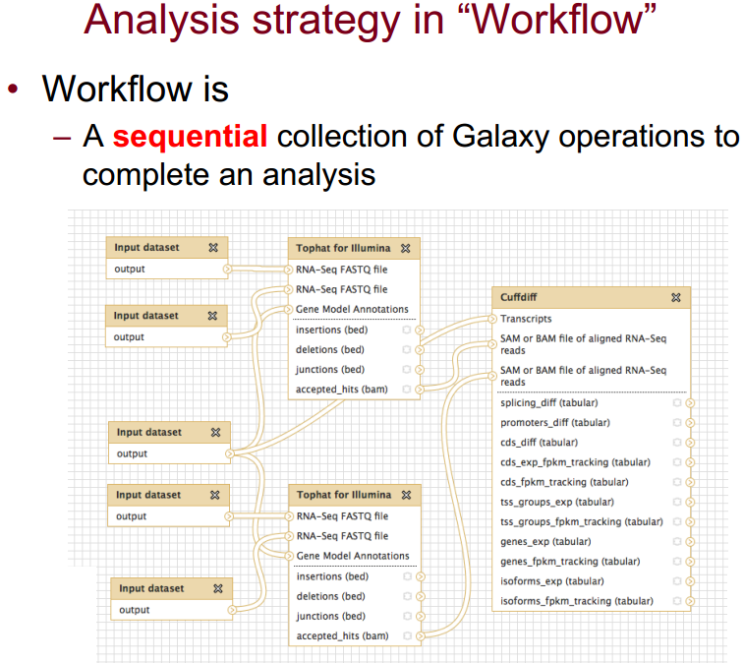
Galaxy workflow

Slide 19
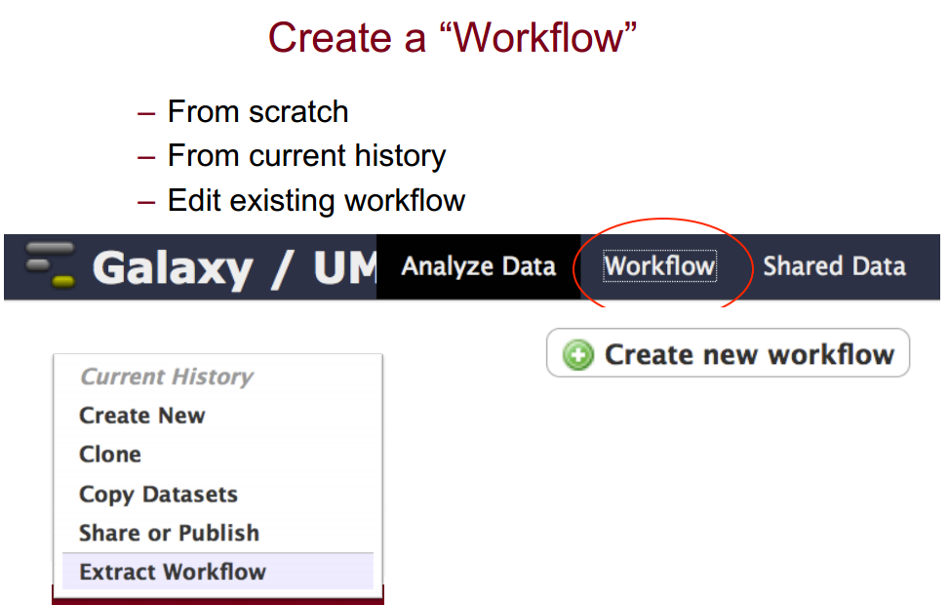
Galaxy workflow

Slide 20
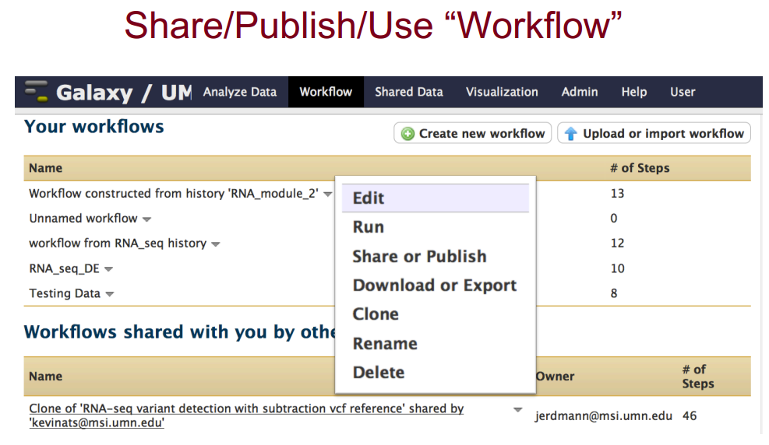
Galaxy workflow

Slide 21
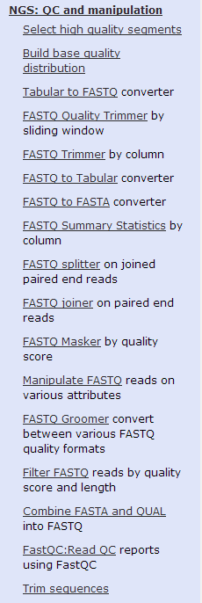
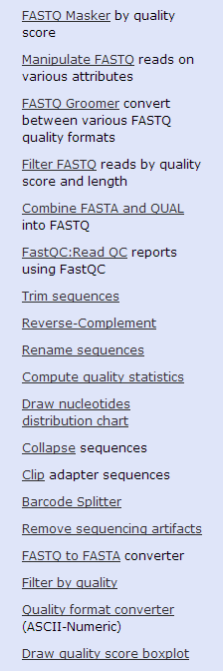
QC and Data Prepping in Galaxy

Slide 22
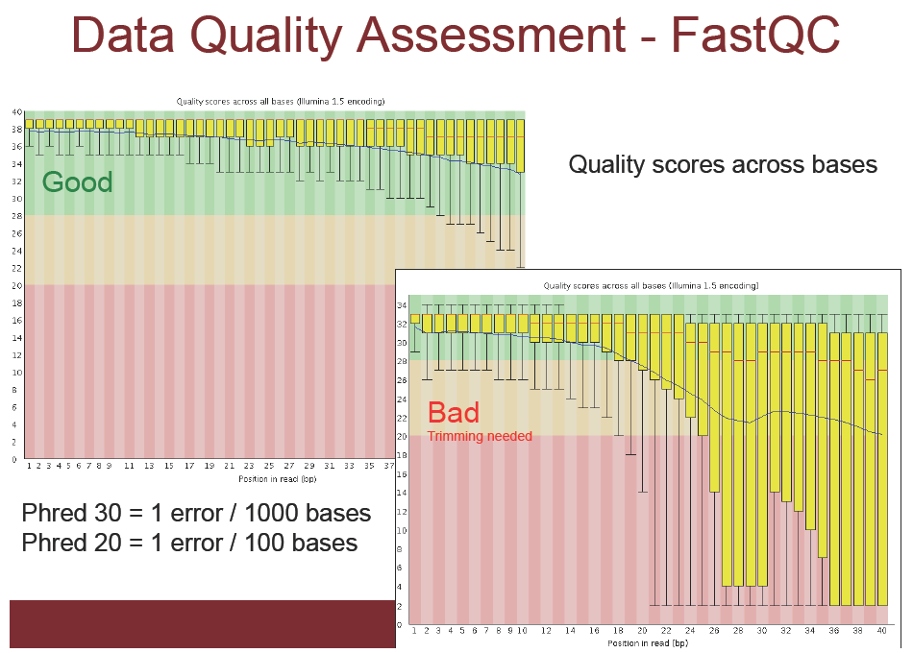
Data Quality Assessment: FastQC

Slide 23
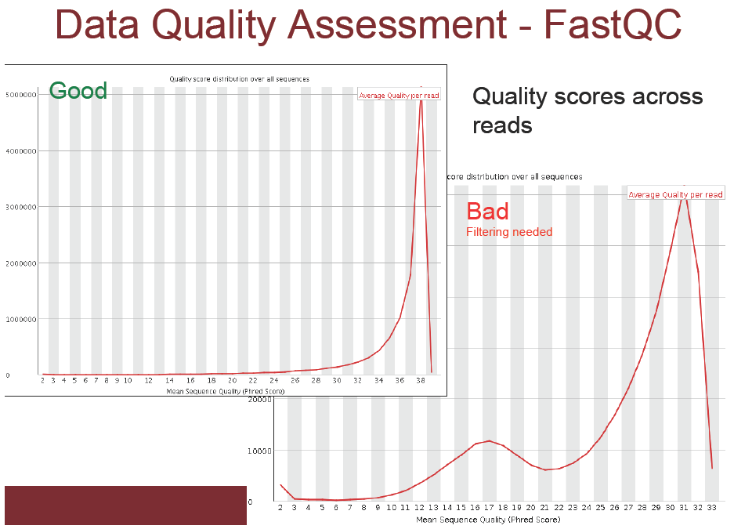
Data Quality Assessment: FastQC

Slide 24
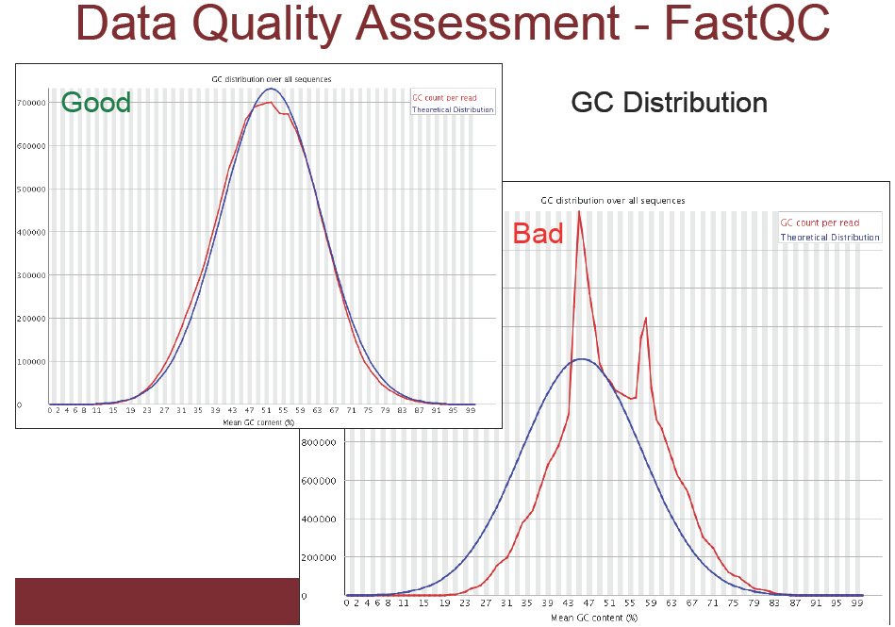
Data Quality Assessment: FastQC

Slide 25
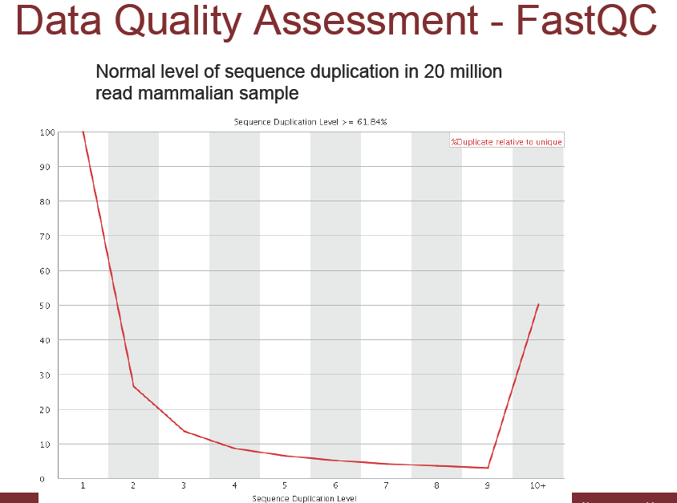
Data Quality Assessment: FastQC

Slide 26
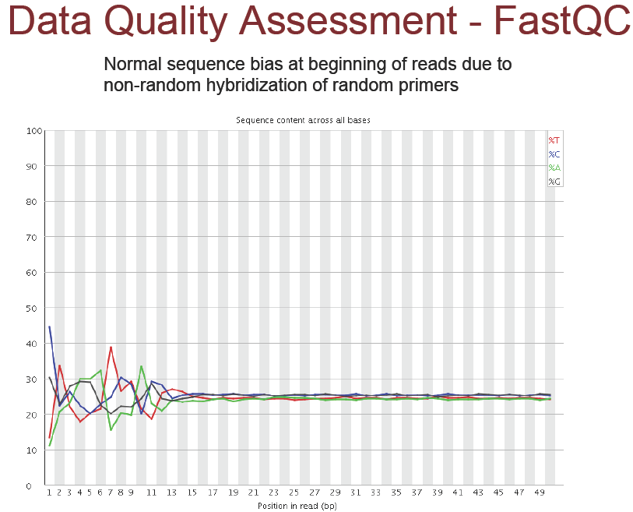
Data Quality Assessment: FastQC

Slide 27
Read Mapping

Slide 28
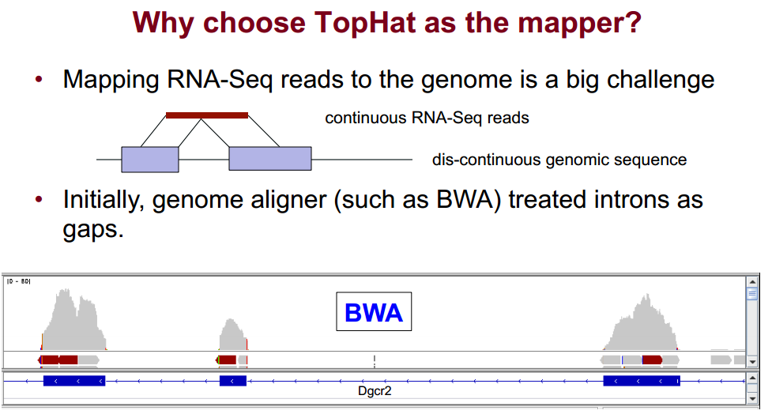
Why TopHat?

Slide 29
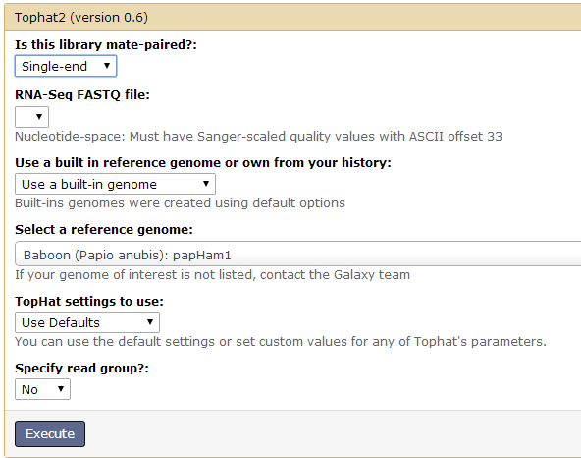
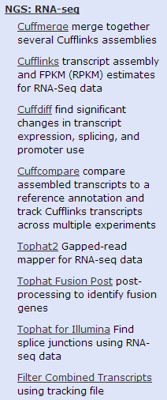
TopHat2 in Galaxy

Slide 30
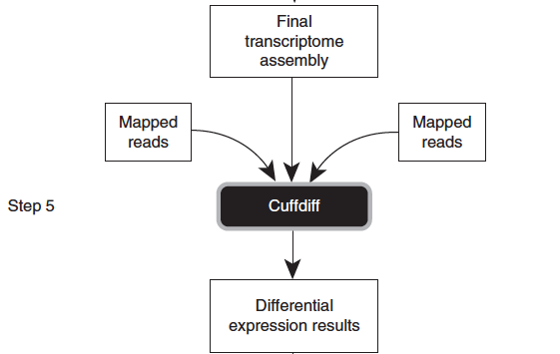
CuffLinks and CuffDiff
CuffLinks is a program that assembles aligned RNA-Seq reads into transcripts, estimates their abundances, and tests for differential expression and regulation transcriptome-wide.
CuffDiff is a program within CuffLinks that compares transcript abundance between samples

Slide 31
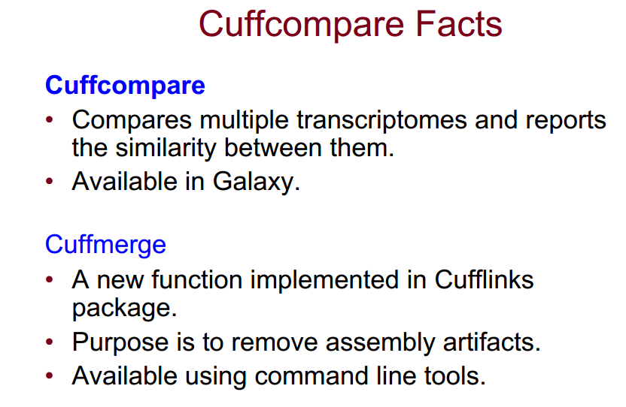
Cuffcompare and Cuffmerge

Slide 32
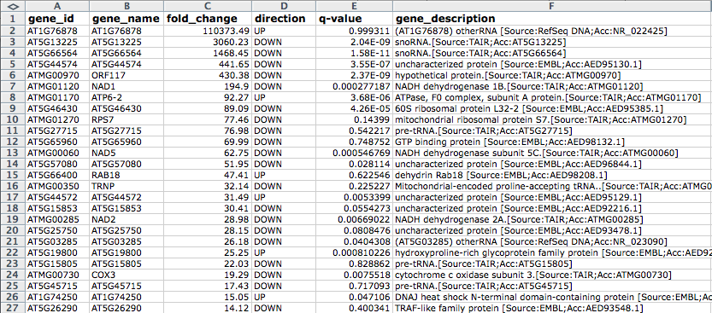
CuffDiff results example

Slide 33
RNA-seq results normalization
Differential Expression (DE) requires comparison of 2 or more RNA-seq samples.
Number of reads (coverage) will not be exactly the same for each sample
Problem: Need to scale RNA counts per gene to total sample coverage
    Solution – divide counts per million reads
Problem: Longer genes have more reads, gives better chance to detect DE
    Solution – divide counts by gene length
Result = RPKM
  (Reads Per KB per Million)

Slide 34
RPKM normalization

Slide 35
RNA-seq hands-on
Go to http://galaxyproject.org/ and then type in the URL address field
https://usegalaxy.org/u/jeremy/d/257ca40a619a8591
(GM12878 cell line)
Click the green + near the top right corner to add the dataset to your history then click on start using the dataset to return to your history, and then repeat with
https://usegalaxy.org/u/jeremy/d/7f717288ba4277c6
(h1-hESC cell line)

Slide 36
RNA-seq hands-on
http://staff.vbi.vt.edu/pawel/RNASeq.pdf

