Slide 1
Introduction to
CellDesigner and COPASI
Modeling Mucosal Immunity
Summer School & Symposium
in
Computational Immunology
Stefan Hoops
June 9, 2014

Slide 2
Outline
Biological Processes
Creating a Process Diagram with CellDesigner
Analyzing your Model with COPASI

Slide 3
Biological Process
What is a biological process?
Participants:
molecules, genes, proteins, complexes, drugs, etc.
Participant Roles:
input, output , modifiers
Happens with a speed, propability, or frequency

Slide 4
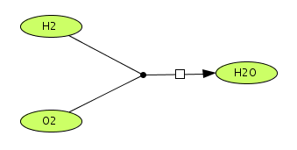
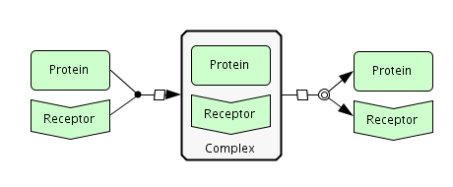
Process Examples
Chemical Reaction:
2 * H₂ + O₂ -> H₂ O
Complex Formation:
Protein A + Protein B = Complex

Slide 5
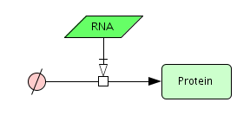
Process Examples
Translation:
-> Protein; RNA
Note: RNA is not consumed

Slide 6
CellDesigner
A graphical editor for creating complex biological process.
Available for Windows, Linux and MacOS X
Download from:
http://www.celldesigner.org/

Slide 7
CellDesigner Hands On
Build the Process Examples in CellDesigner

Slide 8
COPASI
COPASI is a software application for simulation and analysis of biochemical networks and their dynamics.
Available for Windows, Linux and MacOS X
Download from:
http://www.copasi.org/

Slide 9
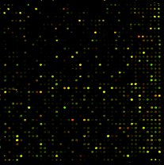
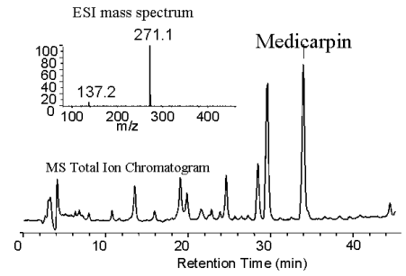
Biological Process Network
A
B
Genome
C + D
E
Proteome
B + 2 F
G +
H
Metabolome

Slide 10
Model in COPASI
COPASI models are process networks.
Kinetic laws may be interpreted as reaction velocities or as reaction probabilities through a user settable flag.
The tool “Convert to Irreversible” helps the user to convert each reversible reactions into 2 irreversible reactions.

Slide 11
Deterministic Simulation
ODE System:
.
.
.
.
.
.
.
.
A
B
C
D
E
F
G
H
-1 0 0
0 -1
0 -1 0
0 -1 0
0 1 0
0 0 -2
0 0 1
0 0 1
v ₁ (A, B, H)
v ₂ (B, C, D, E)
v ₃ (B, E, F, G, H)
=
x ₁
x ₂
…
x _{n}
v ₁
v ₂
…
v _{m}
.
x = N v with:
x =
v =

Slide 12
Stochastic Simulation
Initialize system
Calculate: Reaction probabilities
Generate random numbers to determine:
  time of next reaction
  which reaction happens
Update the system the system

Slide 13
Steady State
x ₁
x ₂
…
x _{n}
v ₁
v ₂
…
v _{m}
.
Condition:
x = N v = 0 with:
x =
v =
Method:
Damped Newton
Forward Integration
Backward Integration

Slide 14
Analysis Tasks
Stochastic and deterministic time course simulation
Steady state analysis (including stability).
Metabolic control analysis/sensitivity analysis.
Elementary mode analysis .
Mass conservation analysis.
Time scale separation analysis
Calculation of Lyapunov exponents.
Parameter scans.
Optimization of arbitrary objective functions.
Parameter estimation using data from time course and/or steady state experiments simultaneously.
Cross Section analysis.

Slide 15
COPASI Hands On
Simulation and Steady State Analysis of the simple process created in CellDesigner

