Slide 1


Modeling Immunity to Enteric Pathogens
Josep Bassaganya-Riera DVM, PhD
Virginia Bioinformatics Institute
Modeling Immunity for Biodefense Program

Slide 2
MIEP Program Goals
Elucidate mechanisms of action underlying immune responses to gut pathogens
Create predictive computational/mathematical models of gut immunity
Disseminate computational models of the gut mucosal immune system
Develop more efficacious vaccines and immunotherapeutics

Slide 3
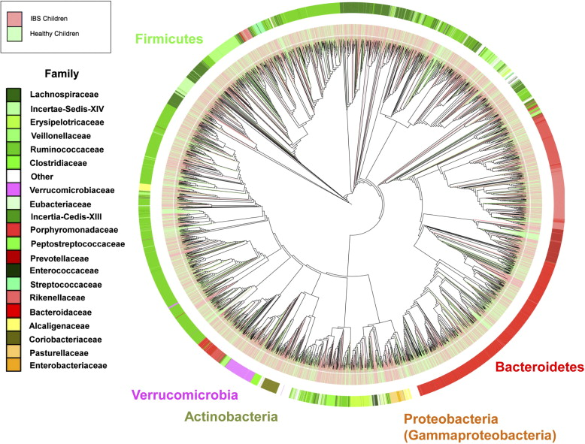
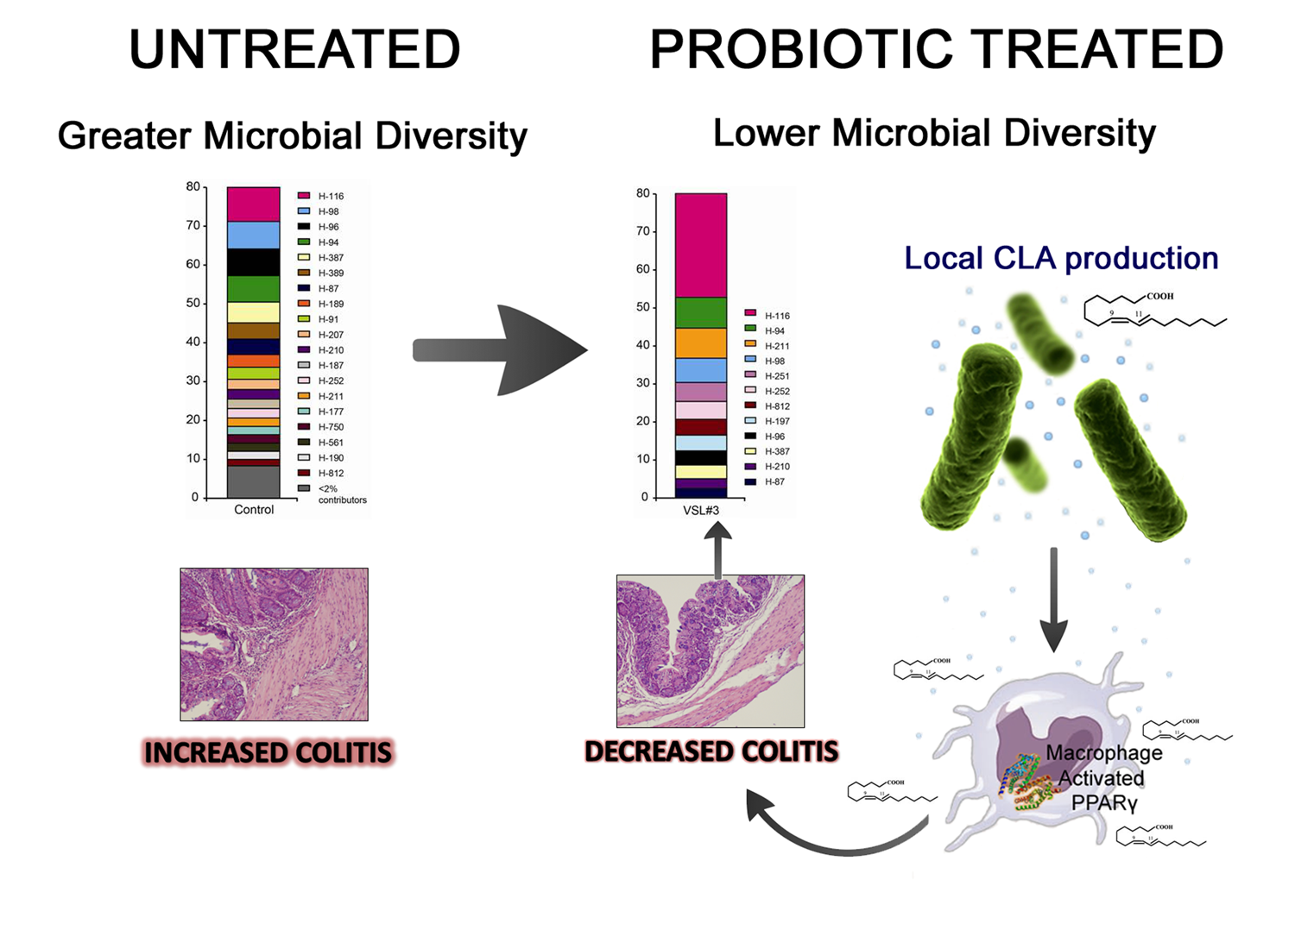
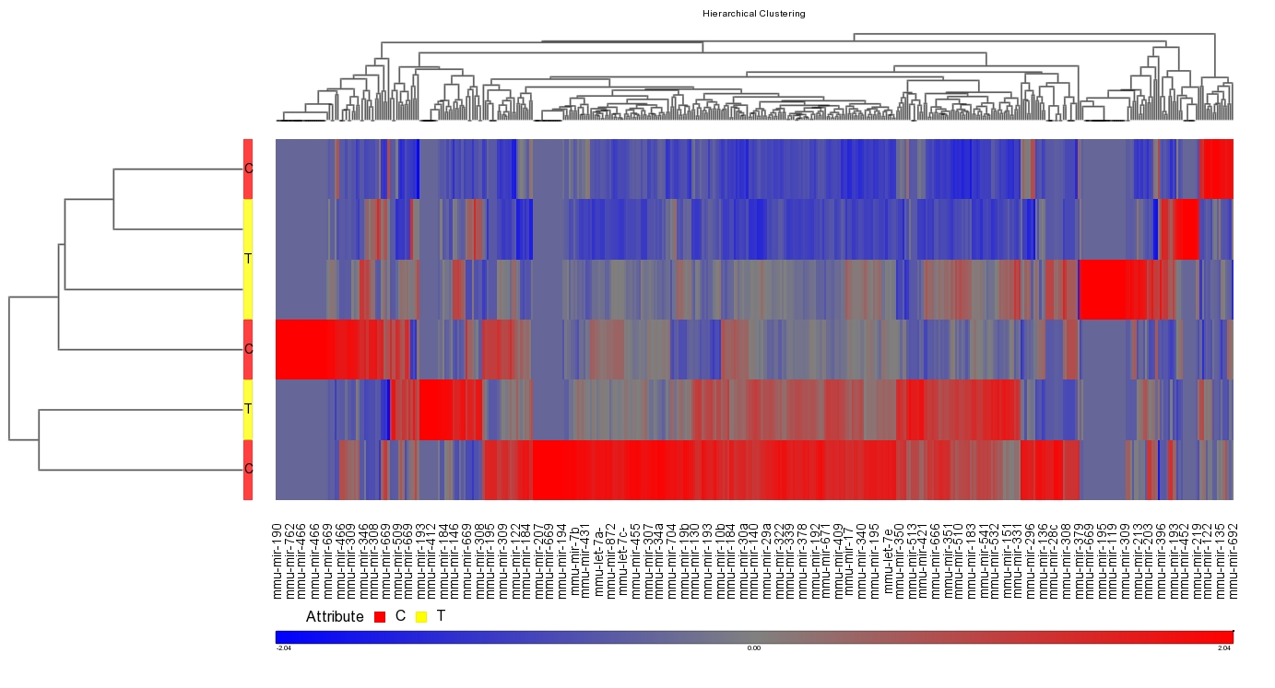
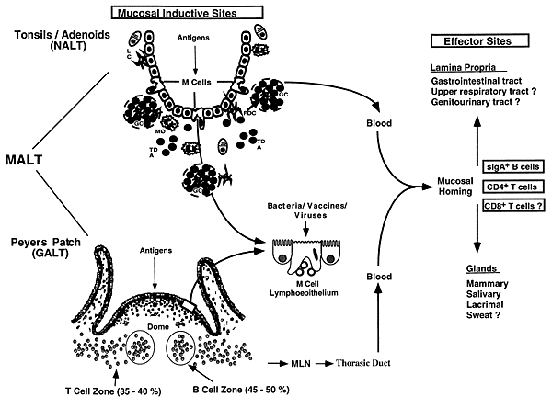
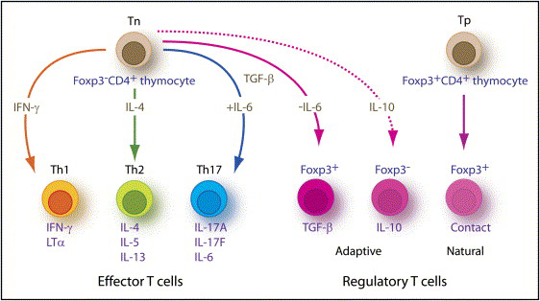
Infectious
Diseases
Notes:
The research thrust of NIMML is broader than immunology and it represents a HUMAN HEALTH program

Slide 4
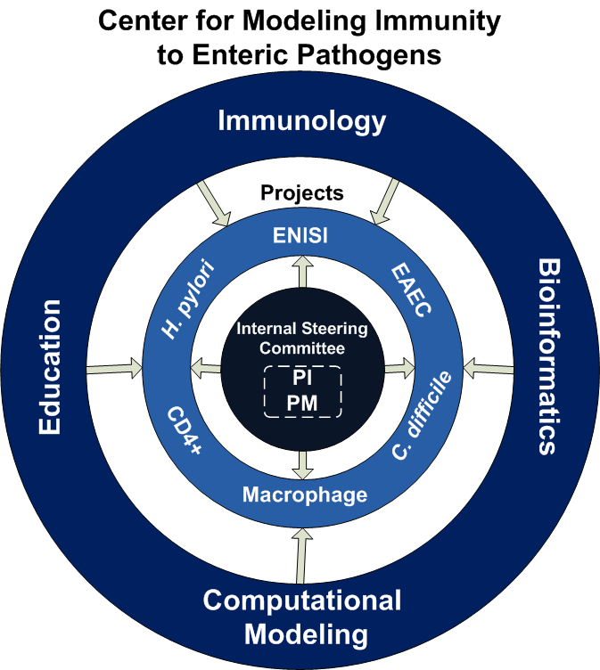
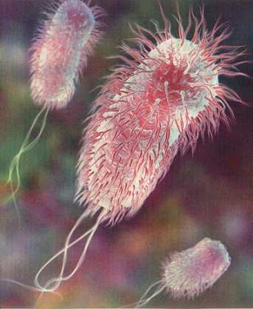
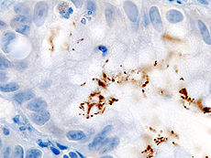
EAEC, C. difficile and H. pylori
Virginia Bioinformatics Institute
Nutritional Immunology & Molecular Medicine Lab
Network Dynamics and Simulation Science Lab
University of Virginia
Center for Global Health
Caprion Proteomics
www.modelingimmunity.org
Notes:
The components have become fully integrated and the lines between them are blurry within MIEP
For instance, our immunology GRAs are capable of building computational models using COPASI, calibrating the models and running simulations.

Slide 5

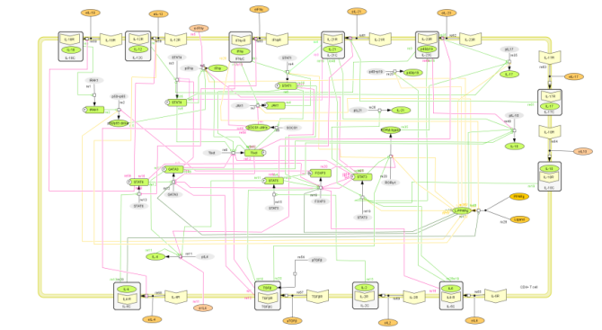
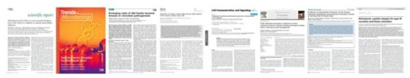


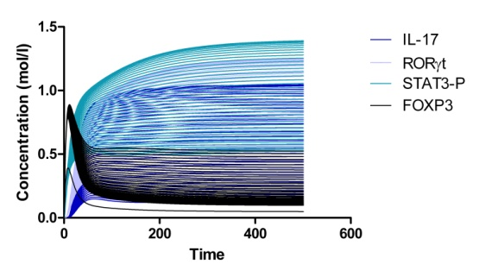
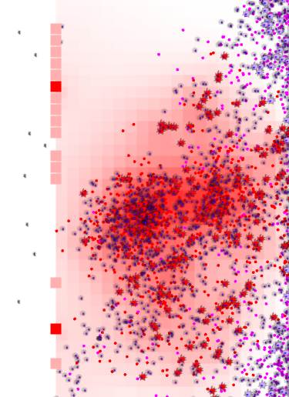
Computational Immunology
Literature &
data mining
REFINEMENT
The Network Model
In vivo hypothesis testing
ENteric Immunity SImulator
Modeling tools
In silico experiments
Hypothesis generation

Slide 6
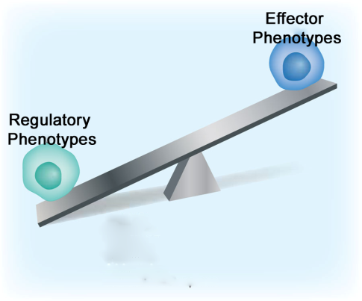
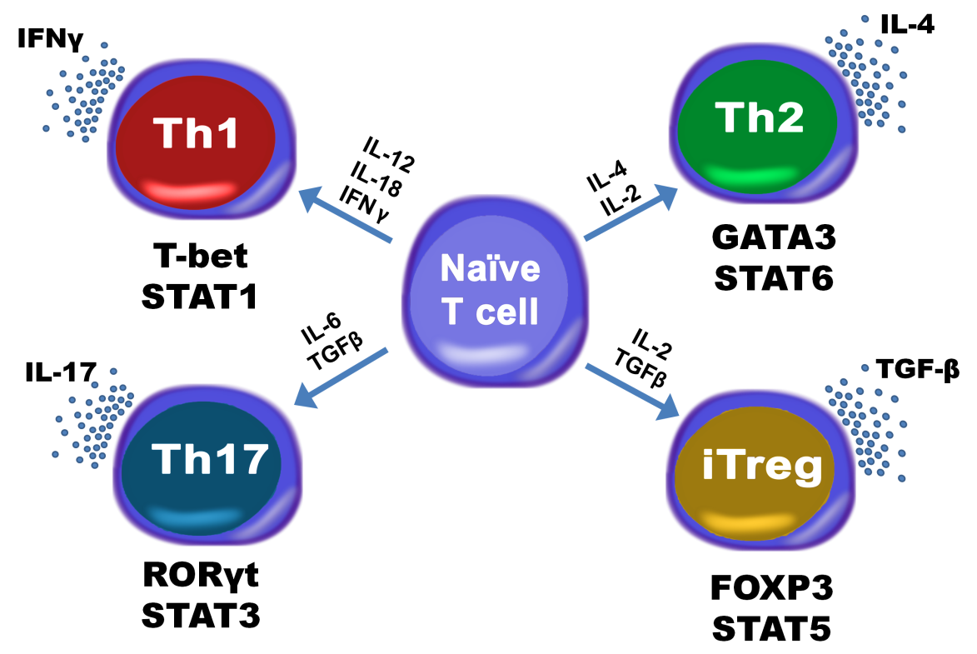
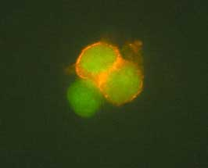
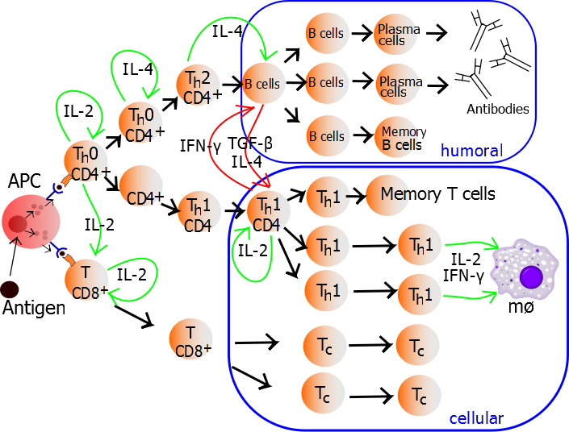
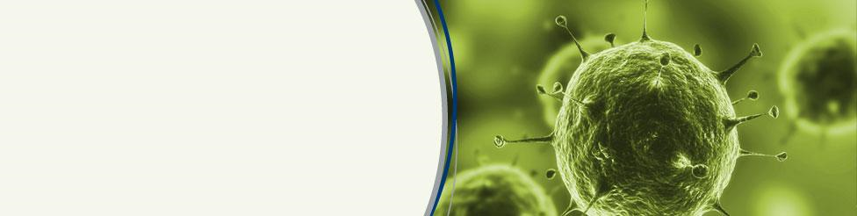
The CD4+ T cell computational model
Introduction
CD4+ T cells orchestrate the specific secondary adaptive immune response by secretion of cytokines and other soluble factors in the environment

Slide 7
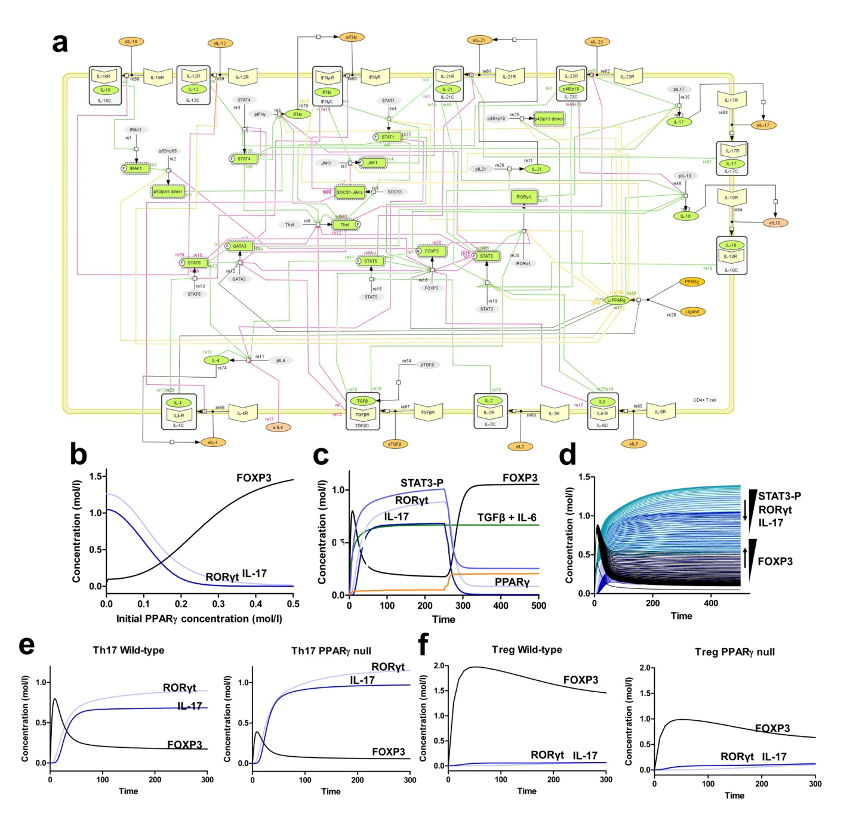
CD4+ T cell Differentiation
Notes:
52 reactions, 93 species
11 external cytokines/their receptor
Reproduces Th1, Th2, Th17 and iTreg

Slide 8
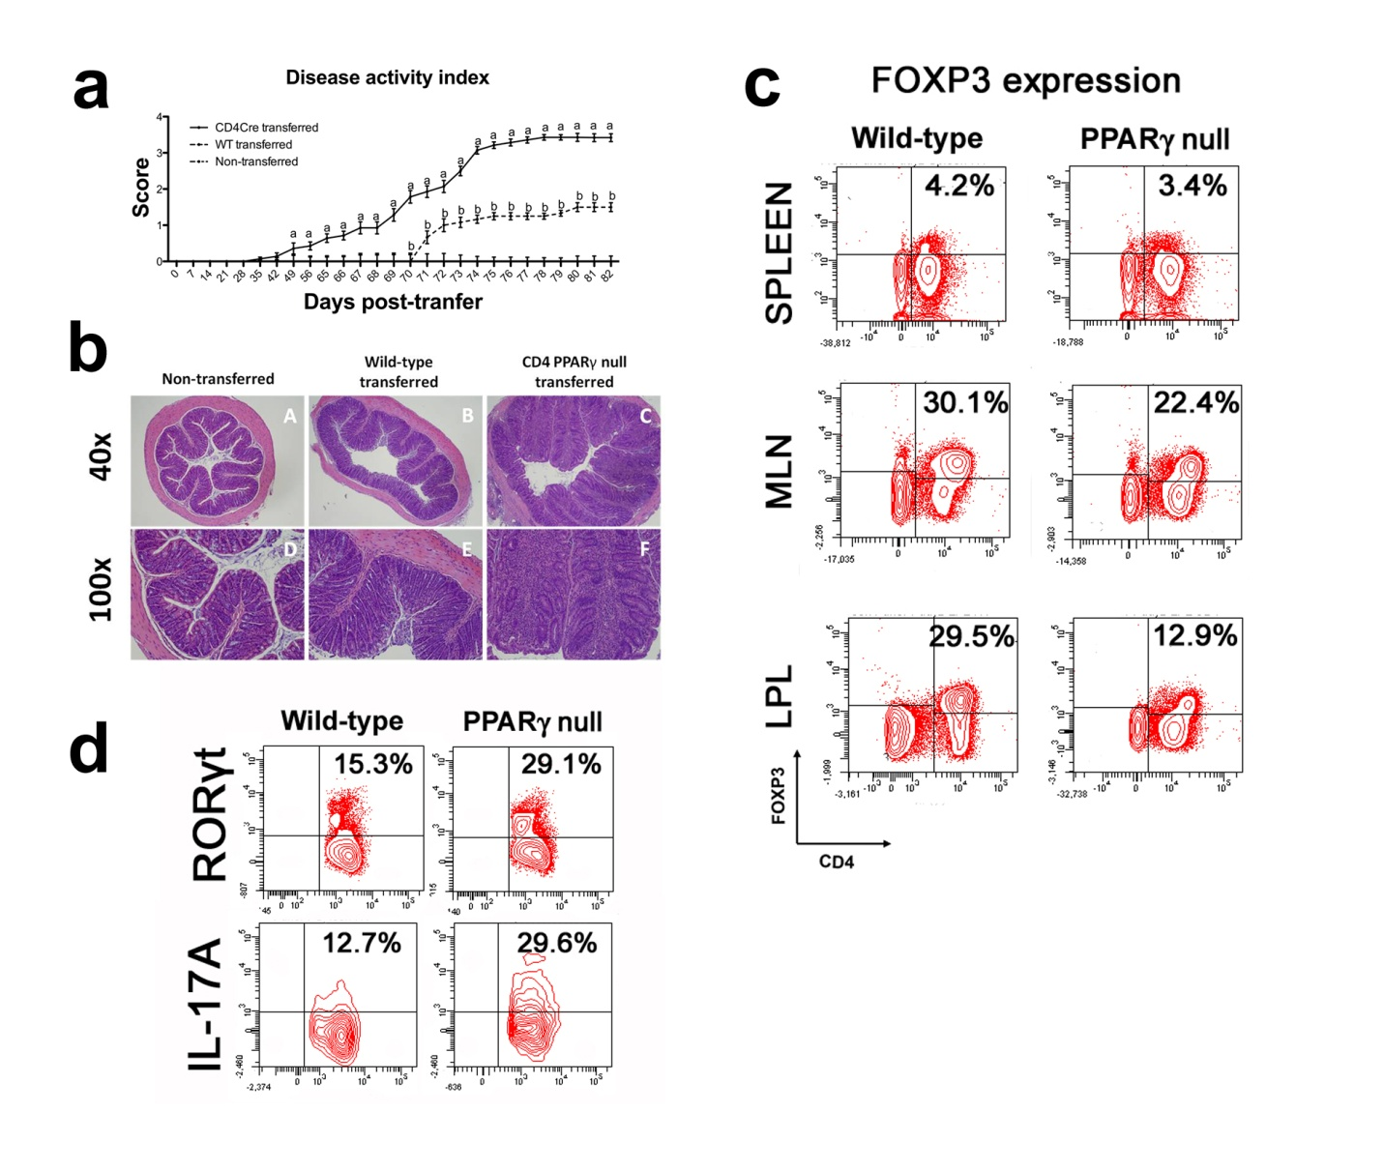
CD4+ T cell Differentiation

Slide 9
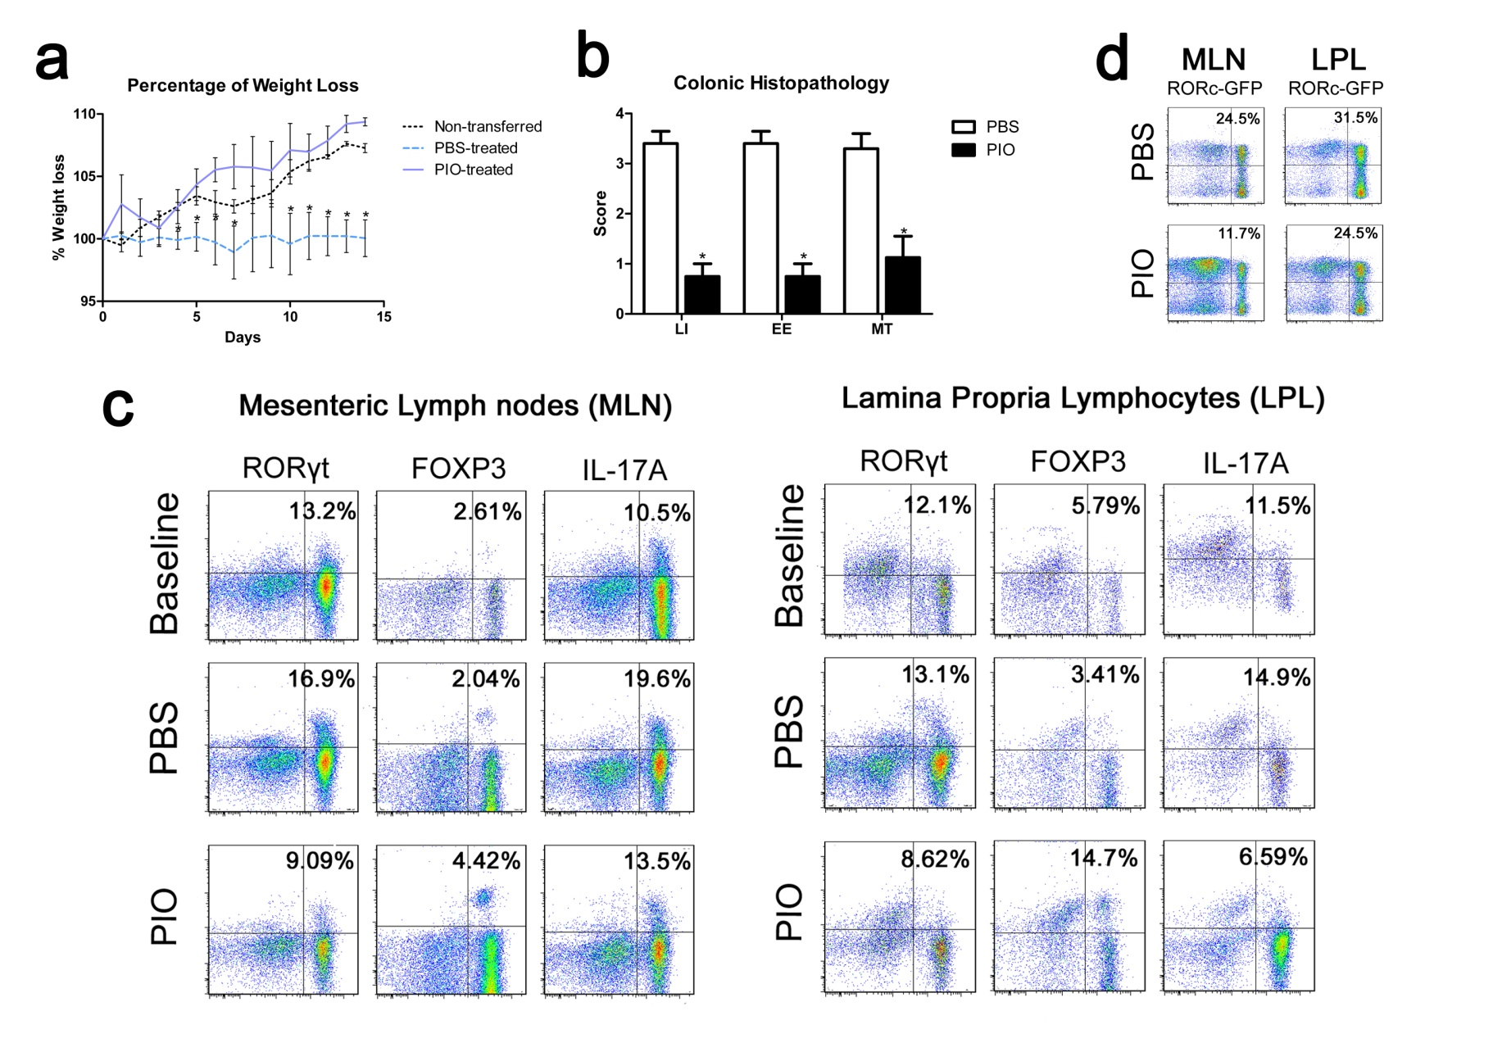
CD4+ T cell Differentiation

Slide 10
ENISI: Agent Based Simulator for Gut Immunity
Agent-based modeling utilizes super computers and simulates fine-grained biological systems
Challenges: scalability and quality visualizations
ENISI scales up to 10⁷ cells with quality user interfaces and graphics
Agents follow cell automata
Contacting agents can interact:
  Agent-Agent interaction
  Group-Agent interaction
  Timed interaction

Slide 11
ENISI: Agents
Participating Agents:
  Bacteria
    Commensal Bacteria
    Tolerogenic Bacteria
  CD4+ T Helper Cells
  Natural T Regulatory Cells
  Dendritic Cells
  Macrophages
  Epithelial Cells
Tissue Sites:
  Lumen
  Epithelial Cells
  Lamina Propria
  Gastric Lymph Node
Cells move in tissue sites
Notes:
The cell types which participate on ENISI. We have about 100 of different phenotypes associated with the simulations which are not listed here.
commensal – typical gut flora
tolerogenic – mediate immune response
Dendritic cells – antigen response
T Cells – type of white blood cell
macrophages – engulf and destroy pathogens

Slide 12
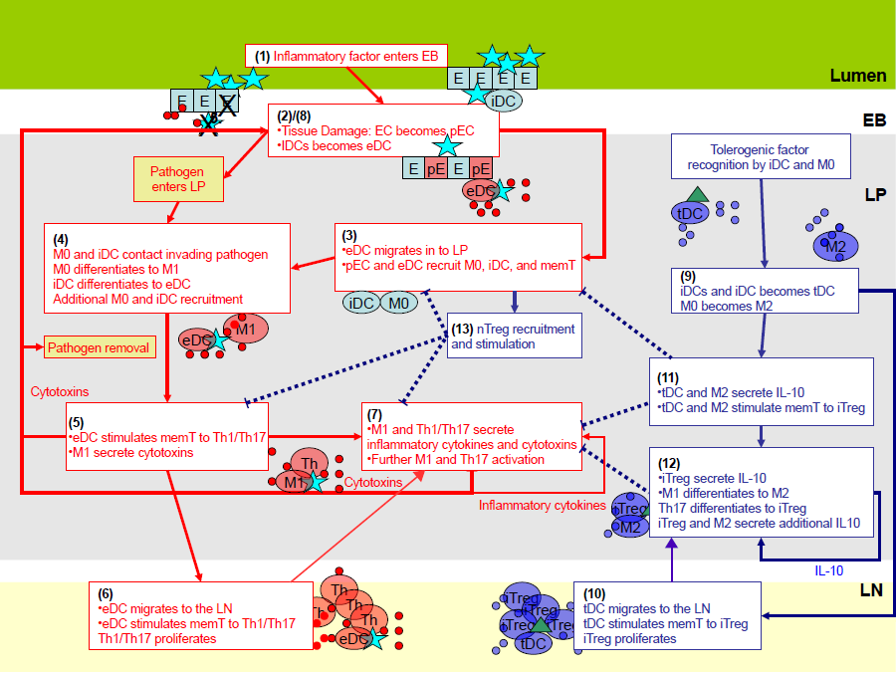
Immune Pathways of Gut Mucosa
1
2
1
4
3
2
Tissue Sites
6
3
5
7
4
6
5
Notes:
The red boxes indicates inflammatory response and the blue boxes represents regulatory response. The process starts when external pathogens such as H. pylori enters into lumen and comes into contact with the epithelial cells. Then there is a series of inflammatory response.
To control inflammatory response so that it does not follow some kind of chain reaction we also have regulatory response. In the normal case without any infection regulatory response dominates over inflammatory response. During infection the inflammatory response rises.

Slide 13
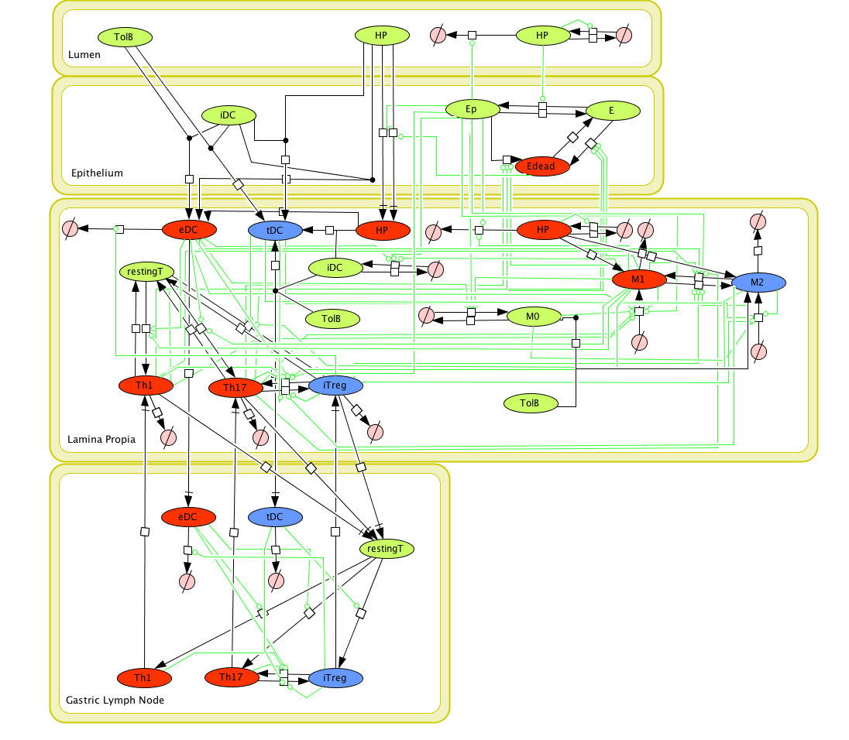





Agent Based Model
Red cells participate in inflammatory response
Blue cells participate in regulatory response
Green cells participate in either response
Cells are compartmentalized.
Notes:
From the immune response pathway we derived an agent based model which is represented here. We implement the model in ENISI.

Slide 14
Example: H. pylori 26695 Pathogenicity
Experimental infection of H. pylori 26695 on mice.
GOAL:
  In H. pylori mediated pathogenesis, in the 85% cases, we observe no lasting epithelial cell damage. But for 15% of the cases we observe chronic cell damage. We want to find out which is causing this chronic cell damage.
Experiment:
  In ENISI infect the in silico gut with H. pylori after 2 days and simulate the infection for 63 days.
  Data collected from a in vivo experiment on mice on days 7, 14, 30 and 60 post infection.
Notes:
What is the experiment all about. We find a clinical problem of H. pylori mediated pathogenicity. In 15% of the cases of this infection we observe chronic epithelial cell damage. We want to find out what is causing this.
For the experiment our in-silico gut represents about 1% of murine gastric mucosa. We infect it with H. pylori and observe the cell population dynamics.

Slide 15
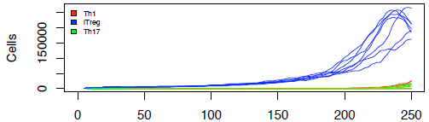
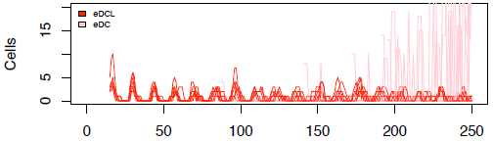
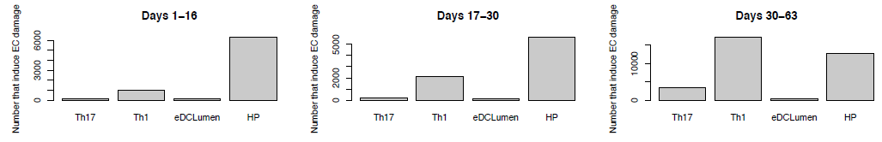
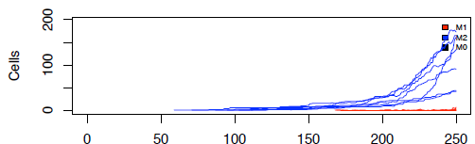
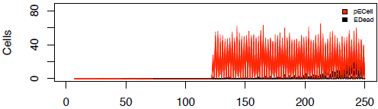
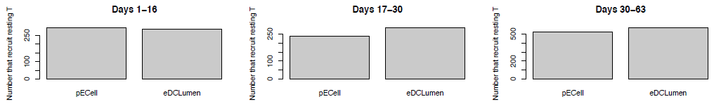
Example: H. pylori 26695 Pathogenicity
Observed Results:
  Using the outputs provided by the ENISI algorithm we found a positive feedback loop triggered by H. pylori infection where chronic epithelial cell damage is observed even when there is no remaining H. pylori in the stomach
  With the knowledge of feedback loop we now have a hypothesis for this chronic epithelial cell damage and can test this in the lab
T-cells
eDC
Inducer cells that cause Epithelial Cell Damage
Macrophages
Epithelial cells
Th1
Inducer cells that recruits T cells
Notes:
So, first we track which is contributing the epithelial cell damage. Then we track the pathway which is the main cause of the problem. We observe that the rise of Th1 cells and Macrophases and eDC are due to epithelial cell damage. Next we investigate the cause of Ecell -> pECell

Slide 16
ENISI Performance
Can simulate 10⁷ cells or ~1% of mouse stomach in 1½ hours on 576 cores

Slide 17
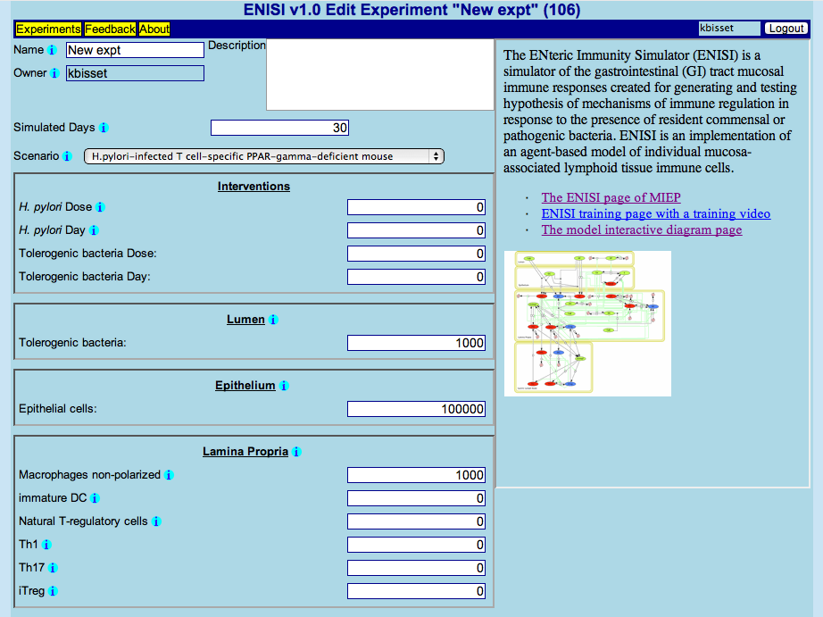
ENISI Web Interface
Notes:
USER FRIENDLY INTERFACE, USERS CAN CREATE EXPERIMENTS CHOOSING CELL POPULATIONS, SAVE EXPERIMENTS

Slide 18
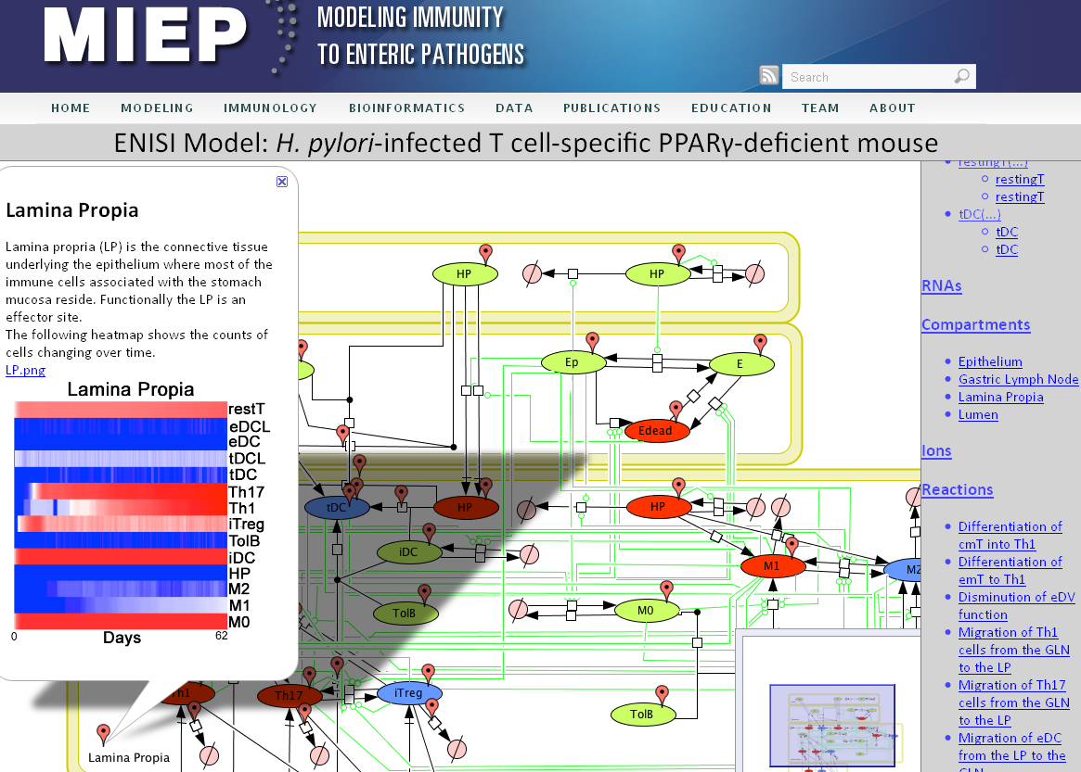
ENISI Result Viewer
Notes:
Here we show the results of ENISI simulations of H. pylori-infected T cell-specific PPAR g null mouse using CELLPUBLISHER. Flow cytometry results in the lamina propria are illustrated using a heatmap. We also include the compartment annotation.
This is available in the MIEP website

Slide 19
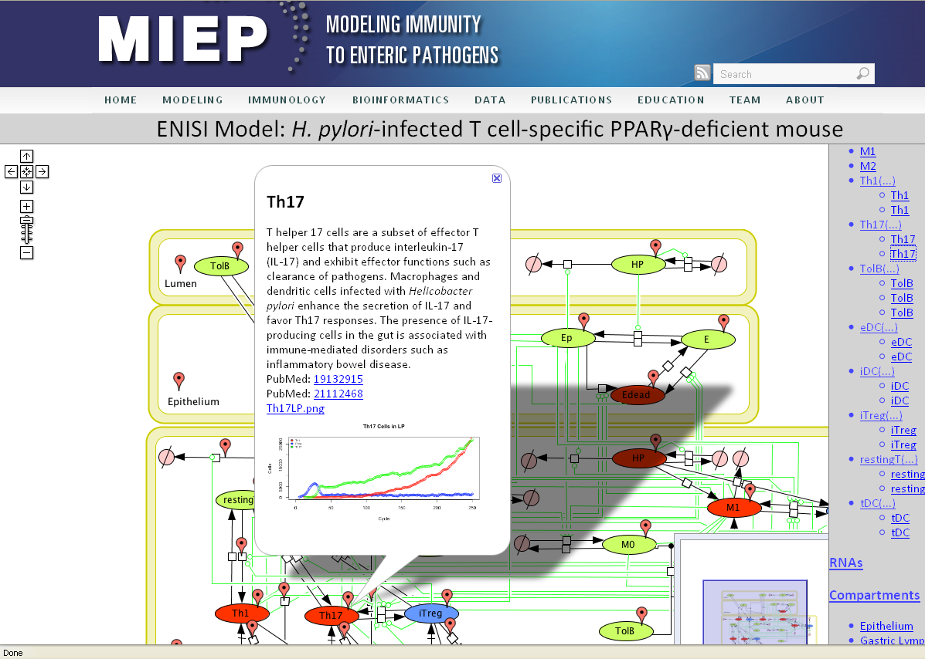
ENISI Result Viewer
Notes:
Here we show the simulation results of one cell type as opposed to the entire compartment, including the annotation.

Slide 20
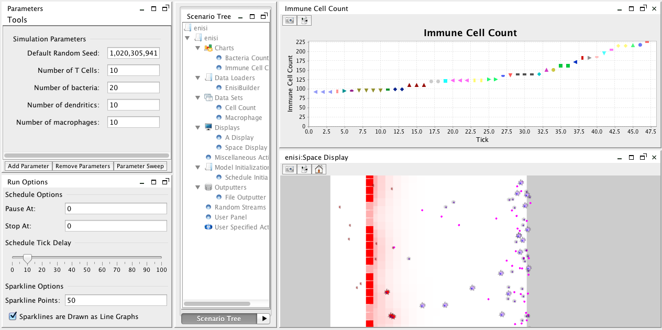
ENISI Visual
  ENISI (ENteric Immunity SImulator) Visual
  Agent based modeling (ABM) tool
  Implemented based upon REPAST platform
  Quality user interfaces and visualizations such as snapshots and videos

Slide 21
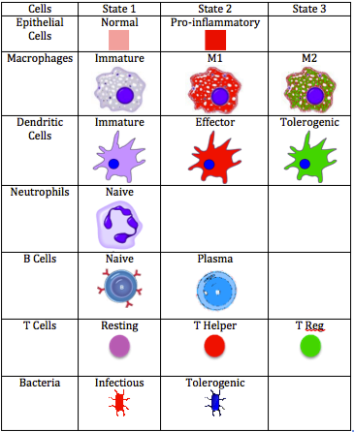
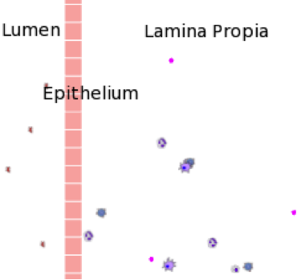
Compartments and Agents
Three compartments: lumen, epithelium, and lamina propia
Agents and states / phenotypes

Slide 22
Cell Behaviors and User Interfaces
Cells secrete cytokine and chemokine into environment
Cell movement: random and chemotactic
Cells change phenotypes: neighbor cells, cytokine concentrations and time dependent
User interface controls initial concentrations, simulation speeds, and state transition propensities
Quality visualizations: figures, snapshots, and videos

Slide 23
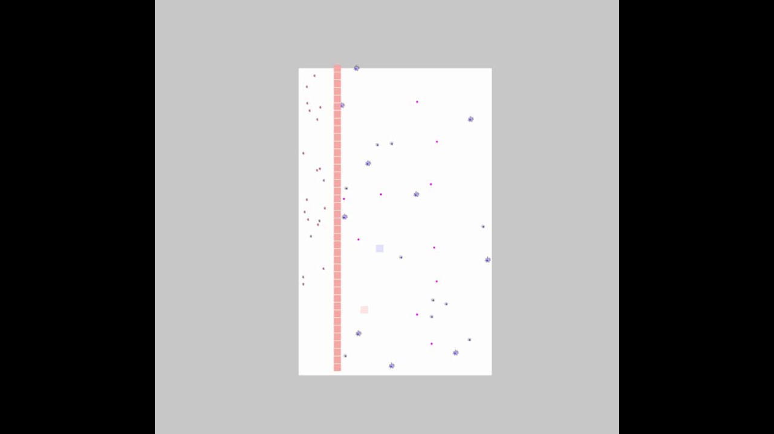
ENISI LIVE DEMO

Slide 24
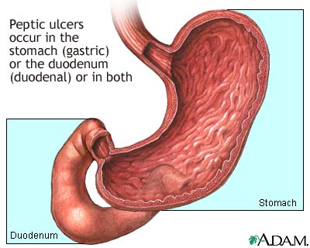
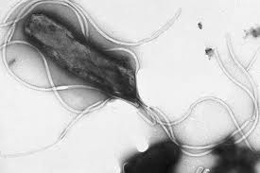
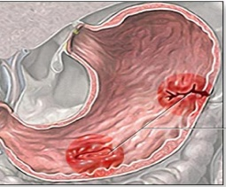
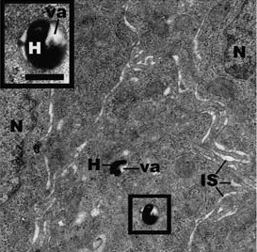
Helicobacter pylori
Gram negative bacteria
Asymptomatic infection
Peptic ulcer
MALT lymphoma
Adenocarcinoma
85 %
15 %
Main pathogenicity factor: CagA (cytotoxin-associated gene A)
Evidence that H. pylori is a facultative intracellular organism
H. pylori was found in human gastric epithelium
from infected patients
Reported Th1 response involving IFN-γ and IL-12
Oezbek, 2010 J Clin Gastroenterol

Slide 25
H. pylori elicits a systemic Th1 response

Slide 26
Systemic functional cytotoxic cell response
Notes:
Circulating NK cells and cytotoxic T cells (CTL) increase upon infection (A)
Increase in IL-15, Perforin, Granzyme A and Granzyme B transripts upon infection (B)
H. pylori J99 induces CD8β^{lo} CTL expressing Tbet (C)

Slide 27
Proliferation towards recall H. pylori antigens
Notes:
Transient proliferation is observed on day 21 post infection (A)
This correlates with increased proliferation of overall T cells (B) and in particular
CD4+FOXP3+ Treg (C) towards the recall H. pylori SS1 antigens

Slide 28
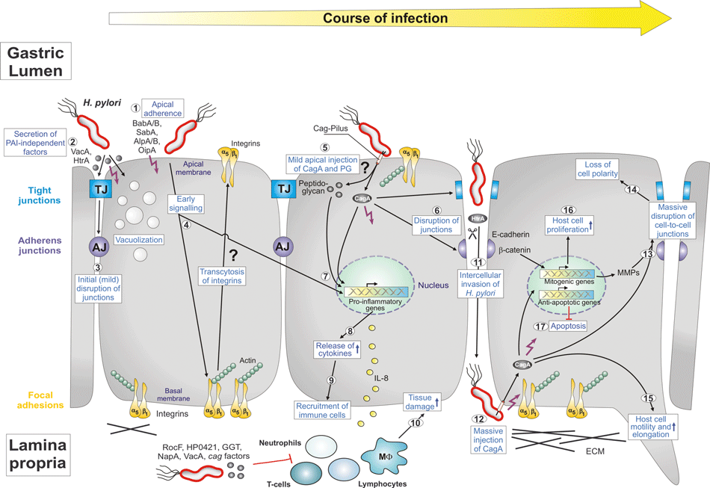
Pig model of H. pylori infection
A
B
C
D
No bacteria
Standard
PM-SS1
SS1
SW-SS1
J99
SW-J99
kDa
250
150
CagA
100
75
37
GAPDH
Tegtmeyer, 2011

Slide 29
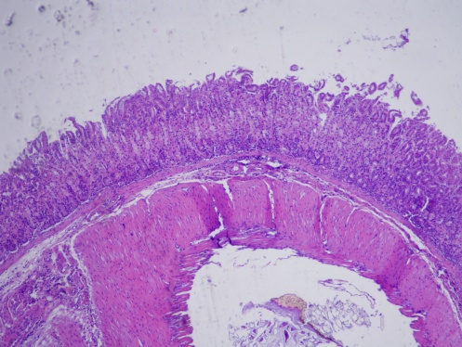
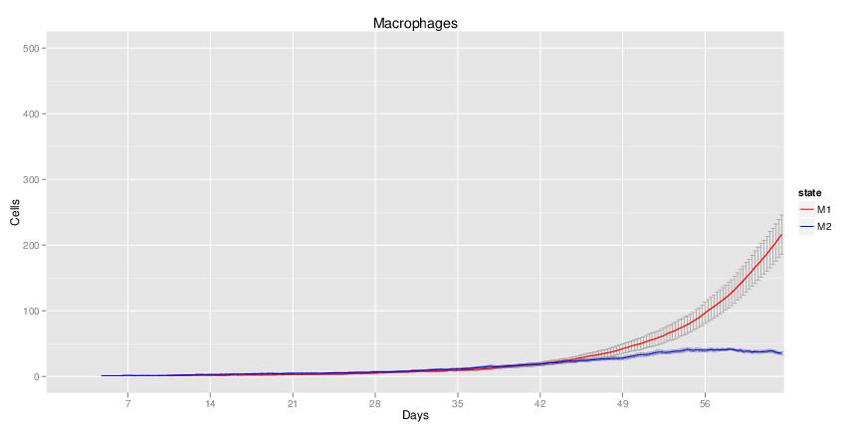
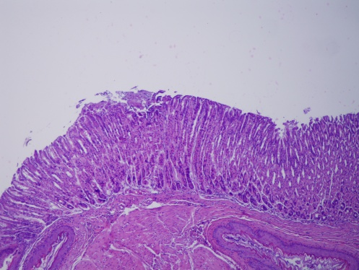
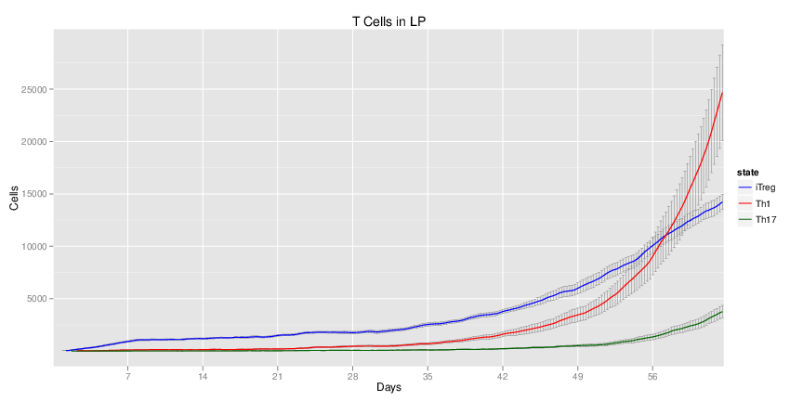
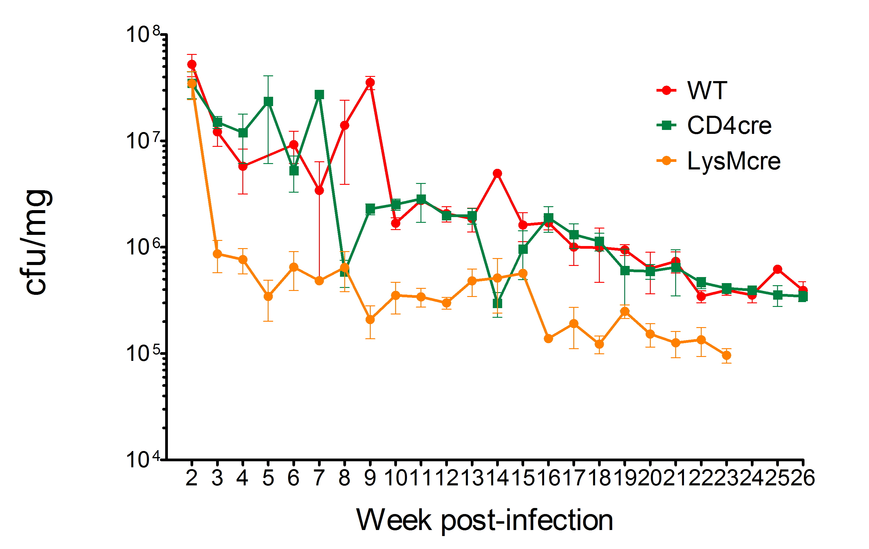
Myeloid PPAR γ deletion
Uninfected
WT 16 wpi
CD4-cre 16 wpi
Lys-cre
16 wpi
Notes:
Deficiency of PPAR g in myeloid cells results in increased Th1 responses and M1 macrophage differentiation.
H. pylori loads drop drastically after week 2 in LysMcre mice
Lack of PPARγ in macrophages seems to help the clearance of bacteria

Slide 30
Clostridium difficile
Gram positive anaerobic bacterium
Nosocomial diarrhea and colitis
Grows in the intestine of individuals with altered microflora
  Antimicrobial therapy
  Immunosupressant treatment
Emergence of several virulent strains
  Increased incidence and severity
Notes:
Treatments:
Unable to restore normal gut microflora
Unsuccessful in bacterial clearance
Destroy other anaerobic bacteria
Colonization with other pathogens

Slide 31
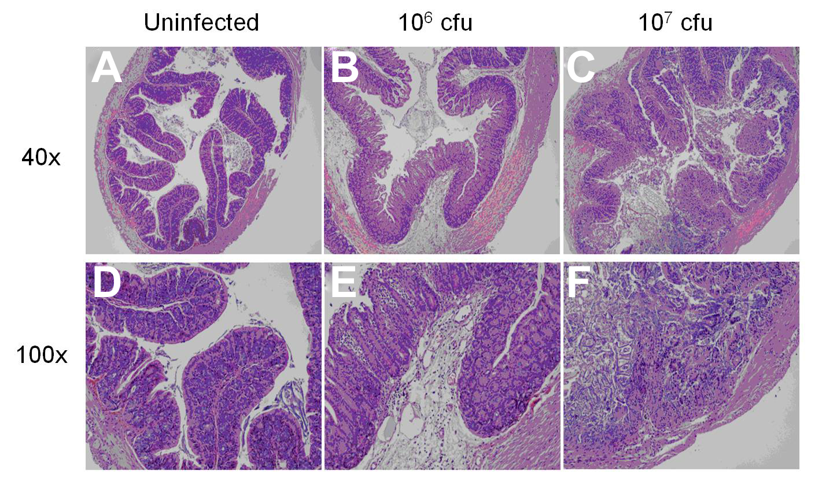



Colonic Lesions
Notes:
photoshop

Slide 32
Colonic Gene Expression

Slide 33
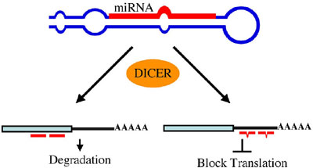
RNA-sequencing
miR-146b
miR-1940
miR-1298

Slide 34
RNA-sequencing

Slide 35
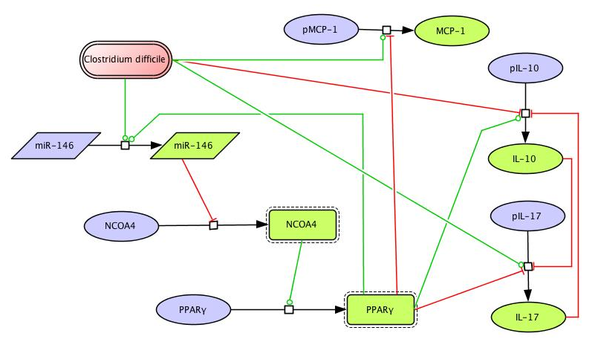
Modeling Immune Responses to C. difficile

Slide 36
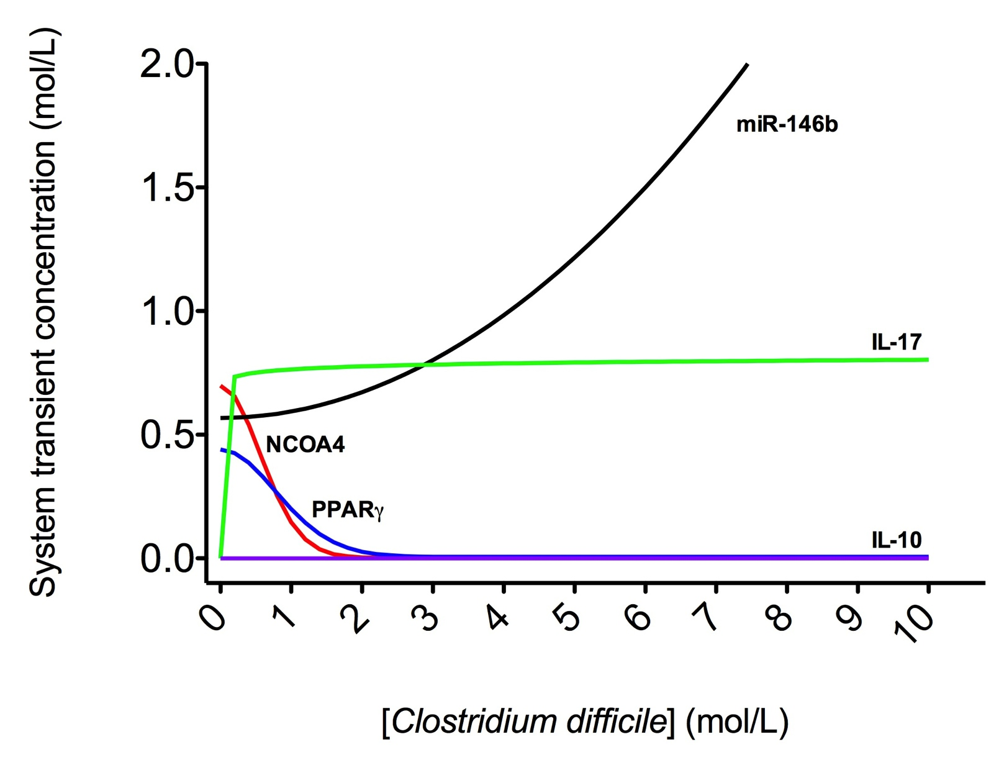
Simulation of C. difficile infection

Slide 37
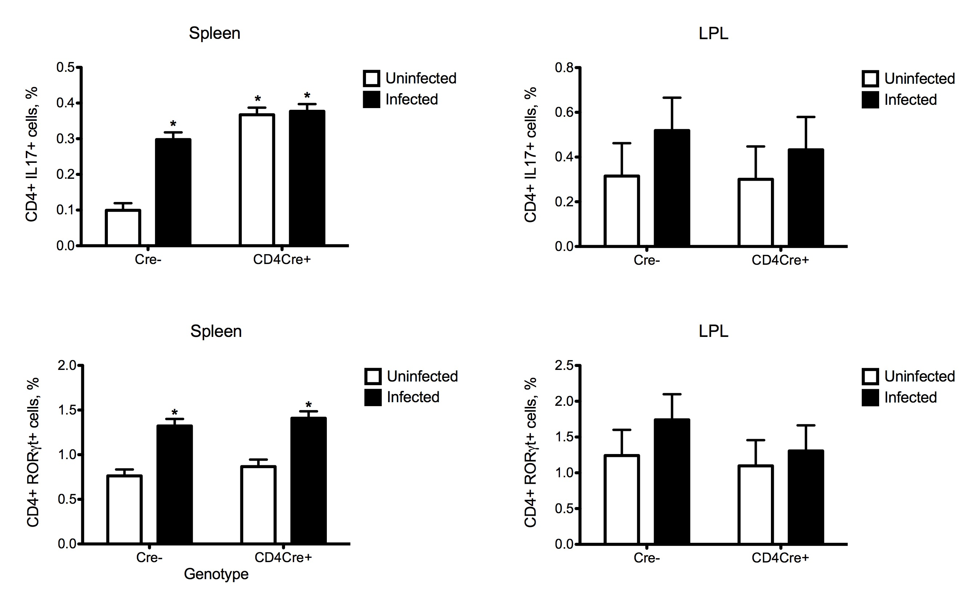
C. difficile infection Favors Th17 Responses

Slide 38

The Loss of T cell PPAR γ Increases CDAD

Slide 39







Modeling Immune Responses to Enteroaggregative E. coli
Fisher Information | EAEC Death
Epithelial cell contacts antigen | 8.88E-22
IL-17 production by Th17 | 1.23E-24
TNF-a secretion by Ep | 1.73E-20
EAEC death by neutrophil | 0
IL-8 production by Ep | 4.12E-26
IL-18 production by M1 | 1.24E-25
M1
M2
$$\left[cytokine\right]=Vf∙r1∙(1+\frac{A^{n}}{A^{n}\text{+}k^{n}}) −Vr∙p$$

Slide 40


a leading cause of enteritis and persistent diarrhea worldwide
EAEC
High risk populations:
  Travelers
  HIV infected
  Malnourished children
41.1%
AAF fimbria:
primary virulence factor attributed to mucosal adherence
Fli-C flagellin:
responsible for
IL-8 secretion
Dispersin:
Allows dissociation from biofilm and spread of colonization

Slide 41

Targeting PPARγ as an inflammatory mediator
PPAR γ
Treg
Th17
Gene expression: Upregulation of proinflammatory markers in CD4Cre+
Histopathology: High leukocytic infiltration early during infection in CD4Cre+ followed by amelioration of colonic inflammation by day 14

Slide 42



Pharmacological blockade of PPARγ
GW9662
a potent PPARγ antagonist
Administration of GW9662 promoted the upregulation of proinflammatory cytokines that correlated to significantly lower levels of EAEC in feces early during infection

Slide 43


Beneficial response attributed to Th17
naïve T cell
Pharmacological blockade
of PPARγ beneficial
Late during infection GW9662 treated mice expressed cytokines responsible for potentiating Th17 differentiation in addition to significantly higher levels of IL17.
TGFβ
IL-6
RORγt
Th17
IL-17
IL-21

Slide 44

MIEP Team
Virginia Bioinformatics Institute
Josep Bassaganya-Riera - Principal Investigator and Center Director
Raquel Hontecillas - Immunology Lead
Barbara Kronsteiner - Immunology Post-Doc
Xia Wang - Laboratory Manager
Xiaoying Zhang - Immunology Post-Doc
Pinyi Lu - Immunology and Modeling GRA
Adria Carbo - Immunology and Modeling GRA
Mireia Pedragosa - Immunology and Modeling GRA
Cassandra Washington – Immunology and Modeling GRA
Pawel Michalak – Systems Biology Scientist
Katarzyna Michalak – Systems Biology Scientist
David Bevan – Education Lead
Jim Walke - Project Manager
Virginia Bioinformatics Institute (continued)
Madhav Marathe - Modeling Lead
Keith Bisset - Modeling Expert
Stephen Eubank - Modeling Expert
Katherine Wendelsdorf - Modeling GRA
Nikki Lewis - Modeling GRA
Maksudul Alam - Modeling GRA
Stefan Hoops - Bioinformatics Lead
Yongguo Mei - Research Software Engineer
University of Virginia
Richard Guerrant - Infectious Disease Expert
James Roche - Infectious Disease Expert
Cirle A. Warren - Infectious Disease Expert
Glynis Kolling Infectious Disease Expert
David Bolick - Sr. Laboratory and Research Specialist
Caprion Proteomics Inc.
Eustache Paramithiotis - Proteomics Director
Funding:
Supported in part by the National Institutes of Health 5R01AT004308 to JB-R, NIAID Contract No. HHSN272201000056C to JB-R, Bassaganya-Riera

Slide 45


COPASI User Workshop
July 30 – August 1, 2012
Center for Modeling Immunity to Enteric Pathogens
Virginia Bioinformatics Institute at Virginia Tech
Blacksburg, Virginia
This user workshop provides hands-on experience with COPASI’s main capabilities, with an emphasis on modeling immunology.
Who should attend: Graduate students and scientists in immunology or related discipline who are interested in using COPASI as a modeling tool. Prior knowledge of COPASI is not required.
For registration information visit:
http://www.copasi.org/UserWorkshop2012
Contact: registration@copasi.org
COPASI’s features will be introduced with existing models related to immunology. Real experimental lab data is used to analyze and fit kinetic models. Some of the features highlighted during this case-based approach are:
Stochastic Simulation
Sensitivity Analysis
Parameter Estimation
Optimization
Reports, Visualization

